Slide 1
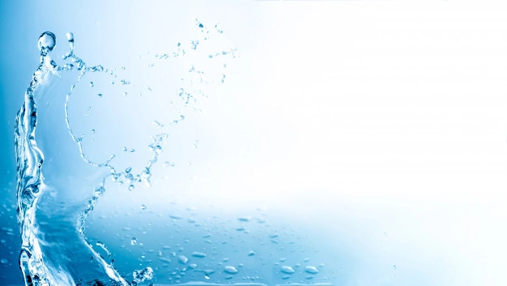
WATER-VODA
We could say the water is life, why? You may learn it on next slide...
by:NIKOLA URADNIKOVA

Slide 2
Water scarcity
Water scarcity is inextricably linked to human rights, and sufficient access to safe drinking water is a priority for global development. However, given the challenges of population growth, profligate use, growing pollution, and changes in weather patterns due to global warming, many countries and major cities worldwide, both wealthy and poor, faced increasing water scarcity in the 21st century.
Nedostatok vody je neoddeliteľne spojený s ľudskými právami a dostatočný prístup k nezávadnej pitnej vode je prioritou globálneho rozvoja. Vzhľadom na výzvy populačného rastu, zbytočného využívania, rastúceho znečistenia a zmien v poveternostných podmienkach v dôsledku globálnemu otepľovaniu čelilo mnoho krajín a veľkých miest na svete, bohatých aj chudobných, v 21. storočí narastajúcemu nedostatku vody.

Slide 3
There are two general types of water scarcity: physical and economic. Physical, or absolute, water scarcity is the result of a region’s demand outpacing the limited water resources found there. According to the Food and Agricultural Organization (FAO) of the United Nations, around 1.2 billion people live in areas of physical scarcity.
Physical water scarcity can be seasonal; an estimated two-thirds of the world’s population lives in areas subject to seasonal water scarcity at least one month of the year. The number of people affected by physical water scarcity is expected to grow as populations increase and as weather patterns become more unpredictable and extreme weather.
Existujú dva všeobecné typy nedostatku vody: fyzický a ekonomický. Fyzický alebo absolútny nedostatok vody je výsledkom dopytu regiónu, ktorý predčí obmedzené vodné zdroje, ktoré sa v ňom nachádzajú. Podľa Organizácie pre výživu a poľnohospodárstvo (FAO) OSN žije v oblastiach s fyzickým nedostatkom asi 1,2 miliardy ľudí. Fyzický nedostatok vody môže byť sezónny; odhadované dve tretiny svetovej populácie žijú v oblastiach so sezónnym nedostatkom vody najmenej jeden mesiac v roku. Očakáva sa, že počet ľudí postihnutých fyzickým nedostatkom vody bude narastať so zvyšujúcim sa počtom obyvateľov a so zvyšujúcim sa stavom nepredvídateľného a extrémneho počasia.

Slide 4
WORTH THE WATER AND DON‘T BE SO RECKLESS!!

Slide 5
Why is water so important?
stimulates metabolism and supports the immune system
supports brain function
deoxygenates the organism
balances the pH value in the body
stimulates the heart and helps lower blood sugar
hydrates
supports skin against aging
-stimuluje metabolizmus a podporuje imunitný systém
-podporuje funkcie mozgu
-detoxikuje organizmus
-vyrovnáva hodnoty pH v tele
-stimuluje srdce a pomaha zniyovat hladinu cukru v krvi
-hydratuje
-podporuje pokozku proti starnutí-

Slide 6
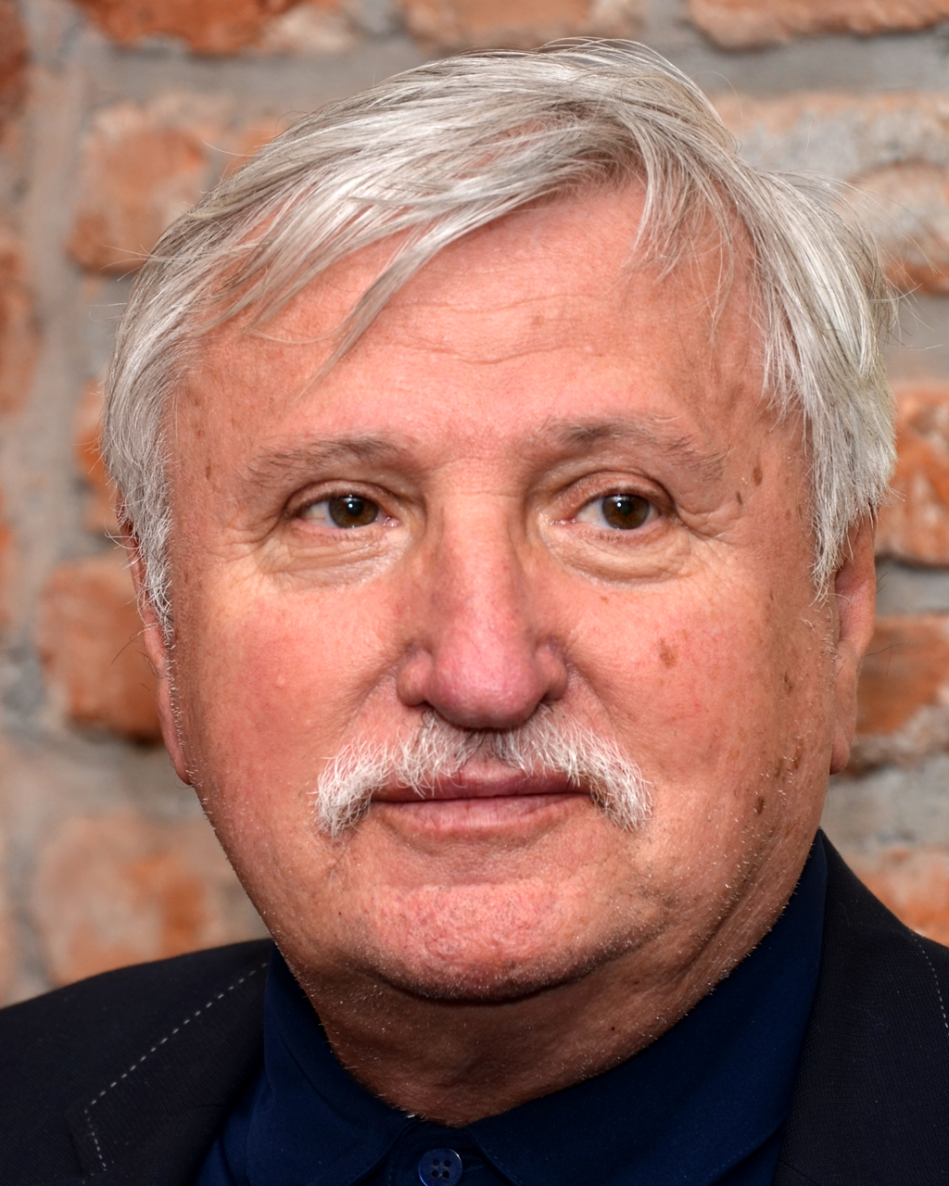
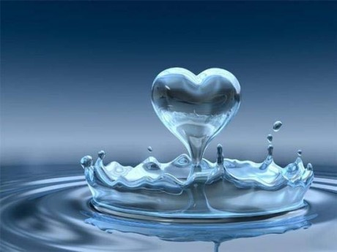
poem by - Kamil Peteraj
When the water loves, once you see on her,
brings dresses by waves, autumn leafs,
when the water loves, and what you are looking for,
the full moon shines, that you already never seems,
and to people she brings, the water is leaving,
to shore secret bloom, flows and nobody knows where,
and to people she brings, and on the shore she is falling,
on mirror honey, say you are here
whole is blue,
full of wonders,
the water good,
by spring clouds,

Slide 7
KAMIL PETERAJ
Kamil Peteraj was born on 18th September 1945 in Bratislava. This city is the capital city of our country - Slovakia.
In his native city he matriculated from the violin study section of the Conservatoire in 1964 and then studied dramatic arts at the Academy of Performing Arts.
For many years he worked as a musical producer at the „Nová scéna Theatre” in Bratislava.
Nowadays he works in advertising.
Peteraj is a poet of imagination.

Slide 8
nová scéna-NEW SCENE in Bratislava

Slide 9
THANKS FOR ATTENTION

