Slide 1
Famous sportsmen
Germany – spain – Romania – GREECE – Slovakia - Bulgaria
LEONARDO BECICA
MATEI BRESUG
DIANA IACOB
MARIE ISENBERG

Slide 2
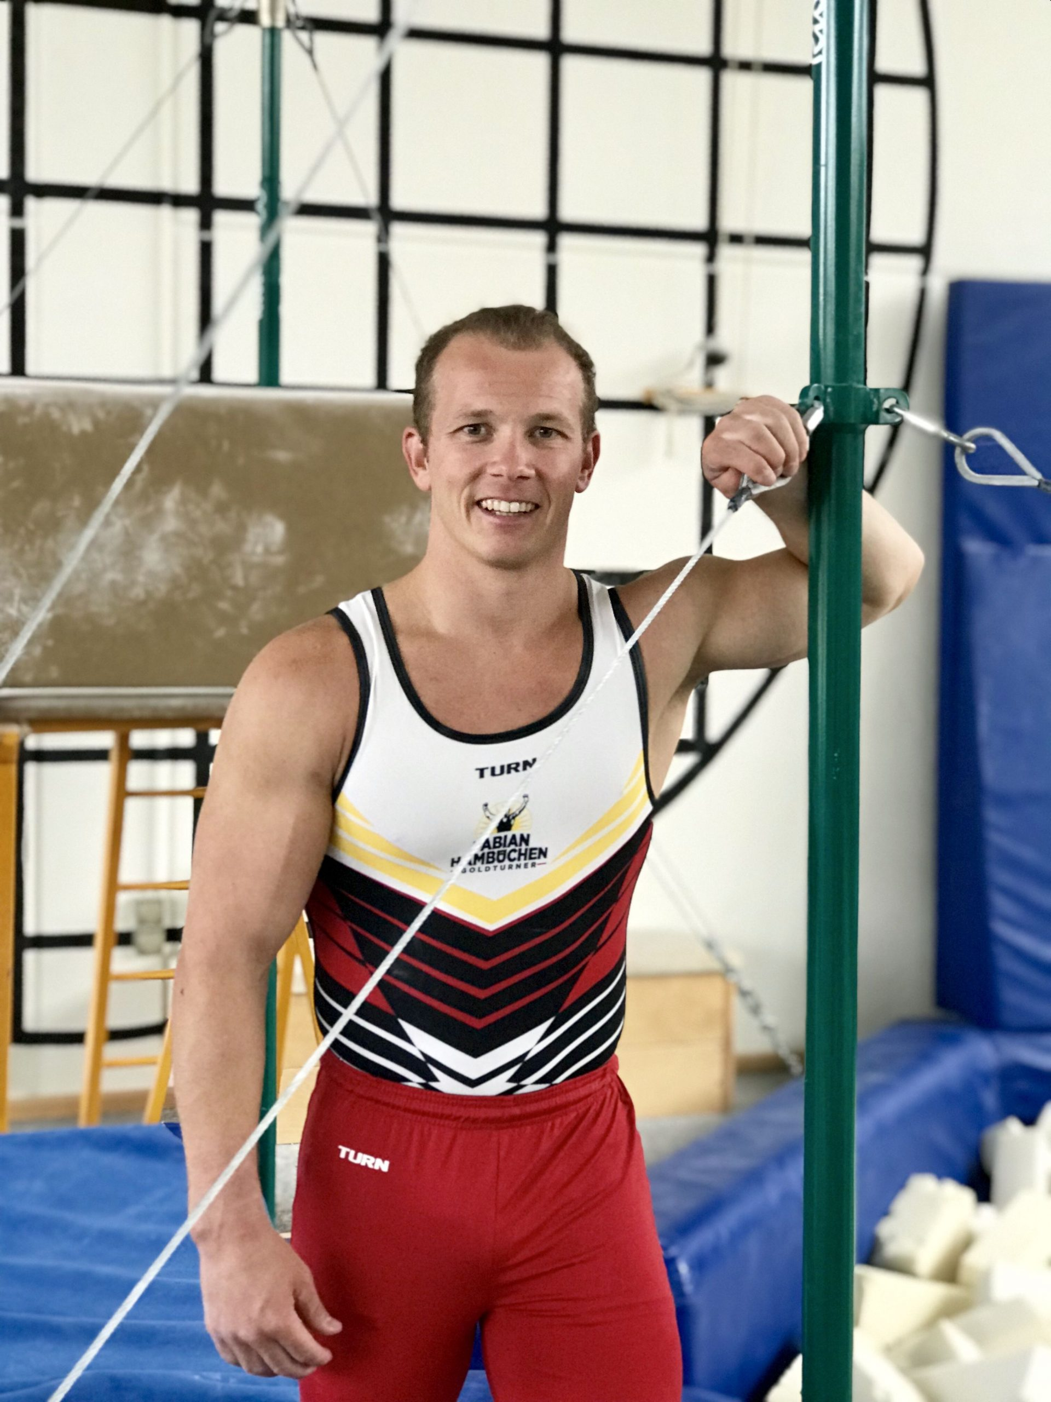
GERMANY
FABIAN HAMBüCHEN
Born on 25 October 1987 in Bergisch Gladbach
Former German artistic gymnast
Greatest successes were on the high bar
Won the Olympic gold medal in 2016
Won the world championship title in 2007
Won the bronze medal at the 2008 Olympic Games in Beijing and the silver medal in London in 2012

Slide 3
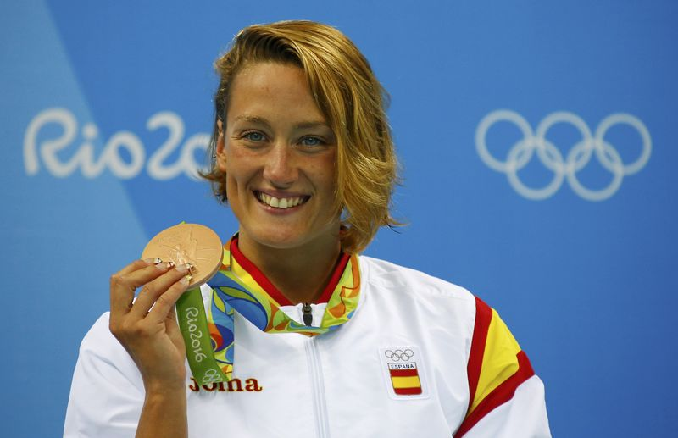
Spain
MIREIA BELMONTE
-Born on 10 November 1990
-Spanish Olympic, world, and European champion swimmer
-First Spanish woman to win a gold medal in swimming at an Olympic Games in Rio
-Cosidered to be the greatest Spanish swimmer of all time

Slide 4
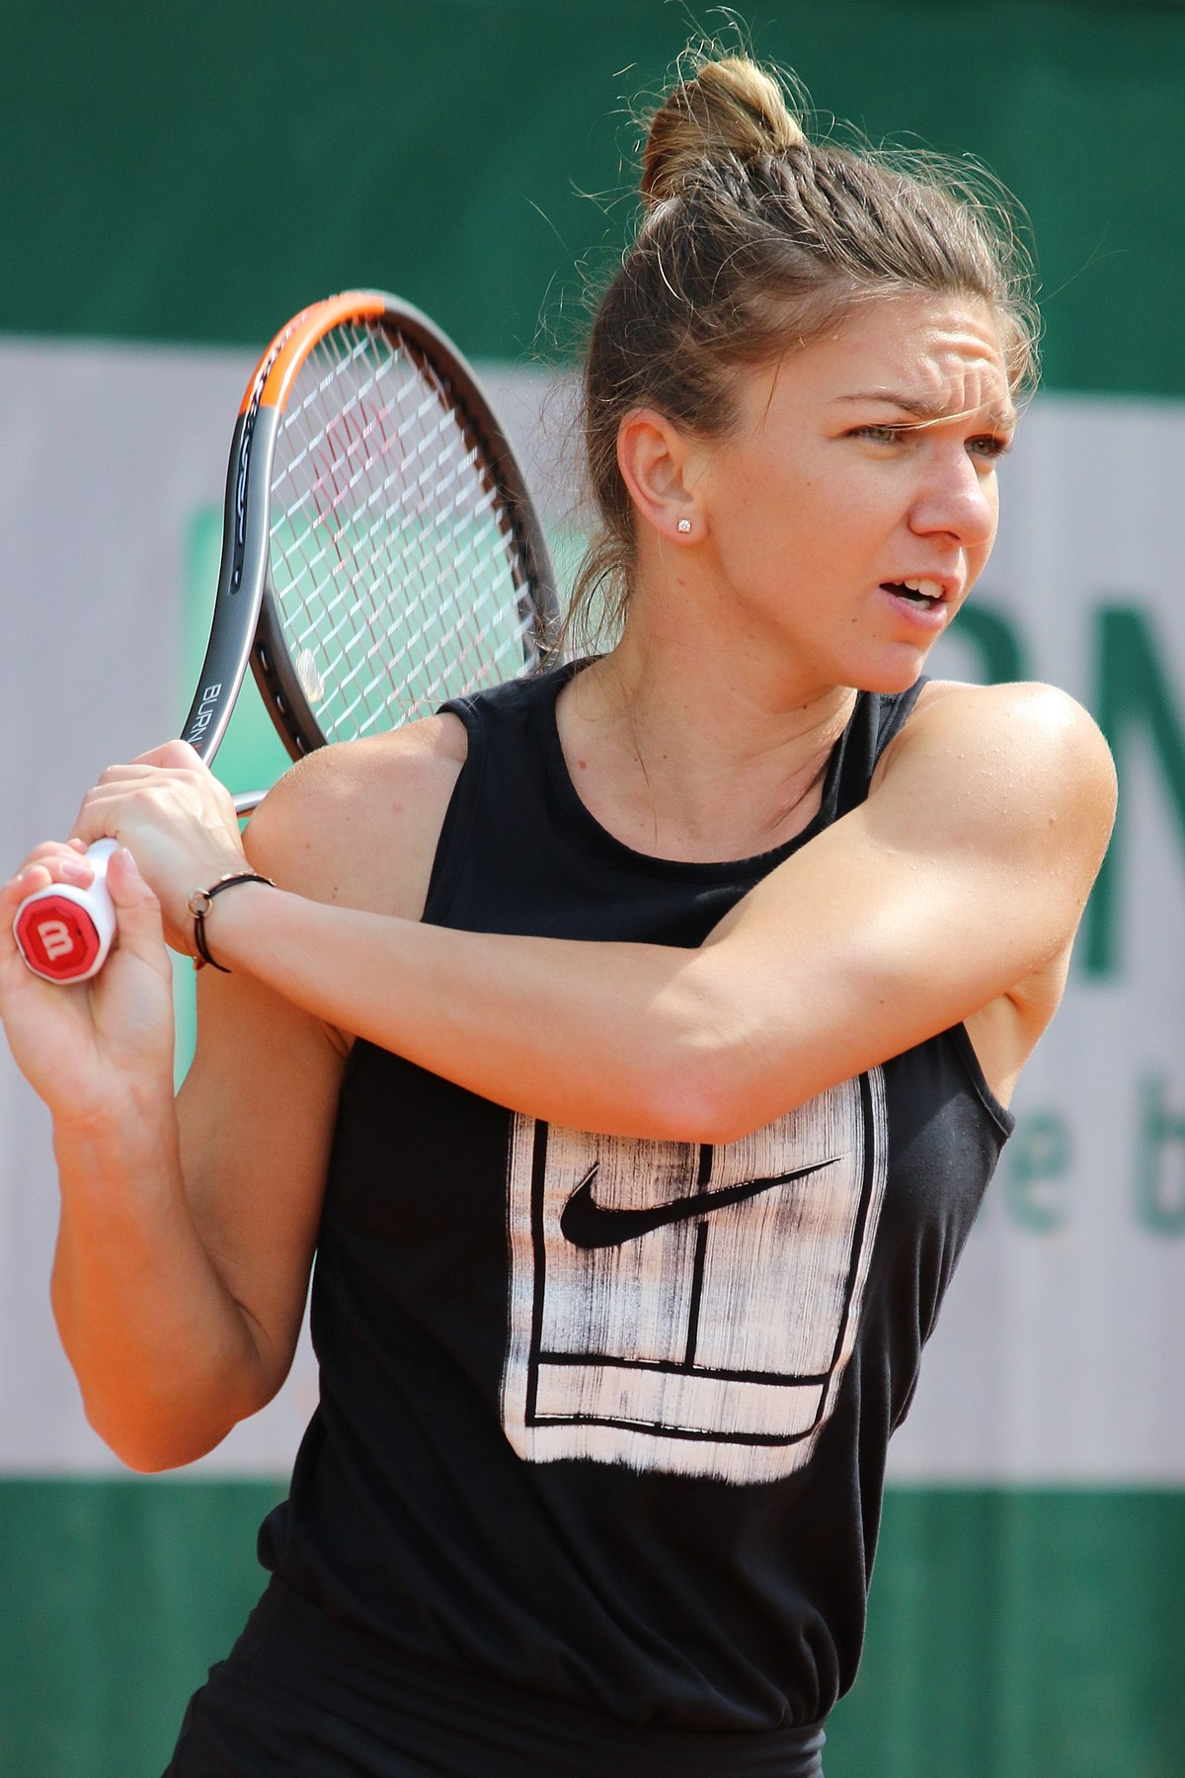
Romania simona halep
-Born on 27 September 1991
-Romanian professional tennis player
-Has been ranked world No. 1 in singles twice between 2017 and 2019 for a total of 64 weeks
-Halep was the year-end No. 1 in 2017 and 2018
-Ranked in the top 10 for 373 consecutive weeks from 2014-2021 (eighth-longest streak in WTA history)
-Has won two Grand Slam singles titles: French Open (2018), Wimbledon Championships (2019)

Slide 5
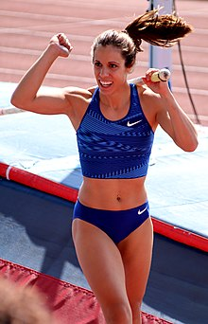
GREECE
Katerina Stefanidi
-Born on 4 February 1990
-Greek pole vaulter
-Won the gold medal at the 2016 Olympic Games with a jump of 4.85 meters
-Competed at the 2012 and the 2020 Summer Olympics
-Current European Outdoor (2018) and Diamond League (2019) champion
-World Outdoor champion, European Indoor champion, two-time World Indoor bronze medalist
-Has won a total of ten (10) medals in all five major international athletics championships
-Regarded as the greatest female athlete in the history of Greek sport

Slide 6
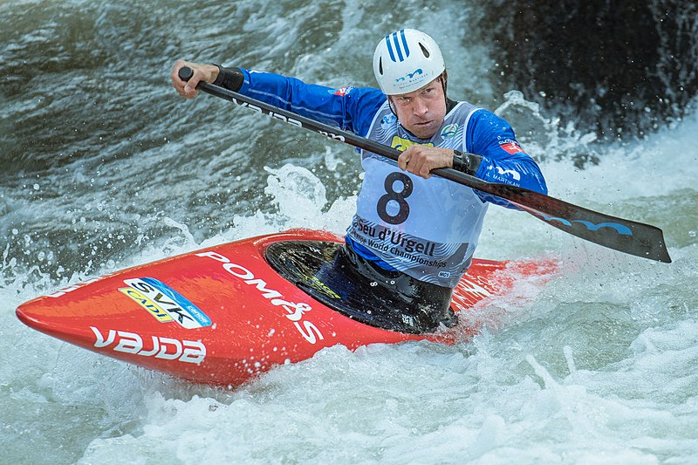
Slovakia michal martikan
-Born on 18 May 1979
-Slovak slalom canoeist
-Has been competing at the international level since 1994
-Became the first athlete to win an Olympic gold medal for Slovakia since the country gained independence in 1993
-Won 5 Olympic medals in total (2 golds, 2 silvers and 1 bronze)
-Won the World Championship title in the C1 individual category four times

Slide 7
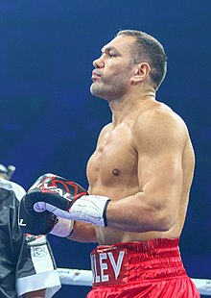
Bulgaria
KUBRAT PULEV
-Bulgarian professional boxer
-Has challenged twice for the unified heavyweight title in 2014 and 2020
-At regional level, he has held multiple heavyweight championships, including the European title twice between 2012 and 2016
-As an amateur, he won multiple medals at international tournaments, including gold at the 2008 European Championships and bronze at the 2005 World Championships

Slide 8
SOURCES
https://en.wikipedia.org/wiki/Simona_Halep
https://de.wikipedia.org/wiki/Fabian_Hamb%C3%BCchen
https://en.wikipedia.org/wiki/Mireia_Belmonte
https://en.wikipedia.org/wiki/Katerina_Stefanidi
https://en.wikipedia.org/wiki/Michal_Martik%C3%A1n
https://en.wikipedia.org/wiki/Kubrat_Pulev

