Slide 1

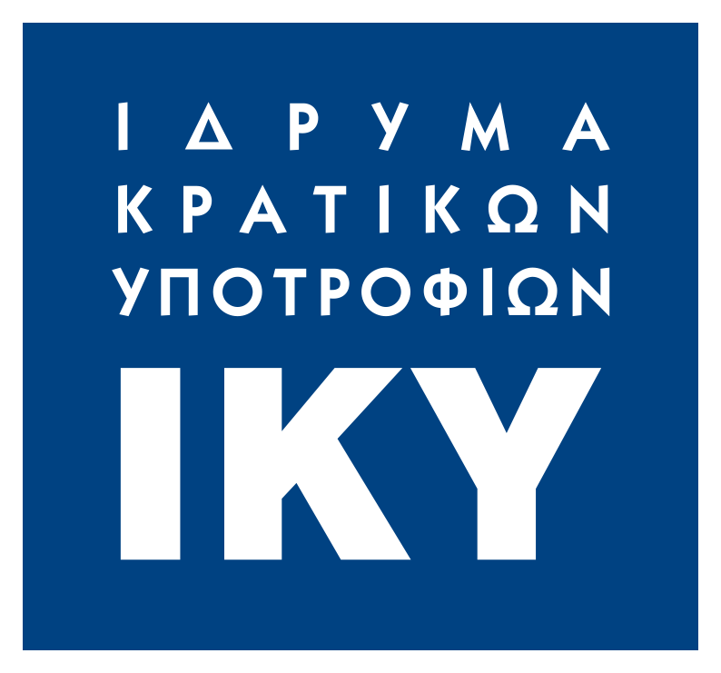
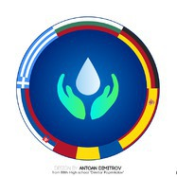
ERASMUS+
Era+ :Integrated Learning Challenges

Slide 2
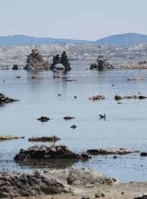
Salt lakes
A salt lake, or saline lake, is a landlocked body of water that has a high concentration of salts (typically sodium chloride) and other dissolved minerals significantly higher than most lakes.

Slide 3
Brine lakes
Brine lakes consist of water that has reached salt saturation. The source of salt may come from the lake’s former connection to the sea. The water evaporates,the salt remains and the body of water becomes brine. Because of the density of brine, swimmers are more buoyant. Examples are the Dead Sea and the Great Salt Lake.

Slide 4
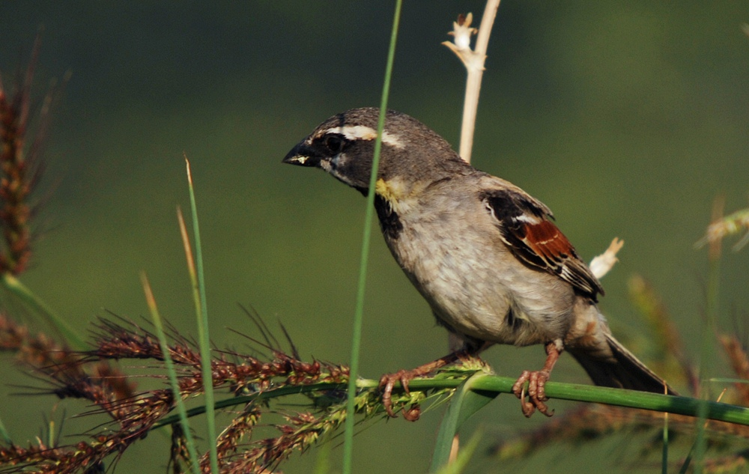
How do salt lakes form?
When water flowing into a terminal lake cannot leave,it evaporates leaving behind any dissolved salts. The resulting high salinity leads to a unique flora and fauna or the near absence of it.

Slide 5
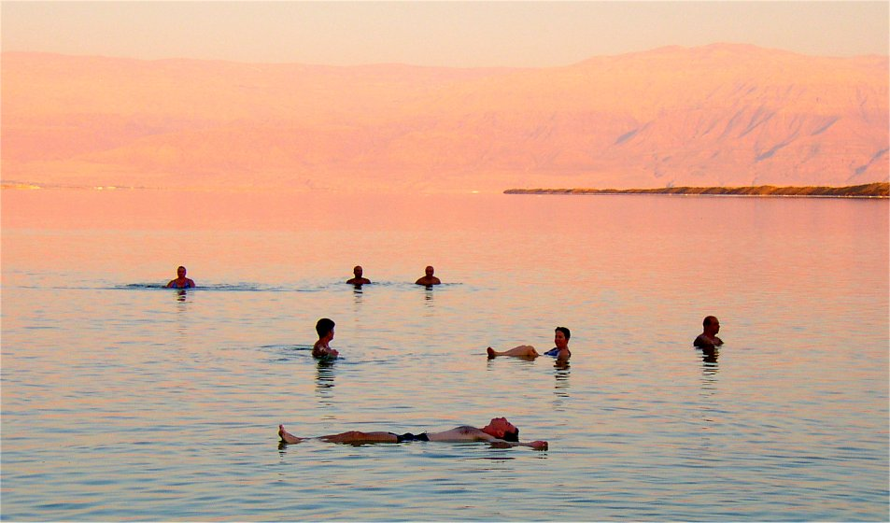
The Dead Sea

Slide 6
Salinity levels
Fresh water (less than 0.05%)
Brackish water (0.05-3%)
Saline water (3-5%)
Brine (more than 5% and up to 28% max)

Slide 7
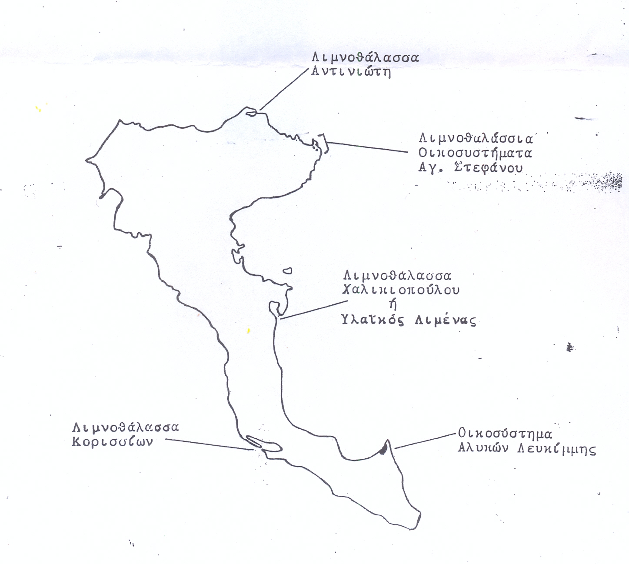
Corfu’s saline and brine lakes
ANTINIOTI LAKE
KASSIOPI/ERIMITIS
CHALIKIOPOULOU
KORISSION
ALYKES LEFKIMMIS

Slide 8
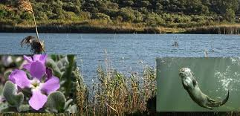
ANTINIOTISSA
Wetland situated on the northern coast
6 Km Perimeter
12 m deep
187,95 ha total surfice

Slide 9
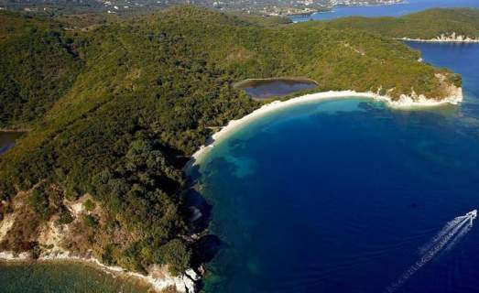
Kasiopi/Aghios Stefanos-Erimitis
Erimitis is composed by 6 beaches and 3 lakes and together with lake Antinioti and Vouthroto (Albania) form a unique hydrotopic system of great ecological importance that offers protection to a variety of rare birds and animals.
So far,it has bean left untouched by tourist invasion, mainly because it can be reached only by foot and by boat.

Slide 10
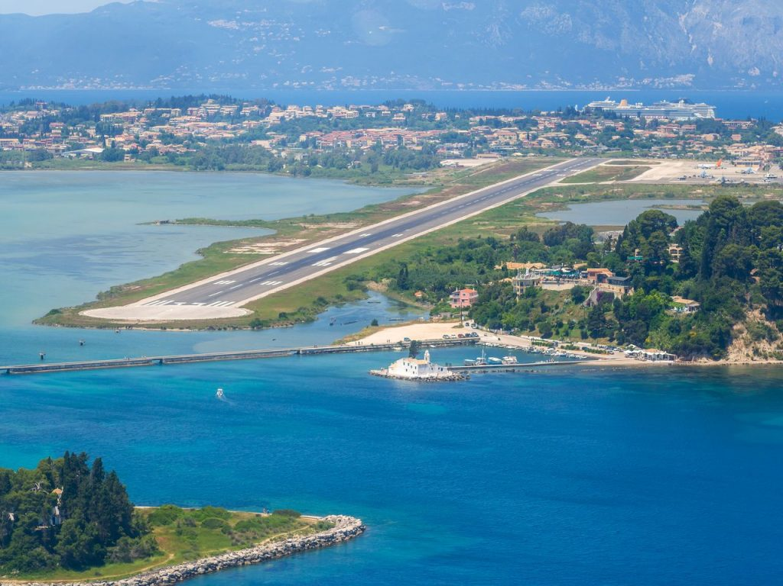
Lake Chalikiopoulou (airport)
This lagoon is situated very close to the modern city of Corfu and where the international airport is located. In its entrance we find two of the most characteristic landmarks of Corfu: Pontikonissi and Panagia in Vlacherna.

Slide 11
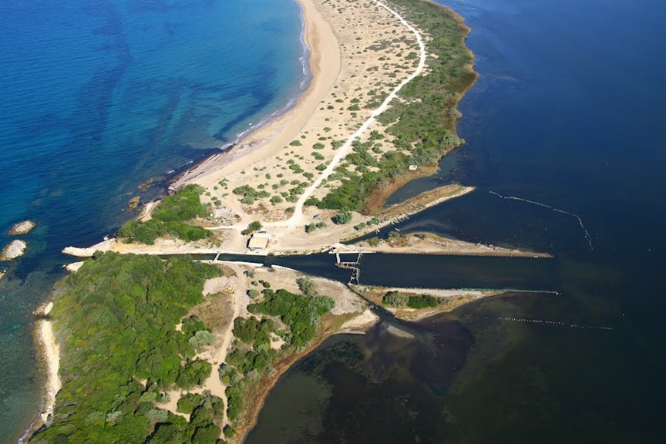
Lake Korission
This is a 427 ha coastal lagoon that is separated from the sea by Chalikouna beach. It drains into the sea through a channel bisecting the beach. It was created by sand dunes about 200.000 years ago.

Slide 12
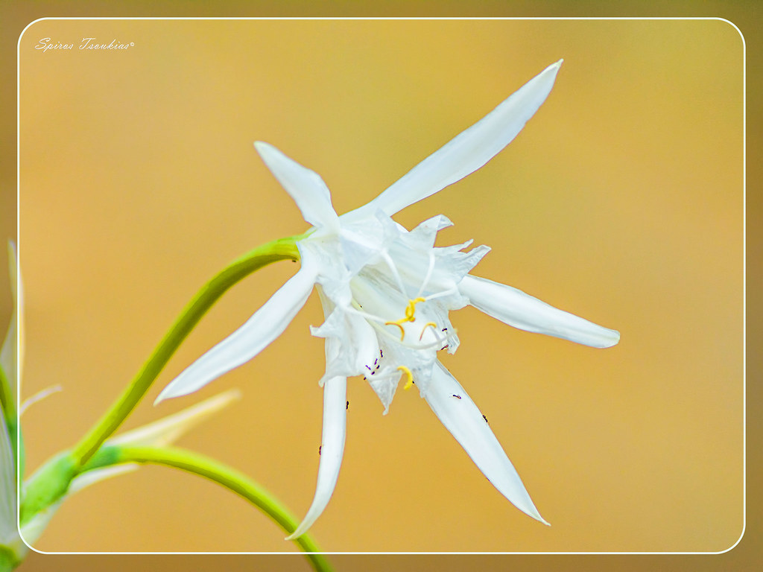
Flora and fauna/Archeological finds
Protection by Natura 2000 Treaty extends to the beach, the dunes that in some places reach the heigth of 15m, birds, flowers, reptile, bats, otters and fish.
Recently, the oldest known prehistoric artifacts in Greece were discovered under the dunes.

Slide 13
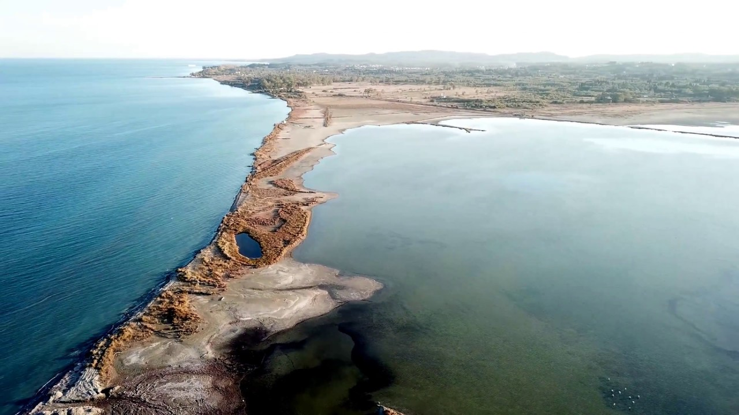
Lefkimmi
Triangular peninsula of 200 ha that is known to be used as a salt production site ever since the Anjou occupation (13th-14th cent. AC) up until 1988. It is partly natural and partly man-made. Lately more than 15 ha are lost to the sea because of corrosion. Its hydrotopic system is changing: seasonal sweet water ponds become permanent.

Slide 14
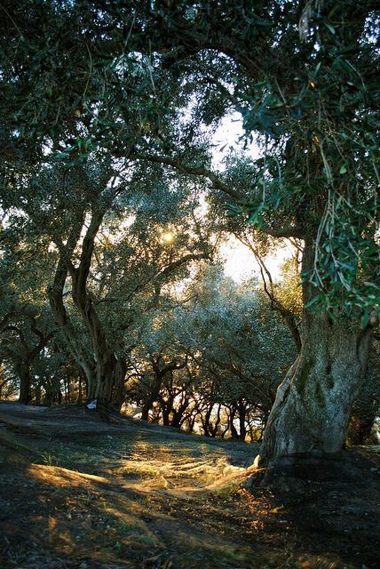
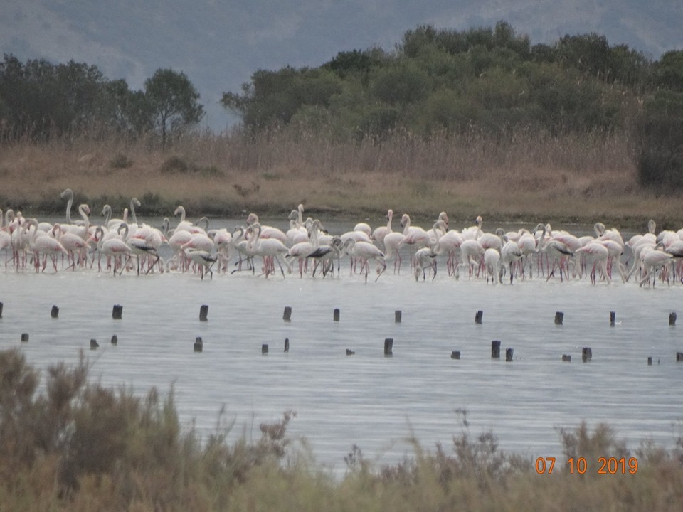
Wetlands, secular olive groves and more than 3000 migrant finicopters

Slide 15
Dangers of the Preservation of Corfu’s Wetlands
All human activities that alter the chemical and biological parameters are a threat to flora and fauna. Those mainly are:
Intensive tourism
Illegal constructions
Agricultural and industrial waste
The expansion of the airport

