Slide 1
Rovinka
By : Emma, Nina, Sofia, Alexandra, Natália, Klára

Slide 2
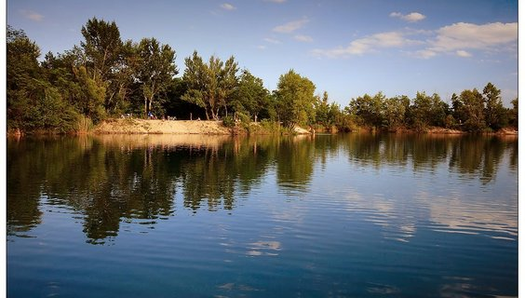
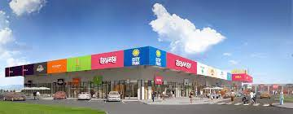
About :
Rovinka is located 3km from Bratislava which is the capital city of Slovakia
It has almost five thousand residents.
We have kindergardens, a primary school, restaurants, cafes, a shopping center, post office, house of culture, football stadium, health centre and lakes
both train and bus transport works here

Slide 3
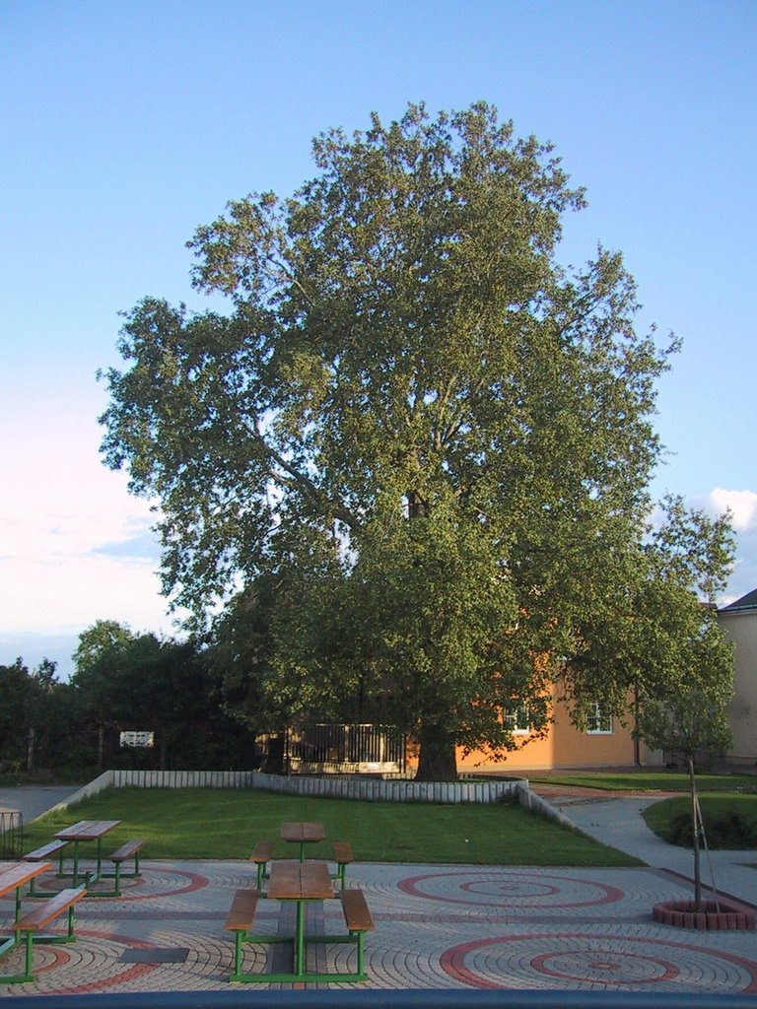
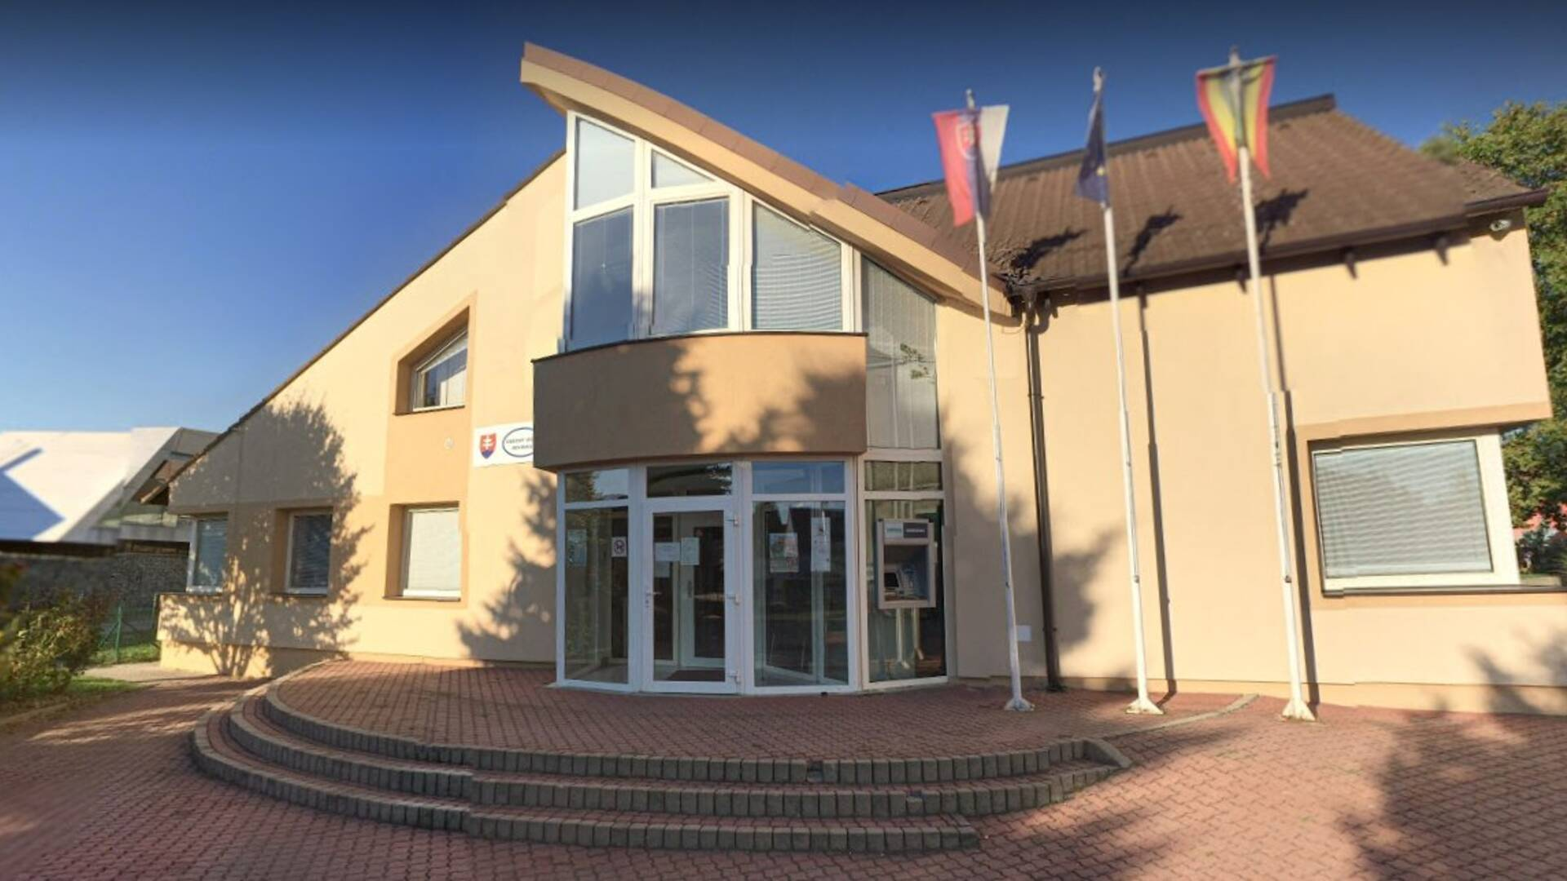
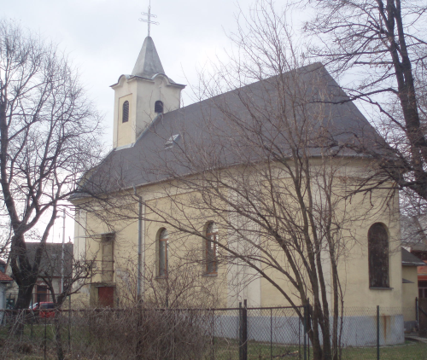
History:
Rovinka was established in year 1235
among the most famous historical monument is the Roman Catholic church from 1798
There is also located a protected tree „Nolipnický platan“ whose age is estimated to be more than 200 years

Slide 4
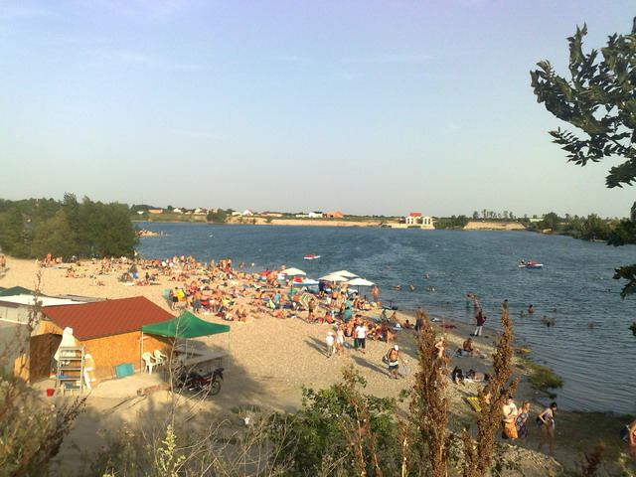
Recreation:
Lake Veľké Košariská attracts many people even from Bratislava, because the water is beautifully clean and families go there to swim and relax
Lake Malé Košariská is mainly used by young people, where they go swimming in the summer and barbecue in the autumn
there is also a bicycle route( Dike ) which is 65 kilometres long

