Slide 1
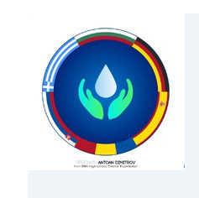
Water sports in Bulgaria

Slide 2
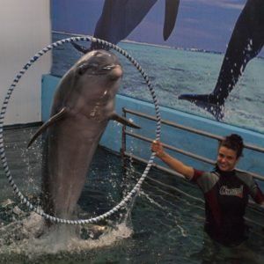
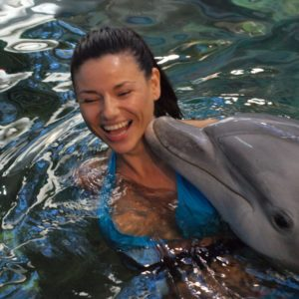
Swiming with dolphins
If you ultimate dream is to swim with dolphins now you can do this during your summer holiday in Bulgaria. The happiness is guarantied in the Festa Dolphinaruim in Varna.
In order to swim in the pool with the dolphins you should be at least 12 years old and have elementary diving skills. During your dive you are going to have chance to hug and kiss dolphins.
In the dolphinarium every day there is a dolphin show. You can buy tickets and see the dolphins play footbal and hear them sing.

Slide 3
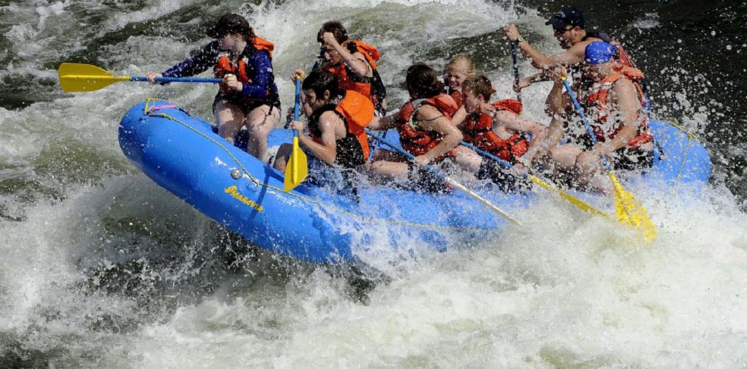
Rafting
In Bulgaria there are two popular places for rafting: Kresna Gorge on the Struma River, which is near Blagoevgrad and the gorge on the Iskar River, which is close to Sofia.
The rapids of the river are suitable for everyone. The program combines adrenaline moments with a relaxing trip and it is a good test for those who want in the future to take part in a more complicated rafting adventure.

Slide 4
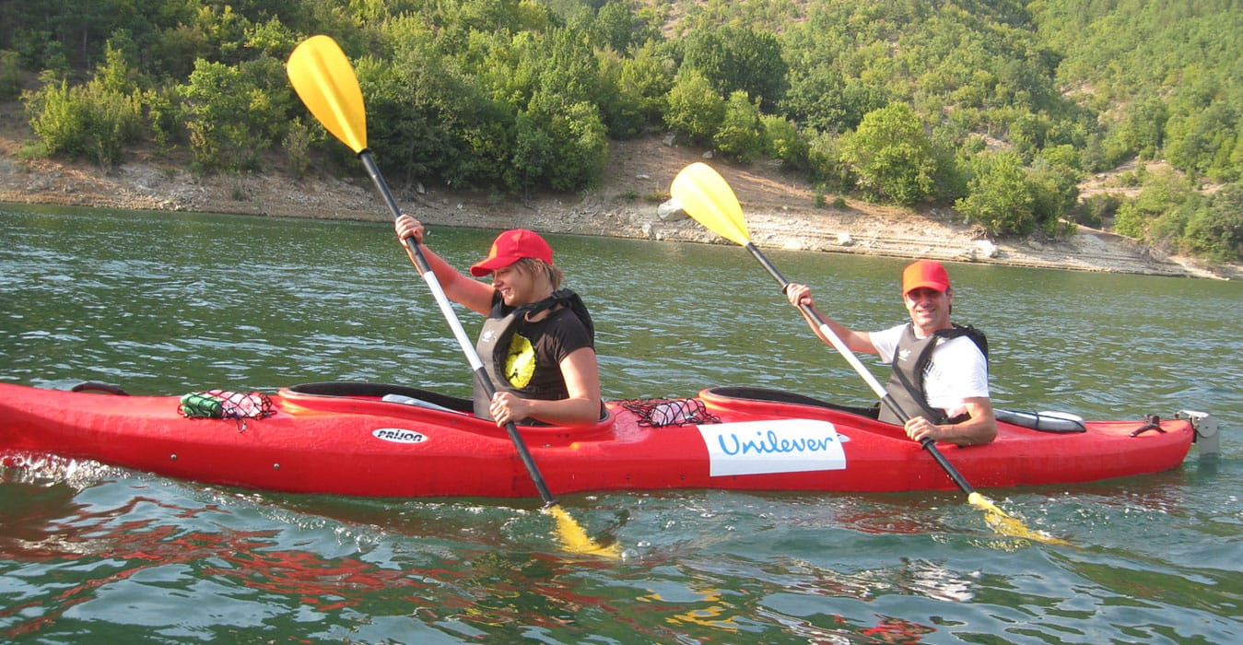
Kayaking
Experience the connection with nature on a kayak. With our kayaking adventures, you can enjoy a relaxing and beautiful holiday. This is the only way to reach places of wild beauty, unapproachable by any other place.
Some people love to glide down glassy waves with the kayak, others enjoy the scenic beauty and knowledge that they can travel to places impossible to reach otherwise. Kayaking is a sport that you can do with family and can take you to the most beautiful places in Bulgaria.

Slide 5
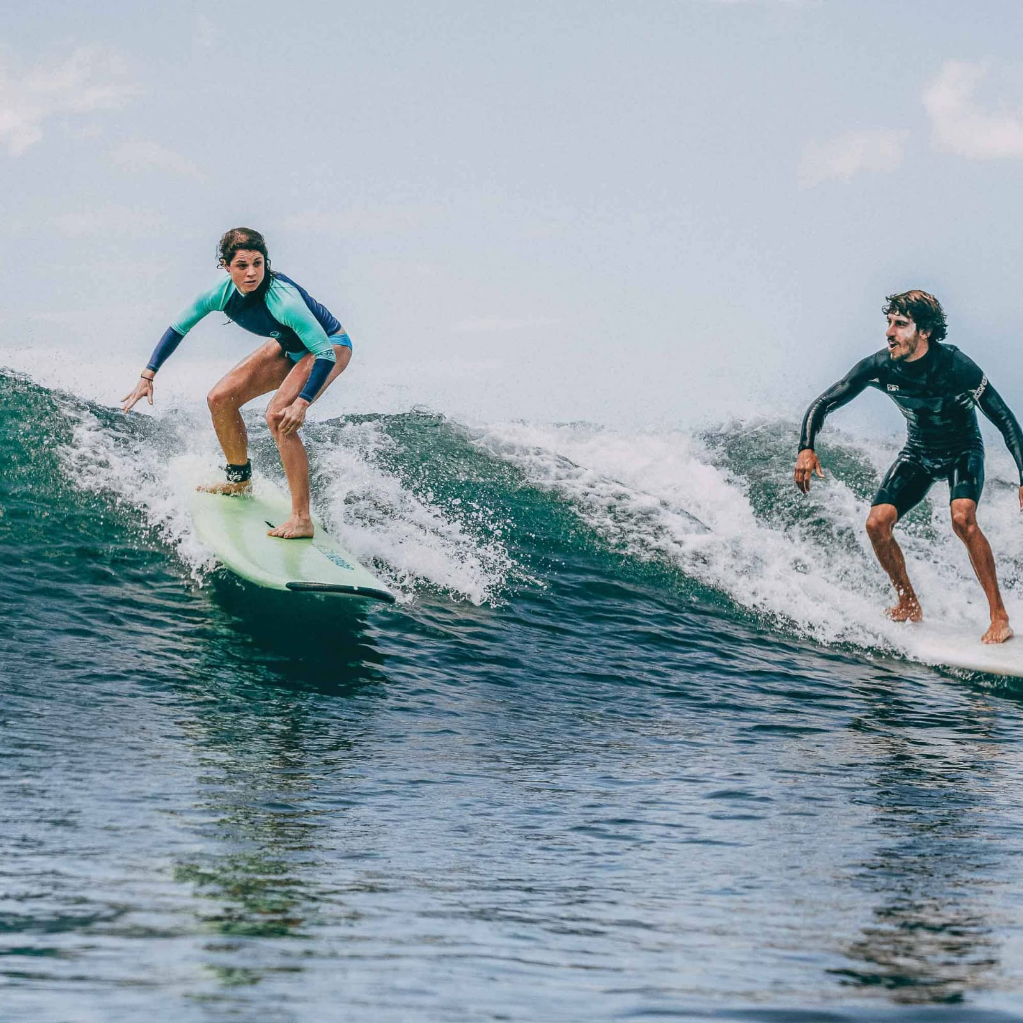
Surfing
Shabla is the place to experience one of the top five surf spots in Bulgaria! There are relatively few surfers here even on good days, so you can enjoy the perfect surfing conditions that the offshore, southwestern winds provide. Moreover, by surfing just off of this hidden beach, you can enjoy good surf at all stages of the tide, and thus enjoy riding the waves from the morning right up until when the sun sets!
As well as surfing, you can also enjoy a range of other activities, including exploring hidden rock caves, fishing and diving. As one of the top beaches along the Black Seaside in Bulgaria, we strongly suggest you give surfing here at whirl!

Slide 6
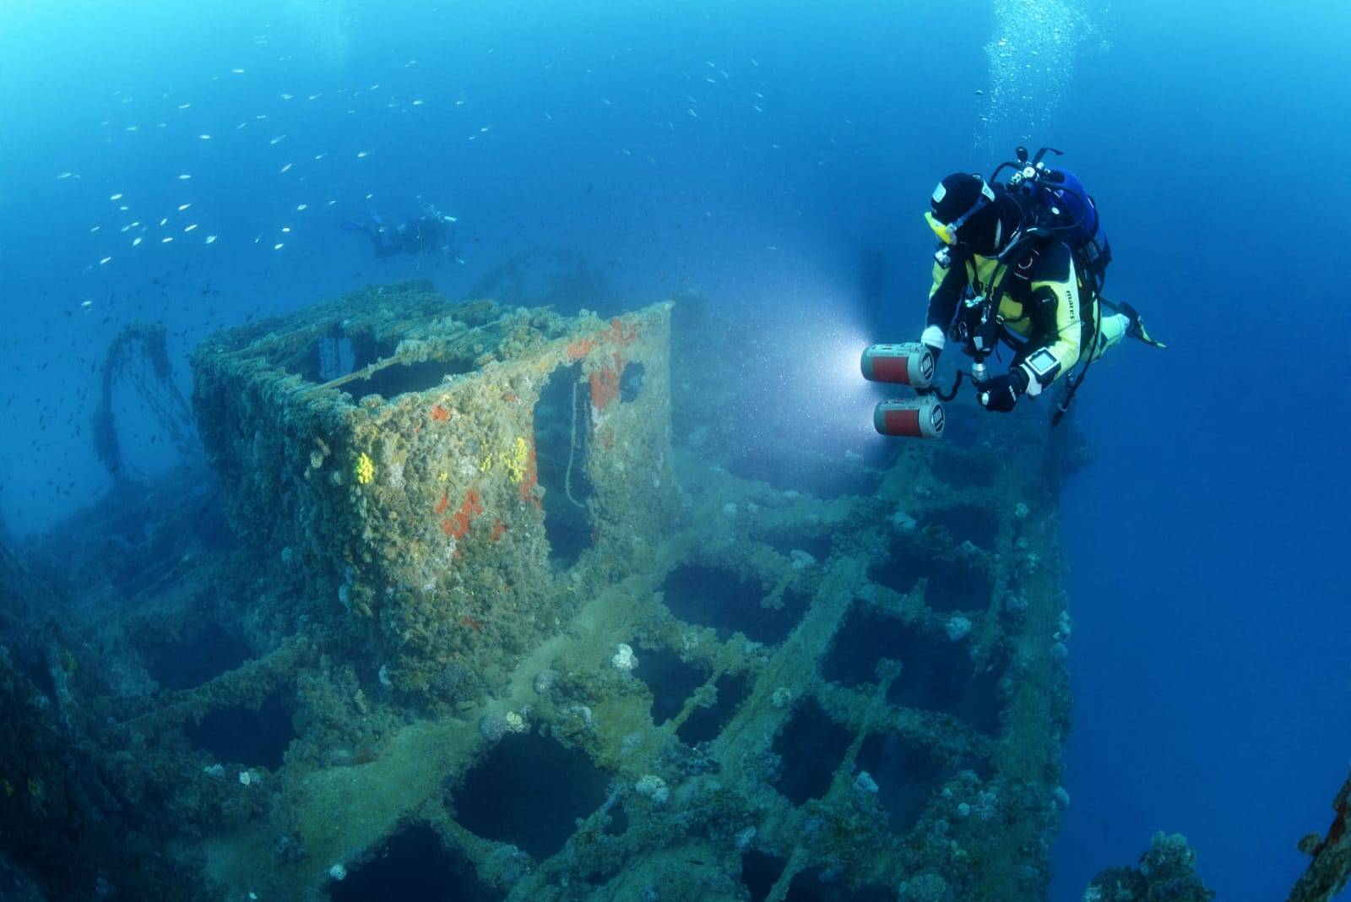
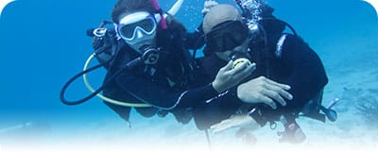
Scuba diving
Black sea is mysterious. Its saltiness is doble less then the other seas and after 200 mether depth the waters have no oxigen wich means there is no life but sunk artefacts are preserved exelently. That makes Black sea one of the best plases for begginers of scuba diving. This is a new sport in Bulgaria which is still growing
In Black Sea there are sunk ships, underwater caves, flora and fauna and beautiful sealife.

Slide 7
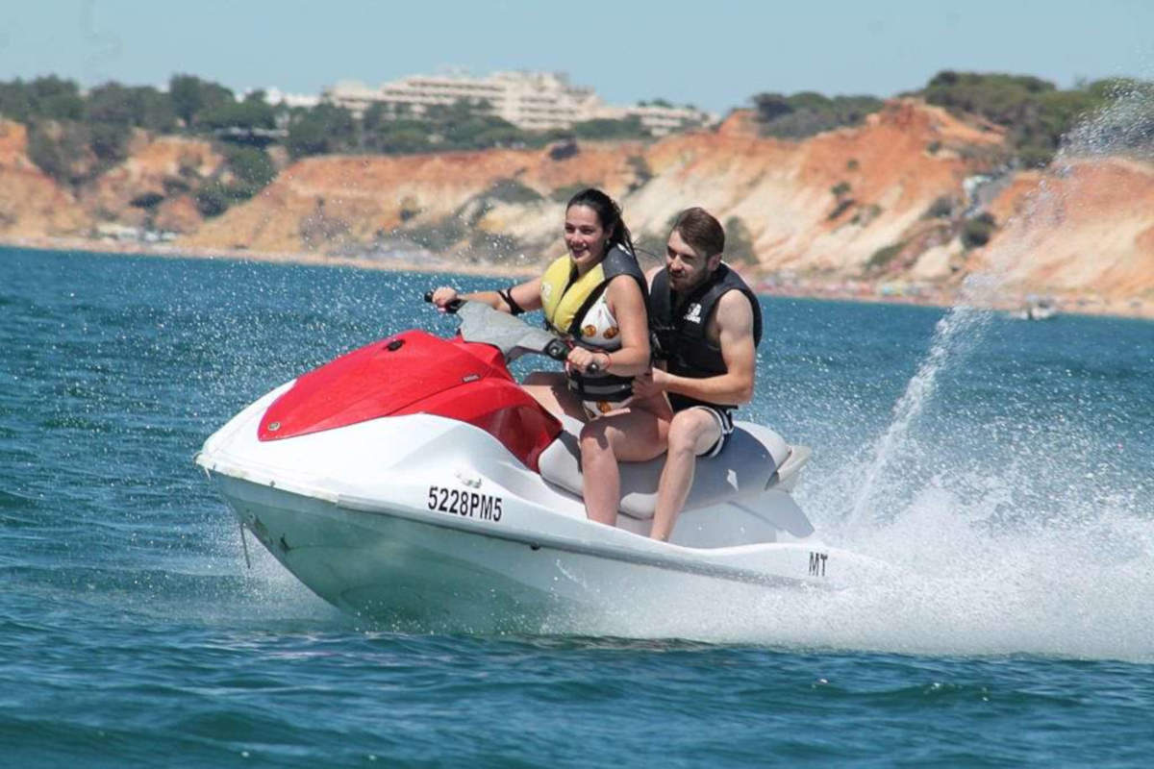
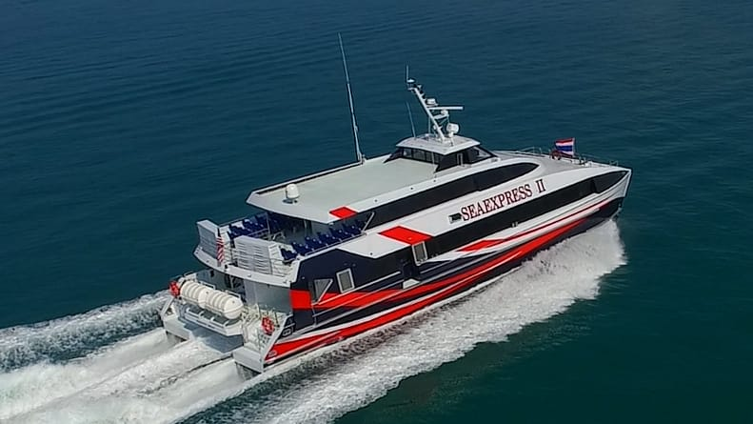
Jetskiing and speed boats
In Bulgaria jetskiing is the most easiest way to get yourself some adrenaline. Jetskiing is very famous around the coasts of Black Sea. For small price you will be taught how to ride the jetski and will be alone in the water, skiing on the surface of it. Of course don’t forget your safety. You will need a safety jaket.
Speed boats are boats with high power engines. Speed boats are usually used for racing in laps or straight lines. But in Bulgaria we are using speed boats for touring around the Black sea.

Slide 8
Thanks for your attention!
Meggie and Martyn

