Slide 1
If it is fine, we shall go out
/Ak bude pekne, pôjdeme von/ Radio drama
Zuzana Uličianska

Slide 2

First part

Slide 3
Second part

Slide 4
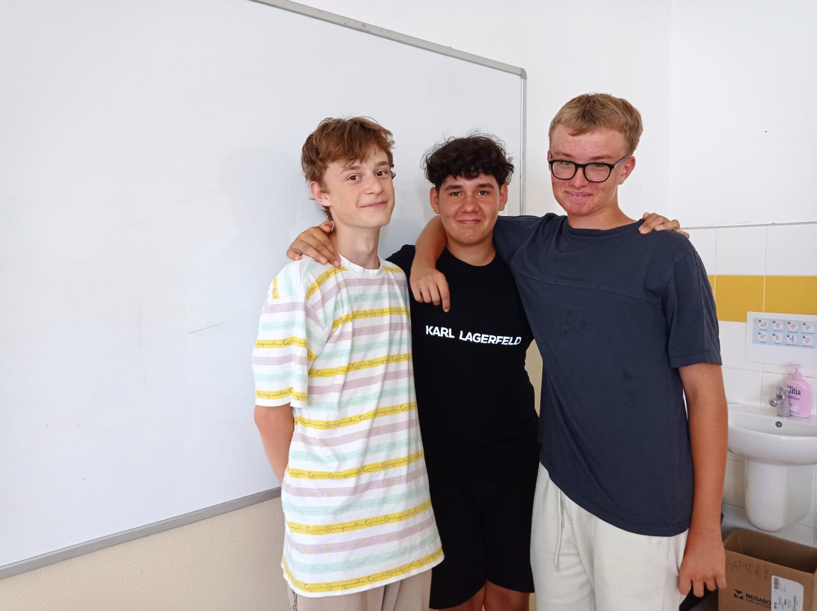
Characters:
Paulina: Adam
Katarína: Mišo Martin: Armend

Slide 5
Sources:
https://slovakdrama.theatre.sk/files/Ak%20bude%20pekne%20-%20anglicky.pdf
https://www.litcentrum.sk/autor/zuzana-ulicianska/zivotopis-autora

Slide 6
Thank you for your attention.

