Slide 1
Water and literature
Petra Blehová

Slide 2
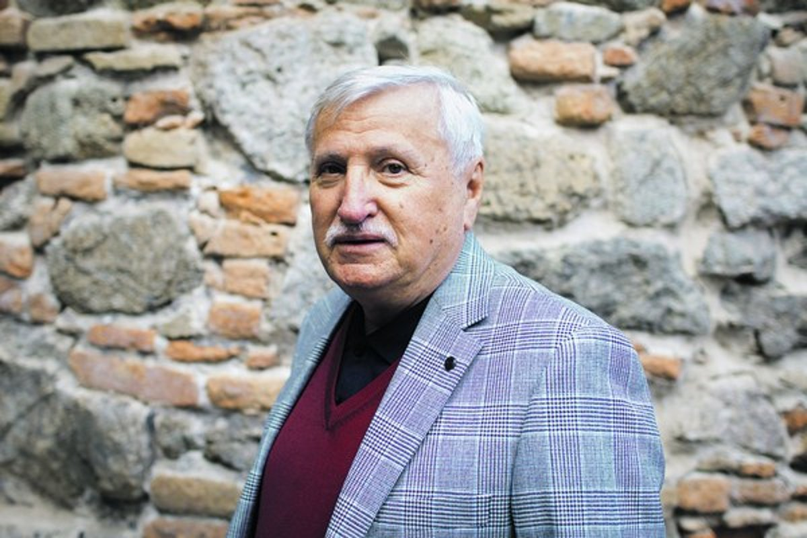
Kamil Peteraj- Keď voda ľúbi
Raz na nej zbadáš
Keď voda ľúbi Listy jesenné
Nosí šaty z vĺn A to čo hľadáš
Keď voda ľúbi Toho už viac niet
Svieti na ňu spln
Odchádza voda
A ľudom nosí Tečie bohvie kam
K brehom biely kvet A na breh padá
A ľuďom nosí Oznam že si sám
Na zrkadle med
Celá je modrá
Plná zázrakov
Tá voda dobrá
Z jarných oblakov

Slide 3
Kamil Peteraj: When water loves Someday you will notice on her
Autumn leaves
When water loves And what are you looking for
she wears dress made of waves Is not there anymore
When water loves
Full moon lights on her The water is leaving
Flows who knows where
And she brings for people And on the shores falls
white flower to the shores Annoucement that you are alone
And she brings for people
honey on mirror
She is all blue
Full of miracles
The good water
From spring clouds

Slide 4
Meaning of water in the poem
Author describes the beginning and end of love. The water symbolizes the love that left him.

Slide 5
If there is magic on this planet, it is contained in water.
Loren Eiseley

