Slide 1



Era+ :Integrated Learning Challenges

Slide 2
The seas pollution
According to a the French Institute for Sea Research and Exploration, the Mediterranean Sea is the most polluted European Sea. According to their report, the amount of sea waste is steadily increasing. Plastic represents over 60% of this waste

Slide 3
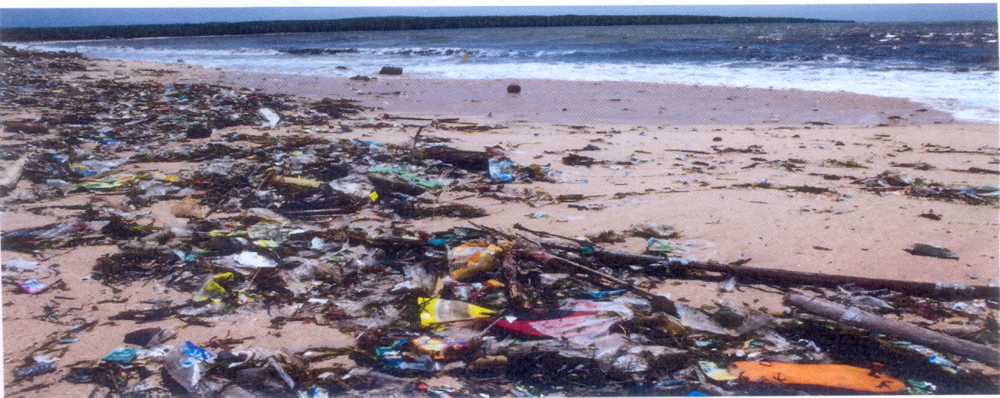
Most plastic waste polluting mediterranean countries:Egypt, Turkey and Italy

Slide 4
Plastic waste is threatening the lives of sea animals
Microplastics are a major part of the issue. Sea animals eat them , suffer for months and then they die. Nets and other man-made equipment can entangle and kill whales, dolphins, tutles, seals and other sea animals.

Slide 5
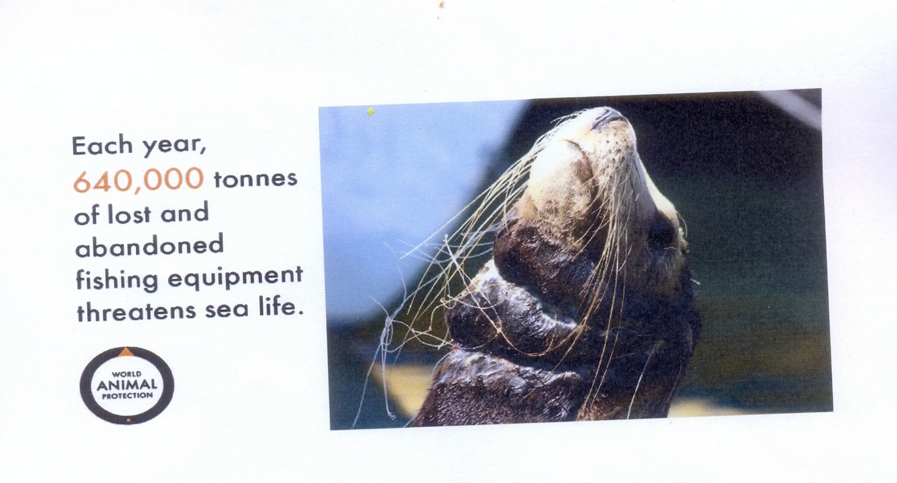
Ghost Gear: fishing gear lost in our oceans

Slide 6
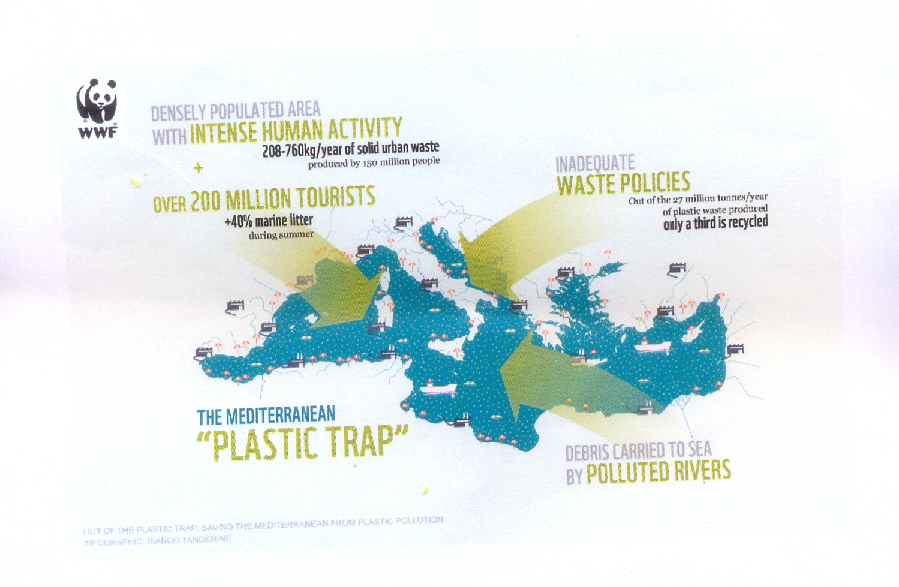
The Mediterranean Plastic Trap

Slide 7
How to save seas from plastic?
Reduce plastic useUse reusable water bottles
Avoid plastic bags, straws, cups-to-go, food containers and utensils
Be aware of packaging
Act for World Ocean Day!

