Slide 1
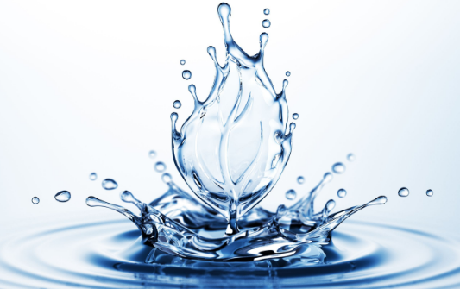
Water and its attributes
Matúš Berek 7.A

Slide 2
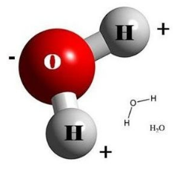
Water...
it is compound of 2 atoms of hydrogen (H) and 1 atom of oxygen (O) and it is the thing which is necessary for the life on the Earth
It is the most extended substance on the Earth
In the normal conditions it is clear liquid without smell and taste
For some animals it makes conditions for life
It makes 70% surface of our planet
Formula of water- H₂O

Slide 3
Its features
It appears in 3 states:
Liquid - In nature it is the biggest amount like oceans, seas, rivers...
gaseous – In nature it appears like water vapor
solid- In nature it appears like snow, ice, for example in Arctic or in high mountain
When the temperature is 0 °C it changes to ice and when the temperature is 100 °C to vapor

Slide 4
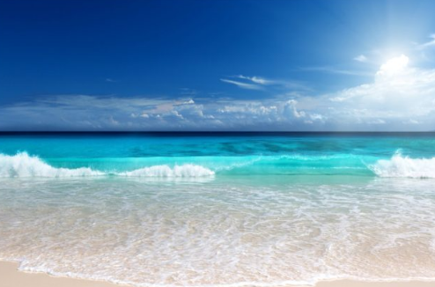
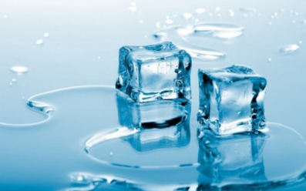
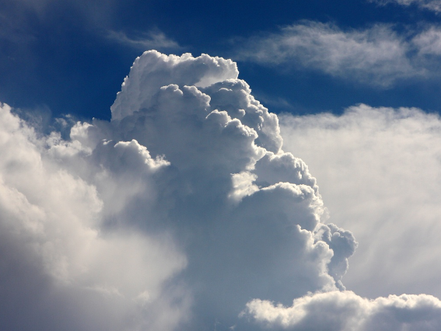
Pictures – states of water

Slide 5
Ďalšie vlastnosti
Density – density of water is variable and its top is in 3,98 °C
Viscosity – Together with density it influence hydraulic features of water, for example the speed of filtering water by sand, the speed od sedimentation. When the temperature is higher, viscosity is lower.
Electrical conductivity- It depends of amount of ions in water, their mobility and temperature
Different minerals can influence the features of water

Slide 6
The kinds of water
distilled – it is without minerals
soft – It contains little minerals
hard – it contains more minerals and comes from underground springs
Mineral water – Is devided by content of melted substances:
very low mineralized
low mineralized
middle mineralized
high mineralized
very high mineralized
brine

Slide 7
Thank you for your attention

