Slide 1
Saving water
The National Military High School
“Stefan cel Mare”
~water consumption in our high school~
Emanuel Gagea-Horga & George-Ciprian Melinte

Slide 2
We can save water in a day by following our daily routine, but we must change some little details which can make a big difference like the next ones:

Slide 3
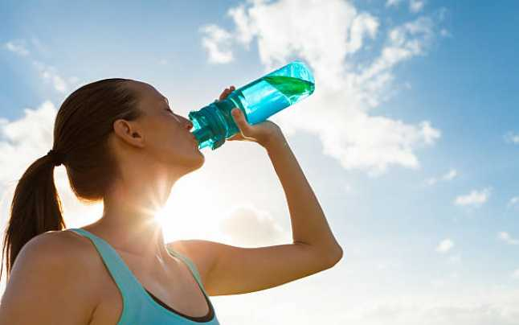
Water is the essence of life, but for saving it we can use reusable bottles made of stainless steel or resistant plastic; in this way we don’t pollute the earth.
~To bottle a liter of water we lose two more.

Slide 4
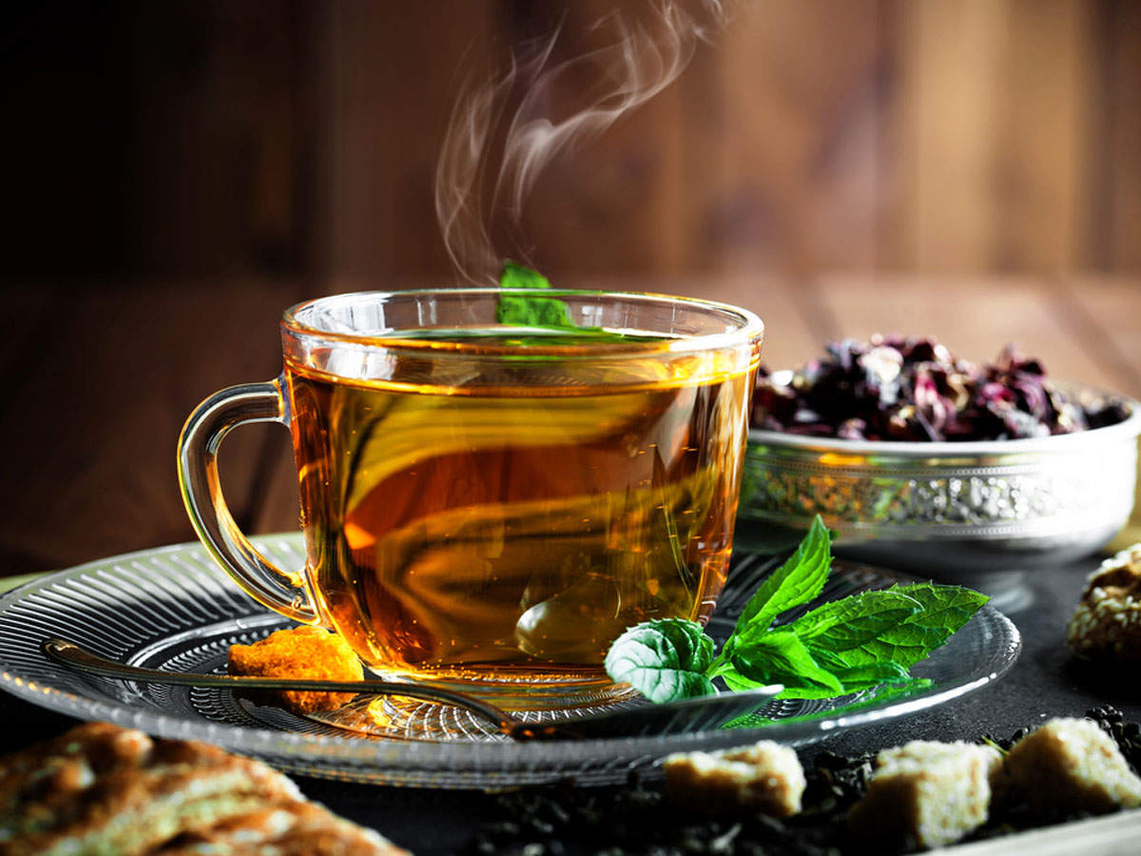
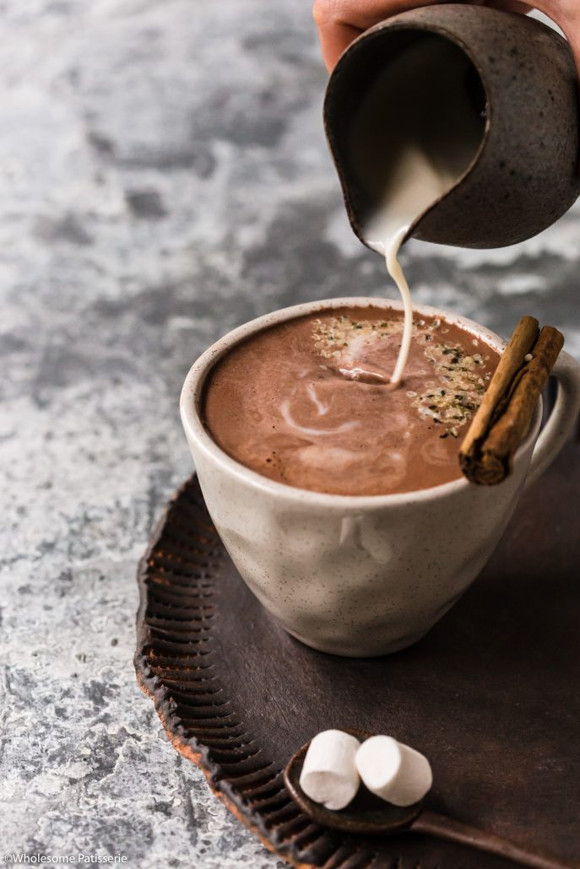
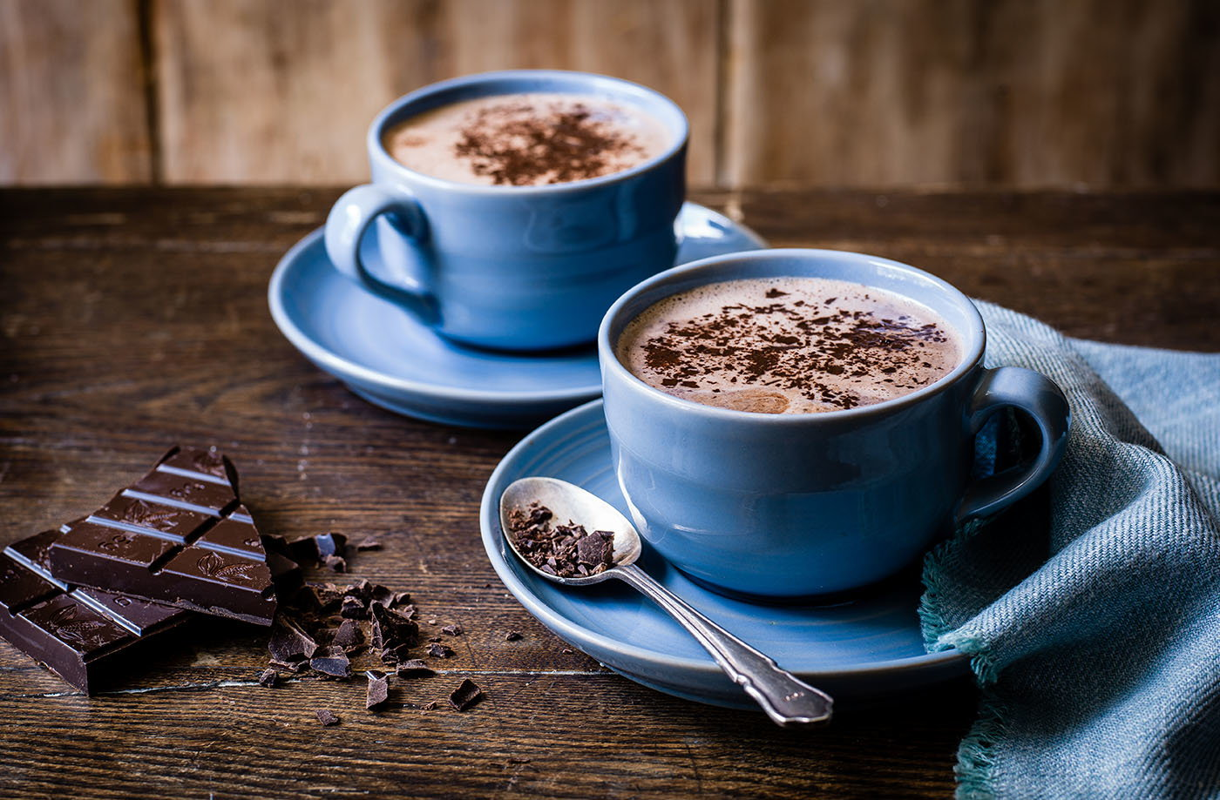
In the cold season, when a tea or hot chocolate with marshmallows is welcomed, we can save water by boiling just as much as we need and approximate what amount we need per person.

Slide 5
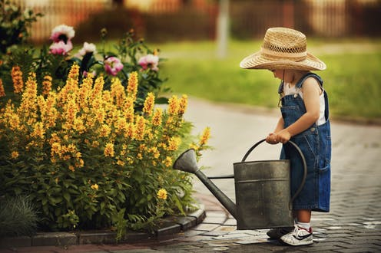
If water remains you could let it cool down and you can use it for watering the flowers which besides looking good in the ambiance of the room, freshen up the air; for this purpose we can collect the rain water too.

Slide 6
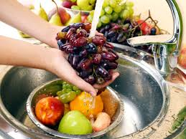
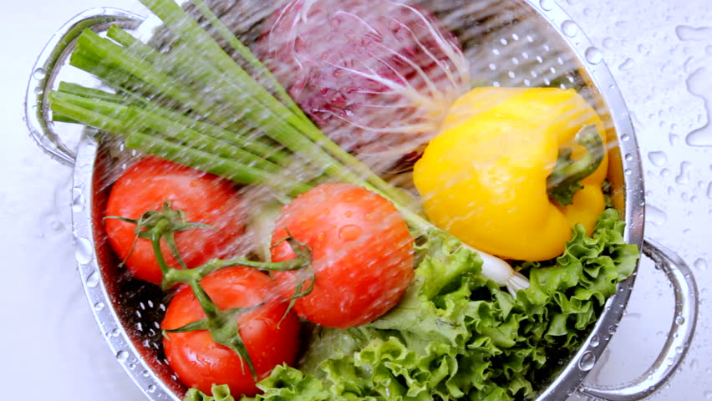
As you know the fruits and vegetables should be washed because on their surface there are a lot of bacteria from the store. We must wash them in a bowl, not in the sink because the water accumulates in the bowl until it’s full so we don’t waste any of it.

Slide 7
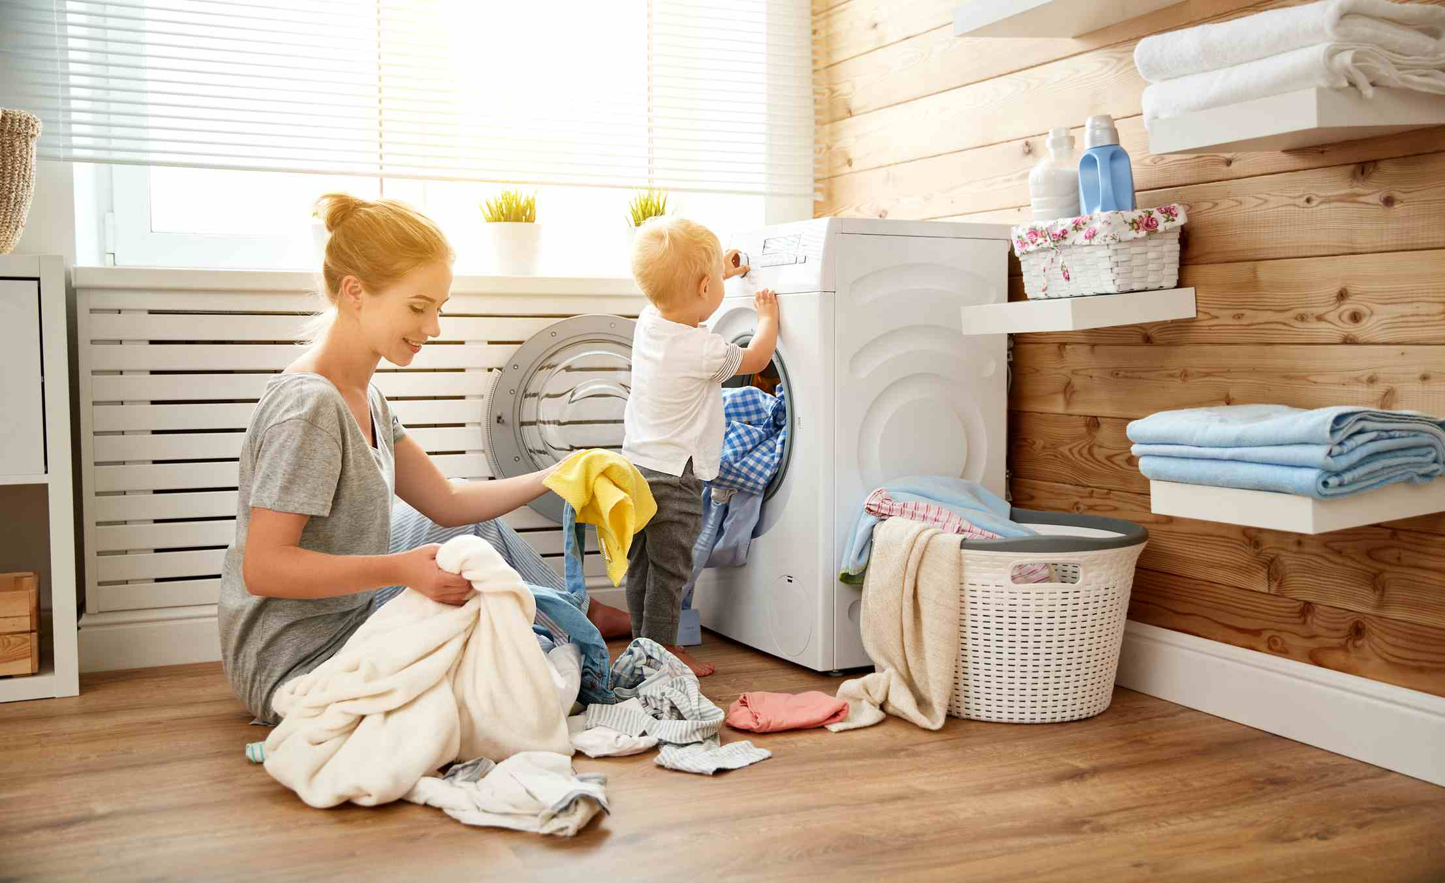
When we do the washing up we must not wash small amounts of clothes because this is a way we waste water.

Slide 8
Water consumption in our school
Average daily water consumption per pupil is 170 liters per day. This means:
Food preparation and cleaning the kitchen utensils
Drinking water
Personal hygiene
Shower
Toilet
Washing dishes by hand and brush the teeth
To this is added 55 liters per week for washing machine
Annual consumption: 245 days x 170 liters = 41650 liters
35 week x 55 liters = 1925 liters
--------------
43575 liters (43.57m³)

Slide 9
We are a big school and we have over 450 pupils; the majority of them do sports. They work hard to reach their target and they need to take a shower even three times a day.
A huge amount of water goes to the cantine, where we eat three times a day.
Every Friday we have administrative program where we do the cleaning and there goes a good amount of water for cleaning.

Slide 10
Bibliography:
https://adevarul.ro/life-style/stil-de-viata/ziua-mondiala-apei--modalitati-poti-economisi-apa-binele-planetei-1_532d7a3f0d133766a820eeb9/index.html
"This project has been funded with support from the European Commission. This publication[communication] reflects the views only of the author, and the Commission cannot be held responsible for any use which may be made of the information contained therein."
2019-1-RO01-KA229-063127

Slide 11
Thank you for your attention!

