Slide 1
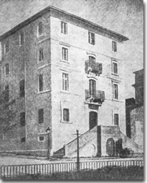
General information about 2nd gymnasium of
Corfu!
 Where the 2nd gymnasium
stands now, there used to be the
1st boys Gymnasium. It was
founded in 1865 and it was the 1st
public school in Corfu after the
unification of the Ionian islands
with Greece. It was housed in the
Grimani barracks up until
September 1943 when it was
bombed. After hasty repairs,part
of the ex barracks was given again
to the 1st gymnasium, up to 1975,
when it was substituted by the
2nd boys' and girls' gymnasium.

Slide 2
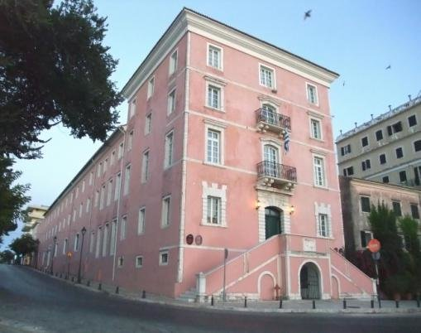
General information on Ionian Academy (ex
Grimani barracks)
 The Venetian Grimani barracks
housed the Ionian Academy from 1840
onwards. The building, situated on the
upper end of Spianada square, was
originally designed to house soldiers,
as well as the residence of the Military
Commander during the Venetian Rule.
Under the British Rule, this became
the seat of the first university in
modern Greece, founded and initially
finaned by Lord Frederick North, Earl
of Guilford. It was destroyed by
German bombing in 1943. It has lately
been restored to function as the
administration building of the Ionian
University. In the back and lower side
of the building there is the 2nd (ex 1st
boys) gymnasium of Corfu.

