Slide 1
Water as a habitat for people

Slide 2
What is ‘habitat’?
It is the natural home or environment of a plant, animal or other organism. It provides the organism that lives there with food, water and space to survive. Human habitat is the environment in which human beings exist and interact. There are 3 types of habitats: terrestrial (land), aquatic (water), aerial/arboreal (air/ tree). The largest aquatic habitat is the Pacific Ocean. Water as a habitat for people can offer space, food, shelter and water. Watery habitat include freshwater (rivers, creeks, ponds and streams) and ocean waters (areas of salty water as seas and oceans). Fresh water accounts for only 3% of the world’s water.

Slide 3
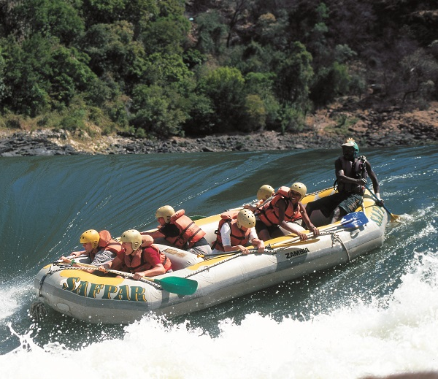
Rivers
The rivers may become a “tourist area”. People can enjoy but it may be more difficult for some animals and plants to survive.
People like to use rivers for energetic activities such as sailing, boating, walking, cycling. That often means that river banks are damaged, water is polluted and much of the wild life goes into hiding.

Slide 4
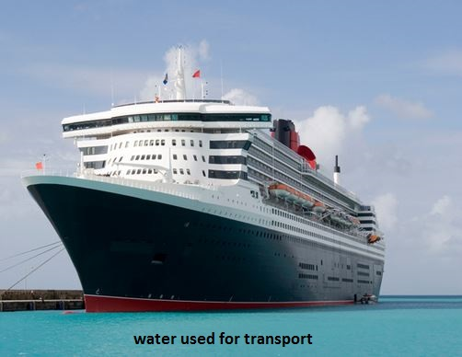
Transport
Rivers provide ready-made transport routes to move people and goods. Some rivers are the easiest or the only way to travel.

Slide 5
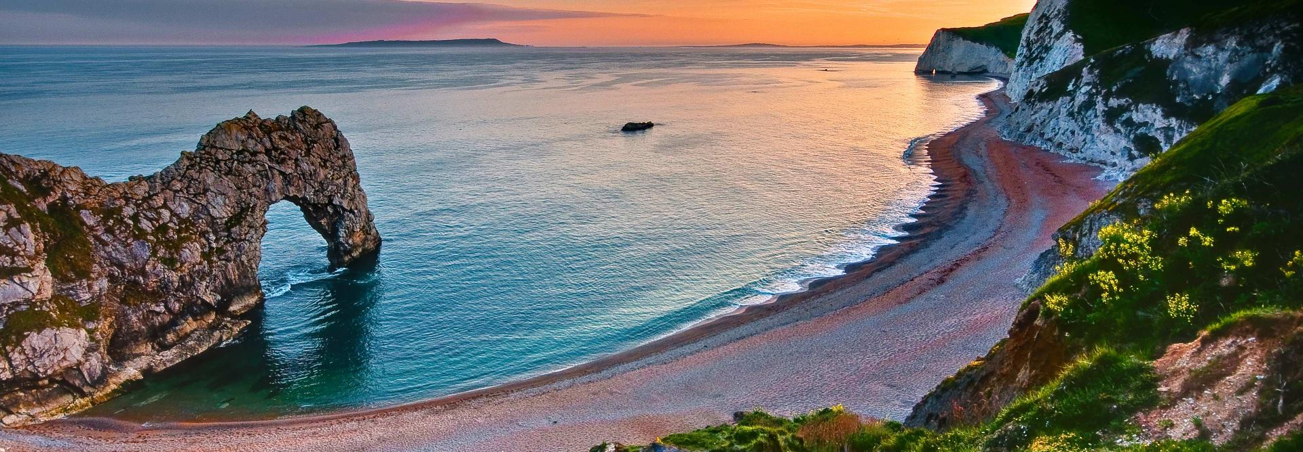
Coasts
They are the place where land and sea or river meet. Coasts are the part of earth where the most development takes place. Around the world these areas support about 4,5 billion people.
Rivers form estuaries and deltas- they are two different types of areas where river and sea mix saltwater and freshwater. They are important for farming. There is plenty of food for plants and animals.

Slide 6
Coasts
Coasts cover only a small area of land, but they are the places where the most people live. Coastal regions have been enormous importance for people- the water and the land provide food.
Fish and shrimp farming are bid business. Many people who live on coasts catch fish.

Slide 7
Tourism
People visit coasts for beaches and beautiful countryside. But coasts can often be overused or polluted, that disturb wild life.

Slide 8
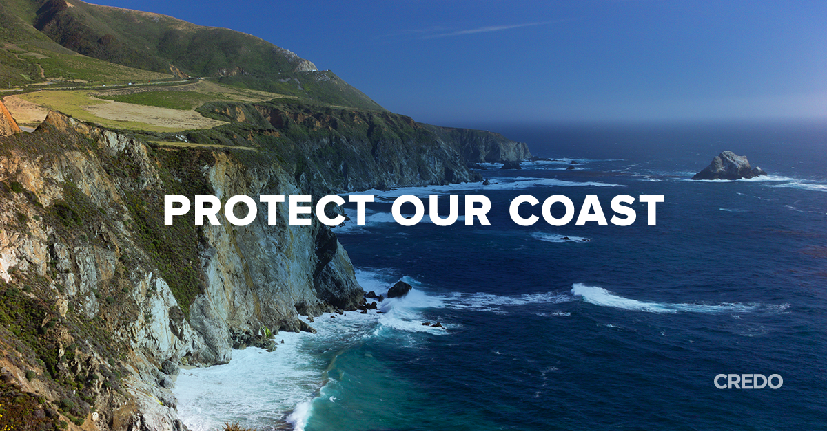
Protecting coasts
Coasts are very valuable. They provide a living for more people than the rest of the land on the planet. They are valuable areas for both – their natural state and when they have been changed for human use. Building and development are necessary for people to live, work and trade. But there needs to be a balance between people’s needs and natural world.

Slide 9
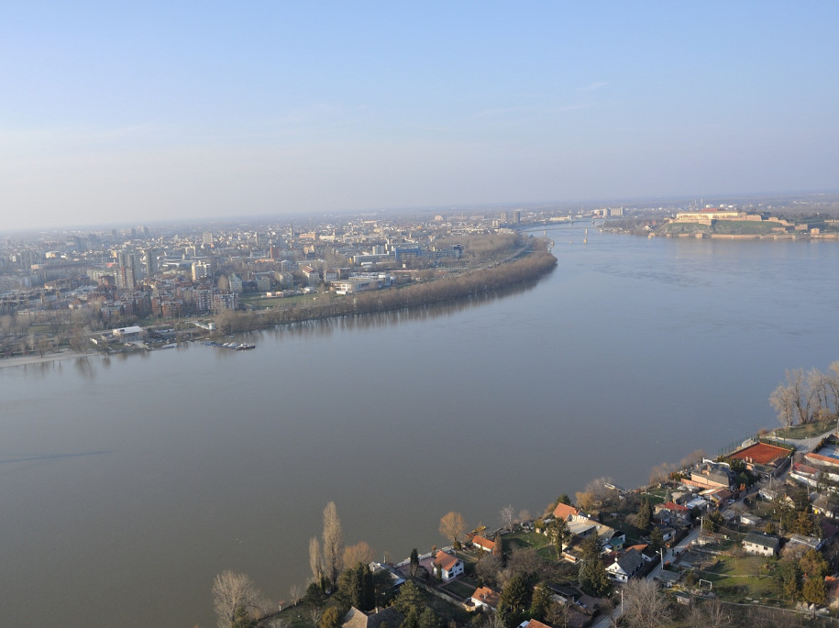
Rivers in Bulgaria
The longest river is the Dunabe (2.888 km), which spans most of the country’s northern border. Important towns are Ruse and Vidin. Maritsa (480 km) is the longest and the deepest that runs through the country. Maritsa passes through Plovdiv.

Slide 10
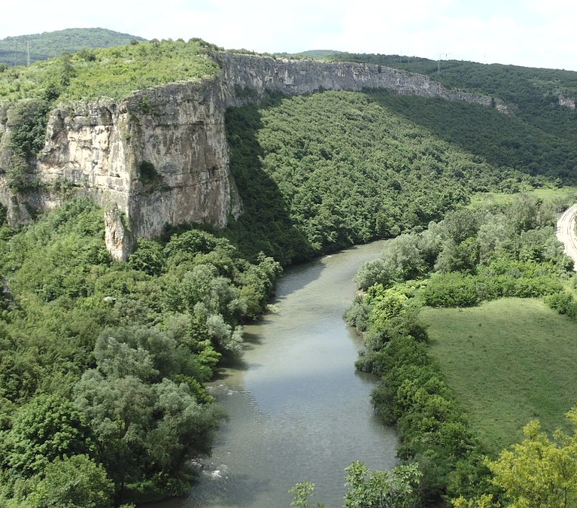
Rivers in Bulgaria
Other important rivers are: Iskar (368 km), Arda, Ropotamo ( is relatively short river and flows in Black Sea; the lower section of the river is a natural reserve since 1940 and a protective area), Rezovska ( is running through Bulgaria and Turkey), Yantra ( springs from Stara Planina; the bends that the river makes surround the hills of the Old Bulgarian capital Veliko Tarnovo- Trapezitsa and Sveta Gora).

Slide 11
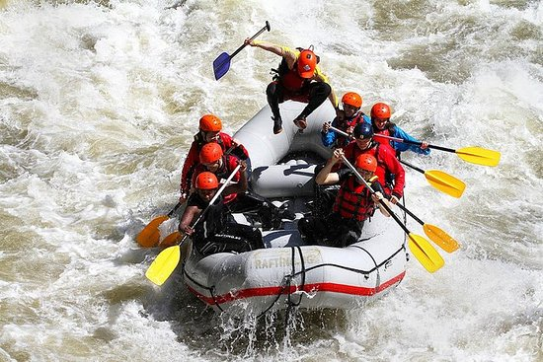
Rivers in Bulgaria
There are good opportunities for adventure tourism: wild water rafting and canoeing, diving delta- and para- gliding in the valleys of the Vatcha, Iskar, Struma, Mesta rivers.

Slide 12
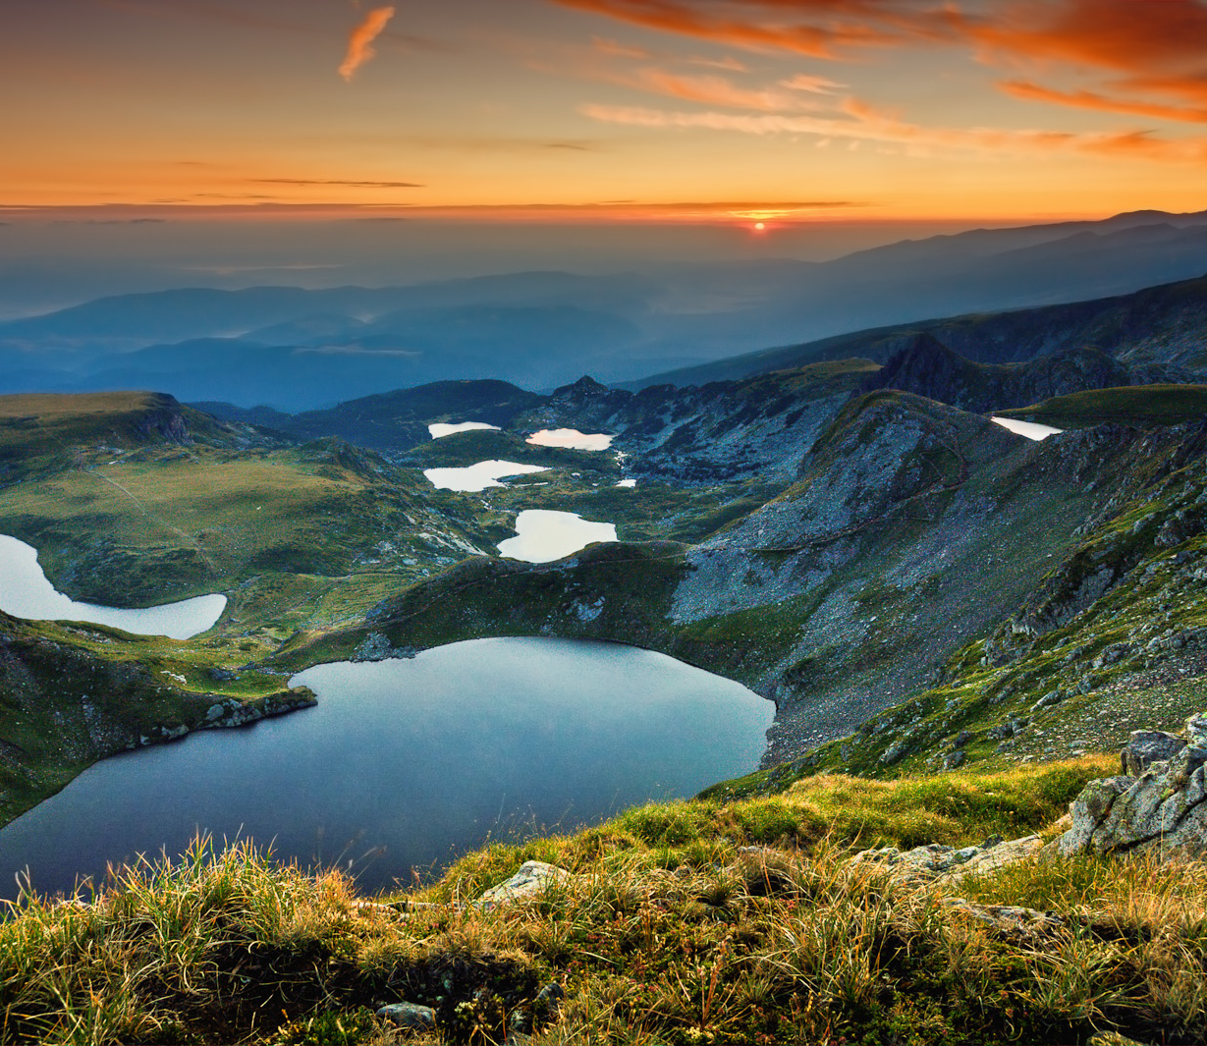
Lakes
Bulgarian natural lakes are about 330-near the Black Sea or high glacial lakes in the Rila and Pirin mountains.

Slide 13
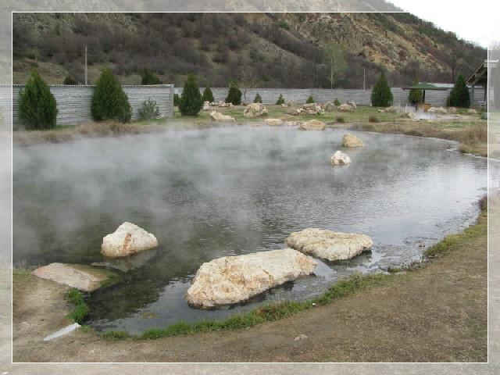
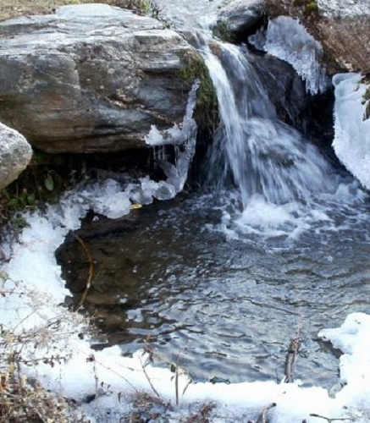
Mineral Water
There is abundant mineral water that ranks Bulgaria among the leading countries of the world in terms of balneology. Bulgaria is rich in mineral springs in that very greatly in physicochemical composition. Bulgarian mineral waters are used in balneotherapy and medical tourism.

Slide 14
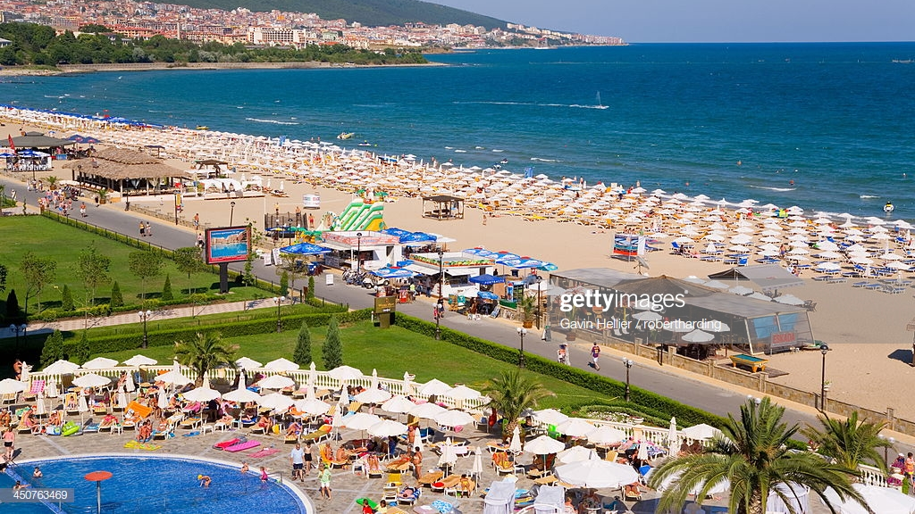
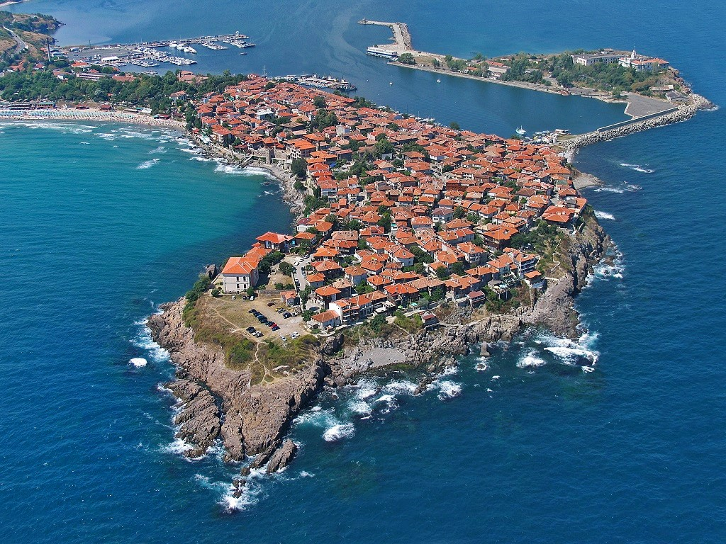
Bulgarian Black Sea Coasts
Black Sea is a marginal sea of the Atlantic Ocean through the Mediterranean Sea. Burgas is the second largest city on the Black Sea coast. The city is surrounded by the Burgas Lake is important industrial, cultural and tourist centre.

Slide 15
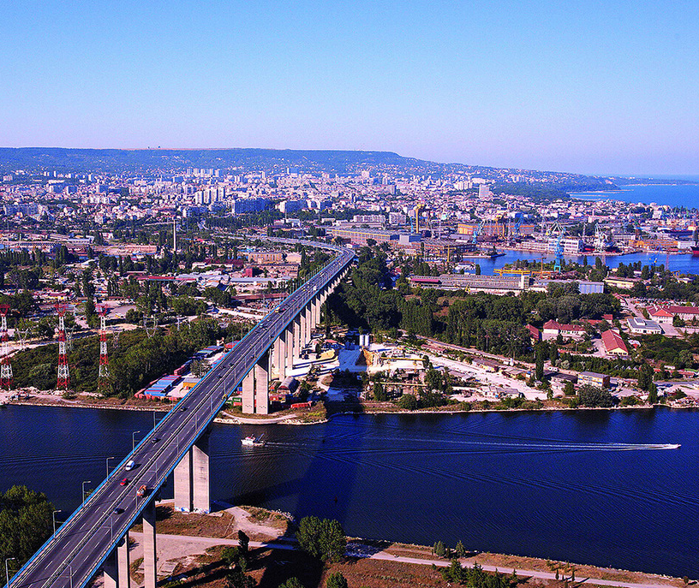
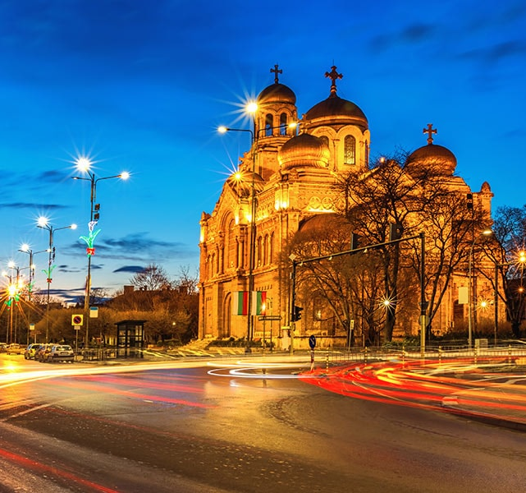
Bulgarian Black Sea Coast
Other significant city is Varna, situated in the Gulf of Varna and is the largest city and seaside resort on the Bulgarian Black Sea Coast. The city is centre for business, transport, education, tourism and healthcare.

Slide 16
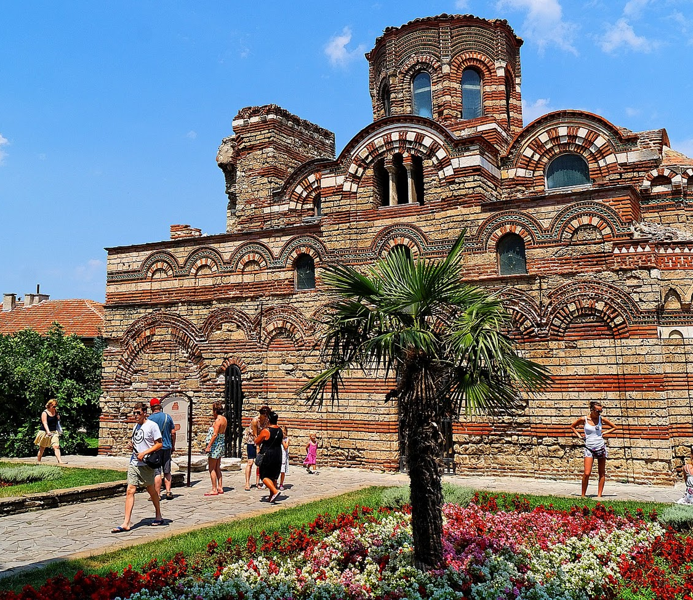
Bulgarian Black Sea Coast
Seaside resorts and towns are Balchik, Albena, Nesebar, Sozopol, Pomorie, Primorsko.

Slide 17
Thank you for the attention!
Made by: Maria Grachenlieva, Ioana Ivanova, Ilianna Aronova, Raya Stancheva, Nikol Stoyanova

