Slide 1
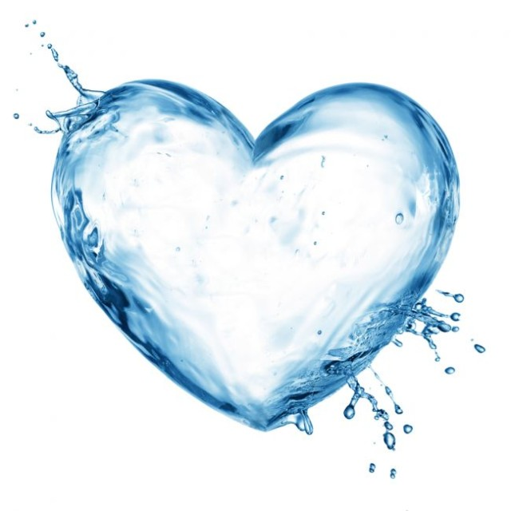
WATER THE BASIS OF ALL LIFE

Slide 2
Planet Earth has been called Blue Planet due to abundant water
on the Earth´s surface. .
Life on Earth probably began in the depths of
the ocean, what means water is
the cradle of life on our Blue Planet.
All living organism on Earth require water for survival.

Slide 3
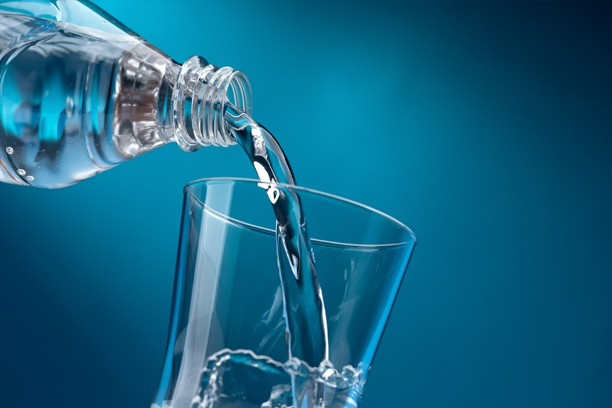

Slide 4
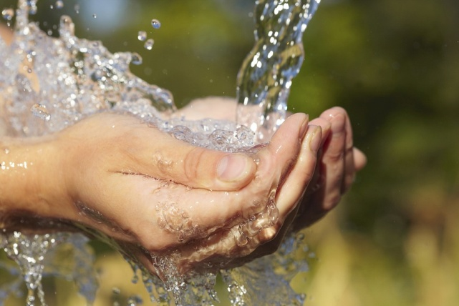
World Water Day
World Water Day is held annually on 22, March as a means of focusing attention on the importance of freshwater. Annual event reminds us to respect and humble to this element.
The resolution to observe WWD was first adopted by the UN General Assembly on December 22, 1992, in Rio De Janeiro.

Slide 5
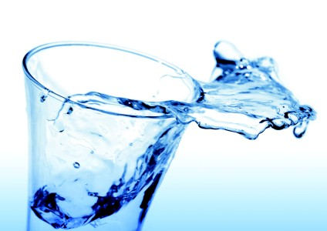
World Water Day is focused on:
• drinking water supply
• importance of water conservation

Slide 6
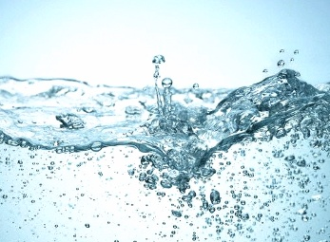
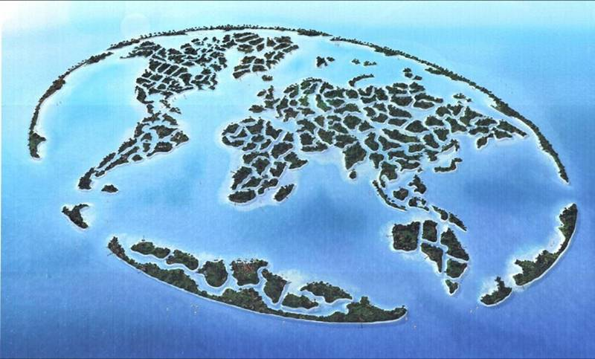
Water is all around us
Covers 70% of Earth´s surface and it has immense importance for Earth and human beings.

Slide 7
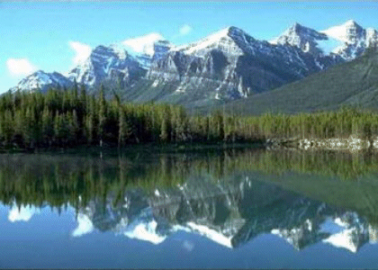
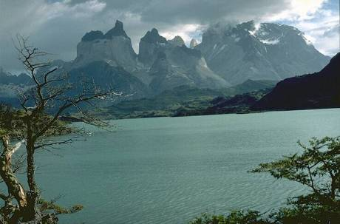
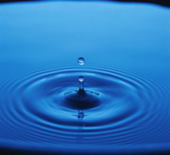
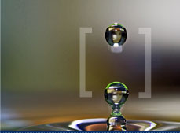
The ocean covers three quarters of the Earth's surface

Slide 8
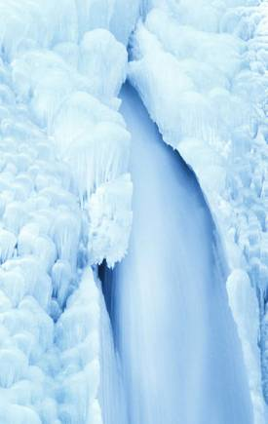
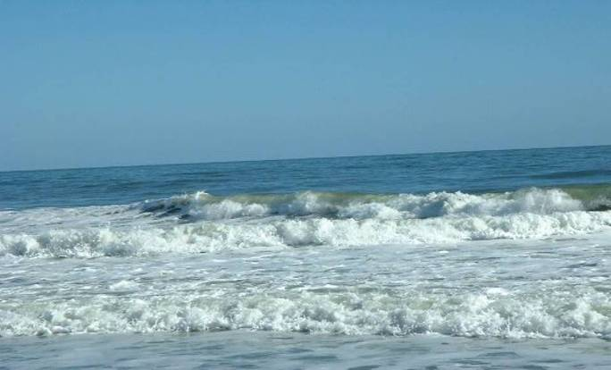
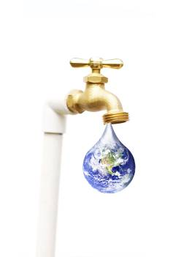
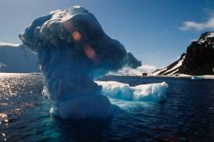
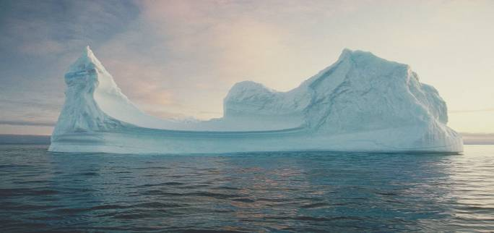
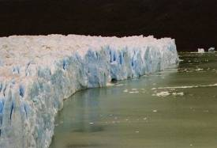
97 % salt water
3 % freshwater
2% glaciers
1% cycle

Slide 9
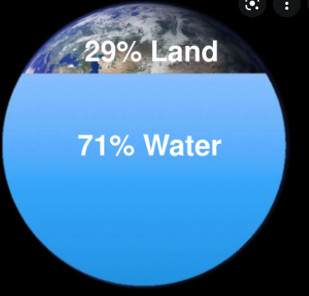
Hydrosphere – total amount of water on Earth
Oceans
Seas
Rivers
Lakes
Glaciers
Groundwater
The ratio land to water
29% land
71% oceans
Salt water
Freshwater

Slide 10
Water is essential for life :
plants
animals
human

Slide 11
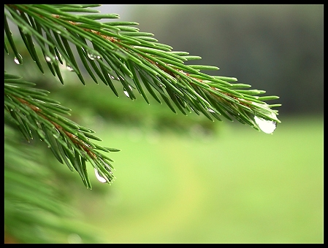
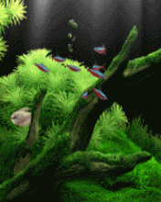
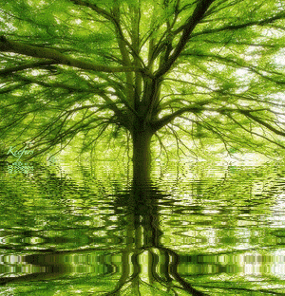
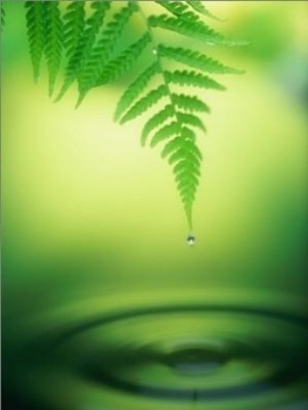
Water is life !

Slide 12
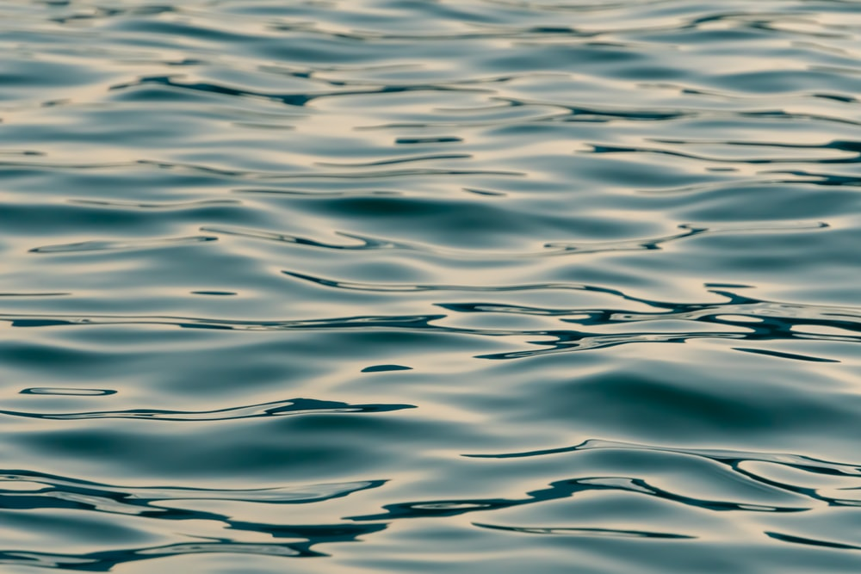
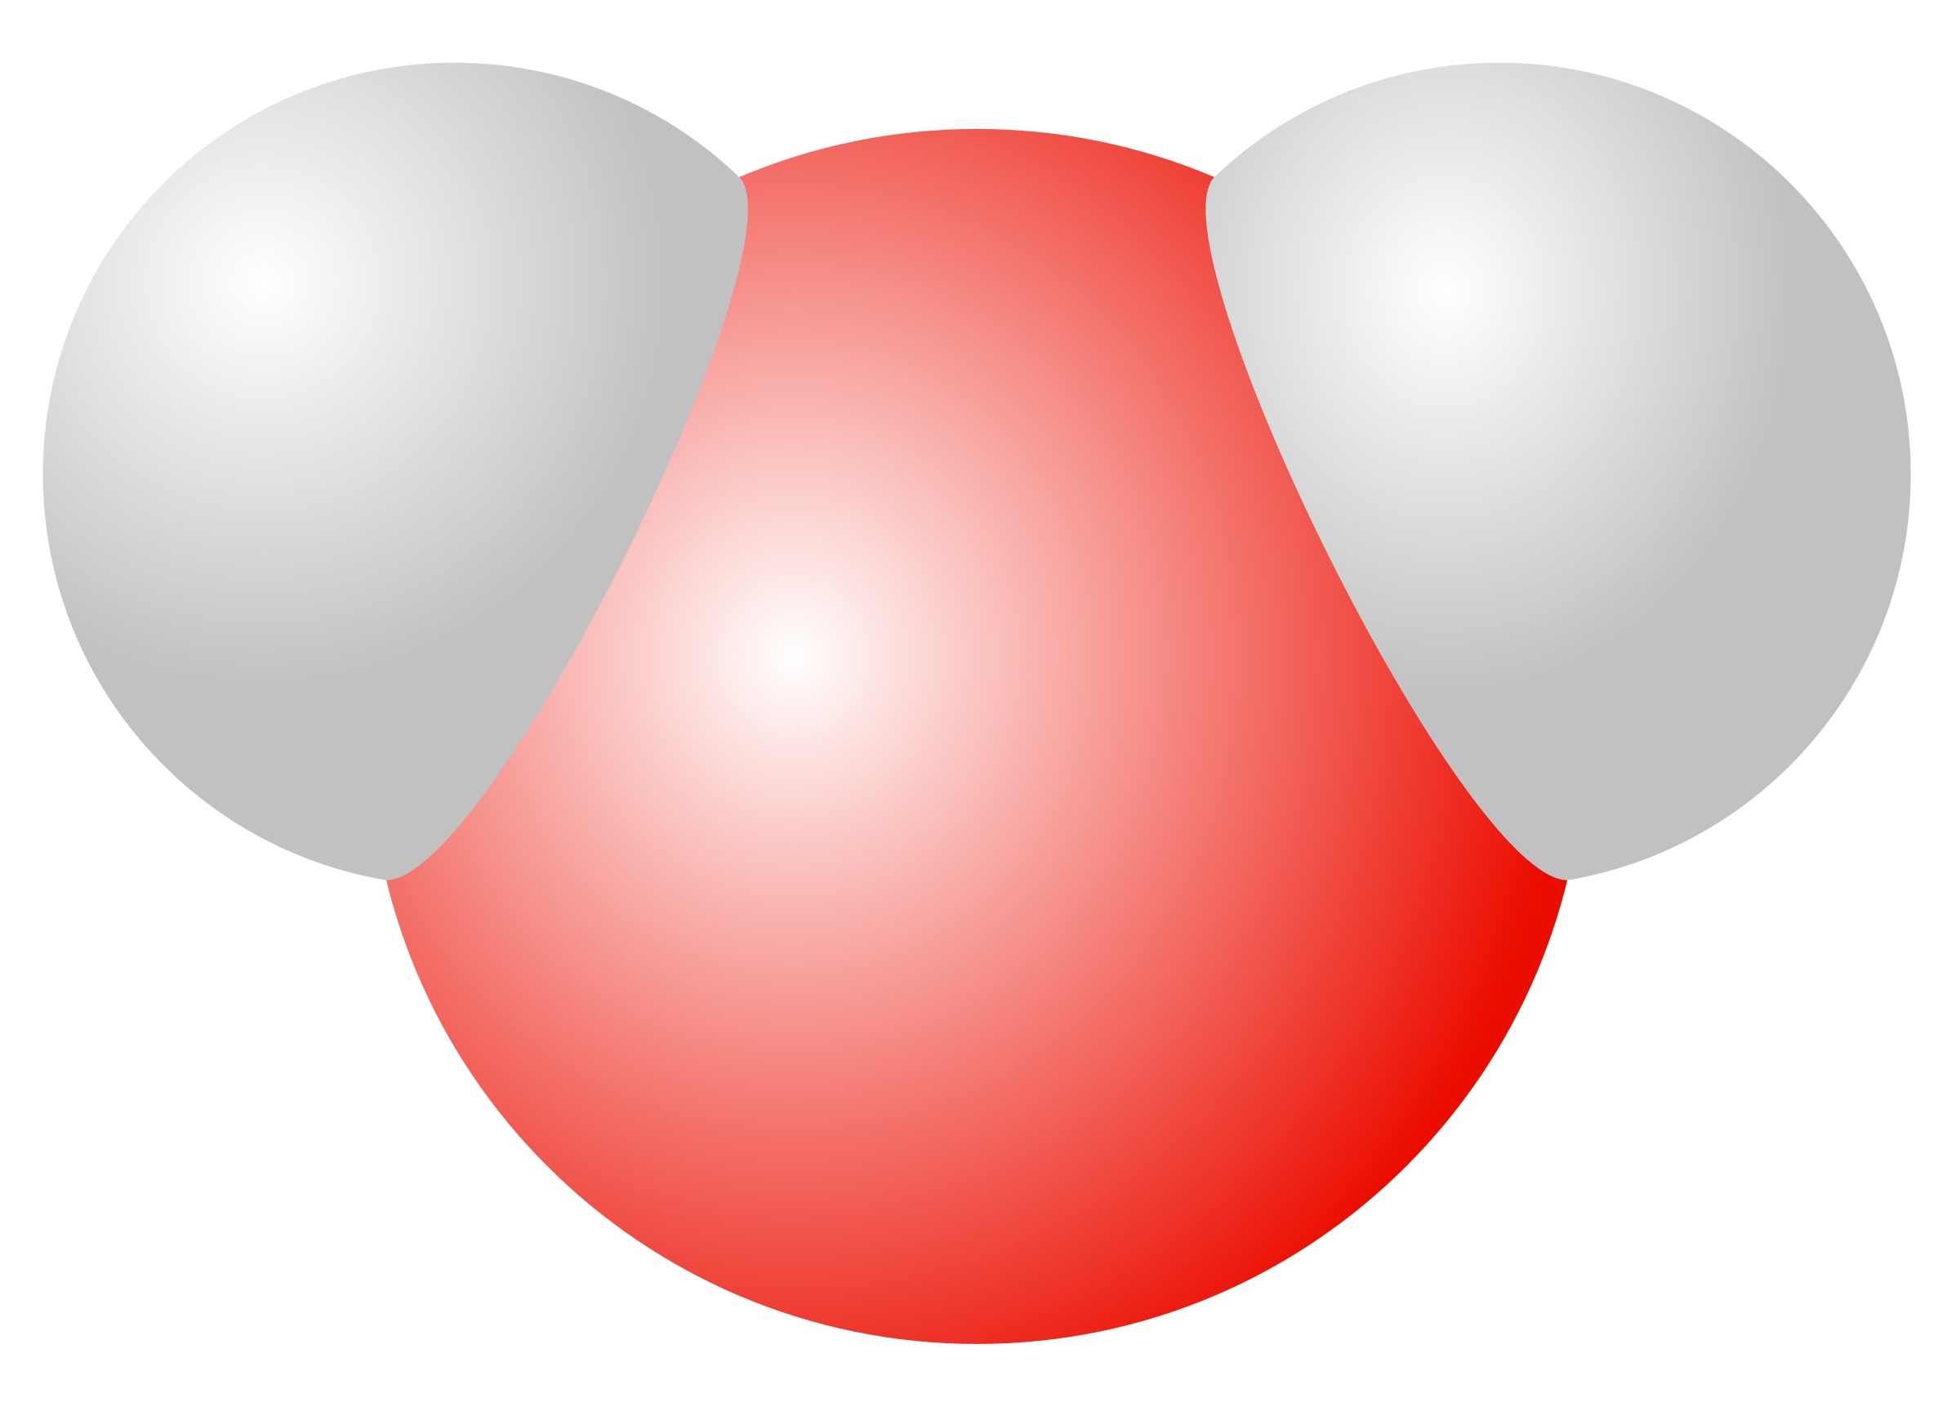
Molecule of water
Has two hydrogen atoms covalently bonded to a single oxygen atom.
Has two hydrogen atoms covalently bonded to a single oxygen atom.

Slide 13
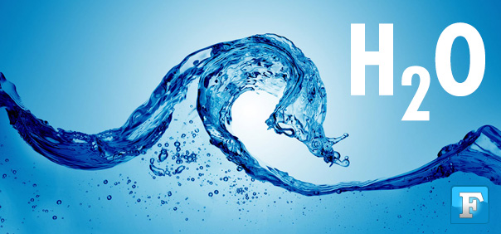
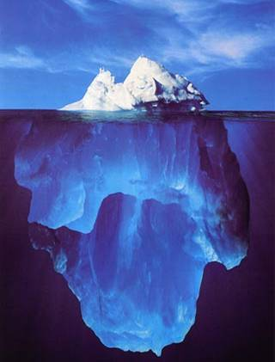
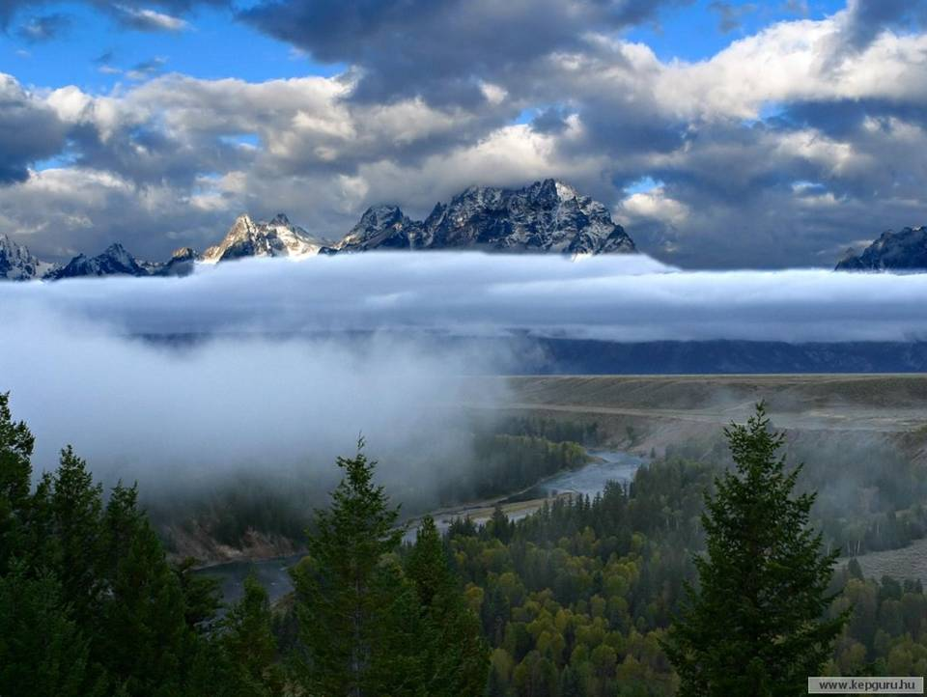
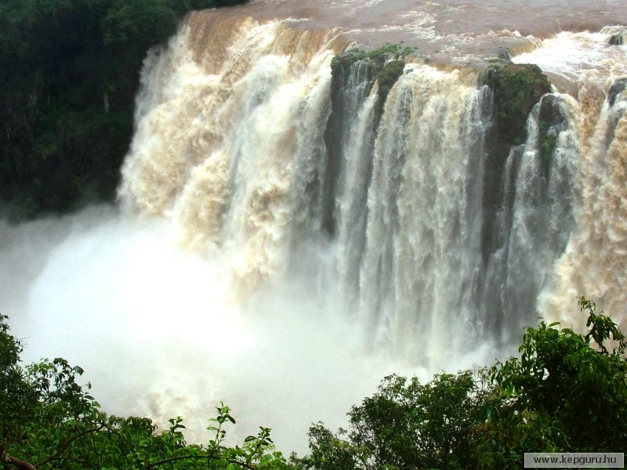
The states of water
Solid – ice, snow
Liquid – freshwater
Gas – vapor

Slide 14
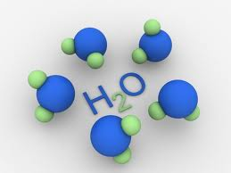
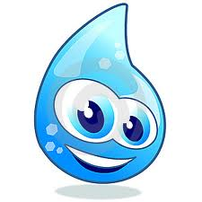
Properties of water
Pure water is practically colorless, odorless and tasteless.
Water is universal solvent
The melting point is 32°F (0°C) and the boiling point is 212 °F (100°C)
Water expands when its frozen
Ice floats on the surface of water because it is less dense than water
At 39°F (4°C) water is the most dense

Slide 15
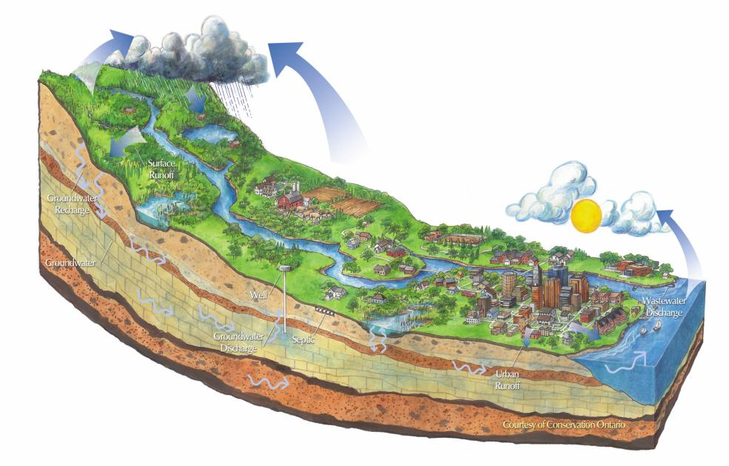
Water vapor turns into clouds when it cools and condenses, and turns back into liquid water or ice.
Water evaporates from Earth´s surface.
Forms clouds..
Part of the water flows directly into rivers and lakes
River flows into oceans and seas and cycle repeats.
Another part of the water flows into groundwater.

Slide 16
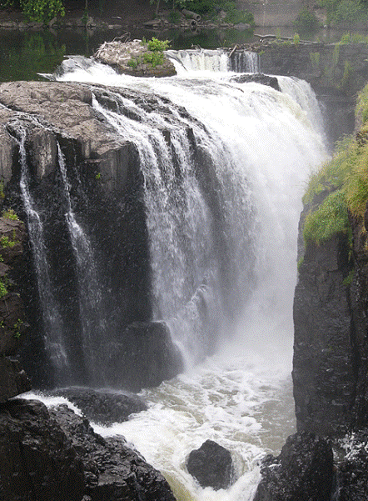
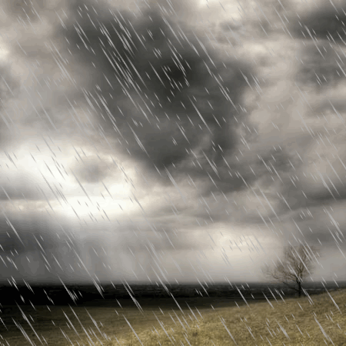
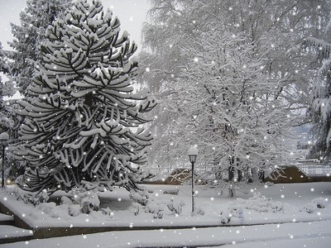
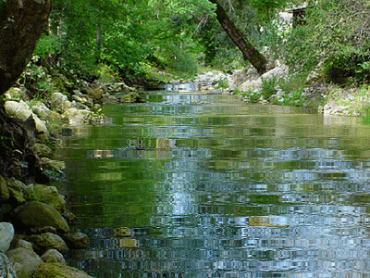
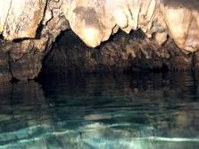
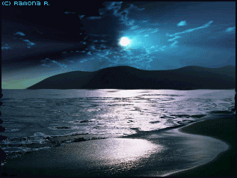
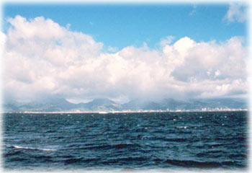
Water cycle in nature – the driving force of
the water cycle is Sun

Slide 17
Worldwide water supply

Slide 18
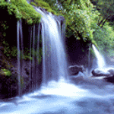
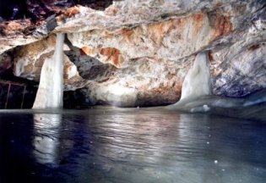
Water occurence:
precipitation
surface water
groundwater

Slide 19
Types of water
drinking water
domestic water
wastewater
Usage :

Slide 20
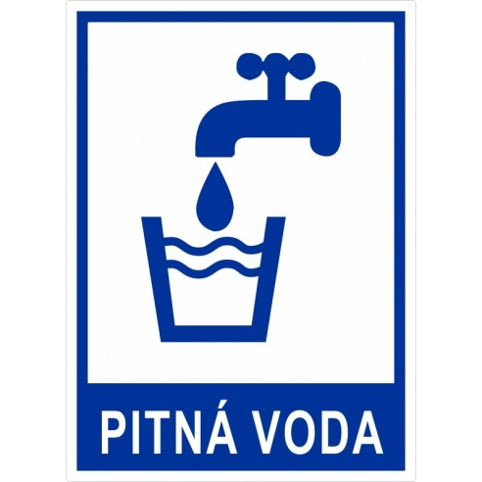
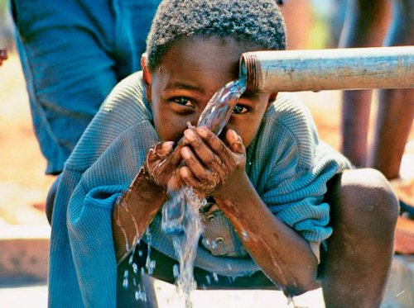
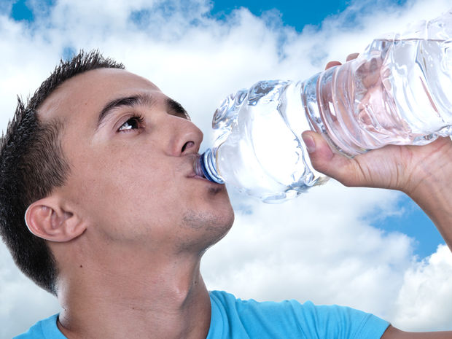
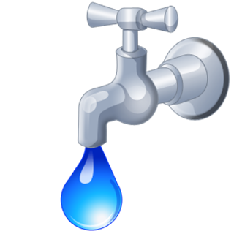
Drinking water
For human being is important for survival
People use wells to get at underground water
Water can be contamined by fertilizers,
chemicals, metals...
Water must be treated to make it safe

Slide 21
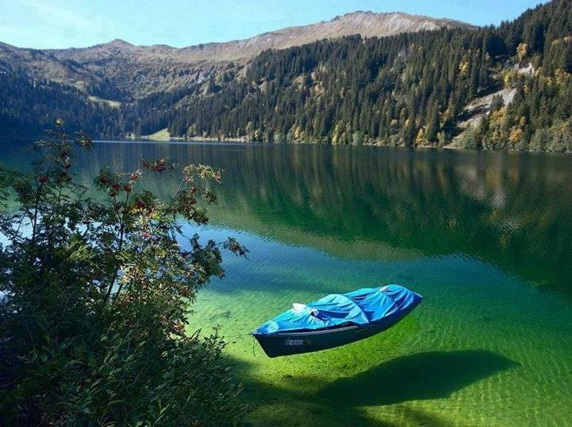
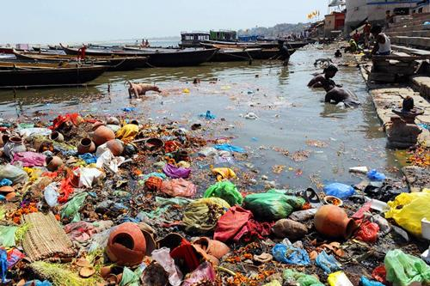
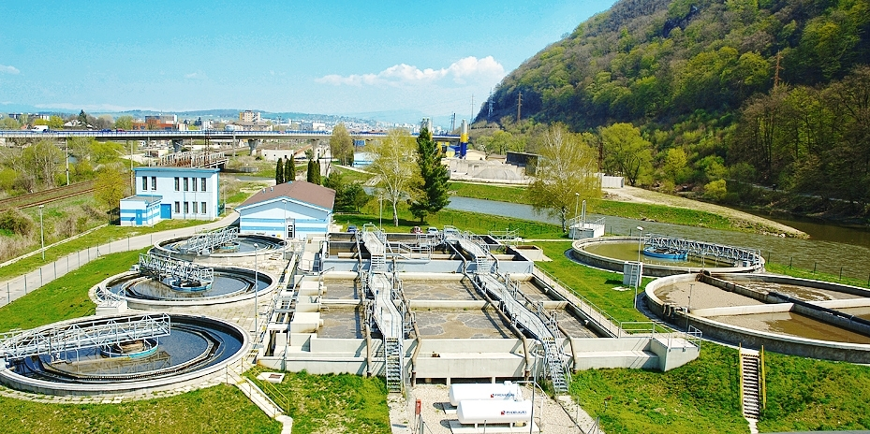
How is surface water treated?

Slide 22
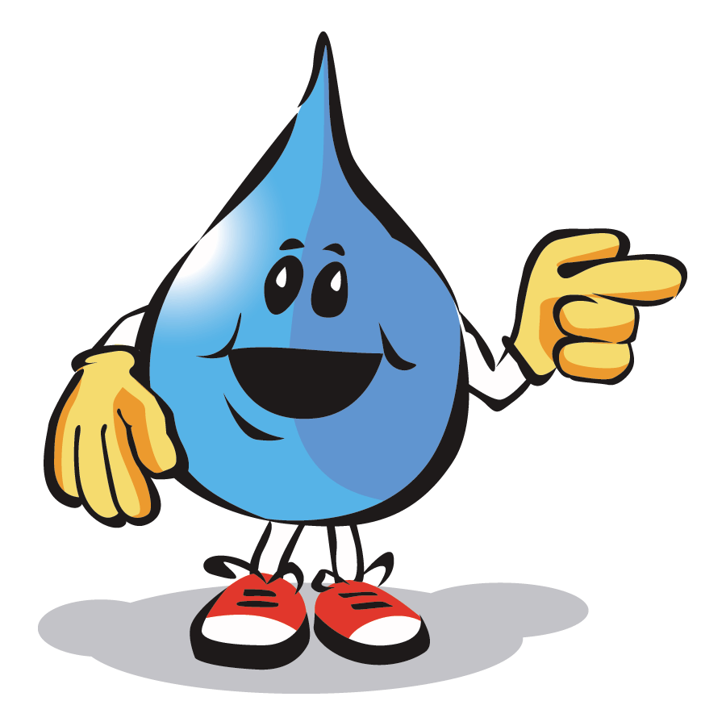
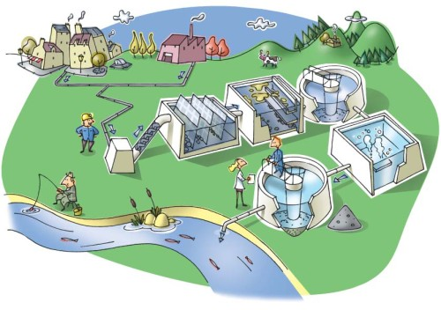
Water treatment scheme:
Sedimentation
čiastočky
Clarification
Pridávaním chemikálii sa vytvoria vločkovité zrazeniny.
Filtration
Čistenie cez pieskové a štrkové filtre.
Prefiltrovaná voda sa dezinfikuje chlórom. Zbaví sa tak baktérií.
Disinfection

Slide 23
Water treatment
1.Sedimentation: solid particles settle first, which fall into the bottom of the watertank.
2.Clarification: with adding chemicals, impurities
form flakes, which fall into the bottom of the watertank.
3.Filtration: runs through gravel and sand filters . 4.Disinfection: to become germ-free water must be carried out with chlorine or ozone.

Slide 24
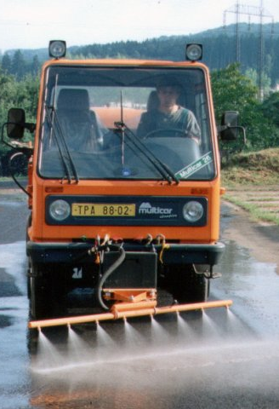
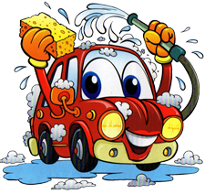
Domestic water
It is only partially treated - purified water.
It is used in industry and in economy.
It may not be appropriate for drinking,
cooking and personal hygiene.

Slide 25
Wastewater
It originates in industry, agriculture,
and households.....
waste water is treated and discharged via a central sewerage system into wastewater
treatment plants

Slide 26
Distilled water
- colorless water, tasteless and odorless, does not contain any minerals
- used in irons, car radiators,
in laboratories ...
- obtained by distillation of drinking
water

Slide 27
Distillation apparatus In our studying classroom we are able to prepare treated water
thermometer
condenser
template
Distillation
flask
Steam flask with stones
Bunsen burner

Slide 28
The importance of water :
In household
drinking
personal hygiene
washing-up
cleaning

Slide 29
For recreational purposes

Slide 30
Irrigation

Slide 31
In industry
Electricity generation
Gabčíkovo waterworks is the largest hydroelectric power plant in Slovakia
construction of hydroelectric power plants

Slide 32
Gabčíkovo waterworks
Was built mainly for reasons of flood protection on the border of the Danube river

Slide 33
Great Rye Island-Žitný ostrov
Was formed between the Little Danube and the Danube.
It is the largest river island in Europe and is also the largest source of drinking water in Central Europe.

Slide 34
Do you know that small Slovakia is one of the water superpowers? Yes, it is. and thanks to that we can choose between the waters. Take a look - Slovakia is literally littered with water!

Slide 35
Slovakia is rich in deep underground springs with varying thermal and mineral properties.

Slide 36
Mineral and distilled water
Mixture
Chemically pure substance
- groundwater
- more than 1 gram of dissolved solids
minerals or CO2 in 1 liter
prepared by distillation
does not contain any minerals

Slide 37
Thermal spas in Slovakia
Turčianske Teplice
Piešťany
Dudince
Bardejov
Trenčianske Teplice
Bojnice

Slide 38
SLOVAK RIVE RS
water wealth
Danube – the largest river →
←Váh – the longest river
Others: Hron, Hornád, Torysa, Latorica, Žitava, Laborec, Uh, Bodrog, Ondava, Nitra, Orava, Ipeľ, Poprad, Tisa

Slide 39
THE LARGEST WATER POLLUTANTS
Water Is an Irreplaceable Natural Resource.
Humans are the main cause of water pollution.
The biggest problems are industrial production,
agriculture, human settlements and transport.

Slide 40
Water pollution is very dangerous :
chemicals
petroleum products
heavy metals
radioactive waste
sewage

Slide 42
Ecological problems
World population is constantly growing, what
causes an increase in the amount of production in industry. Humans impact the environment in many ways. We are the biggest enviromental pollutants.

Slide 43
Report of the Secretary-General from 2021
Billions of people around the world are continuing to suffer from poor access to water, sanitation and hygiene.
Poor sanitation, including poor hygiene, causes at least 120 million disease episodes and 50,000 premature deaths annually.
More than half of the global population lives in cities, and urban areas are still better supplied with improved water and sanitation than rural ones.

Slide 44
Life without water is lost
In areas with no water, there is hunger, misery and poverty.

Slide 45
Average daily water useage:
How many litres of water does a person need per day?
2,5-3 l per day
shower and a bath 40 l
laundry 40 l
flushing a toilet 40 l
Personal hygiene (without a bath) 15 l
cleaning 10 l
washing-up 7 l
drinking and cooking 6 l

Slide 47
Conclusion of water using:
drinking
washing
shower
laundry
watering
cooking
kitchen
bathroom
and other
How many litres of water do
you need per day?
Try to think about it.

Slide 48
Conclusion
World Water Day (March 22) theme is 'Valuing Water‘
The value of water is about much more than its price – water has enormous and complex value for our households, food, culture, health, education, economics and the integrity of our natural environment.
If we overlook any of these values, we risk mismanaging this limited and irreplaceable resource.
Further development of the global and local economy will be decided by the most common and most widespread liquid on our planet - water.
The abundance of liquid water on Earth clearly distinguishes our unique planet .
Without water, life as we know it would not exist. And life exists wherever there is water.

Slide 49
Daily water
Every drop of water is precious.

Slide 52
Protect our water
Follow these rules:
Protect your water resources!
Don't waste it!
Don't pollute it!
Appreciate it!

