Slide 1
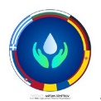
Water movements
Balahura Daria Buzilă Andreea
The National Military High School “Ștefan cel Mare”

Slide 2
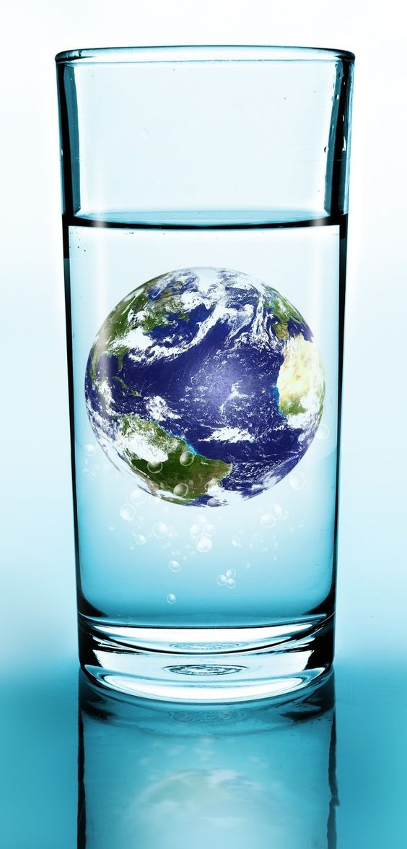
Contents
Something about water
Water cycle
Currents, waves and tides: the ocean in motion
The movement of water in a river
Facts about water

Slide 3
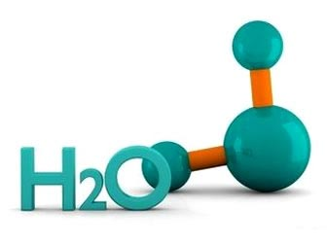
Something about water
Basically, water is a molecule with one oxygen and two hydrogen atoms, bonded together by shared electrons.
In its purest form , it is odorless, nearly colorless and tasteless.

Slide 4
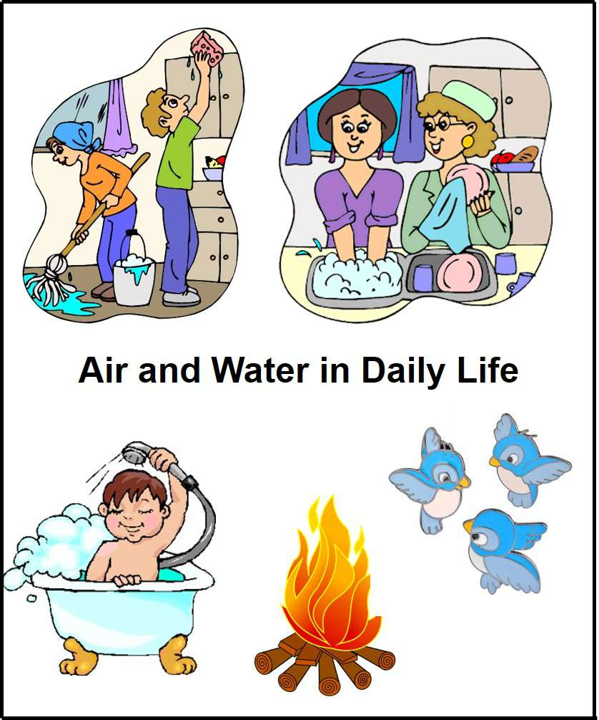
It is in your body, the food you eat and the beverages you drink.
You use it to clean yourself, your clothes, your dishes and everything else around you.
What substance is more necessary to our existence?
WATER

Slide 5
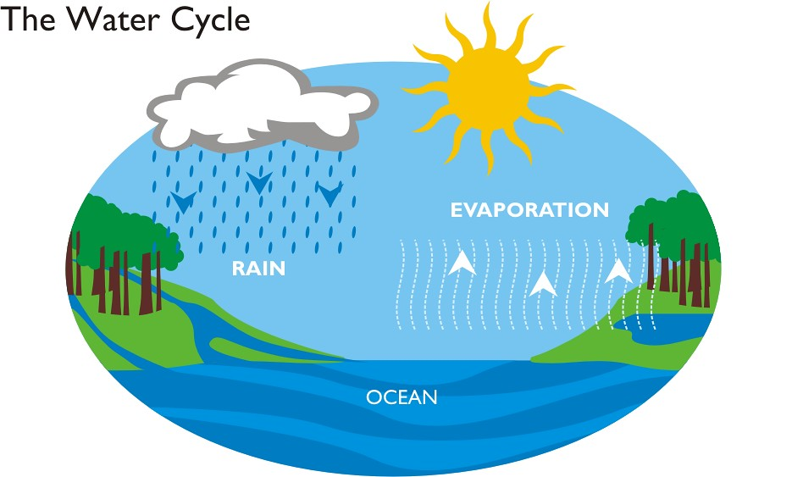
Water cycle
The movement of water around the Earth is vital to support life on land. This continuous process is called „Water Cycle”. Some parts of this cycle are quick, but others take centuries.

Slide 6
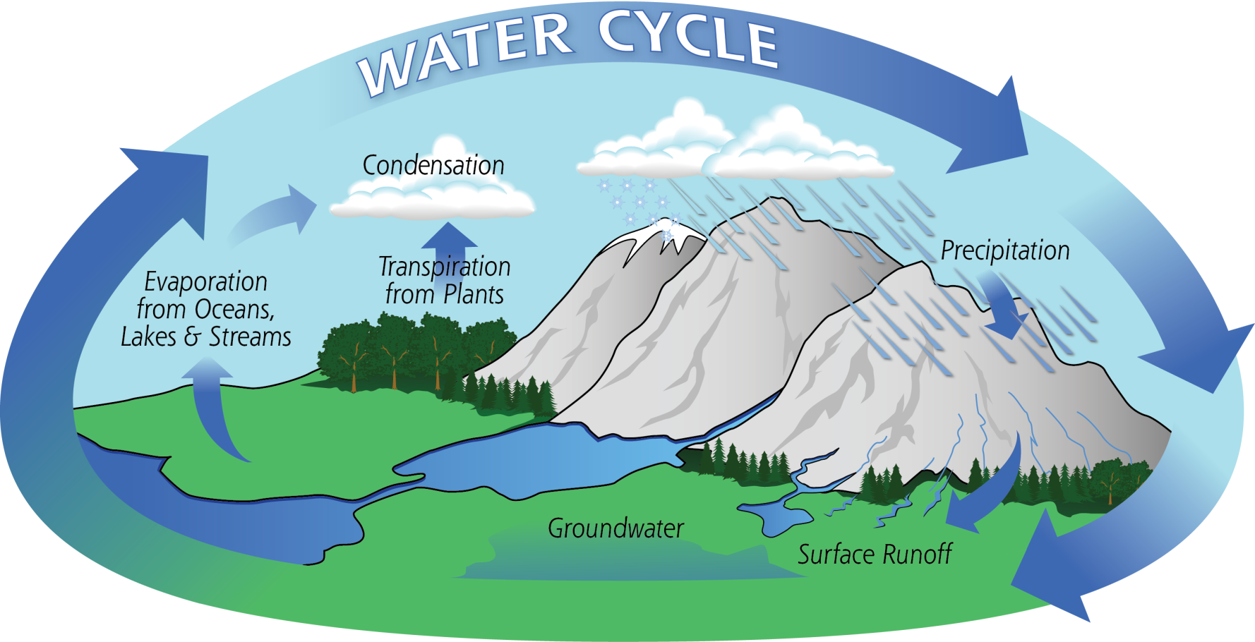

Slide 7
Water Cycle
The water cycle is powered by the Sun. The water in oceans, lakes, wet ground and plants evaporates (turns to water vapor) as it is warmed by the Sun’s rays. The vapor rises into the air, where it cools and condenses (turns back to liquid), forming clouds. It then falls back to the land as precipitations (rain, hail or snow), before draining back into the ocean. Then the process begins again.

Slide 8
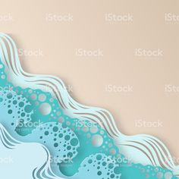
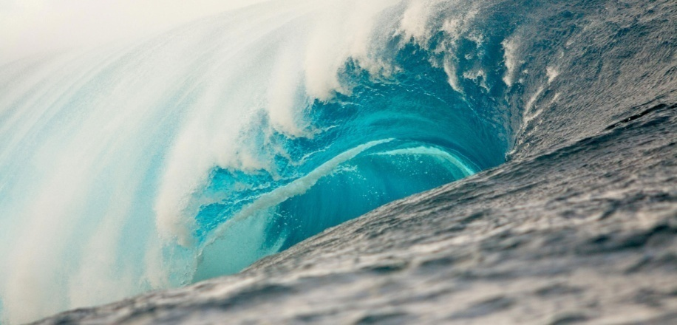
The ocean in motion
There is a lot of water movement. The most obvious examples are the waves and ripples on the water’s surface that are generated by wind or the ocean currents that are due to tides.

Slide 9
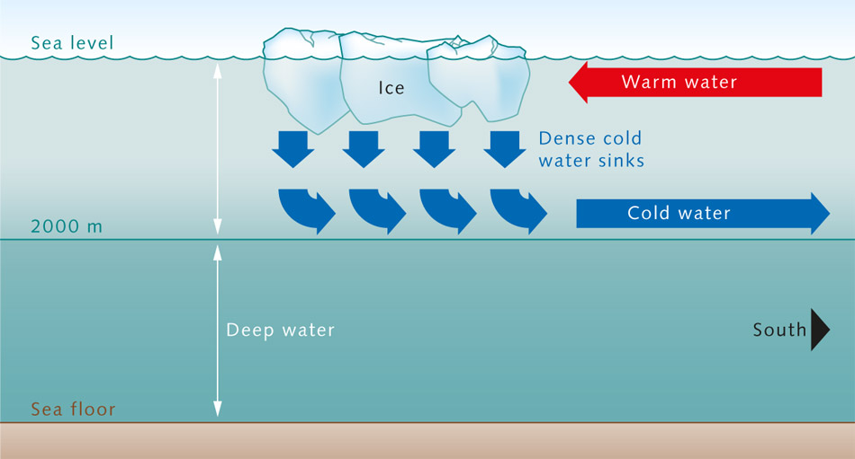
The ocean in motion
It turns out, however, that water can also be moved without wind or tides, which is what happens in the deep ocean. These currents are set in motion by variations in water density caused by differences in temperature and salinity, a process called convection.

Slide 10
Currents
A large movement of water in one direction is a current. Currents can be temporary or long-lasting; they can be near the surface or in the deep ocean. The largest ones shape the Earth’s global climate patterns (and even local weather conditions) by moving heat around the world.

Slide 11
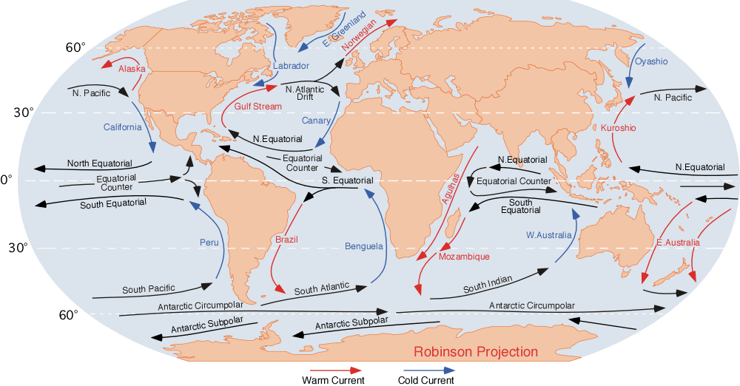

Slide 12
How do ocean currents work?

Slide 13
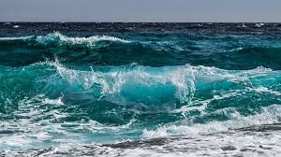
Waves
Waves are a disturbance on the surface of the sea or ocean, in the form of a moving ridge or swell. Waves are caused by the transfer of energy from the wind to the sea. As the wind blows over the surface of the sea, it creates friction forming waves.

Slide 14
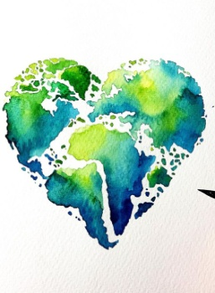
Tsunami
A wave’s size depends on wind speed, wind duration, ant the area over which the wind is blowing. The smallest categories of waves are ripples, and the largest ones are called ,,wild waves’’. But wind is not the only cause of wild waves. A tsunami is a wave created by a disturbance that displaces a large amount of water , like an earthquake or a landslide. Tsunami waves are capable of destroying seaside communities. They also have caused over 420 000 death since 1850.
How tsunamis work

Slide 15
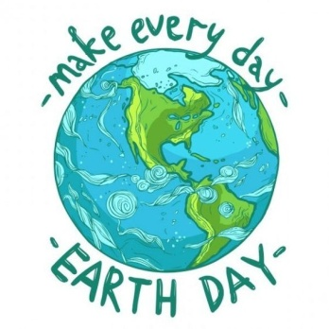
Tides
Tides are actually waves, the biggest waves on the planet, and they cause the sea to rise and fall along the shore around the world. Tides exist thanks to the gravitational pull of the moon and the sun, but vary depending on where the moon and sun are in relation to the ocean as the earth rotates on its axis.

Slide 16
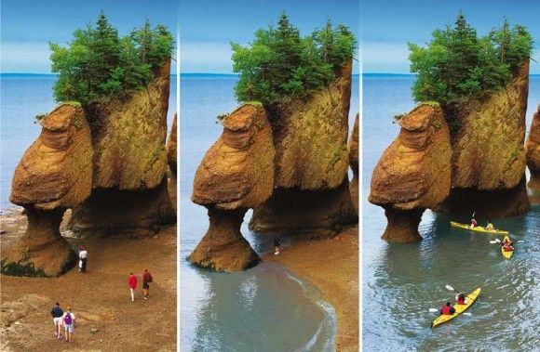
The Bay of Fundy
The Bay of Fundy in New Brunswick, Canada has the highest tidal range. The tides range from 3.5m to 16M, causing erosion to the landscape, creating massive cliffs.

Slide 17
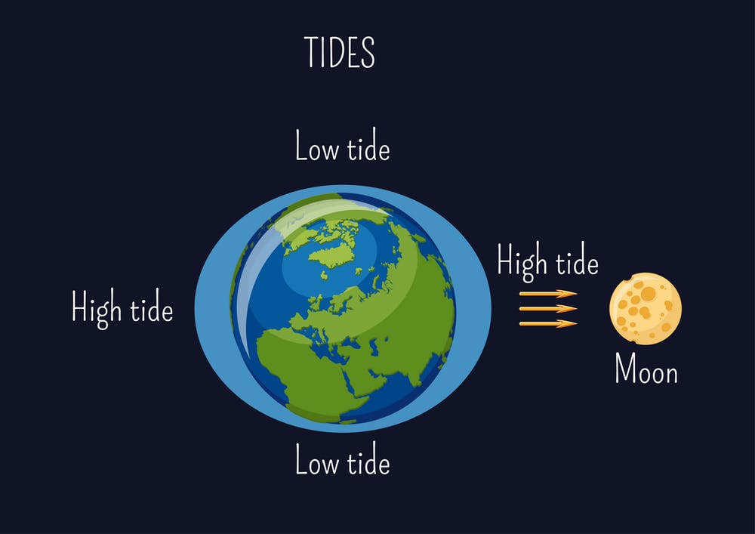

Slide 18
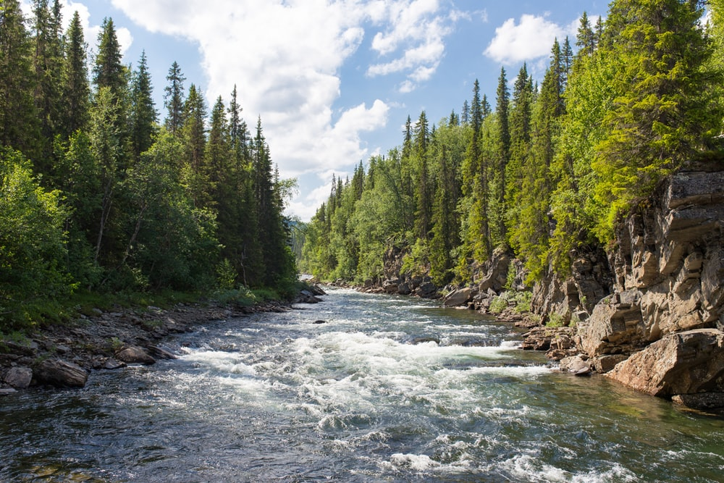
The movement of water in a river
The movement of water in a river is called a current. The current is usually strongest near the river’s source. Storm can also increase the current.

Slide 19
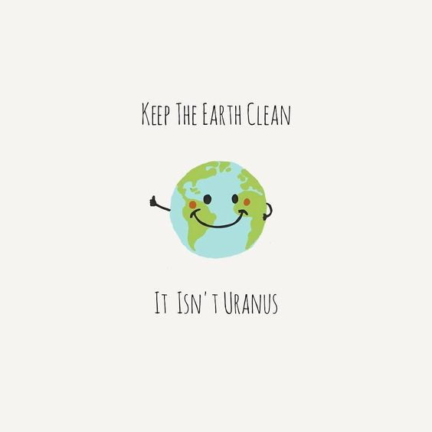
Facts about water
Without the water cycle, life on land would be impossible. There would be no plants, and animals can not survive without plants.
There are parts of the world that are cut off from the water cycle (Atacama Desert).
The currents at the surface of the ocean are affected by global patterns and the Earth’s rotation.
Waves, or more precisely microwaves, can also help cook your food.

Slide 20
Citations
https://ocean.si.edu/planet-ocean/tides-currents/currents-waves-and-tides-ocean-motion
https://science.howstuffworks.com/environmental/earth/geophysics/h2o6.htm
https://www.scientificamerican.com/article/find-out-why-the-ocean-is-in-motion/
https://www.internetgeography.net/topics/what-are-waves/
https://www.nationalgeographic.org/encyclopedia/river/
https://www.youtube.com/watch?v=p4pWafuvdrY&t=10s
https://www.youtube.com/watch?v=Wx9vPv-T51I&t=57s
"This project has been funded with support from the European Commission. This publication[communication] reflects the views only of the author, and the Commission cannot be held responsible for any use which may be made of the information contained therein."
2019-1-RO01-KA229-063127

