Slide 1
BULGARIAN
RIVERS

Slide 3
A river is a large steam of fresh water flowing in a channel. Rivers flow downhill towards the sea. They are like a ”corridor”, linking hills, lowland and coasts.

Slide 4
Rivers in Bulgaria
Danube
Struma
Iskar
Maritsa
Ropotamo

Slide 5
ropotamo

Slide 6
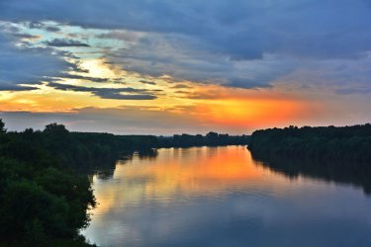
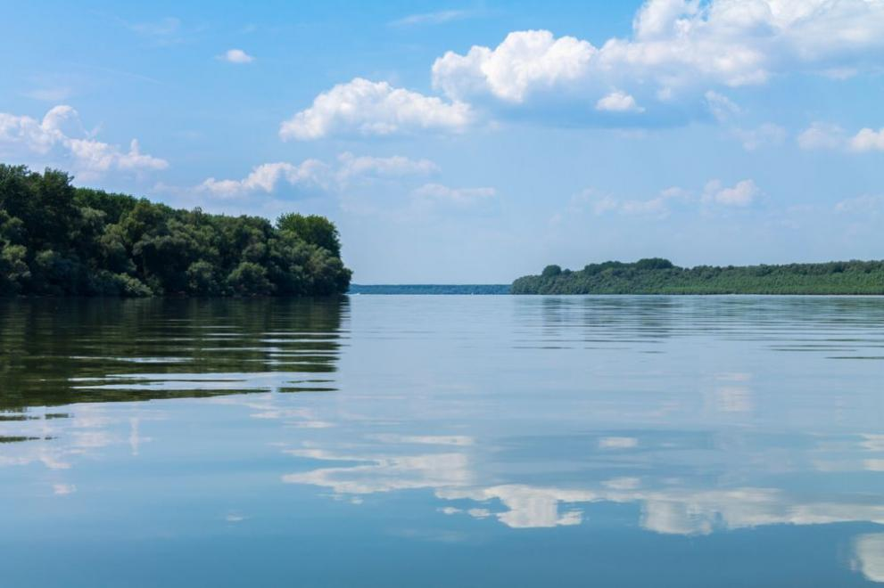
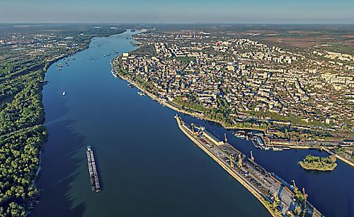
River Danube
The river Danube is the second-longest river in the European Union.
The river is 2.860 km long and flows through or many parts of the border in several European countries.
It ends in the Black sea. In Bulgaria it is 471 km long.

Slide 7
Fauna
The river Danube is home to many mammals, birds and fish species, including:
Great white Pelicans
Sturgeon
Little egret
European kingfishers
European pond turtles
The Danube river is also home to a large diversity of carp and sturgeon, as well as salmon and trout

Slide 8
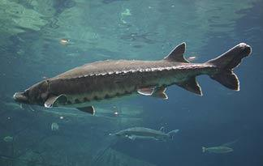
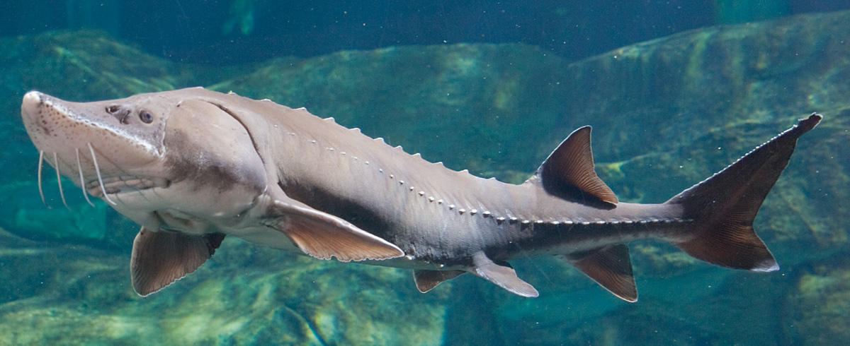
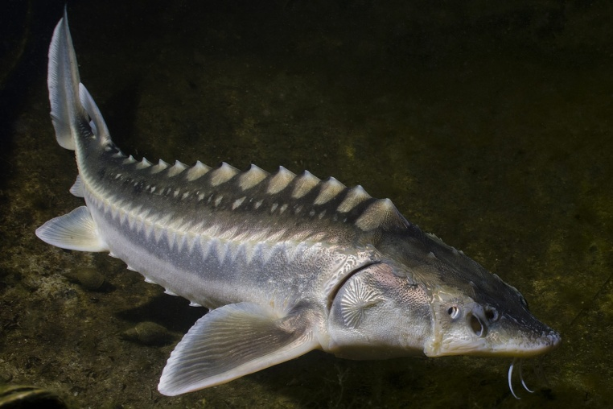
Sturgeon

Slide 9
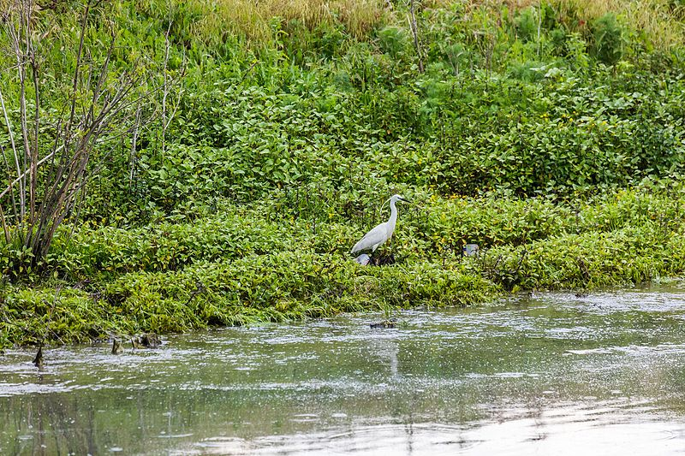
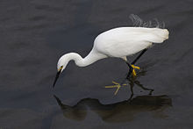
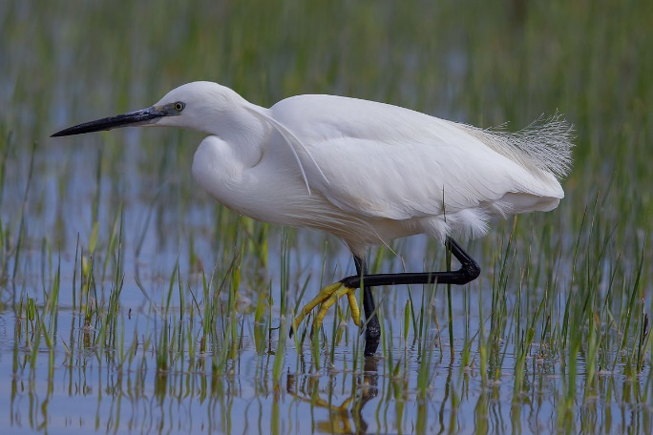
Little egret

Slide 10
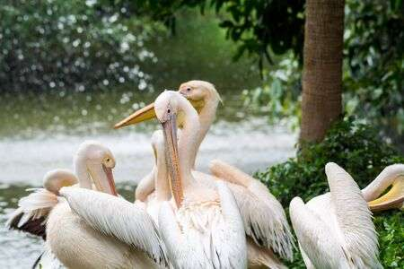
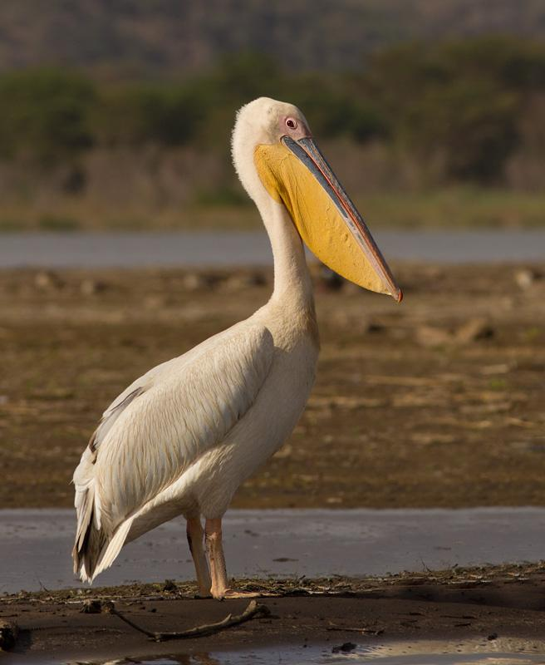
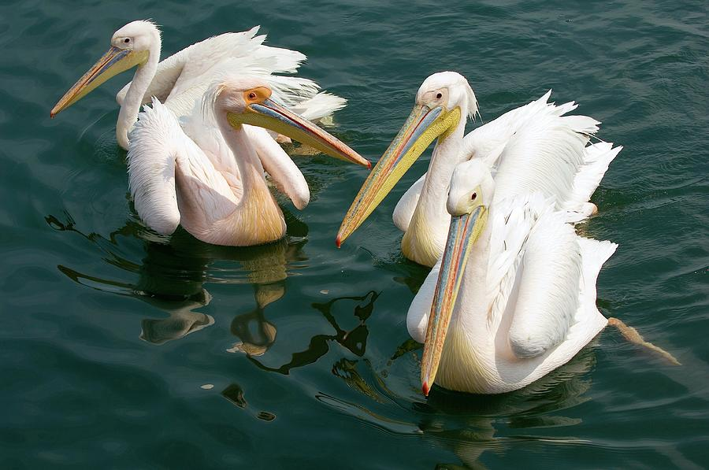
Great white Pelicans

Slide 11
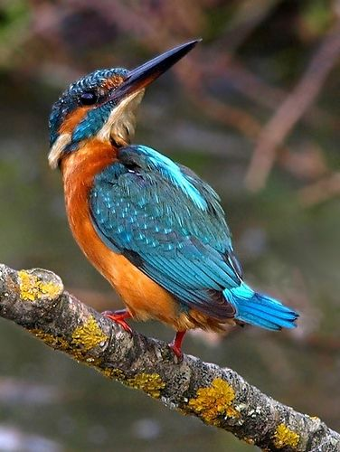
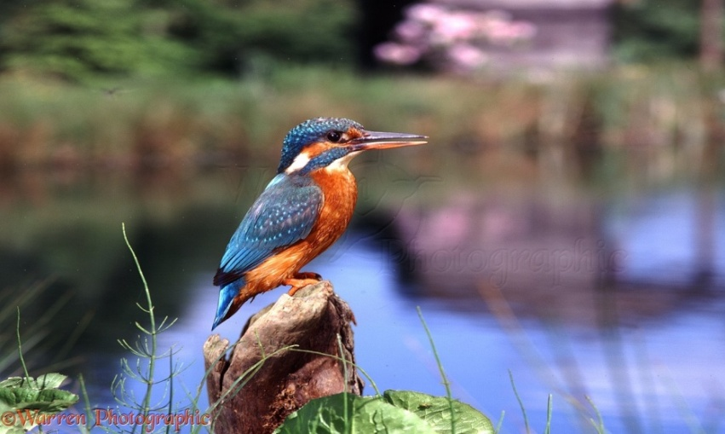
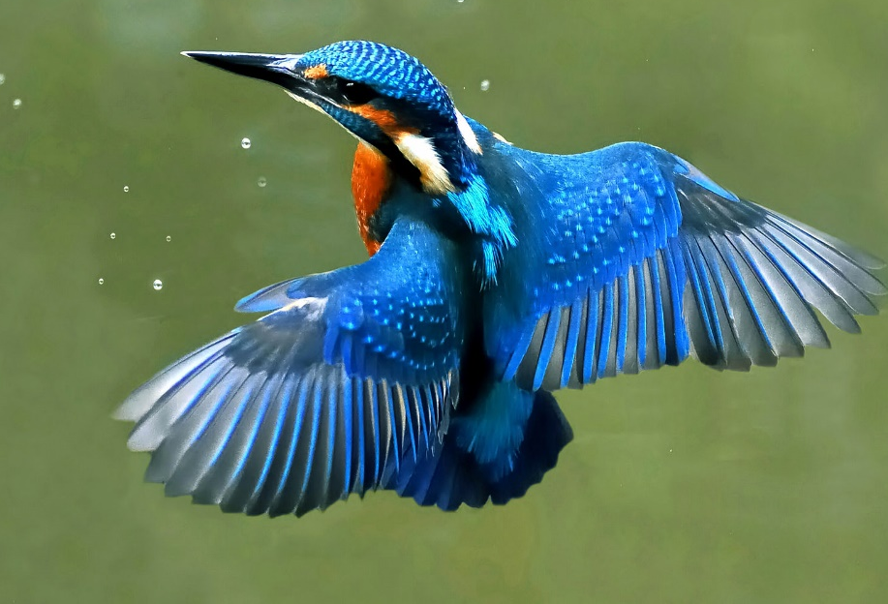
European kingfishers

Slide 12
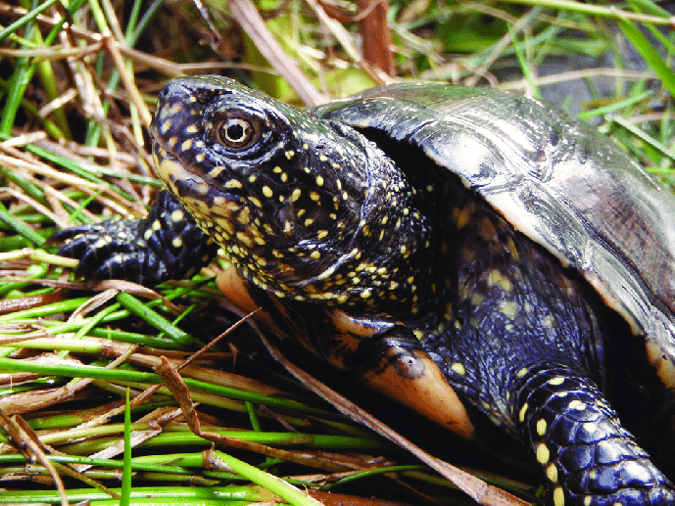
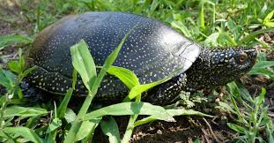
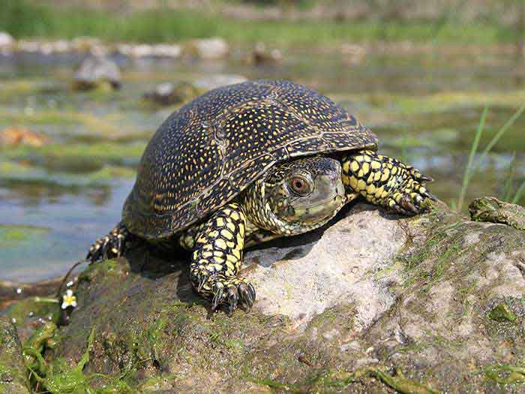
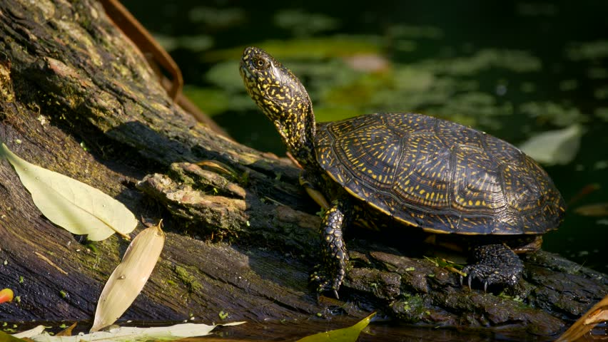
European pond turtles

Slide 13
Flora
Floodplain Forest consist of a suite of plant species that tolerate, not just days, but weeks and even months of flooding.
They provide excellent habitat, particularly for birds which use as nature migratory corridors and nesting sites.

Slide 14
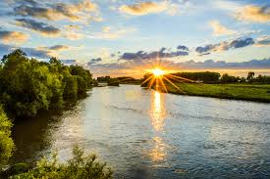
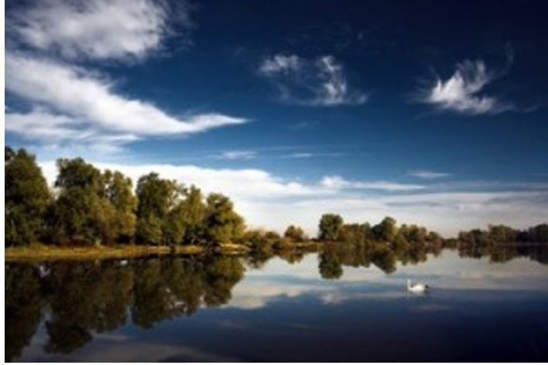
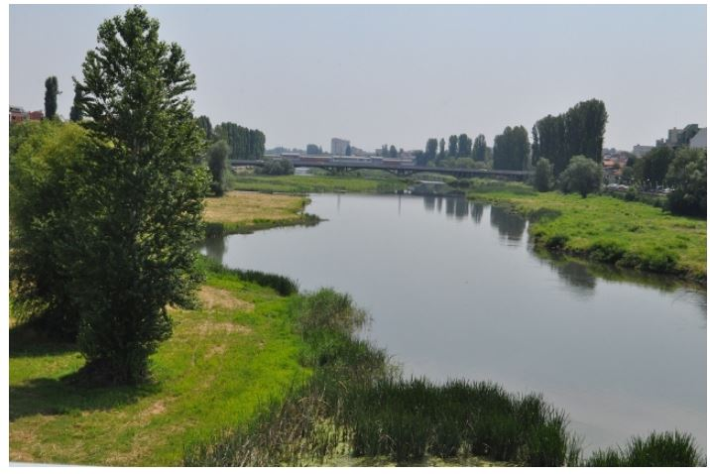
River Maritsa
Length - 472 km in Bulgaria
The forth longest river in our country
Runs solely in the interior of the Balkans.
Forms border between Bulgaria and Greece.

Slide 15
Flora
River Maritsa offers food and shelter to thousands of birds in all seasons of the year.
Forests, lush meadows, reeds, ponds and other reserves create a landscape of unique beauty that enchants the visitors.
There are great biodiversity which provides shelter for a significant number of plants and animals.

Slide 16
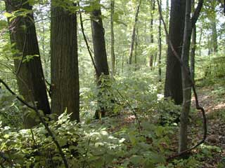
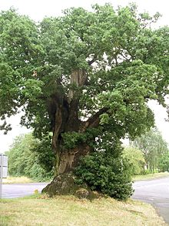
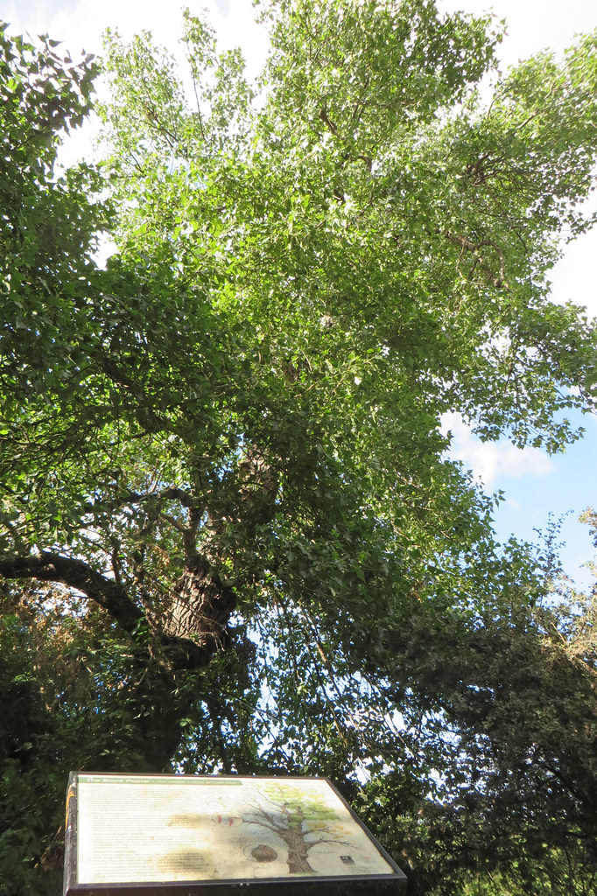
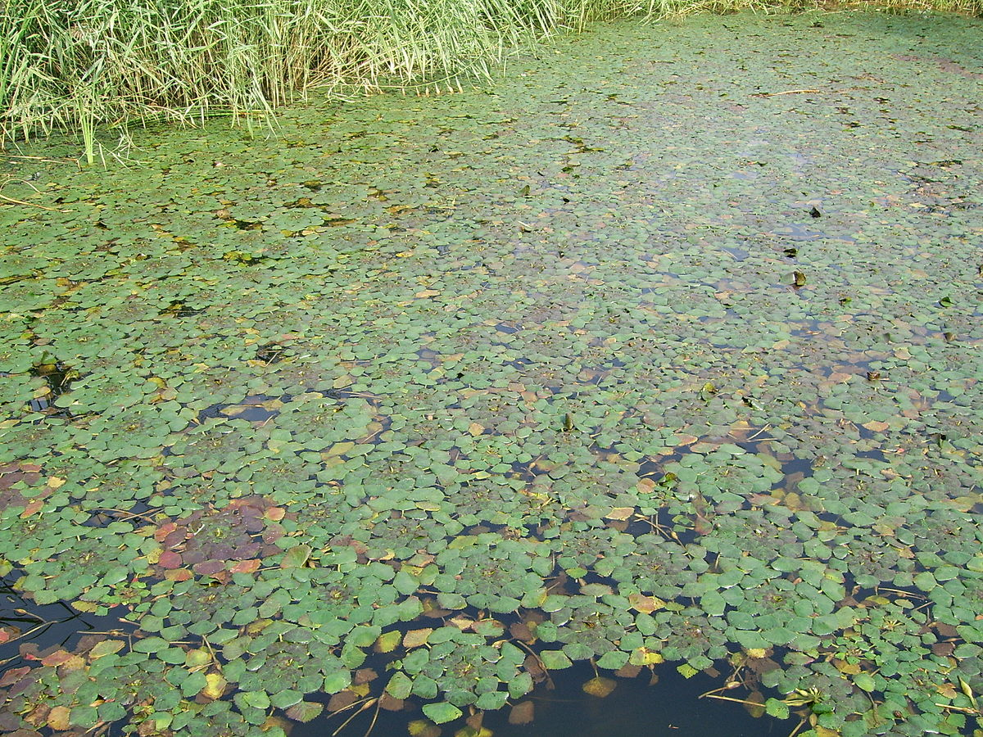
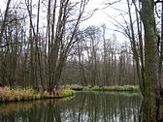
Flora
Water nut воден кестен
Black alder черна елша
Common oak, летен дъб
Black poplar черна топола
Grayish oak дръжкоцветен дъб

Slide 17
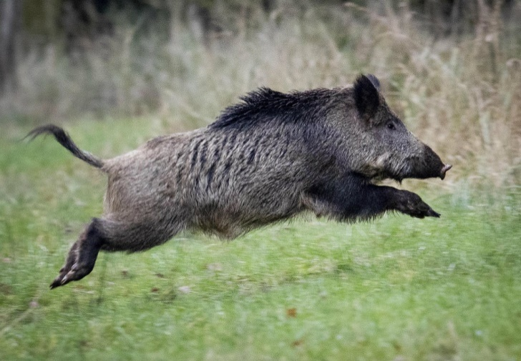
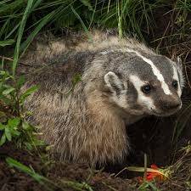
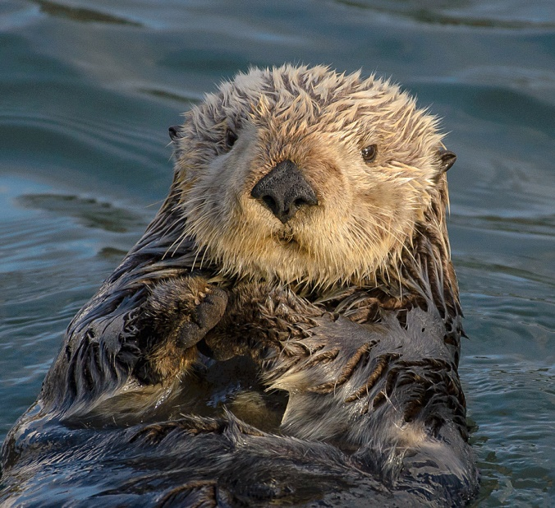
Fauna
About 10 species of mammals live around the river.
The most common are: fox, wild cat, wild board, otter, banger and weasel.
Otter
Wild board
Banger

Slide 18
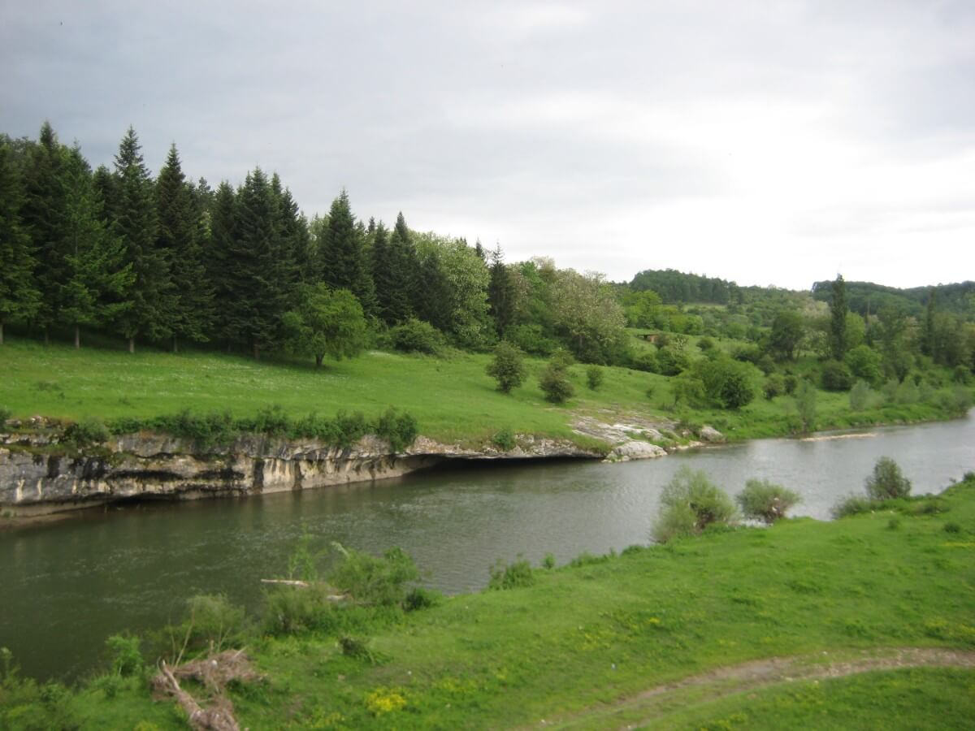
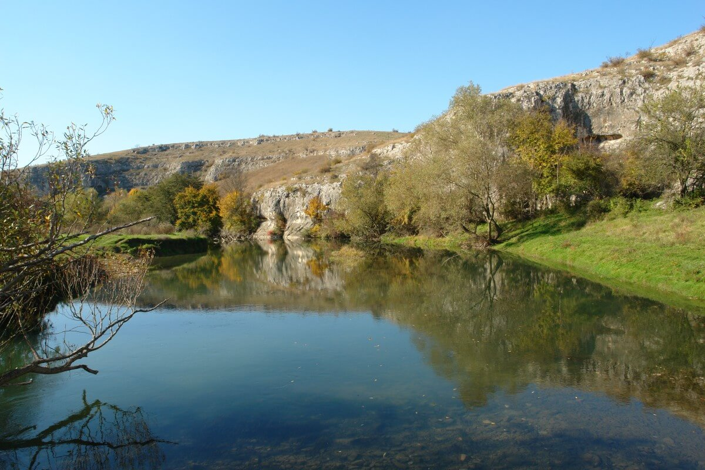
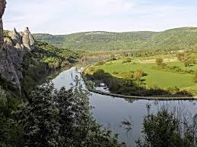
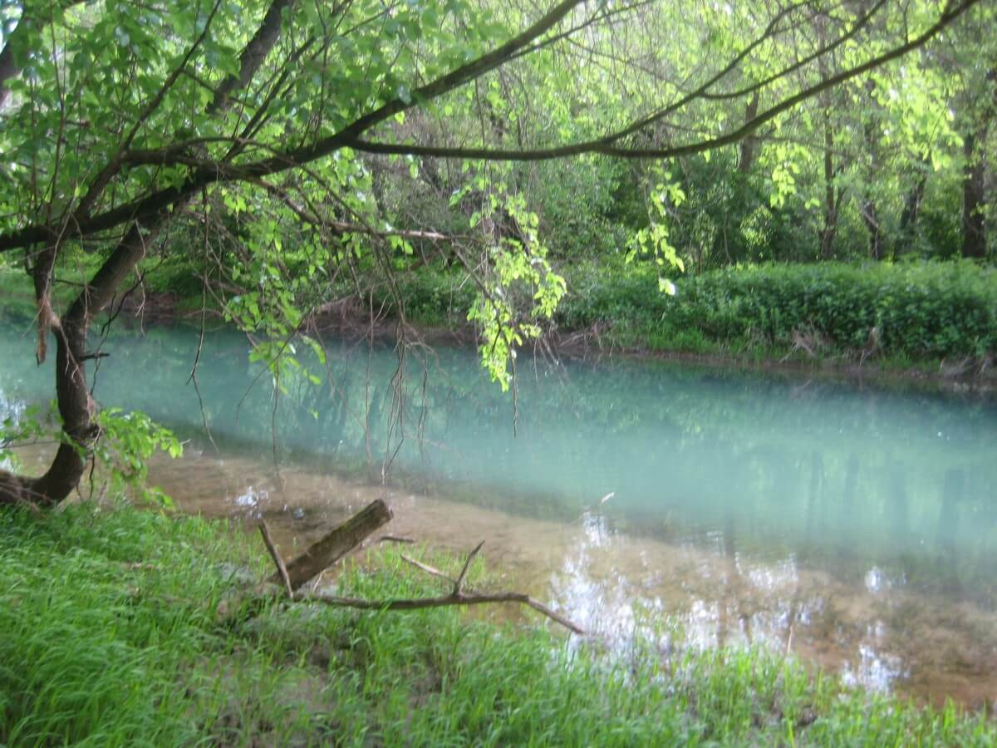
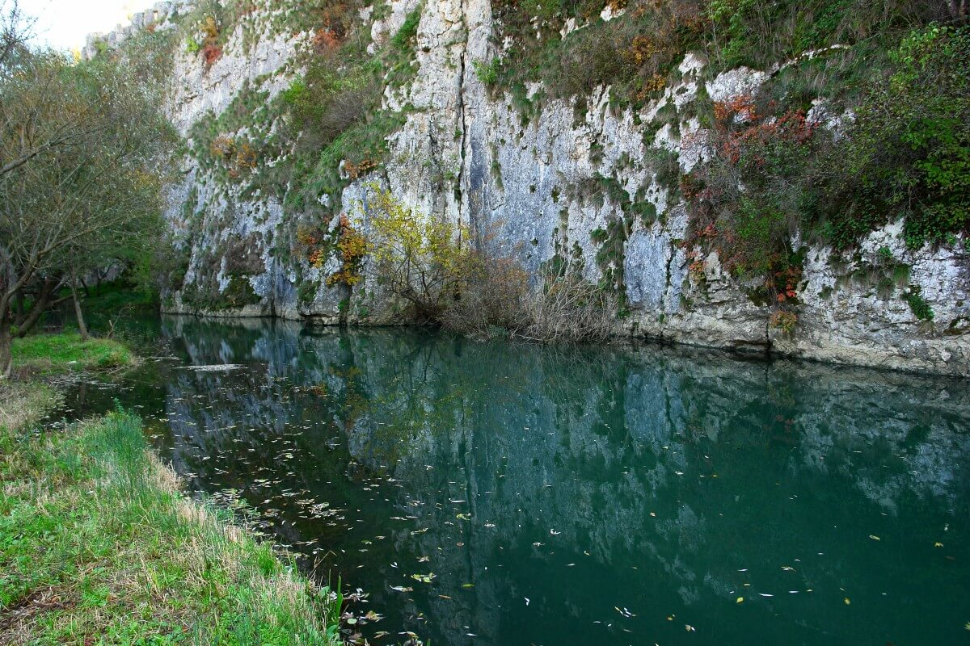
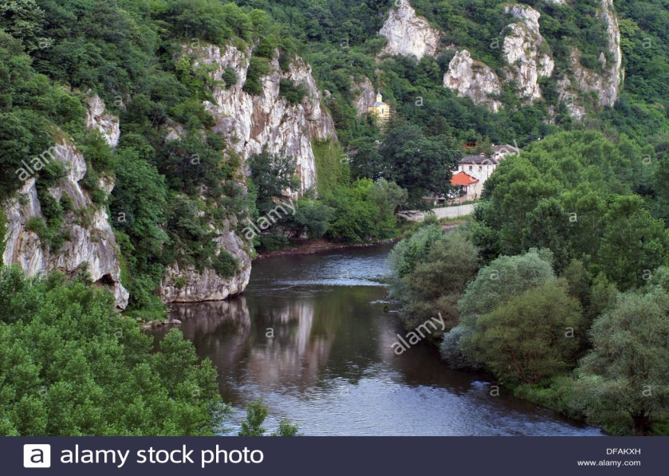
River Iskar
The river Iskar with it a length of 368 km is the longest river that runs entirely within Bulgaria.
The Iskar has significant economic importance, providing water for the needs of the capital Sofia and number of manufacturing places.

Slide 19
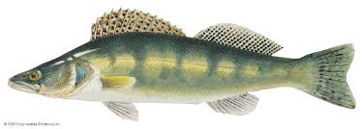
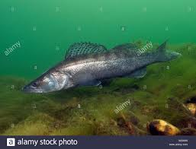
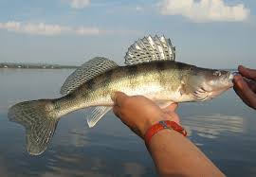
Fauna
There is a diversity of fishes in Iskar, represented by several families:
The family Percudae includes: pikeperch, Volga pikeperch, European perch and so on.
Volga pikeperch
pikeperch
European perch

Slide 20
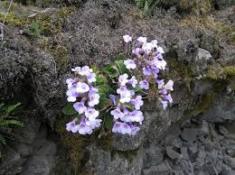
Flora
The Rodopian silivryak.
This is Balkan endemic, a protected relict species, also known as the Orpheus flowers.

Slide 21
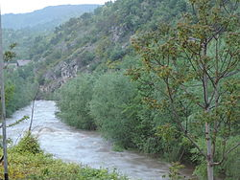
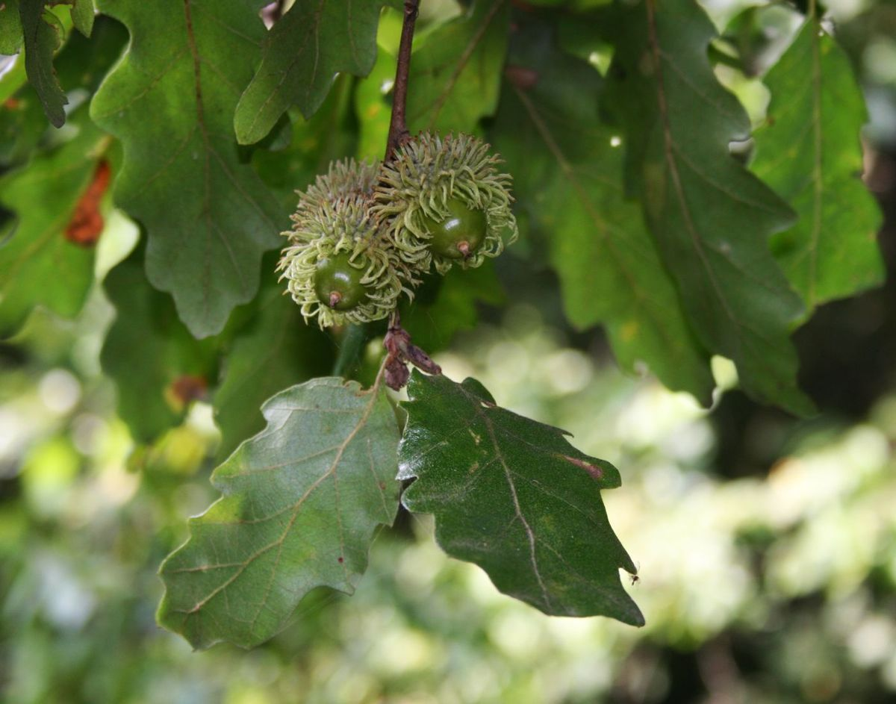
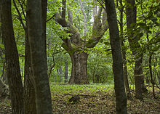
Flora
Turkey oak цер
Italian oak
благун
Carpinus orientalis
Келяв габър

Slide 22
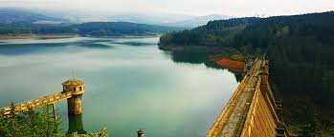
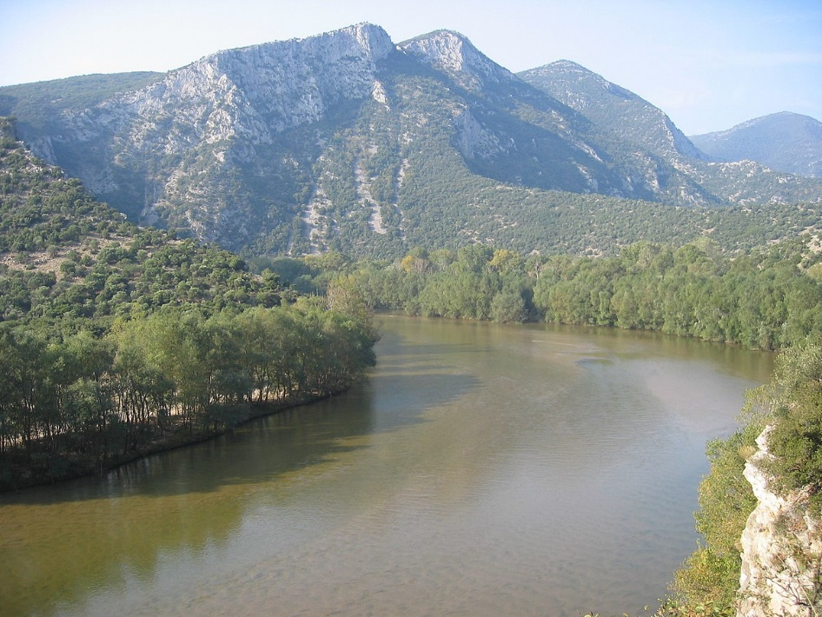
River Struma
River Struma is a river in Bulgaria and Greece.
The river’s length is 415 km, of which 290 in Bulgaria, making it the country’s fifth-longest and , one of the longest rivers that run solely in the interior of Balkans.

Slide 23
Fauna
The Kresna Gorge has been formed by the Struma river, which flows through it. The gorge has rich biodiversity and is home to many Mediterranean plants, species, habitat, landscapes and bird wildlife.
There are approximately 31 species of reptiles, 75 species of birds in this relatively small gorge.

Slide 24
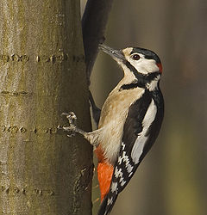
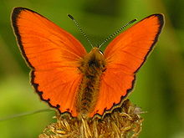
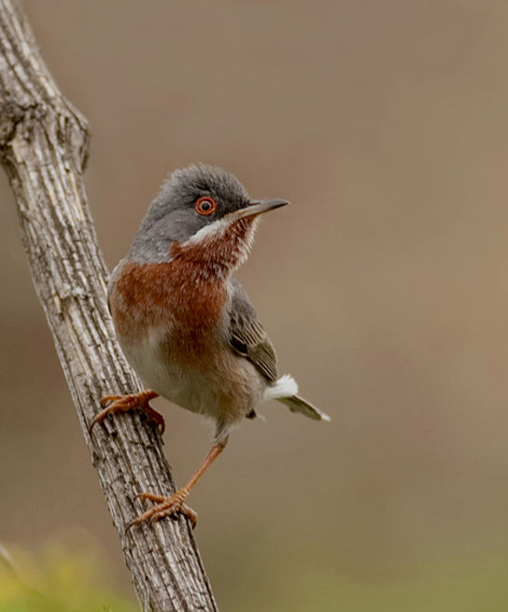
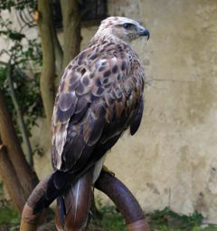
Fauna
The Kresna Gorge has been formed by the Struma river, which flows through it.
The gorge has rich biodiversity and is home to many Mediterranean plants, species, habitat, landscapes, butterflies and bird wildlife.
Notes:
Lycaena candens (Herrich-Schaffer, [1844]) огнена синевка и белоопашат мишелов-long-legged buzzard (Buteo rufinus Balcan Copper, Ч
https://karakostadinov.wordpress.com/2015/01/13/%D0%BF%D0%BE-%D0%BF%D0%BE%D1%80%D0%B5%D1%87%D0%B8%D0%B5%D1%82%D0%BE-%D0%BD%D0%B0-%D1%80%D0%B5%D0%BA%D0%B0-%D1%81%D1%82%D1%80%D1%83%D0%BC%D0%B0/
subalpine warbler (Sylvia cantillans) червеногушо коприварче

Slide 25
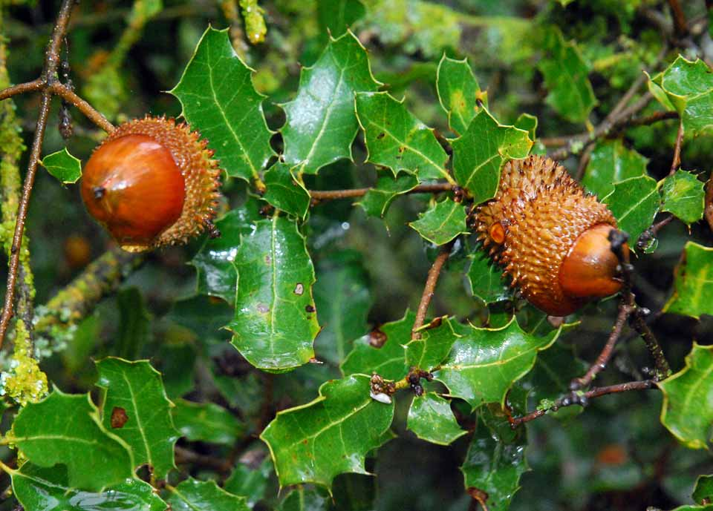
Flora
There are multiple types of forests located inside the gorge, including different types of oak trees.
Considering the climate, typical Mediterranean flora species Quercus coccifera and Phillyrea thrive here.

Slide 26
River Ropotamo
The Ropotamo is a river in south-eastern Bulgaria and its source from the Strandhza mountain, running for 48.5 km to empty into the Black sea.

Slide 27
Flora
The lower course hosts abundant population of European white water lily, the yellow water-lily, Sea wormwood
To protect these ecosystems in 1940 the authorities established the Ropotamo Reserve.

Slide 28
Flora
Most of the river valley is covered in dense riparian forests of oak, ash, elm, etc.

Slide 29
Fauna
The most important mammal species are: red deer, fallow deer, roe deer, wild boar, grey wolf, red fox and golden jackal.

Slide 30
The largest birds of prey are: the white-tailed eagles with a wing-span of over 2 metres.

Slide 31
Let’s go out and care for environment
That’s our first assignment!
The water needs our help there
Because it’s our future to care!

Slide 32
THANK YOU FOR YOUR ATTENTION!

