Slide 1
One of our local artists
Eva Švorcová
(specialist in production from husk)

Slide 2
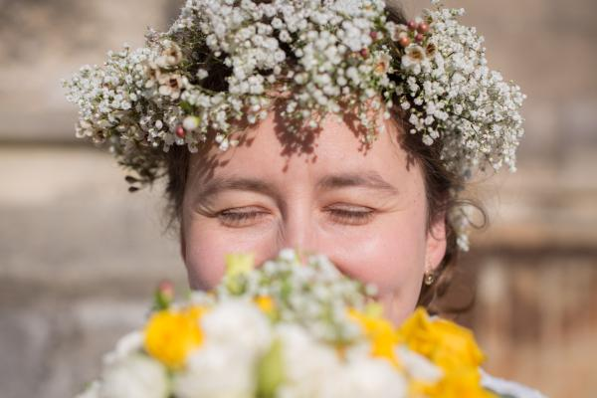
Reasons
We choose her because she is one of our teachers, and she has taught many things to us.
She is always motivates us to try new things and to develop ourselves.
She is very clever and nice person.

Slide 3
On the following slides you will find the questions that were asked and HER answers ...

Slide 4
Where are you from?
I am from Ružomberok.

Slide 5
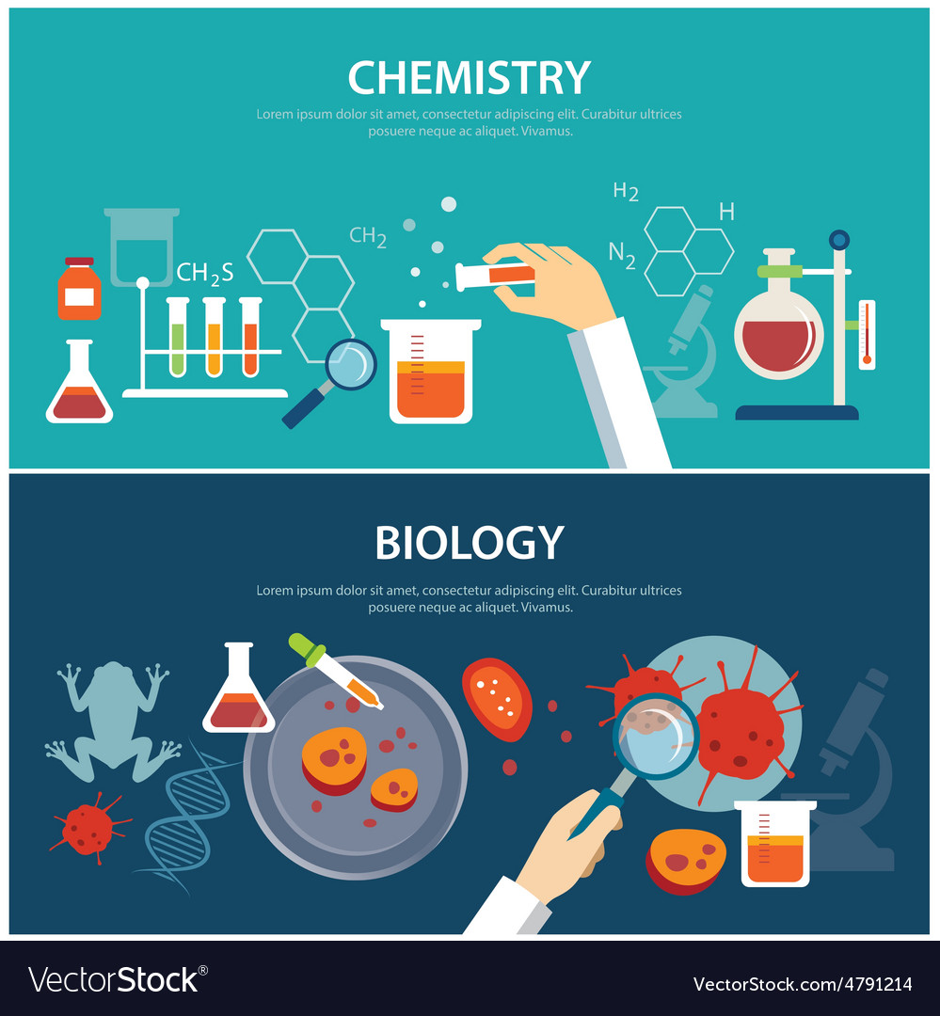
Tell us something about your school life.
I studied biochemistry and microbiology in Bratislava.

Slide 6
Where do you work?
Currently I am a teacher of Chemisty and Biology and now I also work in the Association of Christian Youth Communities as a coordinator for the central and western part of Slovakia.

Slide 7
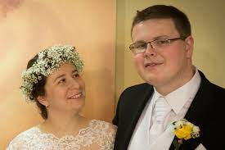
What about your family life?
My husband is Ľubomír Švorca, with whom I met while i was working at the Youth Commission. He is a person who had a major impact on my life and he is inseparable part of my life.

Slide 8
Do you have any good characteristics?
In my opinion, my unique qualities are a good heart, dedication to job and skillfullness.

Slide 9
What helped you to became an artist?
It was definitely UĽÚV.
After college, I decided to devote myself to something creative, so I decided to apply to the Center for Folk Art Production in Bratislava (ÚĽUV). I was most interested in pottery and shell dolls. But later I developed my talents in a much broader scope. In 6 years, I completed other courses in wood carving, basket making, making straw ornaments and Easter eggs, weaving on looms and painting on glass.

Slide 10
What does uĽÚv means? What is it?
ÚĽUV organizes courses and creative workshops for children and adults in its regional craft centers in Bratislava, Banská Bystrica and Košice.In addition to the School of Crafts, the Regional Centers also offer other activities: excursions, lectures, exhibitions, competitions, a specialist library, sale of folk art products, consulting for producers, but also organized meetings of masters and enthusiasts of folk art production.

Slide 12
We have heard that you have a nickname: Elorian. Could you tell us somethings about that?
Elorien is a relatively unusual name that I received during the summer camp in Katarínka. Since then, I adopted this name, and people still call me this way today.
Under the name Katarínka, we can imagine the ruins of the ancient Church and Monastery of St. Catherine of Alexandria, located in western Slovakia. This life experience marked me so deeply that I decided to work there as a volunteer. This time, which lasted 10 years, completely changed my life and she still considers it one of the best decisions.
"It left a lot in me. I owe who I am now to the people at Katarínka who influenced me and to the project as such, where I was able to participate in various activities and learn a lot. "

Slide 13
Do you like any other activities?
I like to take pictures, make videos and I can play four musical instruments. I learned to play the flute as a fourth grader in elementary school, took piano lessons for 8 years during elementary school, and learned to play the violin and guitar as an adult.

Slide 14
Did something chang your life dramatically?
In the past I didn't enjoy making things and selling them as much as passing on my experience to others so that they could enjoy what they make. It was always important for me to pass on what I learned. It was often practical advice or knowledge.
On Katarínka, for example, I really liked accompanying tourists. Although it was sometimes ten times a day, it made me very happy to always see new people who are happy that they learned something new and that they leave satisfied."

Slide 15
How would you finish our interview?
Thanks to Katarínka and volunteering, I found a job, outside of my field, and I do what I learned thanks to volunteering. If I were a doctor, I might not have gotten to Katarínka, ZKSM, the Commission, and I might never have even met my husband. My life would definitely have a different direction."

Slide 16
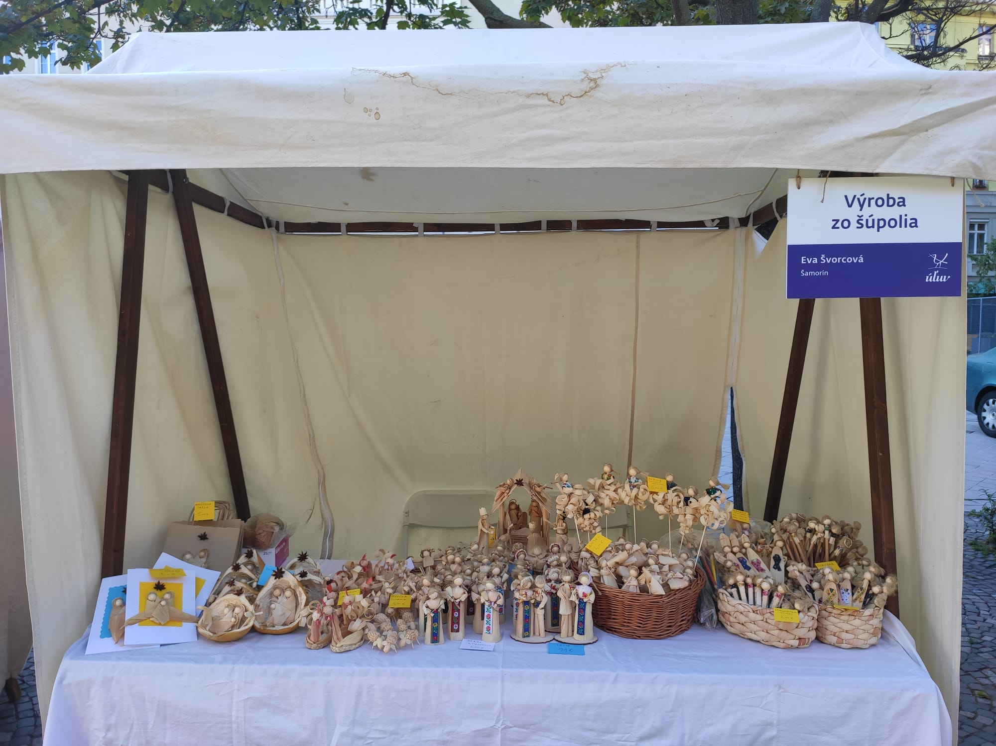
She also sells her things on various events:

