Slide 1
Drinking water
Made by:
Nyisztor Sebastian
Șularu Rareș

Slide 2
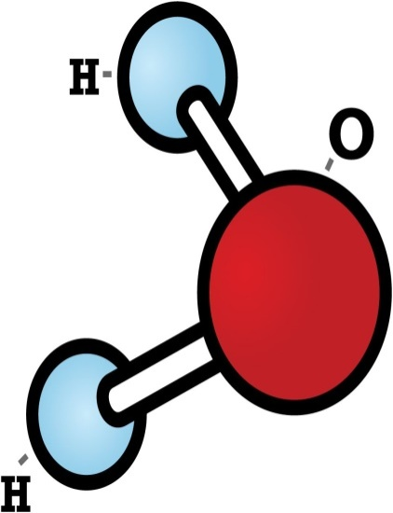
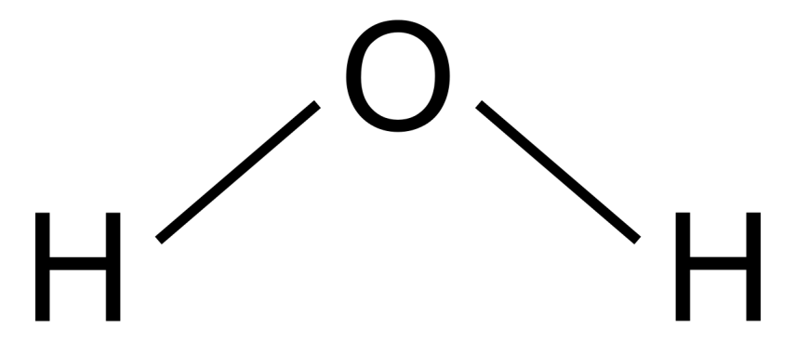
WATER COMPOUND
Water is the most plentiful compound on Earth and it’s essential to life.
Water is an odorless, tasteless and colorless liquid, most often, or slightly blue or even green in thick layers.
Water is a chemical compound of hydrogen and oxygen, having the chemical formula H2O.

Slide 3
WATER SOURCES
Water can be found in 3 states:
SOLID: snow, icebergs, icecaps
LIQUID:
Salty water: seas, oceans
Fresh water: springs, rivers, lakes, underground fresh water, groundwater.
3. GAS: clouds.

Slide 4
PLAIN WATER
Plain water is a very poorly mineralized (oligo-mineral) drinking water, containing less than 500mg salts/liter.
It doesn’t contain added CO2 and it can be consumed in high quantities, without medical prescriptions.
Global plain water consumption increased four times between 1990 and 2005. Spring water and purified tap water are currently the best-selling types.

Slide 5
Mineral water
Mineral water is obtained from a mineral spring that contains various minerals, such as salts and sulfur compounds or with the presence or absence of added gases.

Slide 6
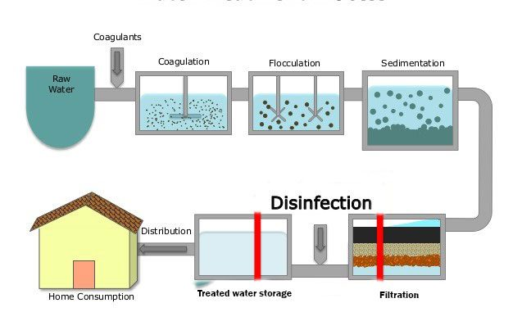
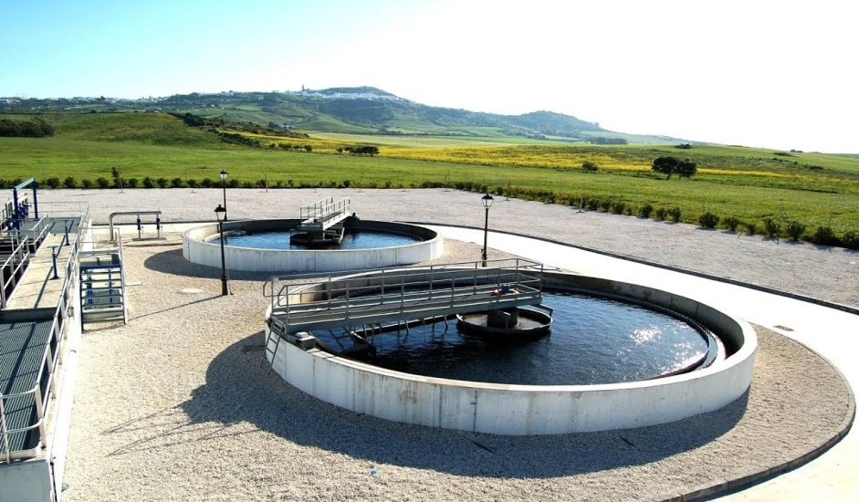
WATER FILTRATION
Filtration is a mechanical or physical operation of separation from solutions or gases, through a filter, of solid (insoluble) substances (particles), but with a density close to the one of the liquid or gas in which they are found.
Water is purified in wastewater treatment plants.

Slide 7
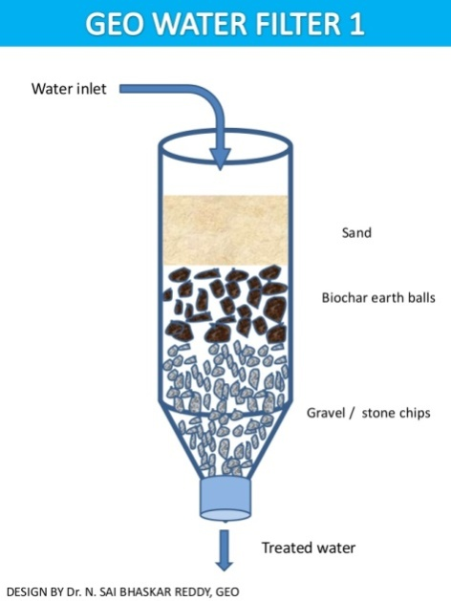
EMERGENCY WATER FILTRATION METHODS
After finding a fresh water source, the first thing you should do is to boil it.
Also, you could use an improved water filter made out of gravel, sand, coal and a small piece of cloth.
Interesting fact: If you are extremely thirsty
and there isn’t any water source near by, you can
just hold a rock in your mouth. It’s going to
generate saliva, which will decrease the thirst
feeling, but it won’t hydrate you.

Slide 8
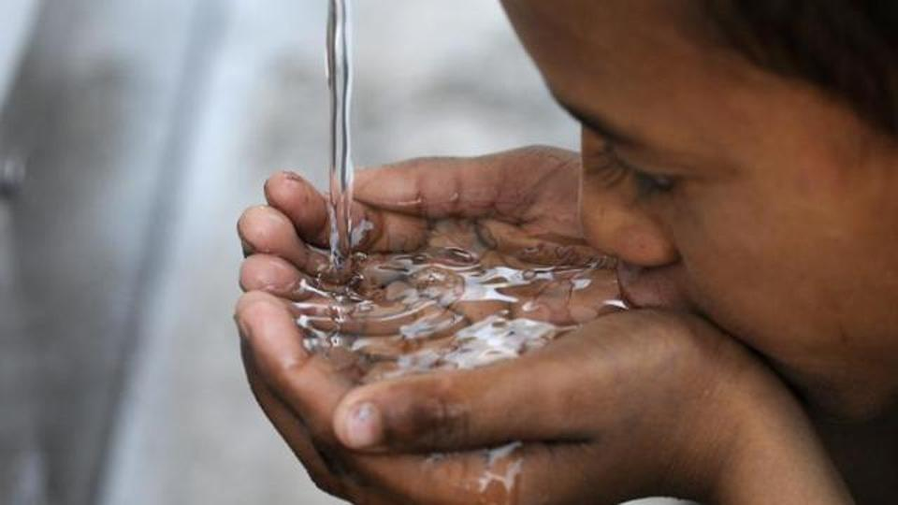
DISEASES CAUSED BY DRINKING NON POTABLE WATER
E. Coli Infection - symptoms: abdominal pain, nausea, vomiting, fever and even bloody diarrhea.
2. SARS –symptoms: gastrointestinal problems with fever and sore throat. It is one of the most common infection spread by contaminated water.

Slide 9
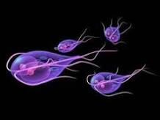
3. Hepatits A – symptoms: fever, fatigue, diarrhoea, nausea.
4. Giardiasis - diarrhoea and weight loss. Children are usually prone to the disease.
5. Typhoid Fever – symptoms: abdominal pain, diarrhea, cramps and chills.

Slide 10
BIBLIOGRAPHY
https://en.wikipedia.org/wiki/Water
https://ro.scribd.com/doc/55174122/Filtrarea-apei
http://www.sfatulmedicului.ro/Infectii-ale-pielii--tesutului-subcutanat-si-muscular/boli-care-pot-fi-contactate-din-apa-contaminata_9277
The Atlas of Water by Maggie Black, Jannet King
"This project has been funded with support from the European Commission. This publication[communication] reflects the views only of the author, and the Commission cannot be held responsible for any use which may be made of the information contained therein."
2019-1-RO01-KA229-063127

