Slide 1
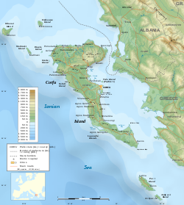
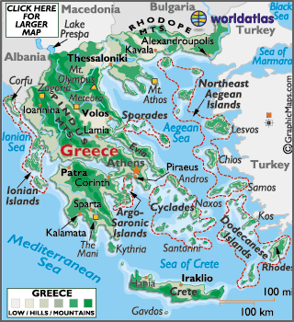
Greece-Corfu

Slide 2
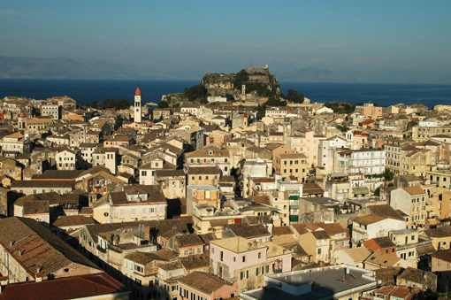
Short history of Corfu
Vasiliki Nikomani

Slide 3
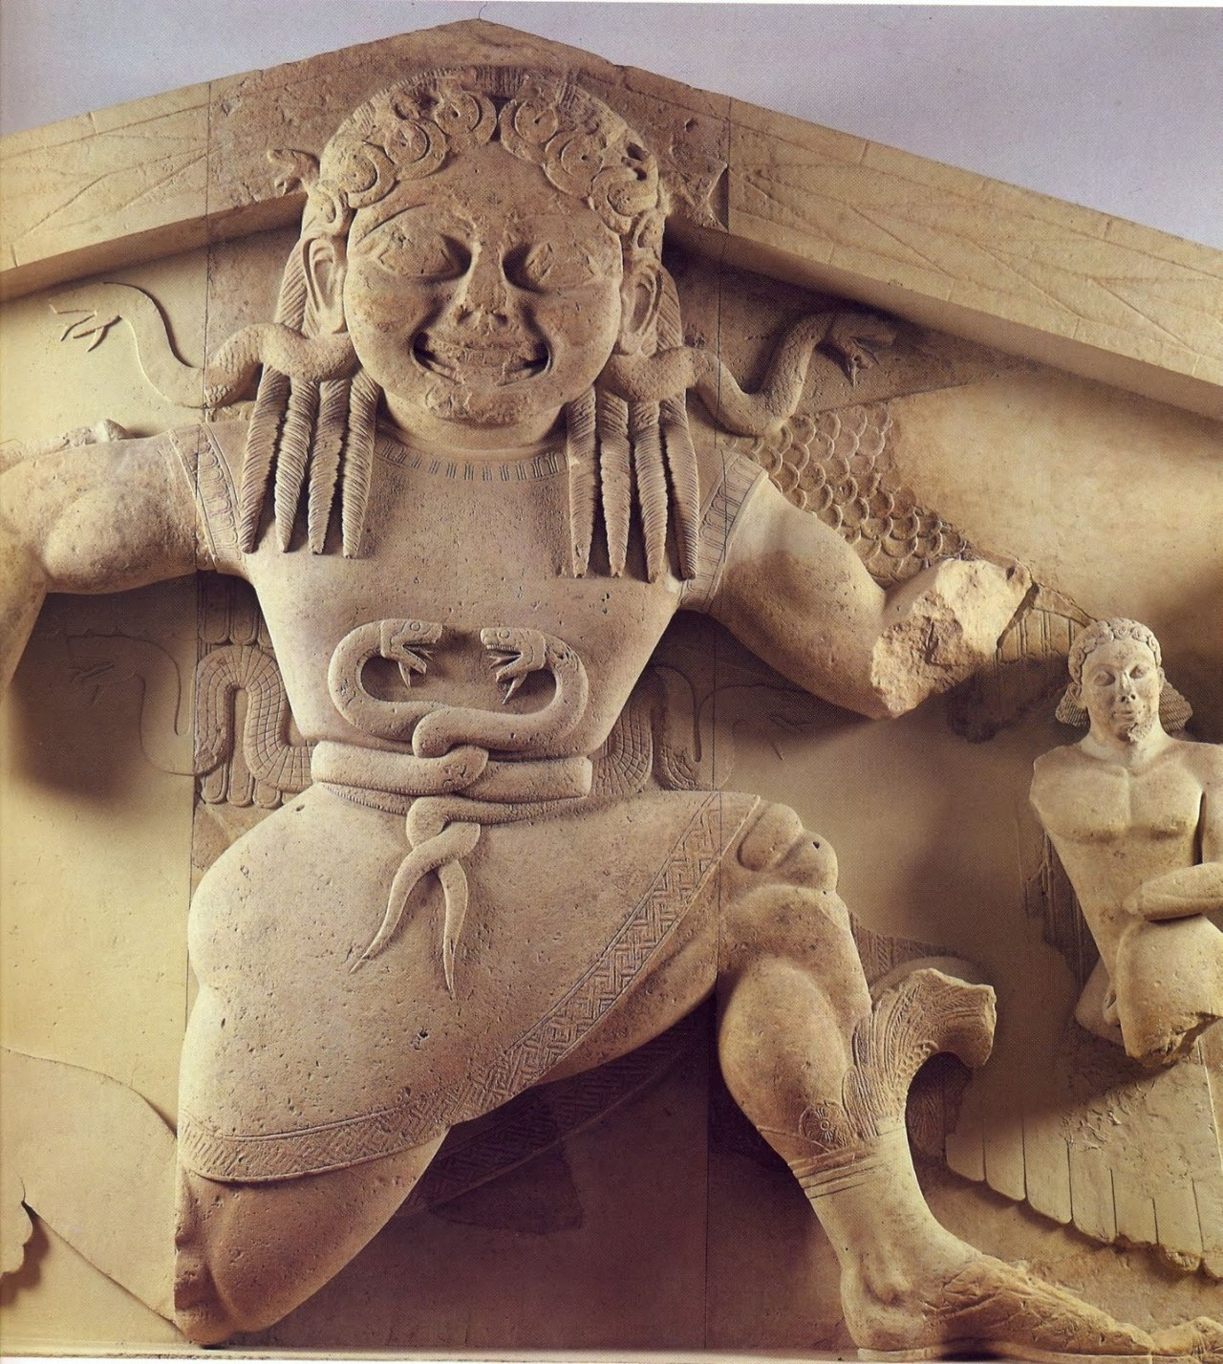
Corfu in Ancient times
In ancient times, Corfu is referred to by various names: Drepanos, Makris, Secheria, Phaeakia and Corfu. From 6th BC Century tradition identifies it with the Homeric country of the Phaeacians, whose king Alkinoos and his daughter Nafsika had hosted the shipwrecked Odysseus at his last station before his return to Ithaca.

Slide 4
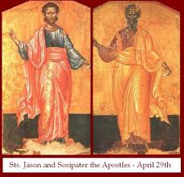
Corfu under Roman rule!
After various catastrophic raids by pirates and especially after the Illyrians invasion in 229 BC, the Corfu demanded the protection of the Romans (of the new rising power) who responded immediately. Thus Corfu was the first Greek part to fall under Roman rule (229 BC). The most important event in the Roman period was the spread of Christianity on the island, in the years of Emperor Tiberius (14-37 AD), by the Israeli Apostles Jason and Sosipater.

Slide 5
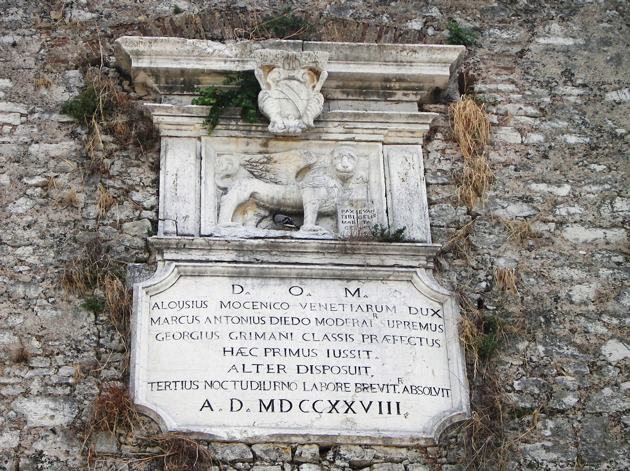
Corfu after Constantinople’s fall!
In 1204 AD after the fall of Constantinople by the Crusaders and the occupation of most Byzantine territories, Corfu successively passed into the power of Venice (1204-1214), the Greeks of the Despotate of Epirus (1214-1258)and Normans of Sicily (1258-1267). The conquest of Corfu and the Ionian Islands began in 1267 and it was particularly long and lasted until the 19th century.

Slide 6
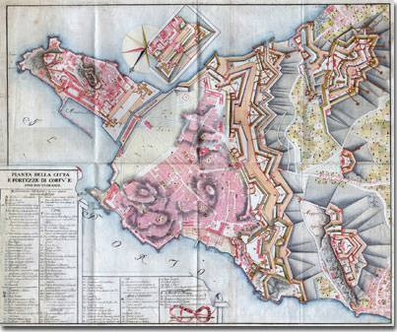
Venitian fortifications

Slide 7
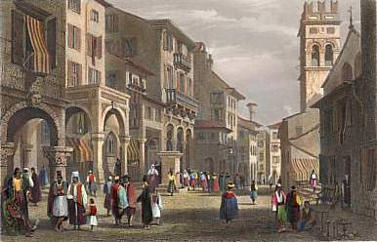
Medieval Corfu

Slide 8
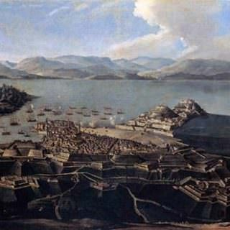
The 1716 Turkish siege

Slide 9
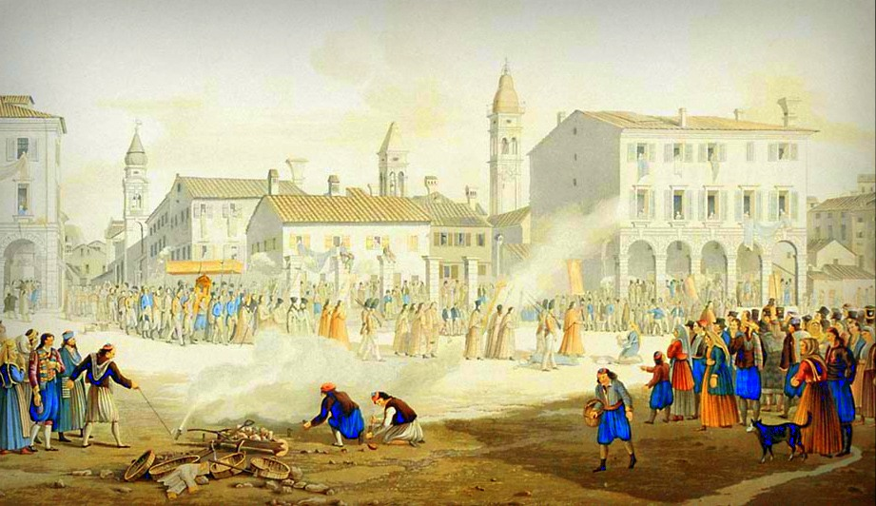
The French domination (1797-1814) and the British Rule-1864

Slide 10
Thank you for your attention!

