Slide 1

Lime in water
Martyn G.
Megie V.
1

Slide 2
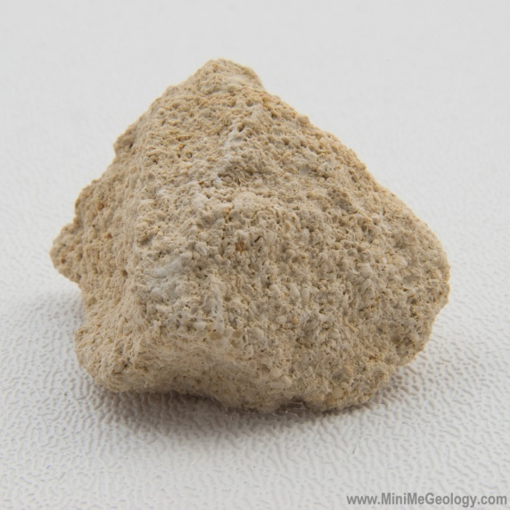
What is limestone?
2
Limestone is a sedimentary rock characterised by a high calcium mineralisation. Limestone is formed in two ways. It can be formed with the help of living organisms and by evaporation. Calcium, scaling and limestone are almost the same thing.

Slide 3
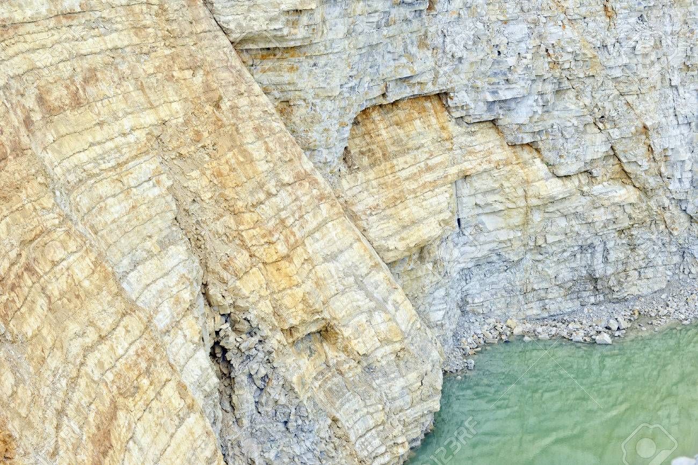
Limestone is formed (scaling) when water containing particles of calcium carbonate evaporates, leaving behind the sediment deposit. The water pressure compacts the sediment, creating limestone. The color of the limestone depends on the other sediments in the mixture besides the mineral calcite, which is white; impurities such as sand, clay, and organic material are also present in limestone and affect the colour.
3

Slide 4
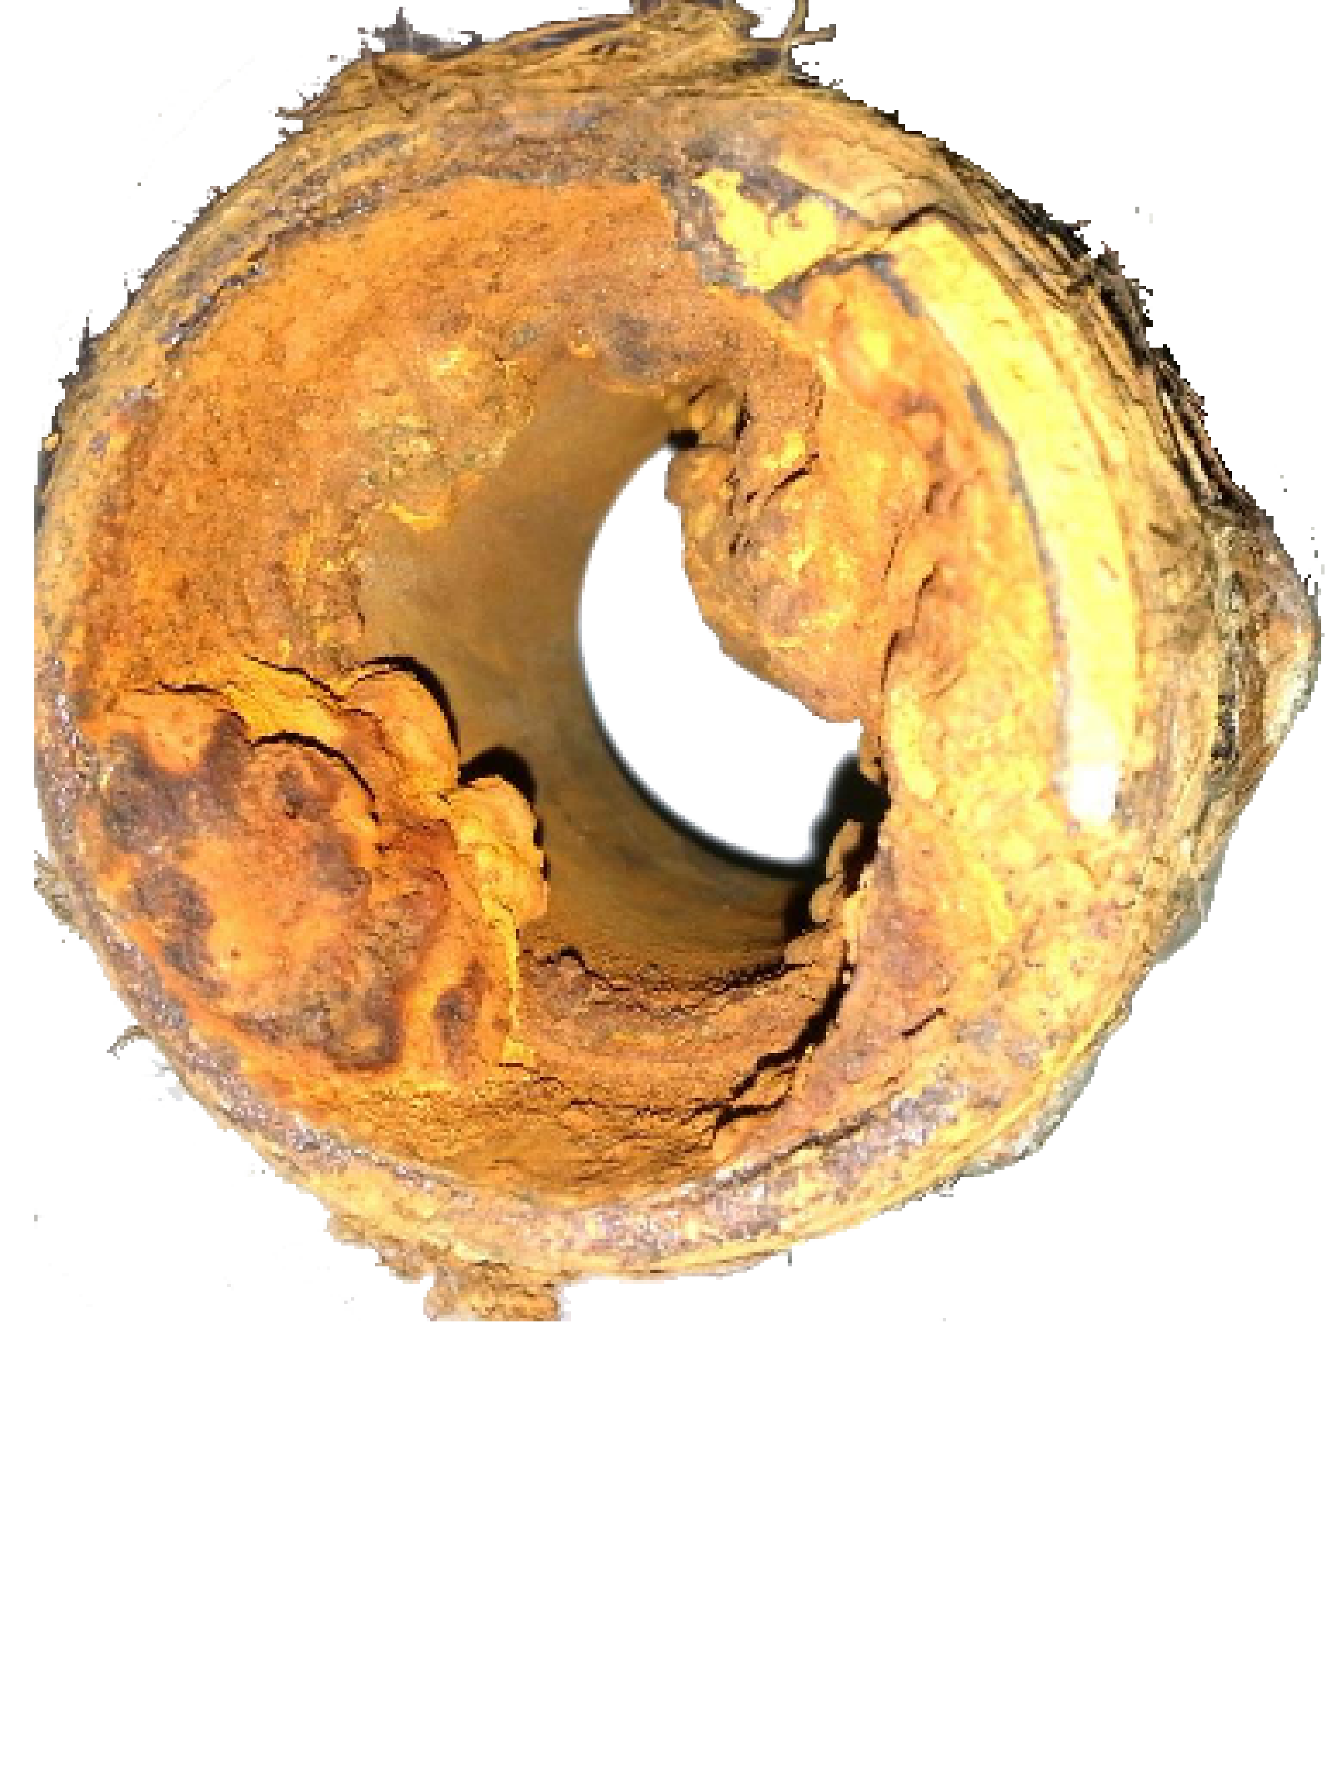
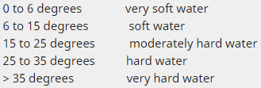
Limestone and water hardness
The simple definition of water hardness is the amount of dissolved calcium and magnesium in the water. Hard water is high in dissolved minerals, both calcium and magnesium. The water hardness is defined as the total hardness (TH) which primarily corresponds to calcium and magnesium salts.It is easy to detect, without testing, the hardness of your water.
4

Slide 5
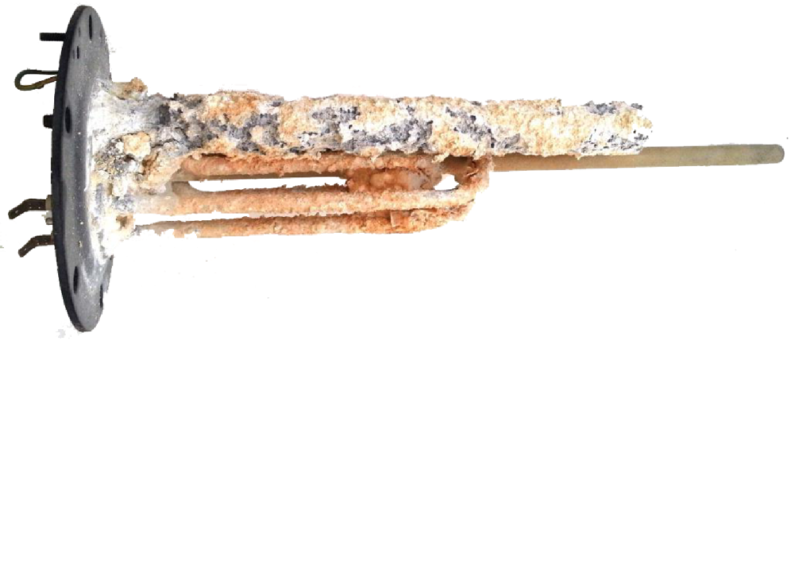
With soft water (rain water), soap makes quickly foam and it is hard to get rid of the soap. On the other hand, hard water (lime) quickly removes soap and even gives hands a little rough after washing. But it needs more soap to wash or clean.
5

Slide 6
The water hardness (limestone) has contradictory effects :
6
Beneficial to health : hard drinking water (rich in calcium and in magnésium) generally contributes a small amount toward total calcium and magnesium human dietary needs. Some studies suggest a correlation between hard water and lower cardiovascular disease mortality. Hard drinking water is also more drinkable. Hard drinking water is high in mineral salts, especially calcium and magnesium ions.

Slide 7
On the other hand hard drinking water has many domestic drawbacks : minerals that cause hard water have a wide impact on households. In the home hard water can lead to the furring and scaling of heating systems, kettles and household appliances such as washing machines. Clothes laundered in hard water may look dingy and feel harsh and scratchy. Dishes and glasses washed in hard water may become spotted as they dry. Hard water may cause a film on glass shower doors, shower walls, and bathtubs. Hair washed in hard water may feel sticky and look dull.
7

Slide 8
Soft water prevents protective carbonated deposits on the pipes and increases the corrosion of pipes and equipments. The water becomes aggressive.
The corrosion, also related to the pH (acidity) of water, can also cause the solubilisation of metals : particularly iron, copper and lead, which creates metallic sludge and mud in the water (closed circuit) as the central heating or tower cooling or a heat pump.
8

Slide 9
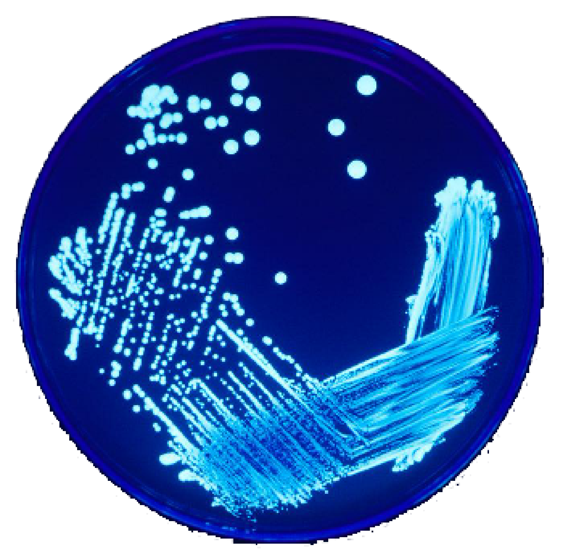
Diseases, contamination, bacteria and our health
Legionella-
9
Water is also a vector of microbial, bacterial (legionella, ...) and viral contamination. Water is a container of food or organic materials, biofilm, microorganisms and algae which interfere dramatically our health.

Slide 10
Thanks for your attention!
10

