Slide 1
Drinking Water
Presentation by Crissy and Alex

Slide 2
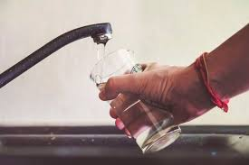
Drinking Water in Bulgaria
Drinking water is safe to drink all over the country but not always pleasant in taste or appearance. Bulgaria's vast supplies of mineral water are widely available in 0.5 litre and 1.5 litre bottles. They are very tasty and not expensive.

Slide 3
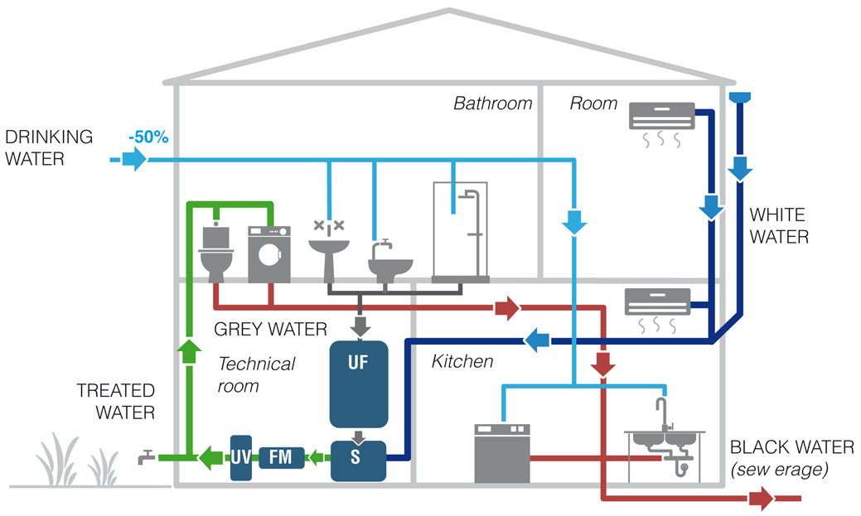
The main source of drinking water is fresh water from nature, which is treated and decontaminated by the relevant city services, which, through the relevant water treatment and water treatment, submit it for distribution in the water supply network.

Slide 4
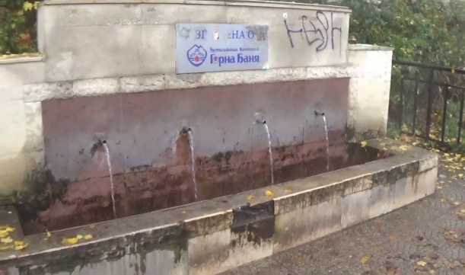
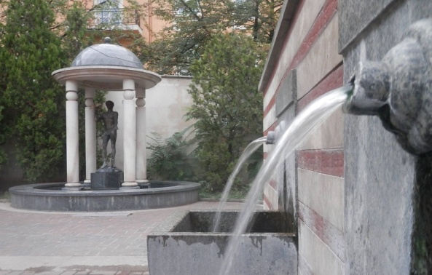
The drinking water in Sofia
Sofia’s water supply system collects water from its drainage basin in the alpine terrains of Rila Mountain some 80 km south of the city. Water is gathered in the Iskar Dam which provides 80% of the city’s drinking water and in the high altitude Beli Iskar Dam which provides about 20% of the water. Before reaching the faucets in Sofia, the water passes through one of the several water purification plants.

Slide 5
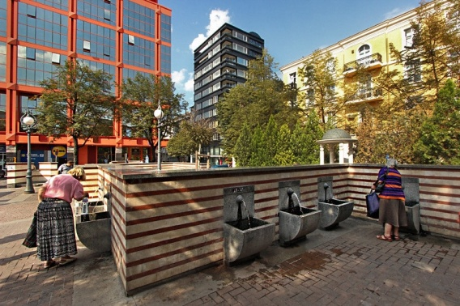
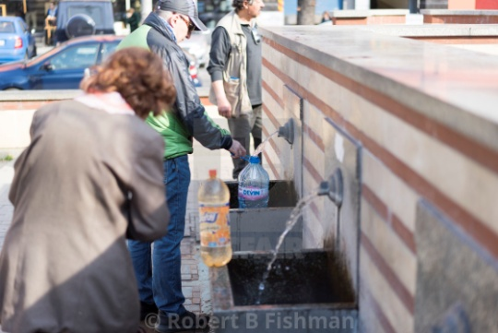
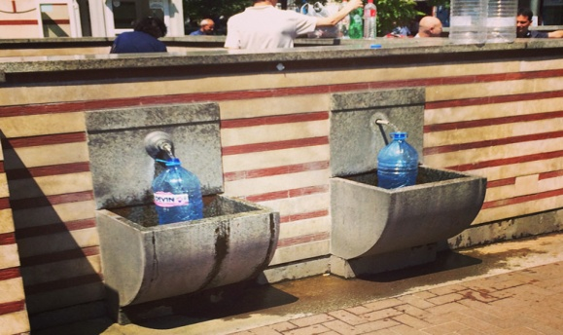
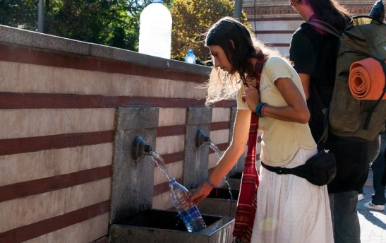
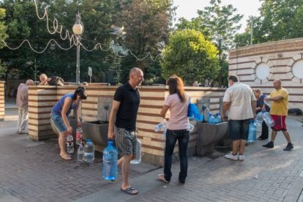
Mineral water of Sofia
Sofia is famous for its mineral waters around the world. The water is quite healthy and in the past, it has been used for medical purposes in bathhouses all over the city. They say the mineral water of Sofia could heal anything but a broken heart.

Slide 6
Historical development in Bulgaria
In Bulgaria, in the past, villages were mainly built around drinking water sources. In each village there are usually fountains or wells that provide the population with sufficient quality drinking water. The transfer of water was done with buckets or bowls. It was not until the second half of the 20th century that the construction of water supply lines for the central supply of Bulgarian villages began massively in Bulgaria.

Slide 7
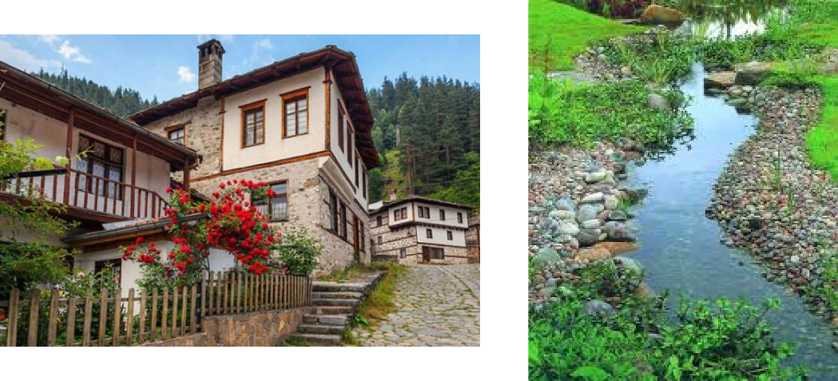

Slide 8
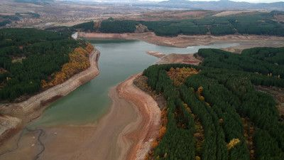
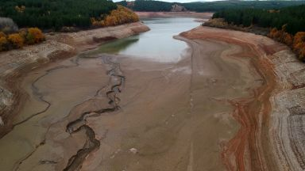
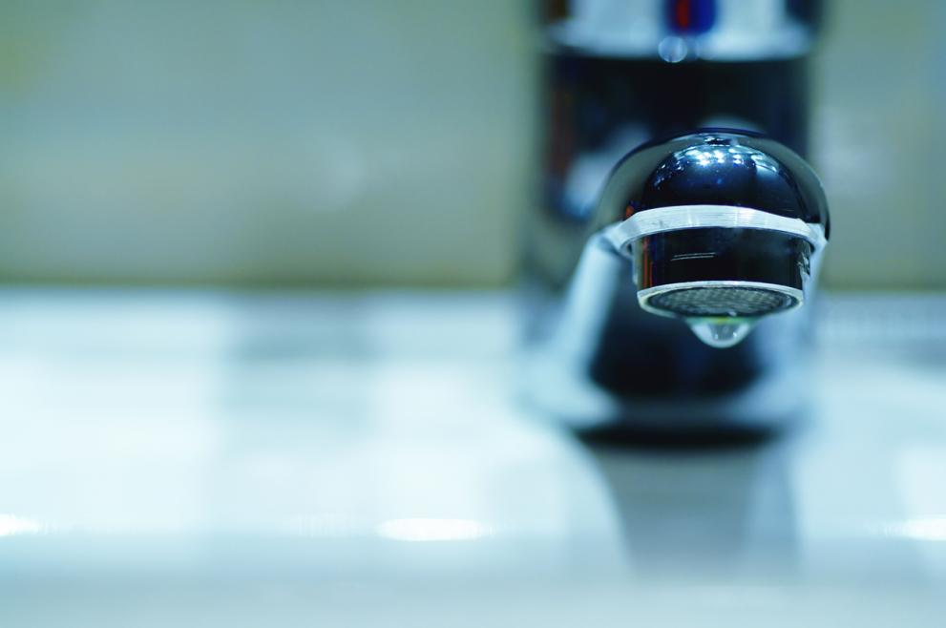
The drinking water of Pernik
The water crsis in Pernik happened because of the low level of the ‘’Studena” dam.One more reason about this disaster is human intervention.A small group of people and a private company are guilty about drinking water shortage but the government has programmes for resolution in this water problem in Pernik city.

Slide 9
Problems with Drinking water
Water pollution has also increased in
the districts of Kyustendil and Plovdiv,
which previously reported no problem. Situation
is worst in the northwestern district
of Pleven, where 14 villages report
heavy metal contamination.

