Slide 1
Water, seas and oceans
Rebecca Jablonská

Slide 2
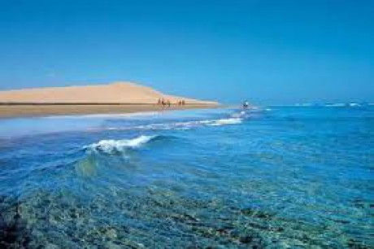
Seas and oceans cover 361 millions km², it is 71 % surface of the Earth.
Sea water represent 96,5 % of all water on our planet.
Average depth of global ocean is approximately 3 790 m.

Slide 3
Oceans cover about 66% of surface of the and the life there is as various as on the ground
Existence of sea animals is allowed mainly by sea plants, mostly of little sea grass called Phytoplankton
Phytoplankton is situated in shoal water and can produce energy thanks to sun light like the other plants

Slide 4
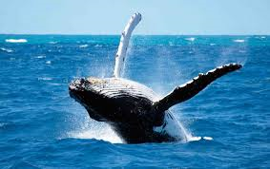
Gulfs are the parts of sea and oceans which are encroach on the mainland
Seas and oceans are linked by straits between islands and mainland
Water surface is turbulent. Flow and outflow are changing regularly.
Coasts of land are changed by water moving

Slide 5
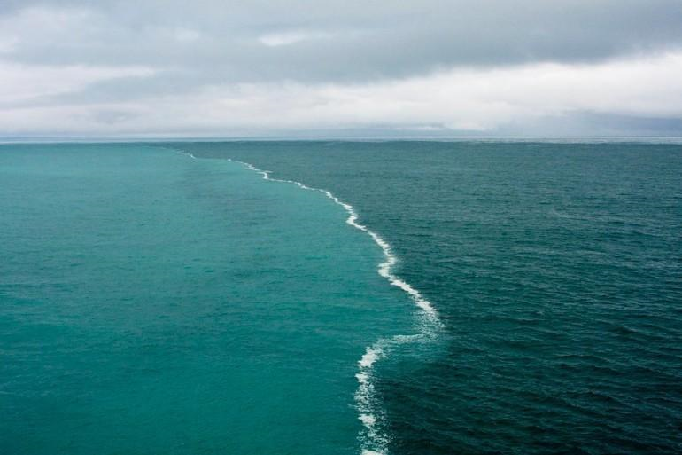
Za ním nasleduje pevninový svah, ktorý sa zvažuje do oceánskych paniev.
The bottom of global ocean isn´t the same.
Mainland threshold is situated near the coast (shelf) The sea there is shoal.
The land slope is next and it´s coming into ocean skillet

Slide 6
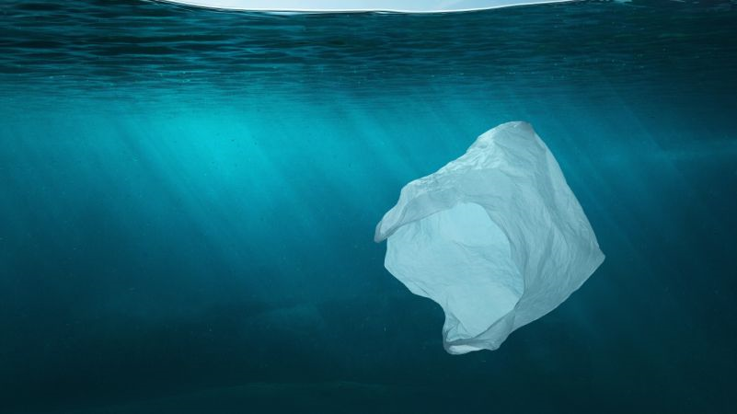
Plastic pollution can affect negative soil, water, seas, rivers, oceans
People must realize plans of recyclation and reduction of using plastic
People still use plastic because it is very cheap, but plastic is decompose for many years and so it is very dangerous for our environment

Slide 7
Thanks for your attention

