Slide 1
Primary school in Rovinka
Školská 266
Rovinka
Slovakia

Slide 2
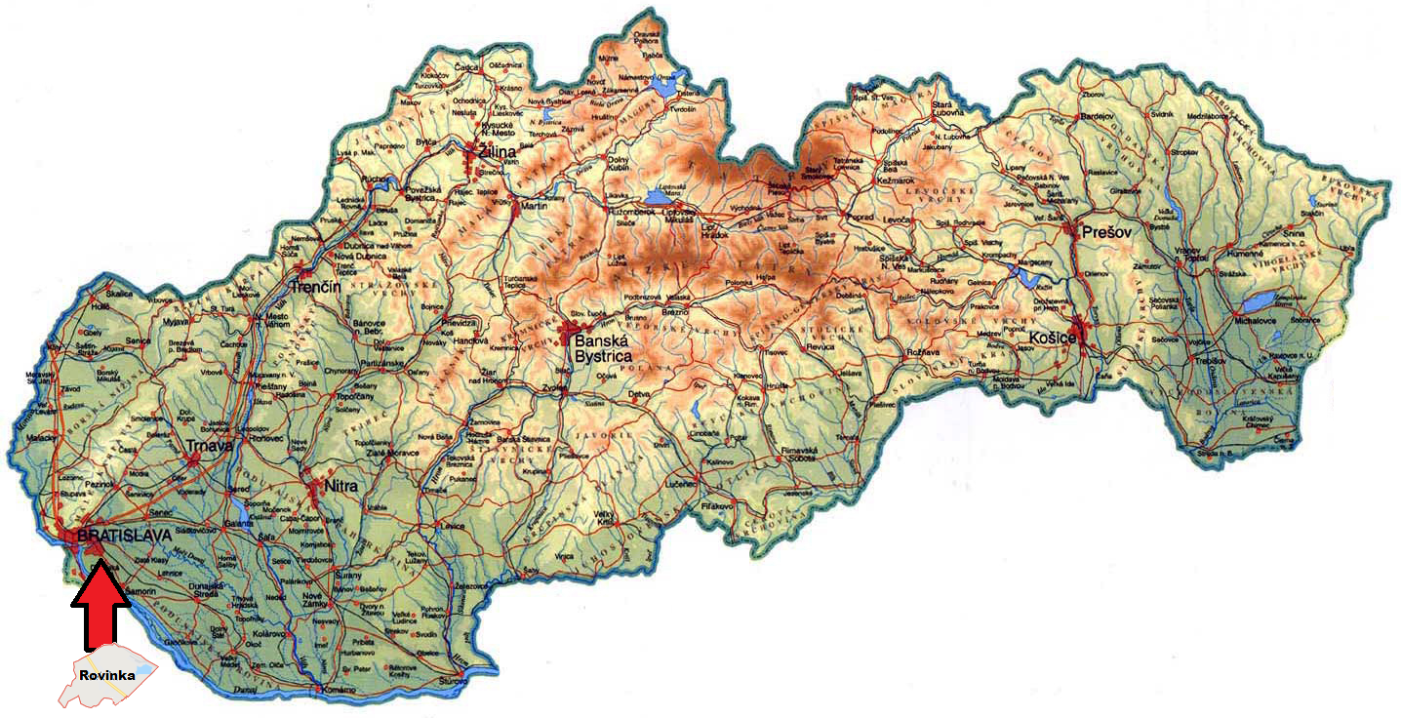

Slide 3
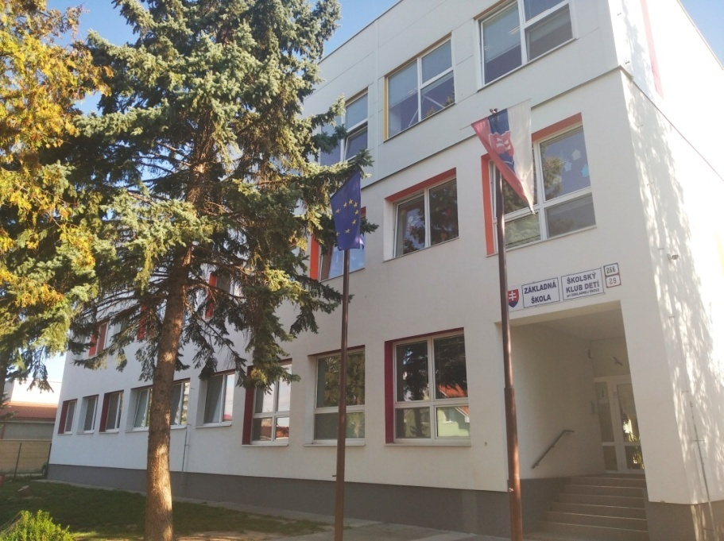
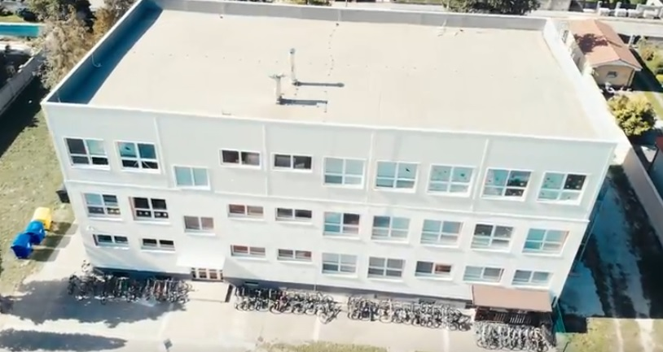
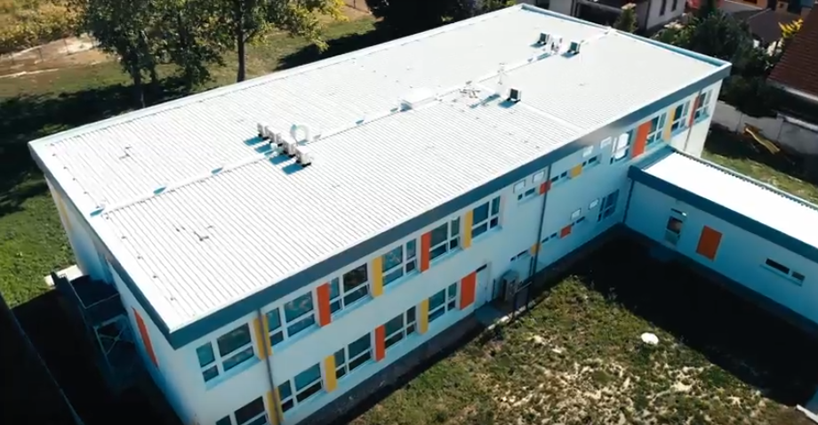
Welcome to our school

Slide 4
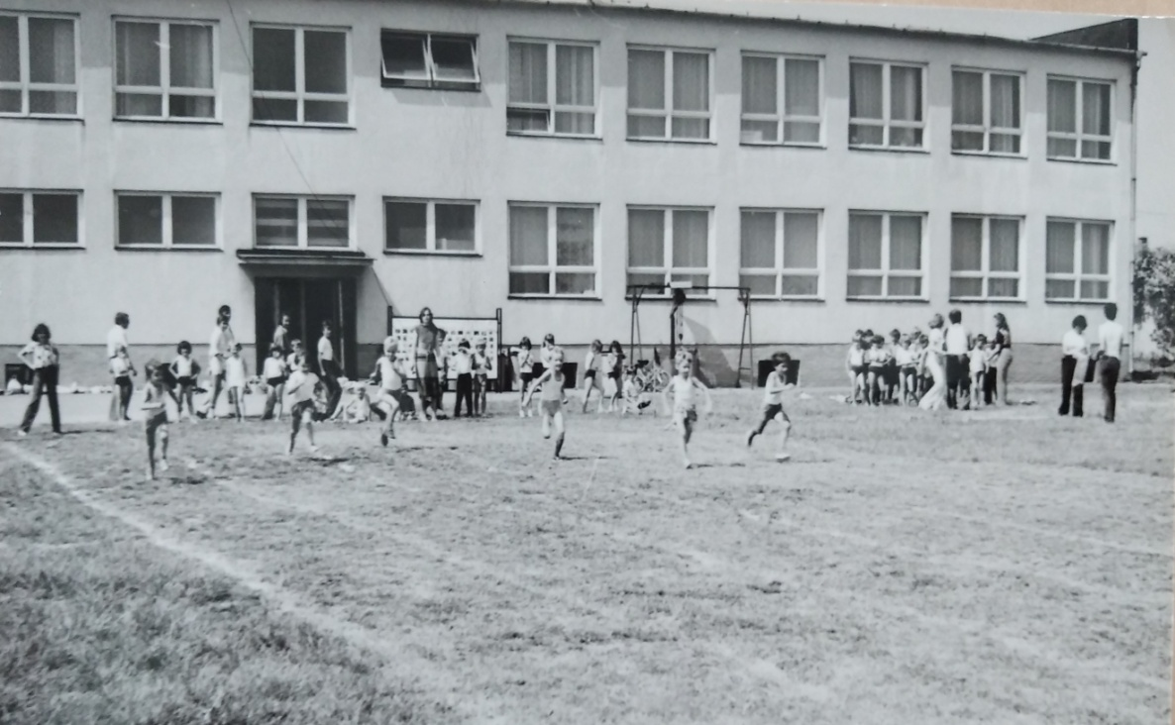
History of our school
established: 1973
number of pupils: 69
number of classes: 4
Nowadays there are:
426 pupils
42 teachers
20 classes

Slide 5
The school aims
Our mission is the education and upbringing of free, reliable and eager to learn pupils,
self-aware and self-conscious individuals capable of empathy and creativity,
in a safe, caring environment where
respect is taught and valued.

Slide 6
What do we offer?
a new and modern school
a strong pupil - parent - teacher collaboration
a family atmosphere
development of every child’s potential
the breakfast club and the after-school club
continual improvement of ICT education

Slide 7
school facilities
2 buildings
a school yard
classrooms
specialist classrooms
locker rooms
a canteen
2 libraries

Slide 8
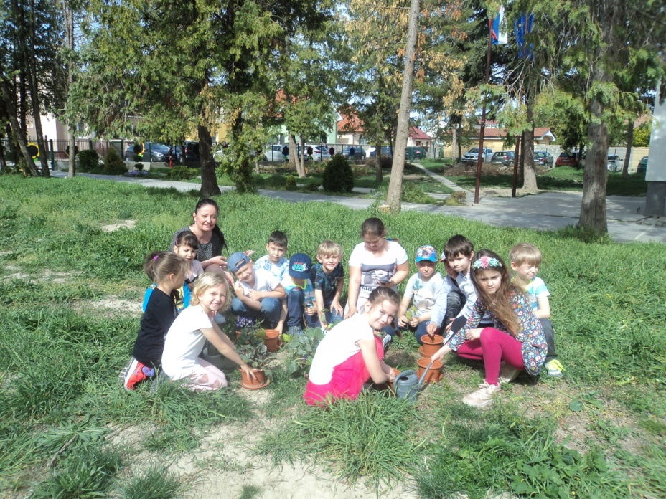
the school yard
A lot of pupils and teachers cycles to school and they can park their bicycles safely using the bicycle stands.
The school yard is used during the lessons and for the outdoor activities in the after – school club.

Slide 9
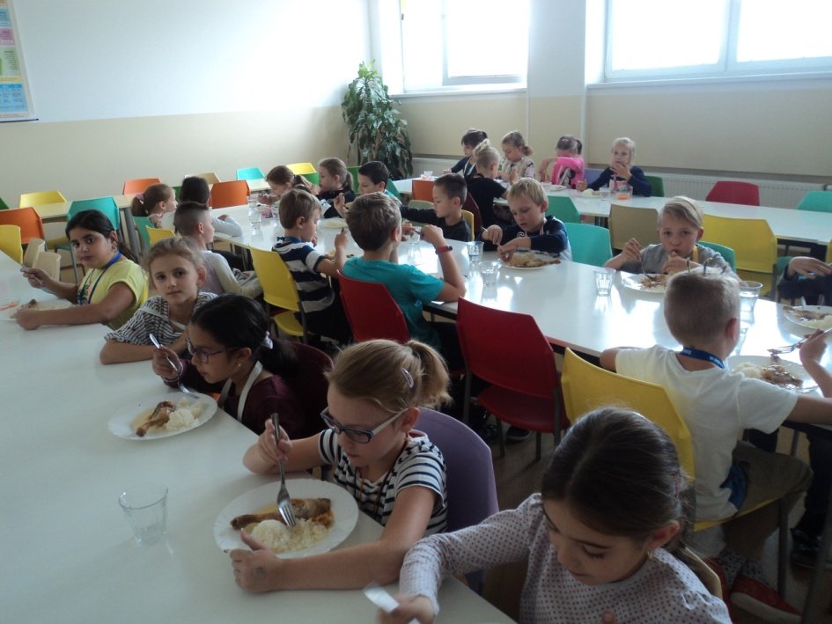
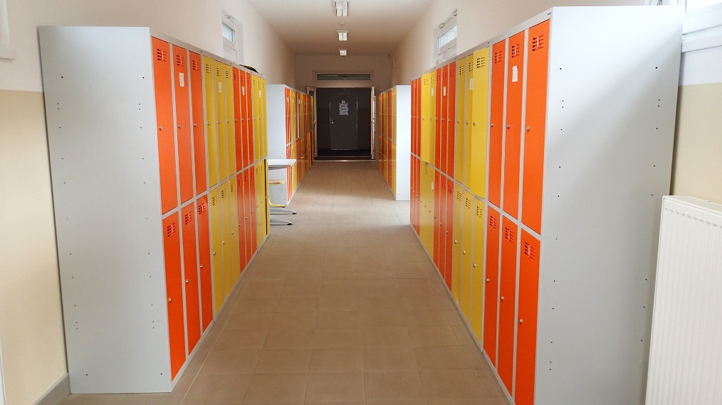
Canteen AND Locker rooms
All meals are prepared by an external contractor and delivered daily straight to our school. Hygiene, maintenance and modernization – those are our utmost priorities.

Slide 10
Classrooms
Every class has its own classroom.
Most of the classrooms are equipped with an interactive board or an external data projector.
The teachers can use a CD player and a laptop in every classroom.

Slide 11
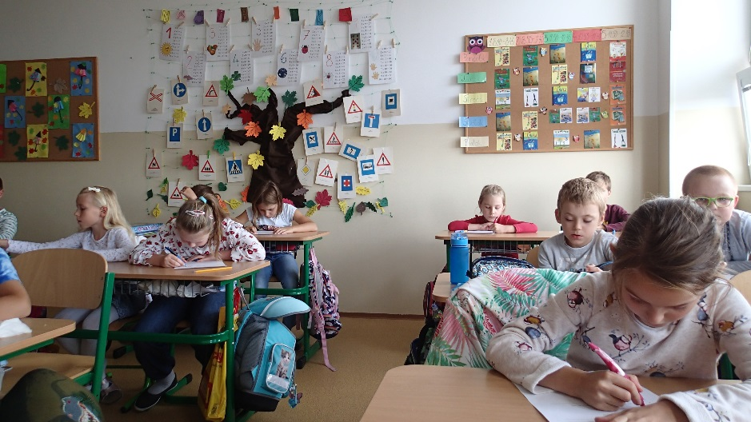
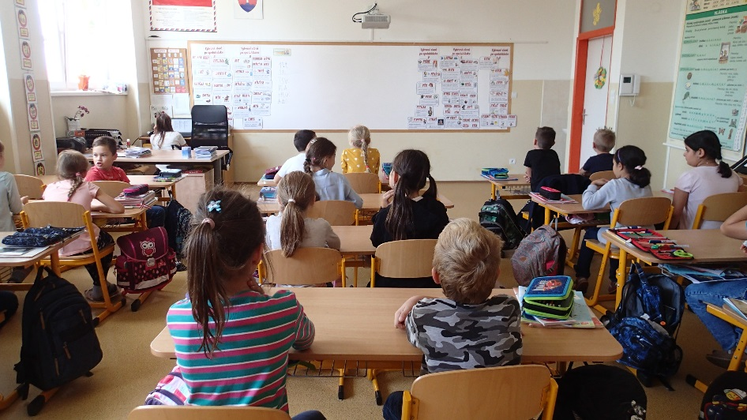
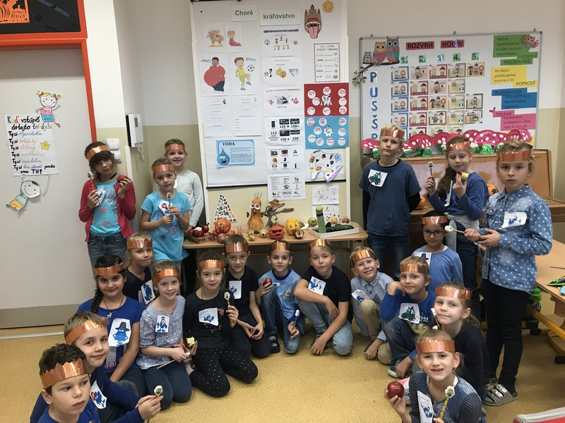
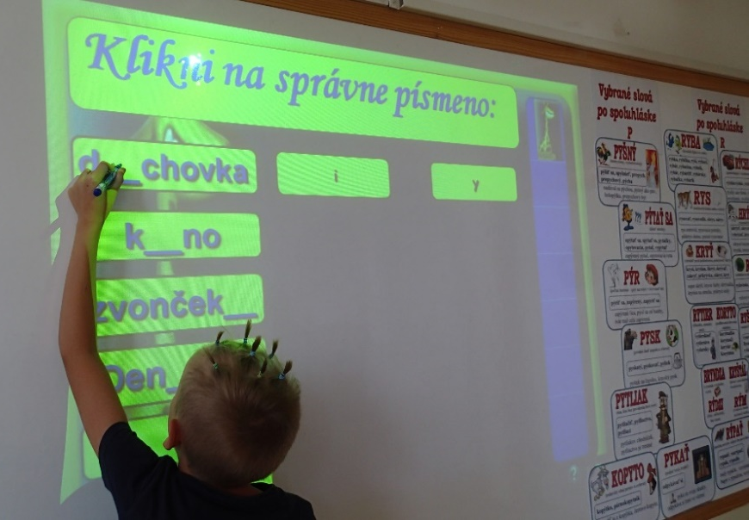

Slide 12
Specialist classrooms
Our school has 4 specialist rooms which have been specially refurbished to a high standard to enable all pupils to achieve their potential:
- a language classroom
- an engineering classroom
- an ICT classroom
- a science lab

Slide 13
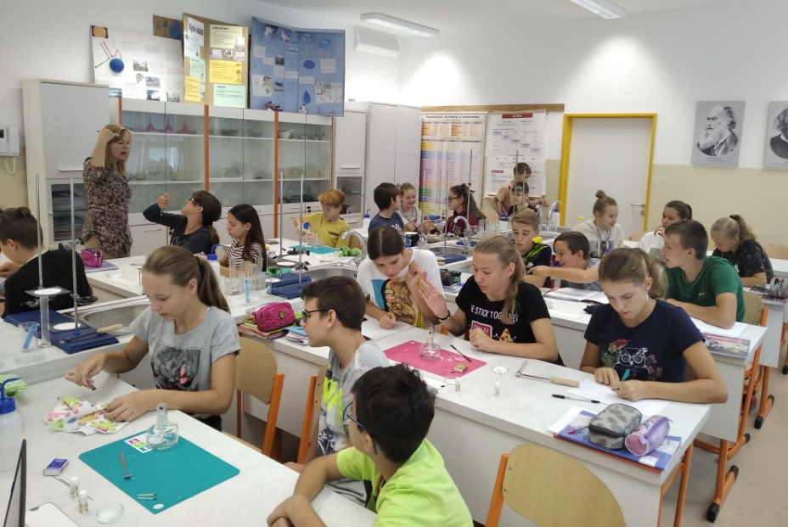
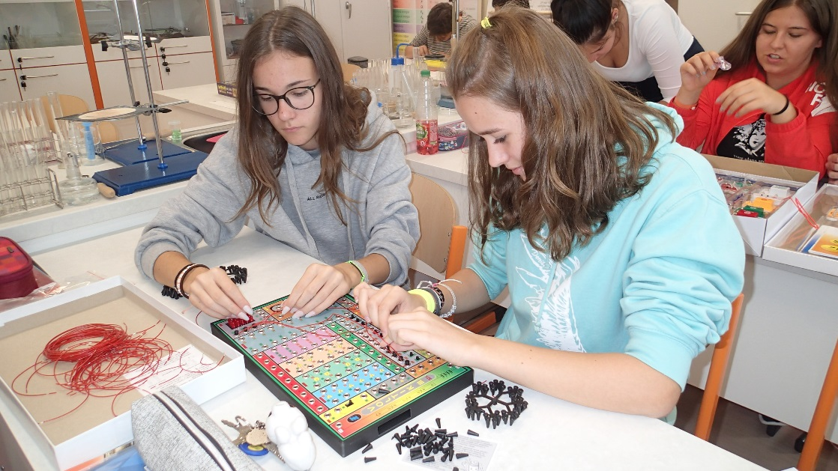
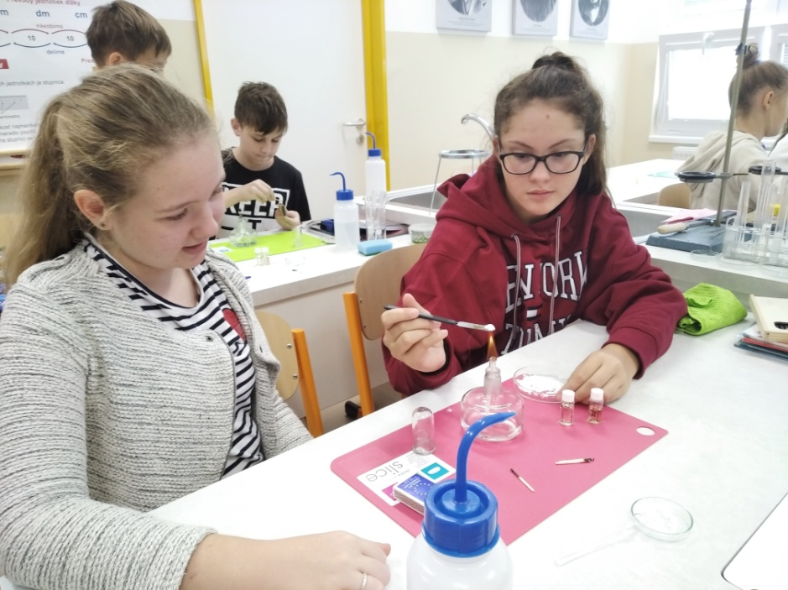
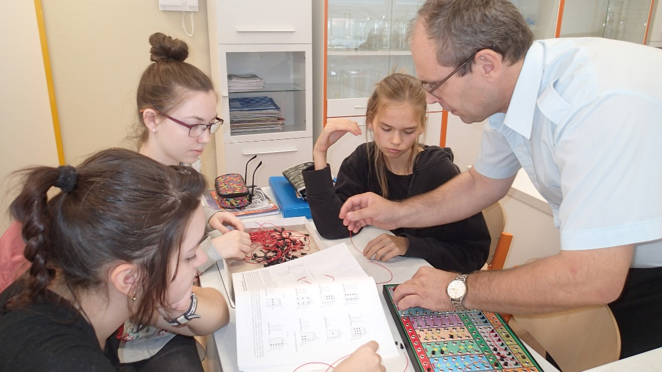
Specialist classrooms
Chemical experiments
Physical experiments

Slide 14
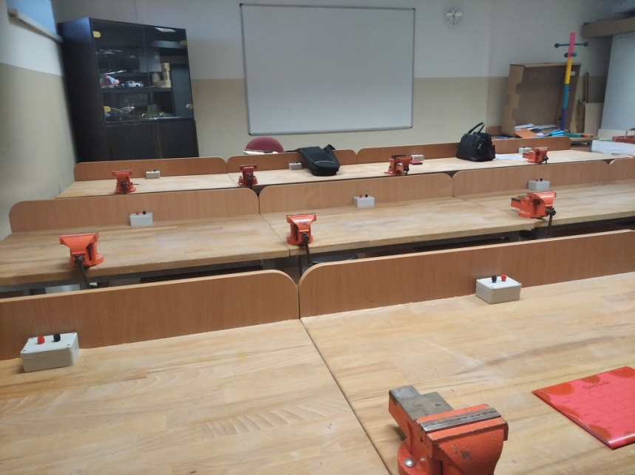
Computer room AND craft room

Slide 15
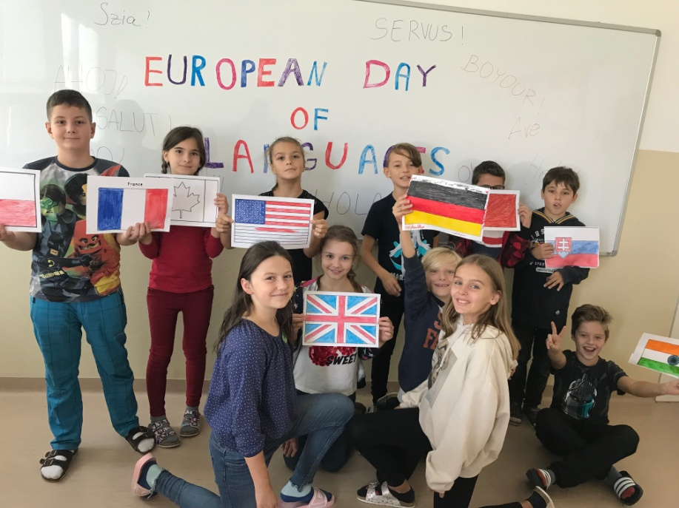
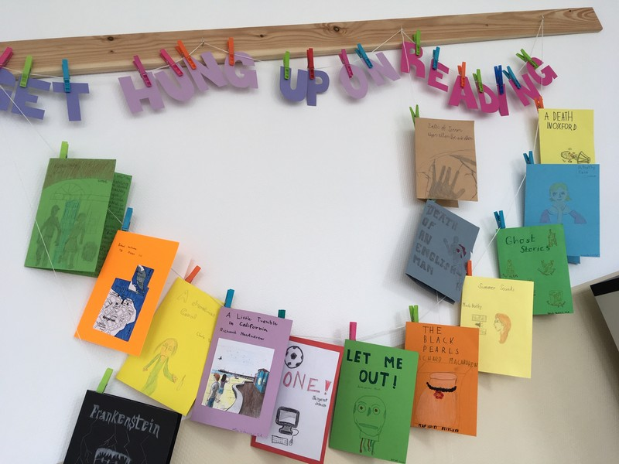
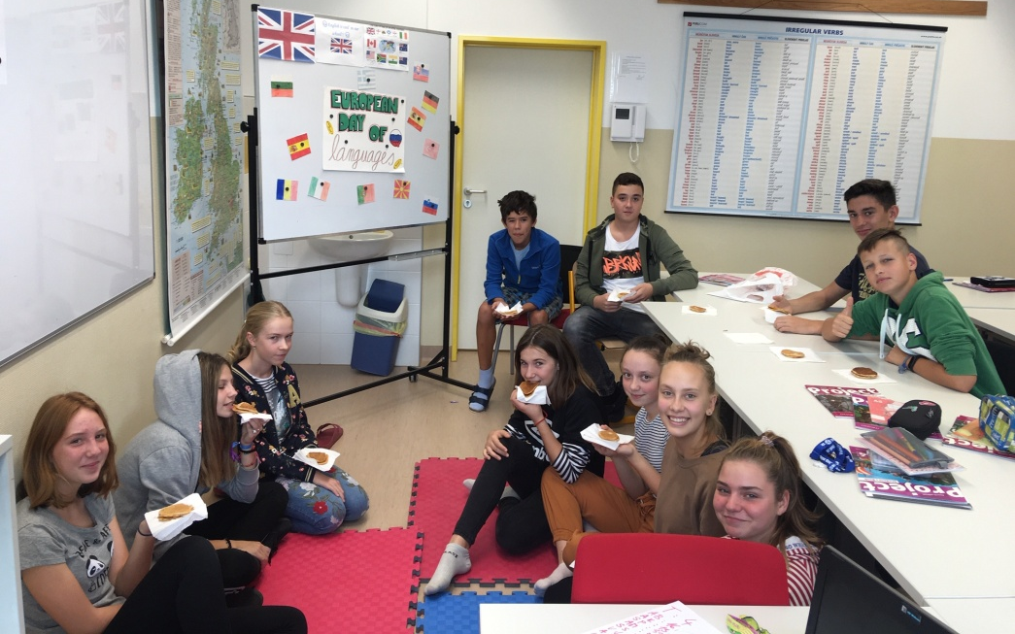
LANGUAGE CLASSROOM
English is compulsory since the very first grade. From the seventh grade on pupils have to opt for another language – namely German and Spanish.

Slide 16
After-School club
Pupils may attend:
- breakfast club from 06:45 – 07:45
- after – school club from 11.40 – 17:30
After – school club activities are sure to help children develop socially as well as help them learn to work as a team and move ideas forward which will serve them well throughout their life.

Slide 17
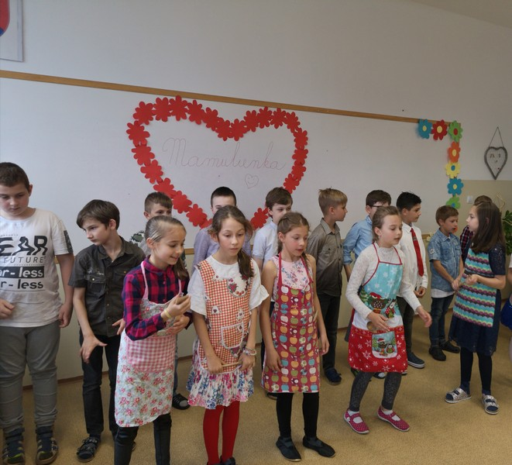
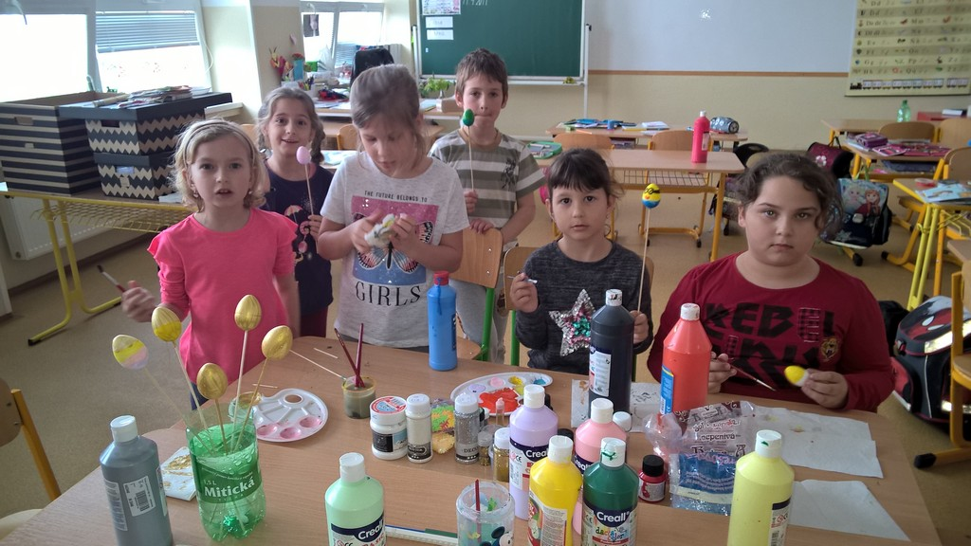
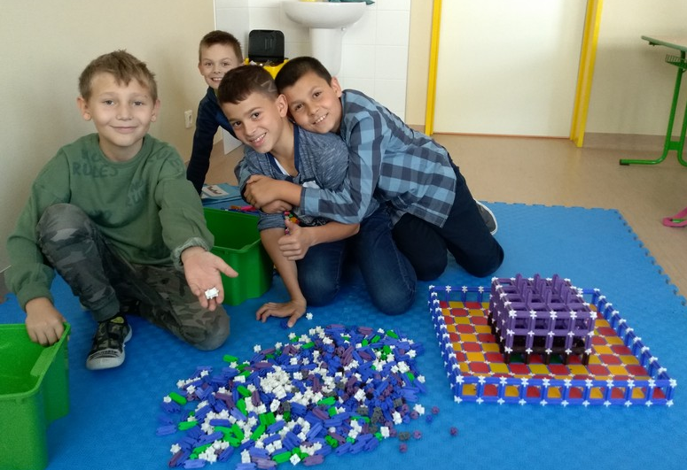

Slide 18
Educational trips and visits
Pupils of all ages take part in visits to places of interest each term. The outings are very varied and might include visits to museums, theatres, a working farm, lectures, field trips, exhibitions, …
Everyone is offered the possibility to participate in varied competitions, and those who do so are known to achieve good rankings even while competing with other schools.
Other extracurricular activities include Resident Outdoor School, swimming, ice skating, skiing ... and many others ☺

Slide 19
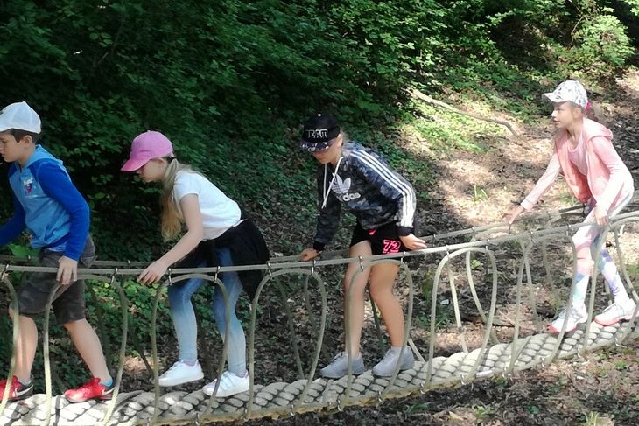
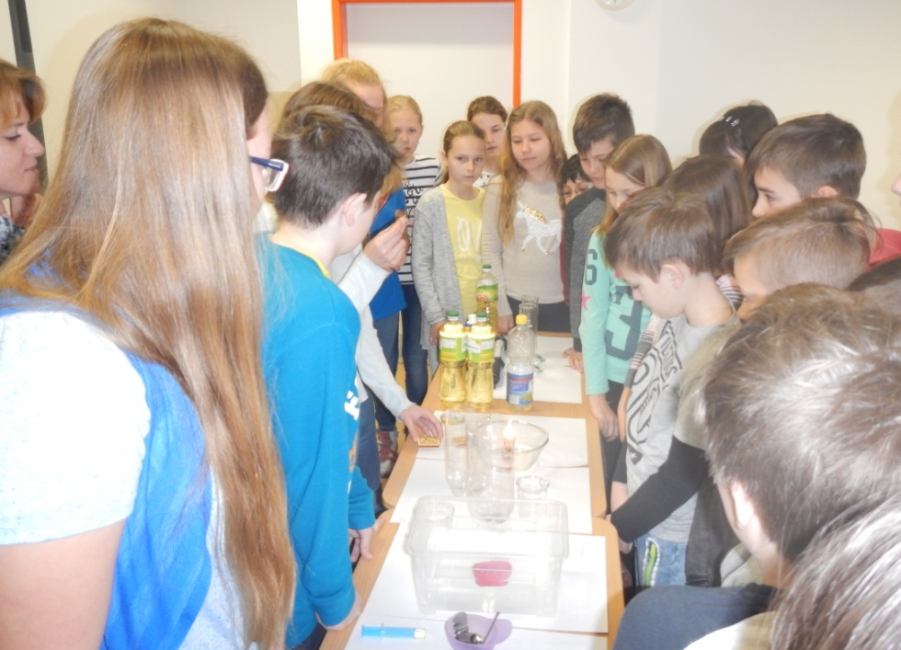
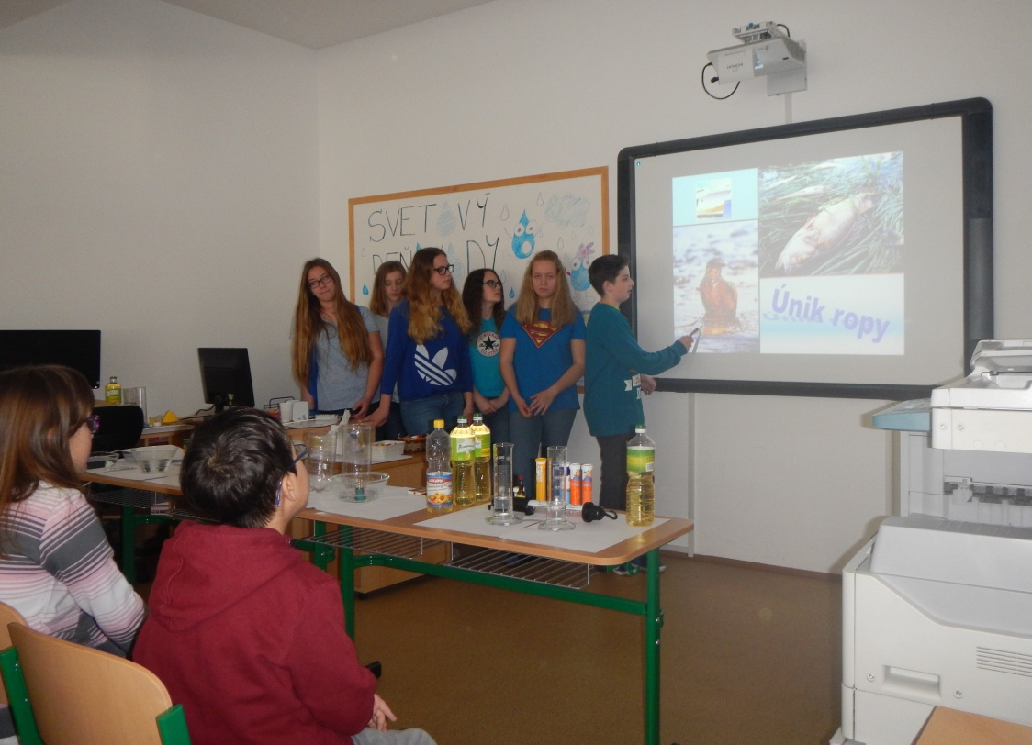
Dunajské luhy – Donau Auen
Project ,,Modrá škola“ (Blue School)
European Day of Languages
World Water Day

Slide 20
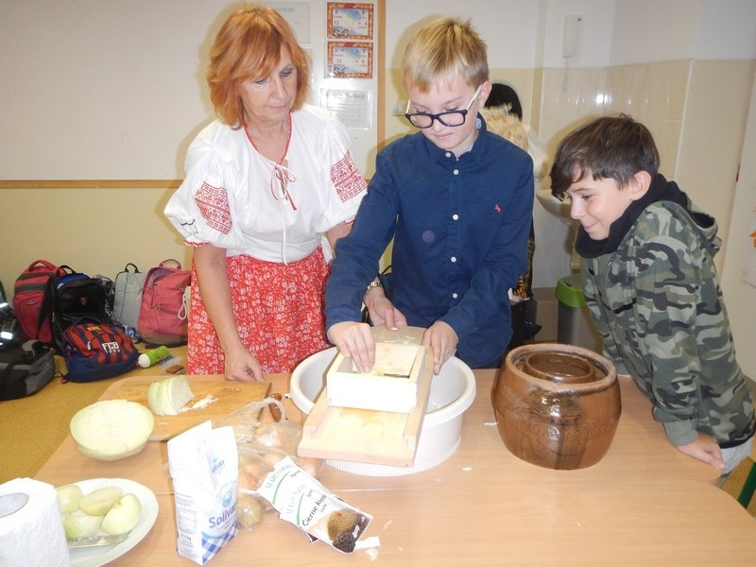
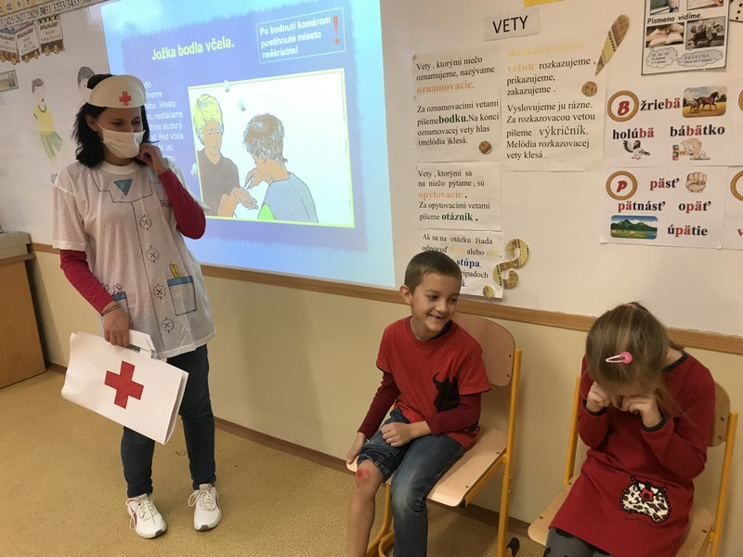
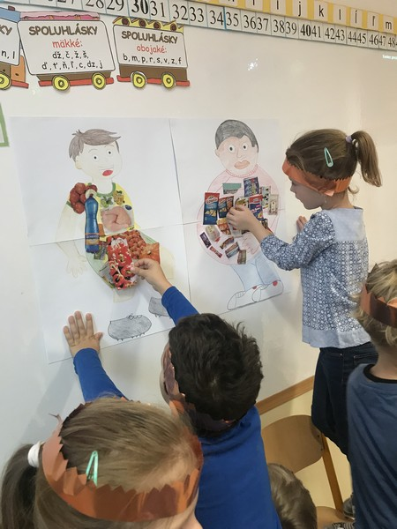
The Slovak wedding
Traditional meals preparation
Direct experience learning
World Health Day activities
Human body learning

Slide 21
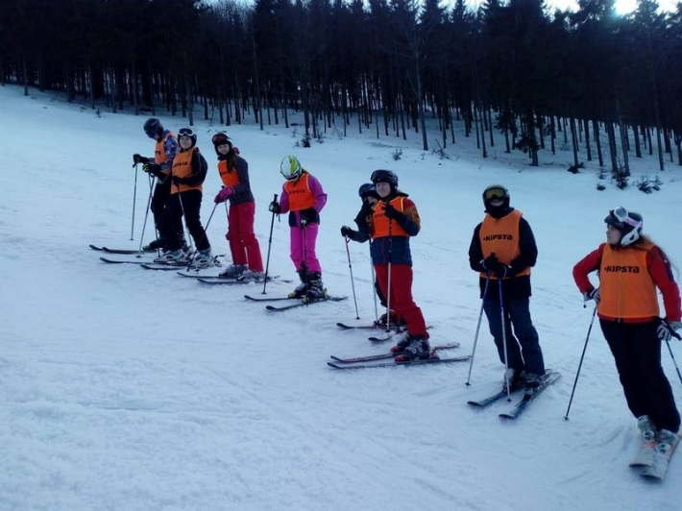
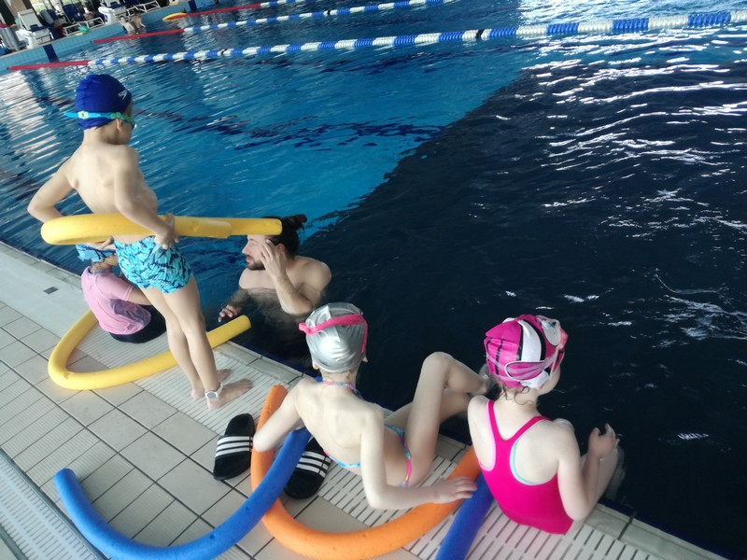
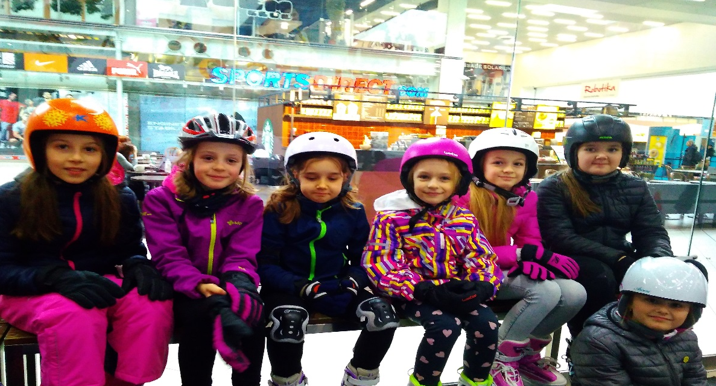
Sport activities
Skiing course
Swimming course
Great emphasis is placed on physical activity of pupils.
Ice skating course

Slide 22
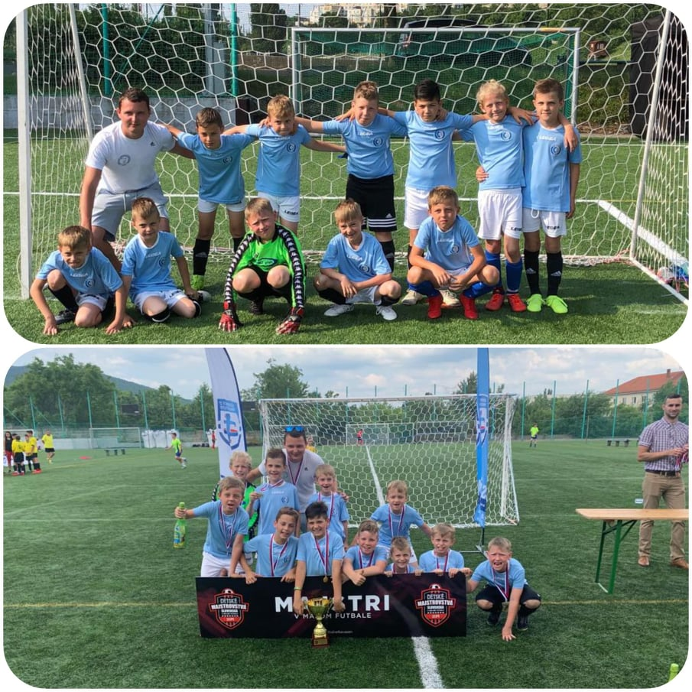
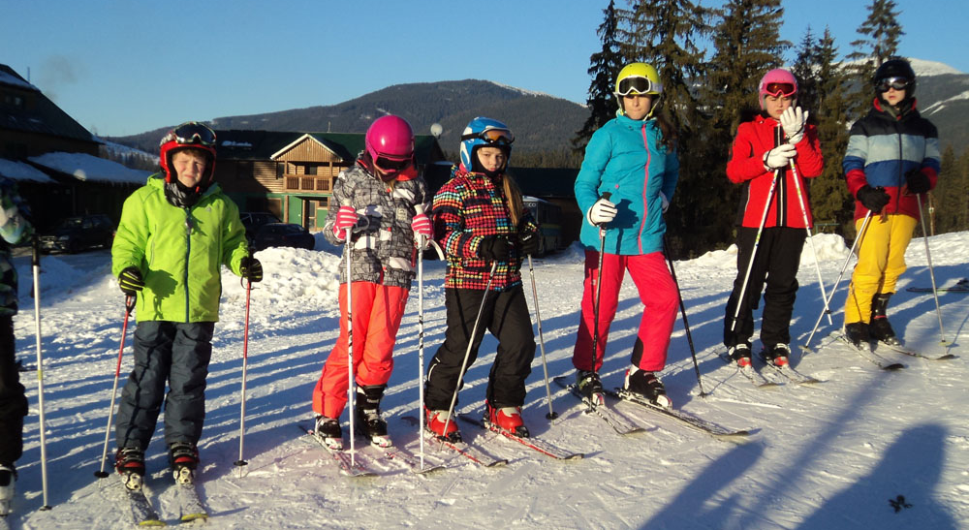
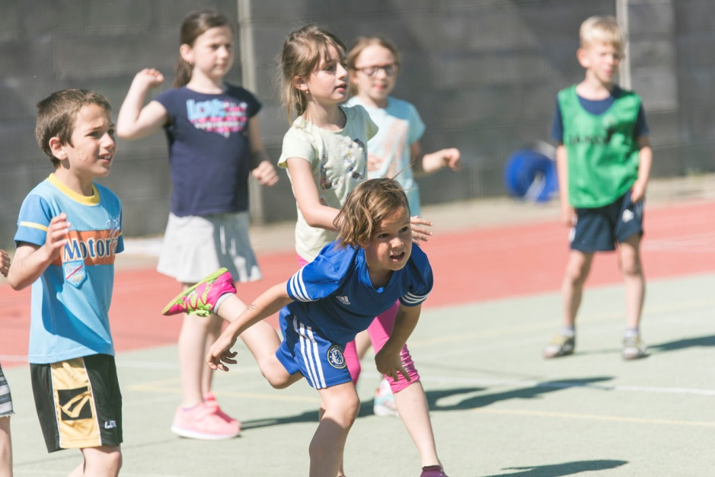
Downhill skiing
The Winners of the National Primary School Football Championship
Sports Day

Slide 23
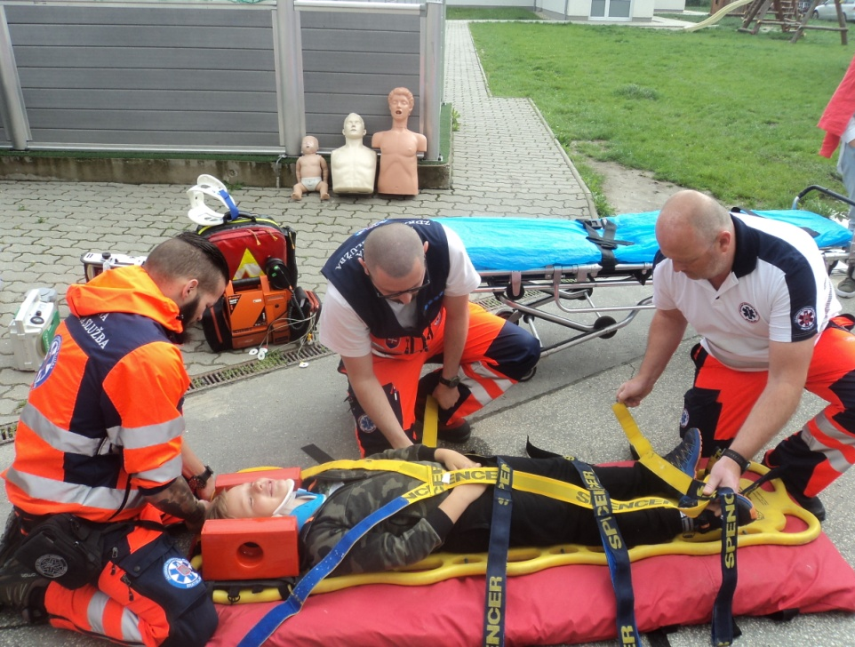
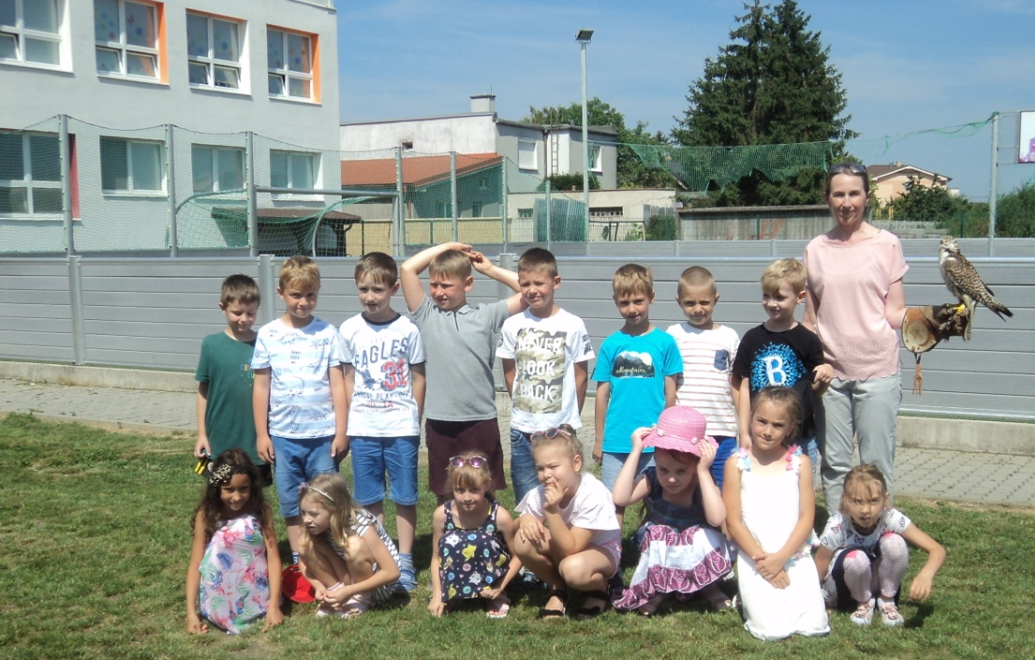
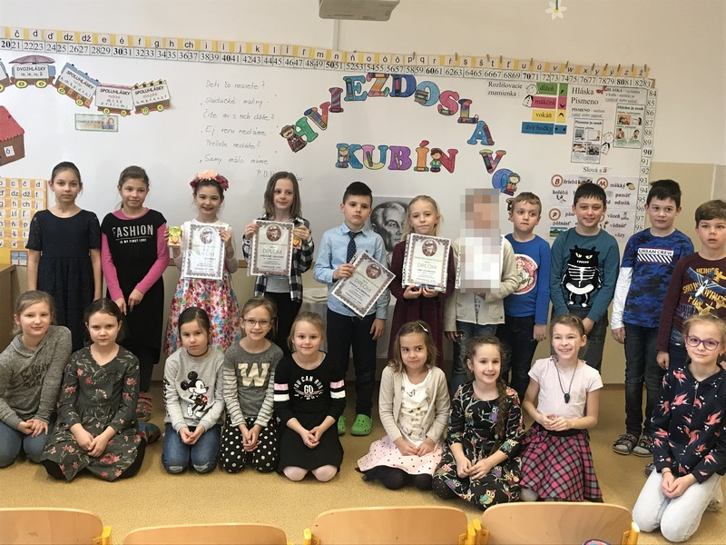
Children’s Day – First aid demonstration
Falconry presentation
Hviezdoslavov Kubín poetry competition
Fun with Chemistry

Slide 24
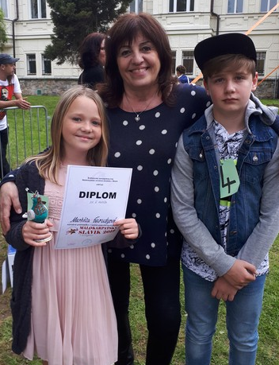
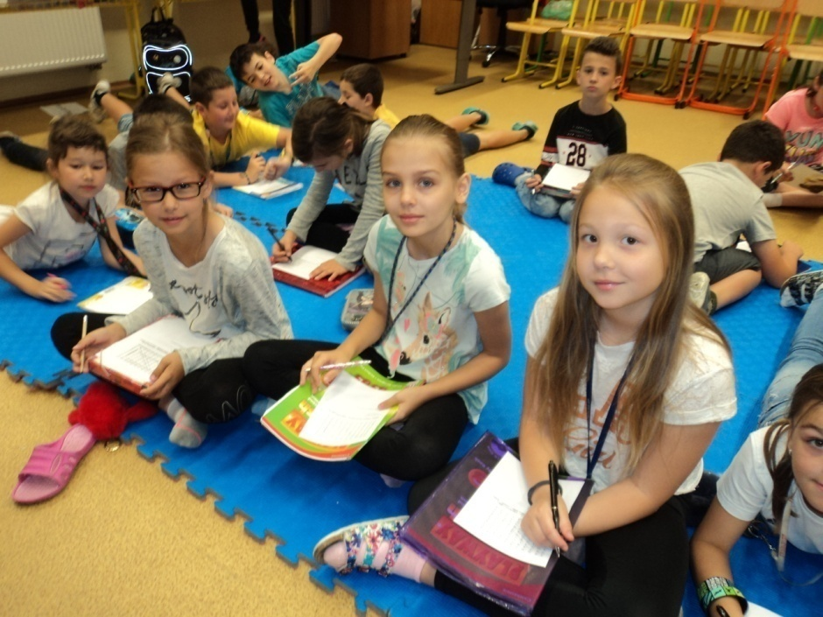
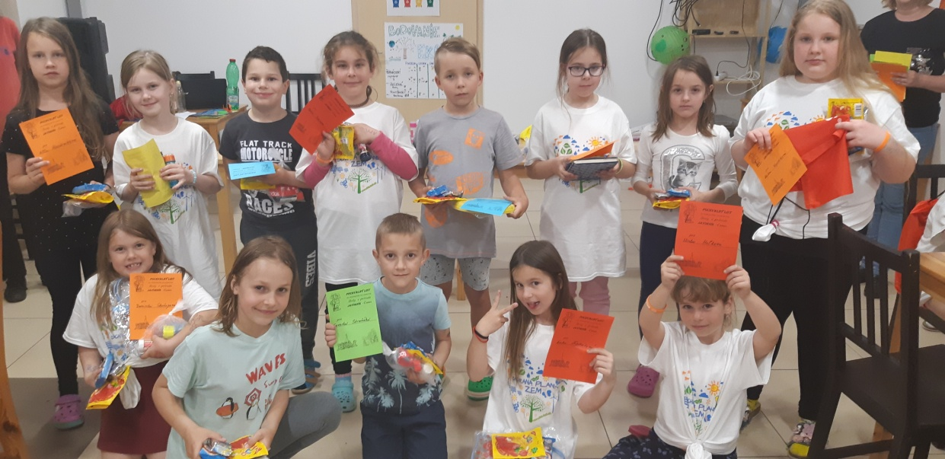
Teamwork
Folk song competition
Resident Outdoor School

Slide 25
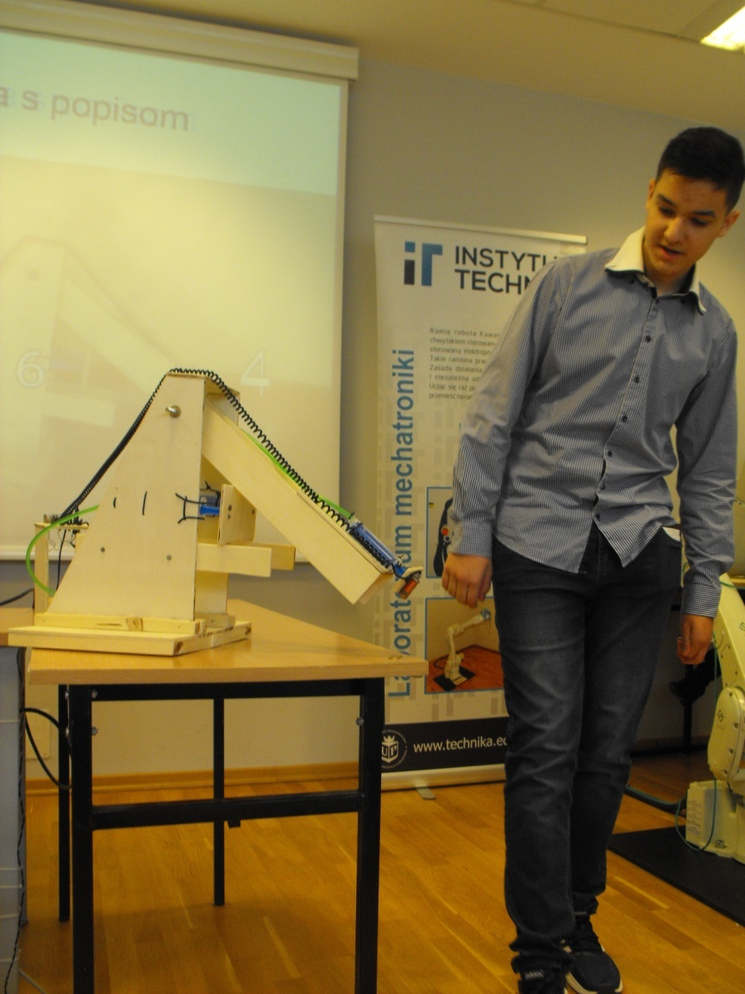
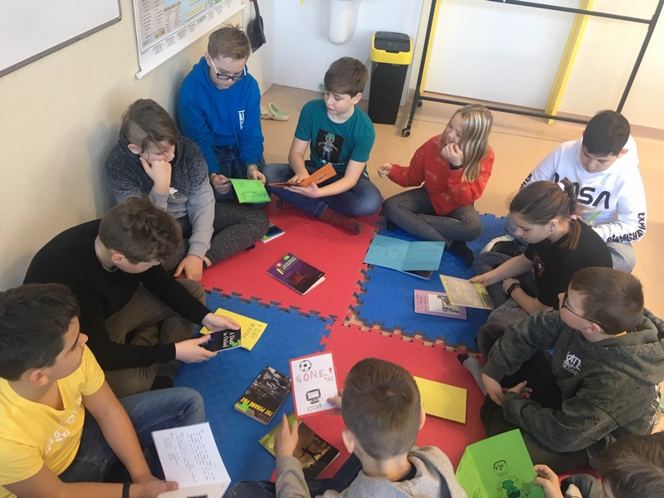
Recycling lecture
Miroslav Voštiar won first place in Polish National Engineering Competition in Cracow.
Reading Diaries in English lesson

Slide 26
Thank you for your attention

