Slide 1
Chemical composition of water
Presented by:
Iftime Alexandre
Stan Sabin

Slide 2
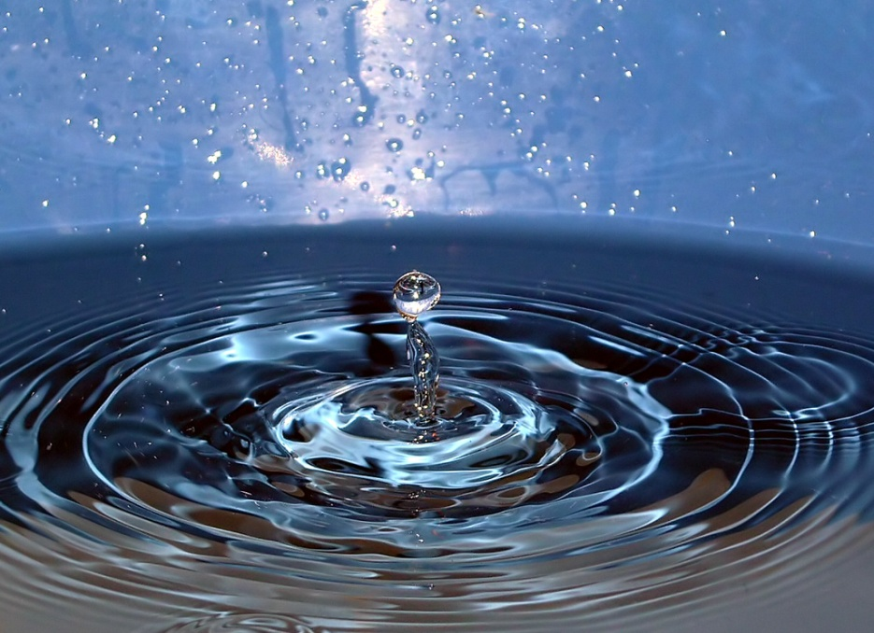
Water is the main constituent for the most living oragnisms. Without providing any calories or organic nutrients it is vital for all known forms of life.
Water shows up as rain, snow, even in oceans, seas, rivers, streams and also in our body, being 60% of it.

Slide 3
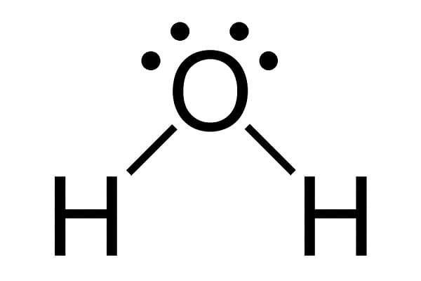
So, we know what the main definition of water is… Now we are about to find out what the chemical composition of it is:
Water is composed of Hydrogen ions (H⁺) combined with Hydroxyl ions (OH⁻) to form H₂O.
Sodium, Potassium, sulfates, bicarbonates, mineral salts and others are contained in water.

Slide 4
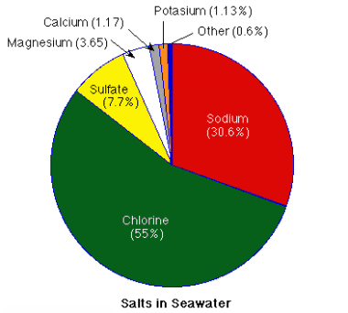
Seawater
Water that makes up oceans and seas is called SEAWATER.
Seawater is not just water, it is also composed of salt which means 2.5% of it.
Biologically speaking, seawater is made of Chloride, Sodium, Sulfate, Magnesium, Calcium and Potassium

Slide 5
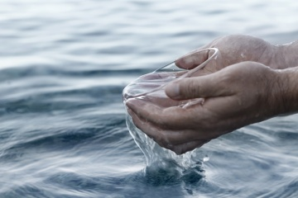
What happens if we drink seawater?
Have you ever wondered what happens if you drink seawater?
Well, drinking seawater means the increasement of the amount of salt in your bloodstream and the amount of work your body has to get rid of.
So, if you are left alone on a sea and you are thirsty ,thinking of drinking seawater is the worst idea!!!

Slide 6
Water Facts!
Did u know?
Water means 31% of human bones.
Drinking water can be find in less than 1% of the water supply on Earth.
Insufficient water consumption is a risk factor for various types of cancer, so u had better drink water!
Less than 1% of the water treated by public water suppliers is used for drinking and cooking.

Slide 7
Thanks for watching
"This project has been funded with support from the European Commission. This publication[communication] reflects the views only of the author, and the Commission cannot be held responsible for any use which may be made of the information contained therein."
2019-1-RO01-KA229-063127

