Slide 1
Water and its importance in human body
Adriana Lukáčková

Slide 2
Water
Water is more than 70% of our body mass
It belongs among main basic nutrients
Our body daily needs a big amount of liquids withouth feeling thirst
Thirst is warning of coming dehydration

Slide 3
Every organ of our body works with liquids
Lack of water can cause: migraine,fatigue, nervousness, pain of joints, poor quality skin
Water makes conditions in our body in which all chemical processes are made

Slide 4
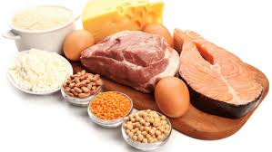
Water is in each cell and helps to make glycogen and proteins
Protein – is high-molecullar natural cell, which base is one or more chains made from aminoacids

Slide 5
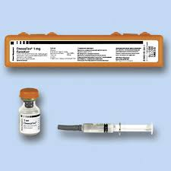
glycogen
When the level of glucose goes down in our blood degradation systems in liver are started
Glycogen is cleaved on glucose and it´s releases to the blood.
In high level of glucose in blood glycogen is made
Hormones insulin and glucagon control this process

Slide 6
The body is got rid of electrolytes when the receiving of water is low and we can see it in sport activities
Electrolyte - is liquid in which molecules are cleaved to ions

