Slide 1
BULGARIAN ERASMUS TEAM
ERA + INTEGRATED LEARNING CHALLENGES

Slide 2
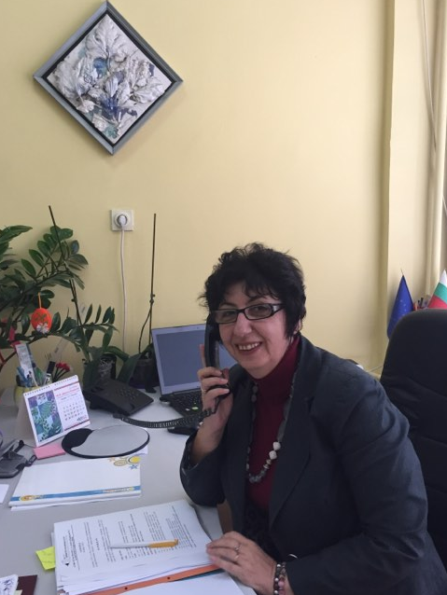
NADKA VODENICHAROVA
She is our school principal. She graduated Maths and IT. She’s got MA in Educational Management. She is very supportive and innovative principal.

Slide 3
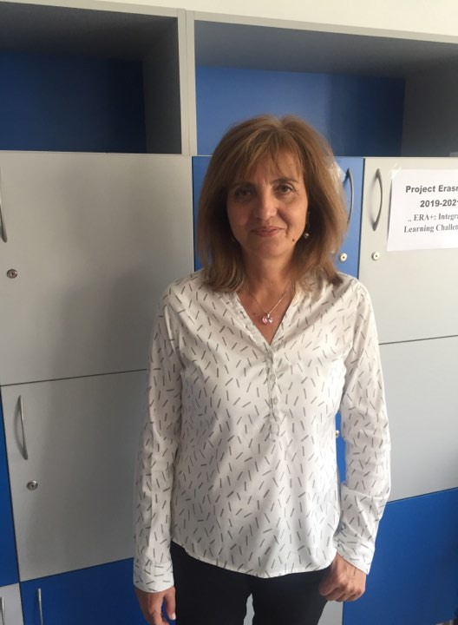
DESISLAVA DIMITROVA
She is a deputy – principal. She’s been teaching English for 14 years. She’s interested in travelling and exploring new cultures.

Slide 4
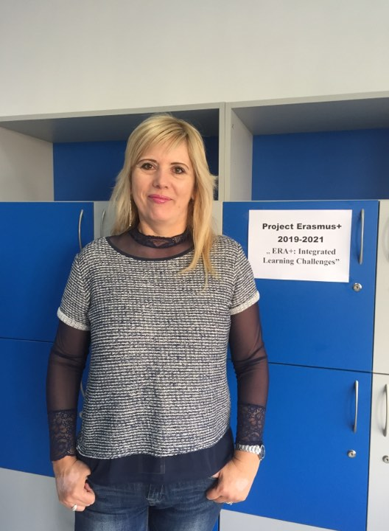
DIANA ANTONOVA
She’s the coordinator of the project. She’s into team working, teaching English and new technology. She’s maintaining our project blog. She’s been working on many international projects. Diana loves her students.

Slide 5
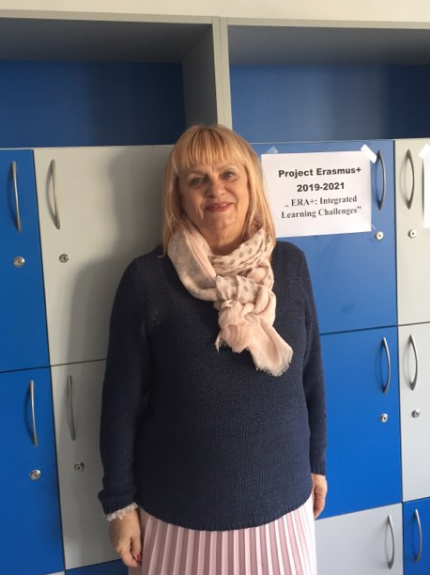
DANIELA VITANOVA
She has been teaching English for 20 years. Daniela is interested in music, languages and she loves Norway.

Slide 6
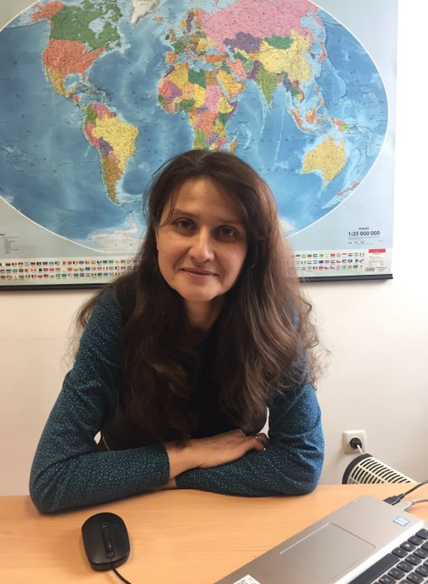
MARIA SHALAMANOVA
She graduated Biology and IT. Maria is a very creative person. She uses innovative approaches and is really into new technology.

Slide 7
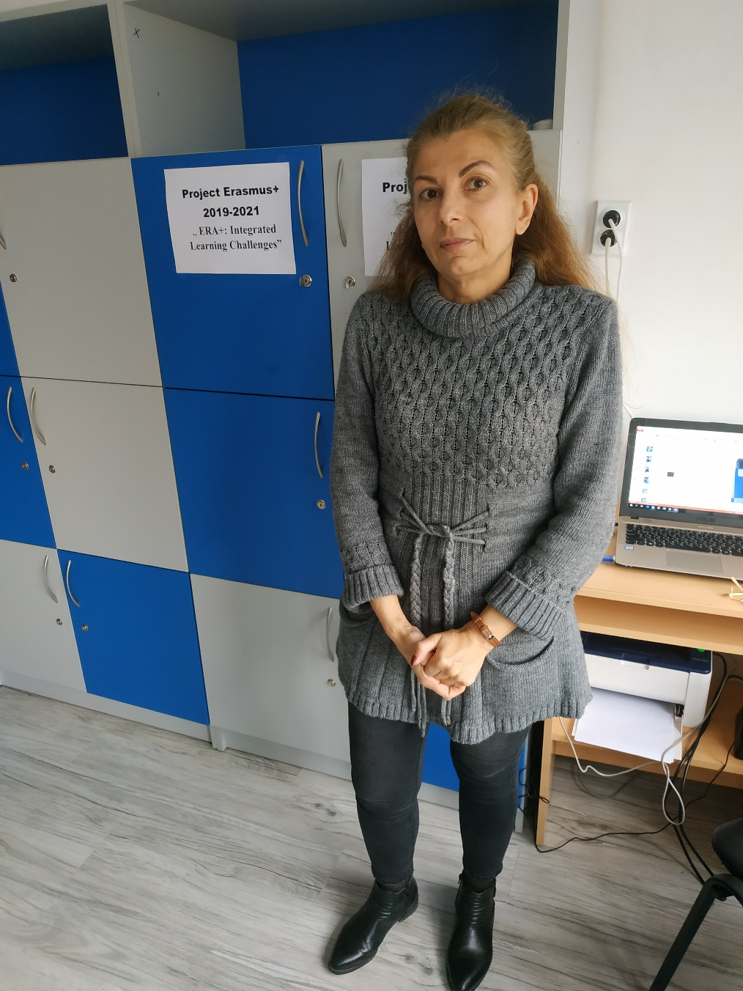
NADIA LILOVA
She is a Spanish and English teacher. She’s been working on three eTwinning projects so far. She’s interested in languages and theatre.

Slide 8
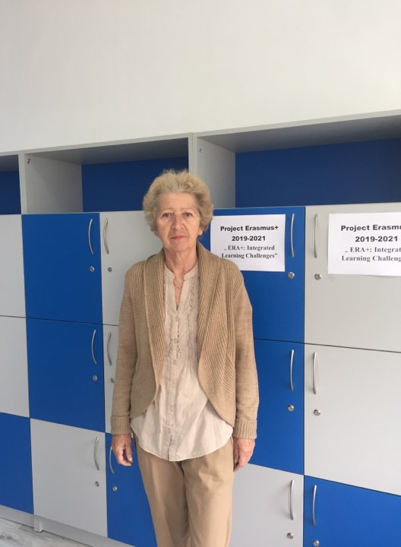
ELI KONSTANTINOVA
She’s a Spanish teacher. Eli has been an interpreter in Cuba for many years.
She loves theatre, books and languages.

Slide 9
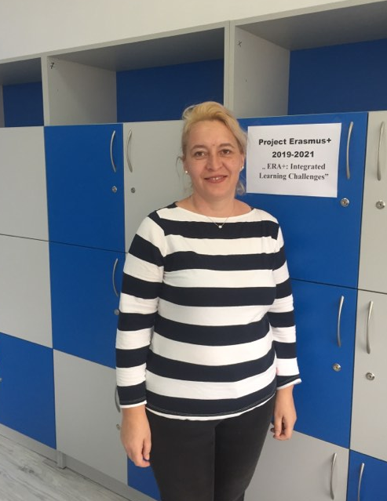
DESISLAVA KRUMOVA
She teaches Russian. She’s very good at handcrafting and cooking. She loves reading and nature.

Slide 10
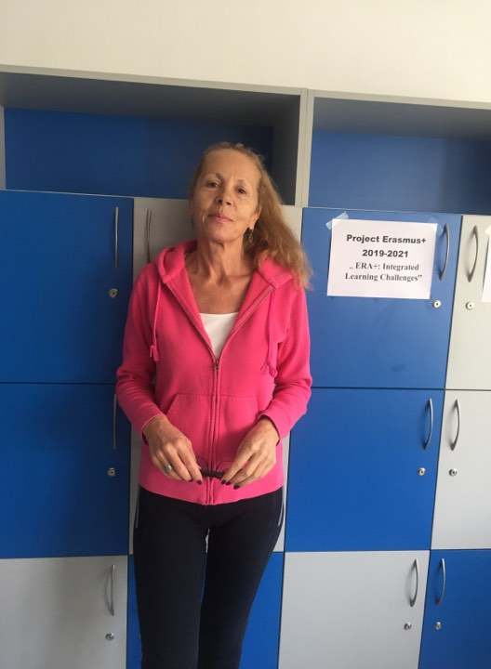
ANNA ALEKSANDROVA
She’s been PE teacher for many years. She loves swimming, volleyball and basketball. She’s good at gardening.

Slide 11
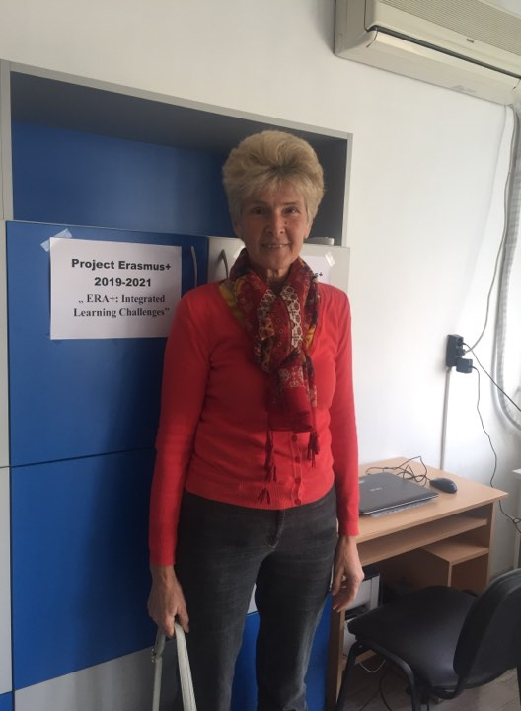
TANIA MIZOVA
She’s an Art teacher, having her own exhibitions.
She loves drawing and travelling.

Slide 12
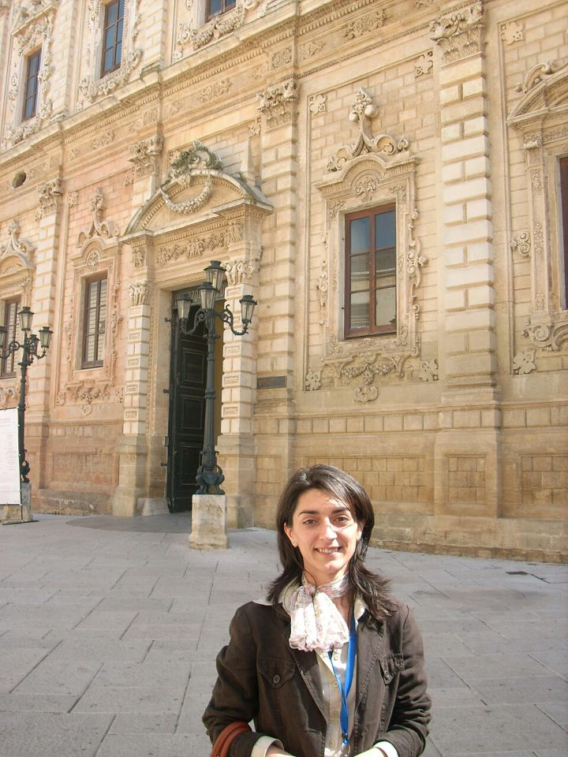
STEFKA STOYANOVA
She’s been teaching Art for many years. She’s a very creative artist. She likes drawing horses and landscapes.

Slide 13
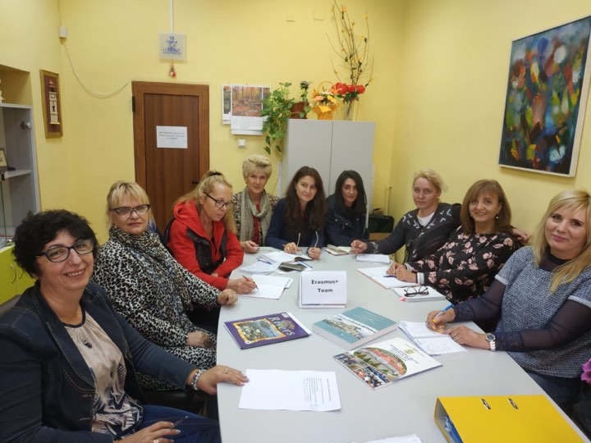

Slide 14
WE ARE HAPPY TO WORK
TOGETHER!

