Slide 1
Bratislava

Slide 2
Information
It is the capital and largest city of Slovakia.
The population of the city is about 475,000.
Bratislava is situated in southwestern Slovakia, within the Bratislava Region. Its location on the borders with Austria and Hungary makes it the only national capital that borders between two countries.

Slide 3
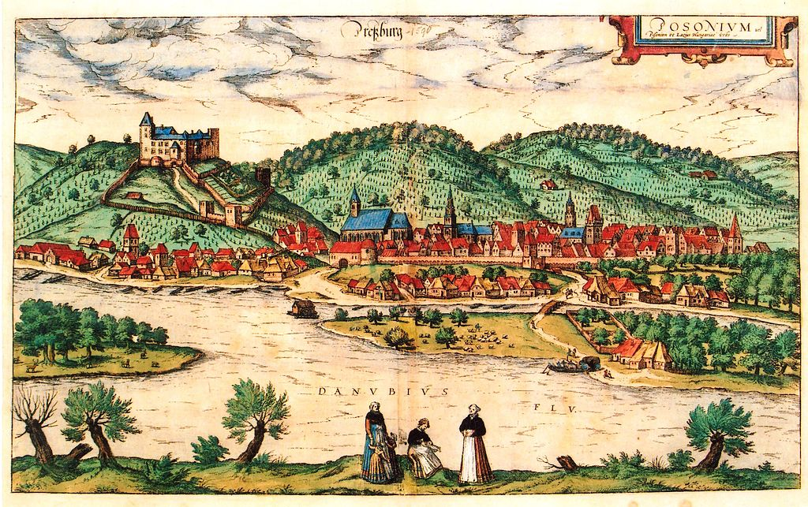
History
The city became a coronation town and the seat of kings, archbishops (1543), the nobility and all major organisations and offices.
Between 1536 and 1830, eleven Hungarian kings and queens were crowned at St. Martin.
The city was designated the new capital of Hungary in 1536, after becoming part of the Habsburg monarchy and marking the beginning of a new era.

Slide 4
Architecture
The cityscape of Bratislava is characterized by medieval towers and grandiose 20th-century buildings, but it underwent profound changes in a construction boom at the start of the 21st century.
Most historical buildings are concentrated in the Old Town. Bratislava's Town Hall is a complex of three buildings erected in the 14th–15th centuries and now hosts the Bratislava City Museum. Michael's Gate is the only gate that has been preserved from the medieval fortifications, and it ranks among the oldest of the town's buildings

Slide 5
Castles
One of the most prominent structures in the city is Bratislava Castle, situated on a plateau 85 metres above the Danube.
The castle hill site has been inhabited since the transitional period between the Stone and Bronze ages] and has been the acropolis of a Celtic town, part of the Roman limes Romanus, a huge Slavic fortified settlement, and a political, military and religious centre for Great Moravia.

Slide 6
Devin
The ruined and recently renovated Devín Castle is in the borough of Devín, on top of a rock where the Morava River, which forms the border between Austria and Slovakia, enters the Danube. It is one of the most important Slovak archaeological sites and contains a museum dedicated to its history. Due to its strategic location, Devín Castle was a very important frontier castle of Great Moravia and the early Hungarian state. It was destroyed by Napoleon's troops in 1809.
It is an important symbol of Slovak and Slavic history.

Slide 7
Important Buildings
Bratislava is the seat of the Slovak National Theatre, housed in two buildings.
The first is a Neo-Renaissance theatre building situated in the Old Town at the end of Hviezdoslav Square.
The new building, opened to the public in 2007, is on the riverfront.The theatre has three ensembles: opera, ballet and drama. Smaller theatres include the Bratislava Puppet Theatre, the Astorka Korzo '90 theatre, the Arena Theatre, L+S Studio, and the Naive Theatre of Radošina.

Slide 8
Transport
Bratislava's M. R. Štefánik Airport is the main international airport in Slovakia.
The airport is located 9 kilometres north-east of the city centre.
It serves civil and governmental, scheduled and unscheduled domestic and international flights.
The current runways support the landing for all common types of aircraft.
It served 2,024,000 passengers in 2007.

Slide 9
Sport
Football is currently represented by the only club playing in the top Slovak football league, the Fortuna Liga.
ŠK Slovan Bratislava, founded in 1919, has its home ground at the Tehelné pole stadium.
ŠK Slovan is the most successful football club in Slovak history, being the only club from the former Czechoslovakia to win the European football competition the Cup Winners' Cup, in 1969.
Bratislava is home to three winter sports arenas: Ondrej Nepela Winter Sports Stadium, V. Dzurilla Winter Sports Stadium, and Dúbravka Winter Sports Stadium.
The HC Slovan Bratislava ice hockey team has represented Bratislava from the 2012–13 season in the Kontinental Hockey League.
Slovnaft Arena, a part of Ondrej Nepela Winter Sports Stadium, is home to HC Slovan. The Ice Hockey World Championships in 1959 and 1992 were played in Bratislava, and the 2011 World Championship were held in Bratislava and Košice, for which a new arena was built.
The city also played host to the World Championship in 2019.

Slide 10
Football stadium Tehelné pole Hockey stadium Ondreja Nepelu

Slide 11
Thank you for your attention

Slide 12
Presentation was made by:
Simon Horváth Nicol Bezdeková
Šimon Gajdoš Rebeka Kirthová
Štefan Nemčanský Nikolas Lojka
Ľuboš Prokeš Filip Blanár
Martin Belian
Dalibor Sečkár
Zakhar Karasov
Peter Kadáš

