Slide 1
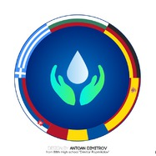
Water as a habitat for people
Creciunescu Andra & Spoiala Teodora
The National Military High School “Stefan cel Mare”

Slide 2
Content
What is a habitat?
Types of habitats
Types of aquatic habitats
Fun facts
Underwater habitats
Temporary living on water
Perks of living near water
Living on an island

Slide 3
What is a habitat?
A habitat is the place which provides suitable conditions such as food, protection and shelter for anyone who lives in it.

Slide 4
Types of habitats
Forests
Grasslands
Deserts
Mountains and polar regions
Aquatic

Slide 5
Types of aquatic habitats
Aquatic habitats divide in two main categories:
Freshwater habitats, which have a very low level of salt water (less than 1%), are:
Lakes
Rivers
Lagoons
Marine habitats, whose salt concentration is more than 1%, are:
Oceans
Seas
Coral reefs

Slide 6
Fresh water habitat

Slide 7
Marine habitat

Slide 8
Fun Facts
Can you believe that people can actually live under water?
Well, if not, you and us from yesterday have something in common.
Pay attention, and if you are still skeptical, you’re about to have a change of heart
Have you ever imagined there are people who have fallen in love so hard with water that they refuse to step foot on land?
Well, they do exist, so stay tuned!

Slide 9
Underwater living
Underwater habitats are places where people can live for extended periods of time. They can work, rest, eat, sleep etc.
How is this viable?
The trick is that it is not exclusively underwater, but it includes a significant component to make it possible.

Slide 11
World record living underwater
Tour of the underwater habitat

Slide 12
Temporary living on water
This people are true mariners, yacht owners, fishermen or simply travelers, having the passion for water in their blood
5 psichological reasons why humans love water
No matter if they work or travel, their heart will forever belong to the sea, maybe in the search of the lost angelic songs of mermaids

Slide 13
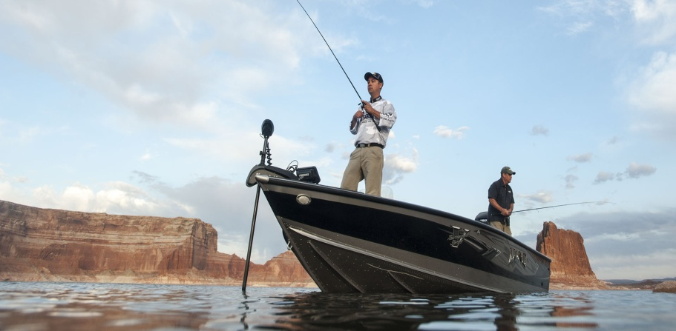

Slide 14
Perks of living near water
Water makes industry possible
Water is an asset for local businesses
Local water sustains life
Water means beaches
You can’t beat that natural beauty
Watersports

Slide 15
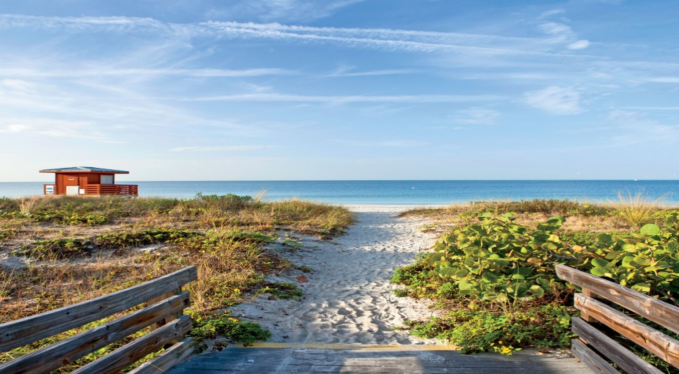
Living on an island
As the majority of us live on lands with no direct resource of water and we are used to it, so are the inhabitants of islands. They connect any little thing they do with the ocean, forming an unbreakable bond with it because the ocean cures everything.

Slide 16
Daily activities
FOOD
On an island you don’t need McDonald’s as much as you would think, since one of the main cuisine is fish, not to mention the exotic fruits.
JOBS
Most of the islands we know are tropical ones, so it should come as no surprise that the main economical activity there is tourism, notwithstanding the fisherman position.

Slide 18
Sundays are indeed a day of rest

Slide 19
Bibliography
https://www.youtube.com/
https://www.wikipedia.org/
http://beachboxtv.com/
https://www.newsweek.com/
"This project has been funded with support from the European Commission. This publication[communication] reflects the views only of the author, and the Commission cannot be held responsible for any use which may be made of the information contained therein."
2019-1-RO01-KA229-063127

Slide 20
Just Us and the fabric of stars

Slide 21
THANK YOU!!!!

