Slide 1
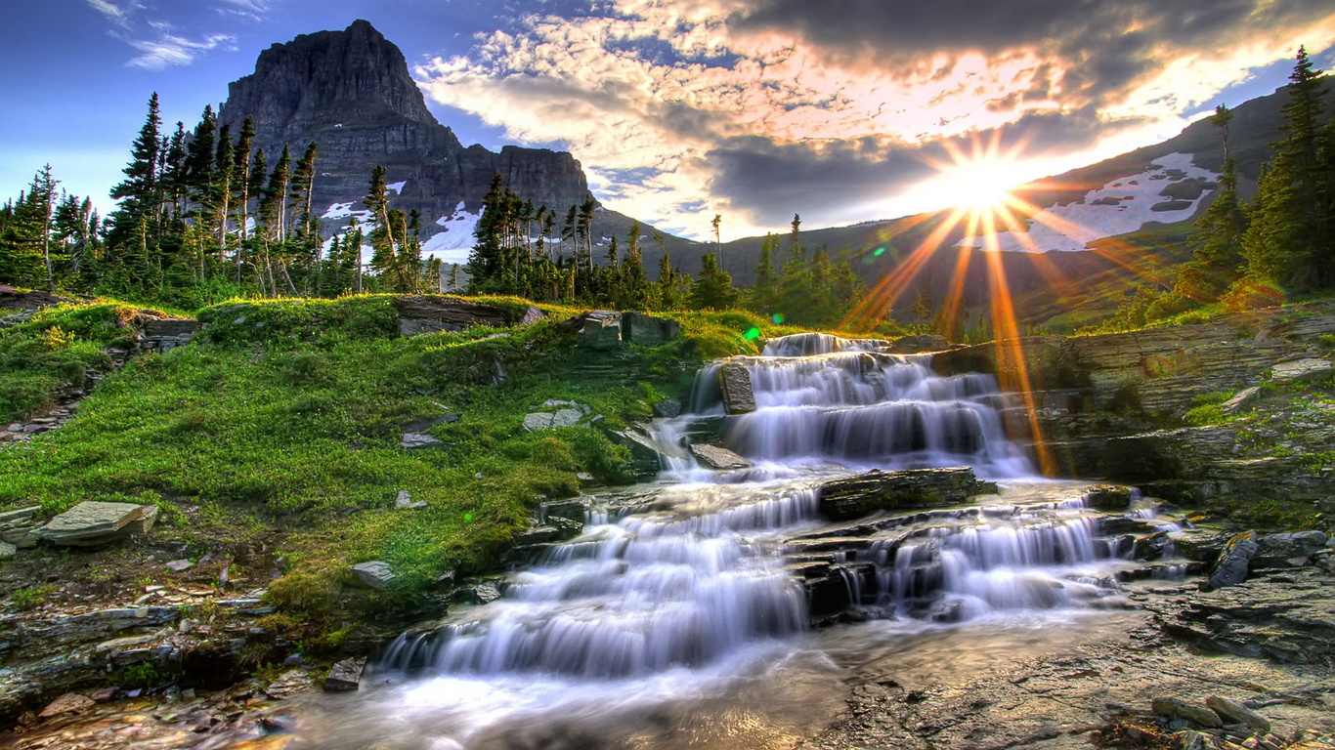
River zonings
Puiu Irina
Găitan Nicolai

Slide 2
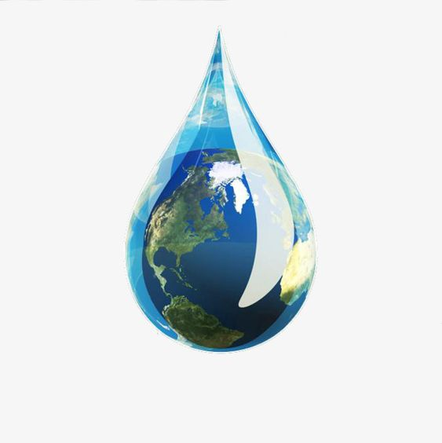
Contents:
What is an ecosystem?
What are Lotic Ecosystems?
River Ecosystems
River zones
River corridor
Animals and plants living in freshwater

Slide 3
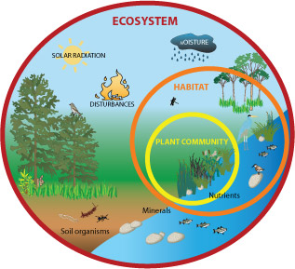
What is an ecosystem?
An ecosystem is the sum of interactions between plants, animals and microorganisms and between them and non-living physical and chemical components in a particular natural environment.

Slide 4
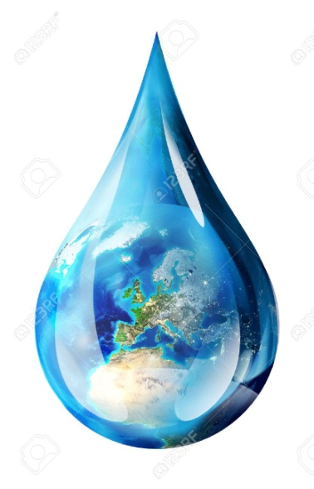
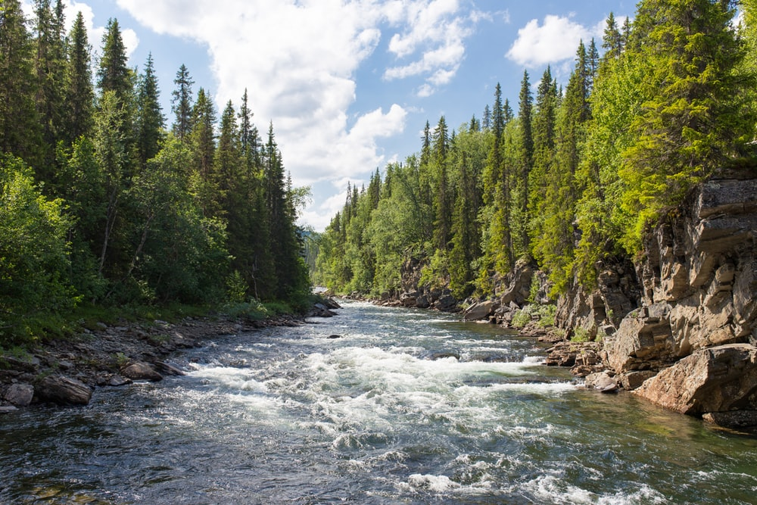
What are Lotic Ecosystems?
Lotic ecosystmes include all flowing inland bodies such as creeks, rivers, streams and so on. The ecology of flowing water is very unique in many ways and often shaped by the nature and behavior of the flowing water.

Slide 5
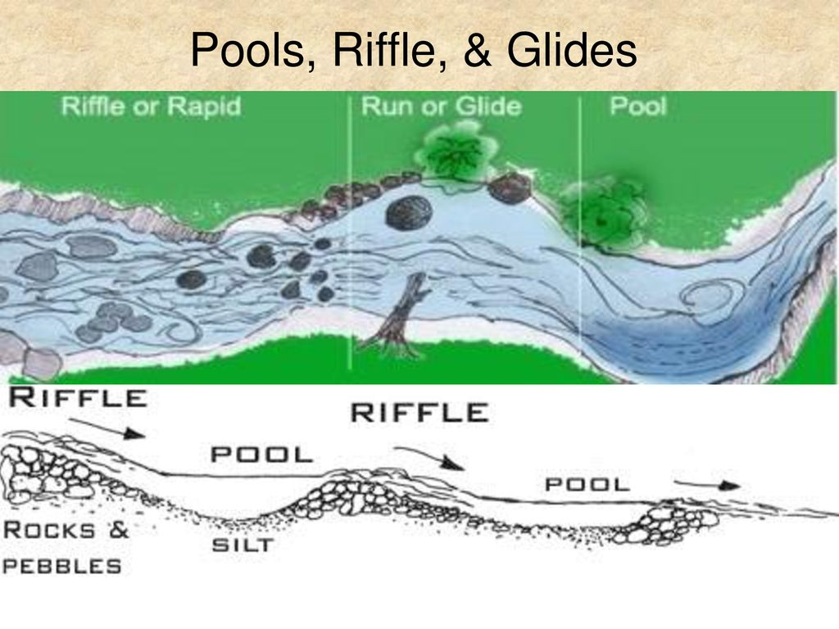
Lotic ecosystems have two main zones, rapids and pools. Rapids are the areas where the water is fast enough to keep the bottom clear of materials, while pools are deeper areas of water where the currents are slower and silt builds up.

Slide 7
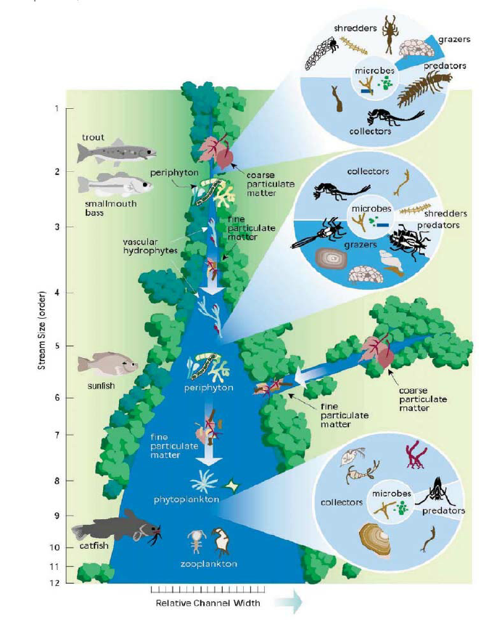
River Ecosystems
River ecosystems are part of larger watershed networks or catchments, where smaller headwater streams drain into mid-size streams, which progressively drain into larger river networks.
River ecosystems are prime examples of lotic ecosystems.

Slide 8
Unifying characteristics of running water
Flow is unidirectional.
There is a state of continuous physical change.
There is a high degree of spatial and temporal heterogeneity at all scales.
Variability between lotic systems is quite high.
The biota is specialized to live with flow conditions.

Slide 9
The adaptation of living organisms to this ecosystem
Organisms in these waters have suckers and hooks that help them stick to the water-bed, rocks or plants.
Some of them also have a streamlined body that help them swim against water currents.
Plants such as diatoms, moss, and sponges attach themselves firmly with the substratum.

Slide 10
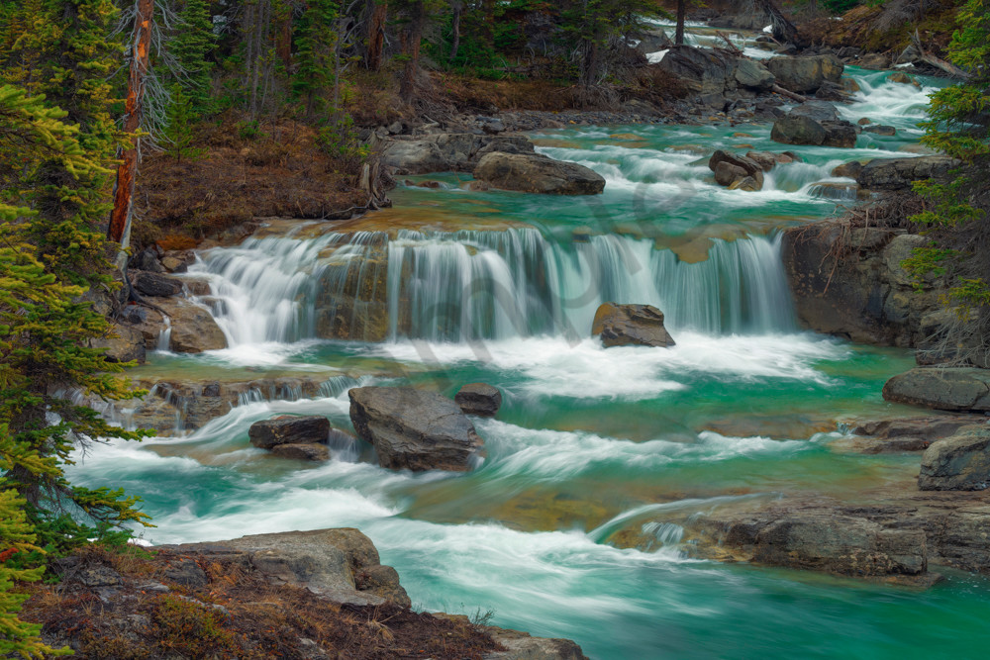
1. Water flow
Factors that make river ecosystems different:
Water flow is the main factor that makes river ecology different from other water ecosystems.

Slide 11
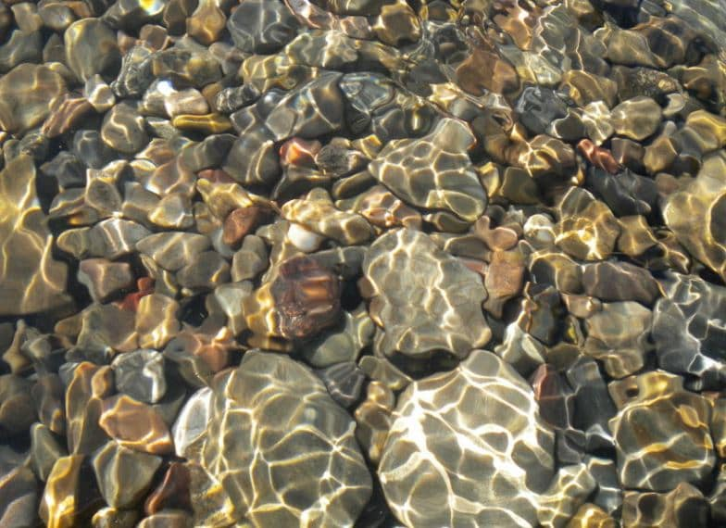
2. Substrate
The substrate is the surface on which the river organisms live. It may be inorganic, consisting of geological material from the catchment area such as boulders, pebbles, gravel, sand or silt, or it may be organic, including fine particles, leaves, wood, moss and plants.

Slide 12
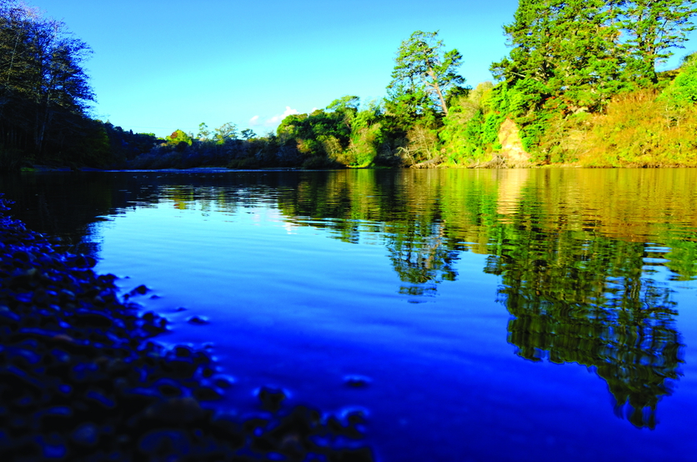
3. Light
Light provides energy for photosynthesis, which produces the primary food source for the river. It also provides refuges for prey species in the shadows it casts.

Slide 13
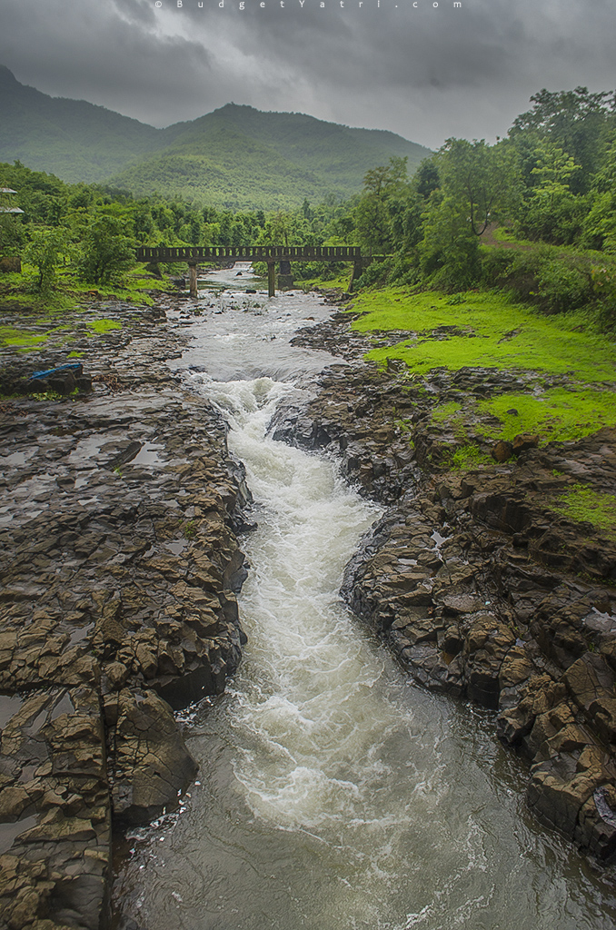
River zones
All rivers, regardless of their type, have the same stages of structural changes from source to delta. The profile of every river can be divided into three zones: source zone (headwaters), transfer zone and deposition zone.

Slide 14
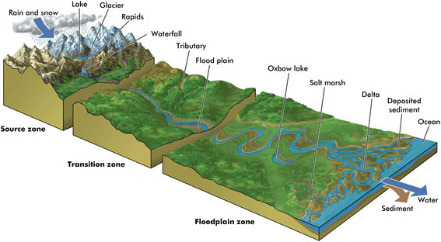

Slide 15
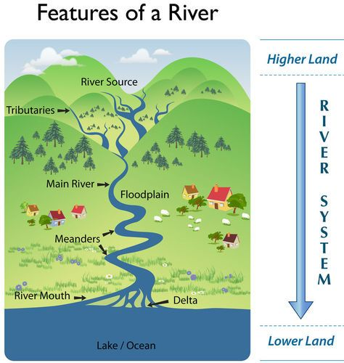
Source zone
Source zone (headwaters) are mountain streams that slope rapidly downhill and form V-shaped river valleys, often forming waterfalls. These rapids shape and carry large- size sediments downstream.
Headwater areas are the upstream areas of a watershed, as opposed to the outflow or discharge of a watershed

Slide 16
Transfer zone
Transfer zone is characterized by a lower altitude. The flow velocity is slower, the river bed becomes wider, and meanders form. Some of the larger sediments settle at the interim area between the source zone and the transfer zone, thus forming the so-called sediment cones. Other sediments are carried further downstream. Erosion and deposition processes are in equilibrium in the transfer zone.

Slide 17
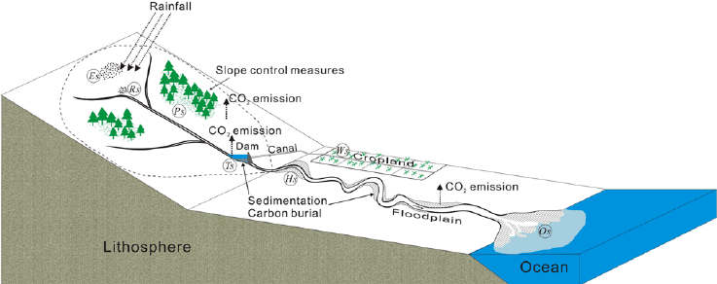
Deposition zone
Deposition zone is of rather low slope; flow velocities are slow, forming wide meanders. Most of the sediments, including the finest ones, settle in this area. The river mouth often opens into a wide delta bottomed by fine sediments, and the river splits into many arms.

Slide 18
Different stages of the Long river profile
Stages that a river goes through from its source to its mouth

Slide 19
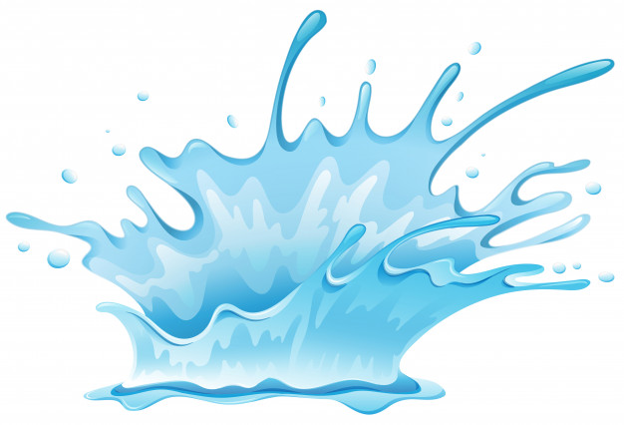
River corridor
"River Corridor" means the land area adjacent to a river that is required to accommodate the dimensions, slope, planform, and buffer of the naturally stable channel and that is necessary for the natural maintenance of a dynamic equilibrium condition.

Slide 21
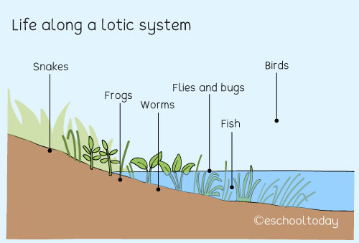
Living in fast-flowing water
Fast-flowing water causes problems for freshwater life. Drifting plankton cannot survive, which means that there is little food. Despite this, some small animals cling to the rocks or stream beds, providing prey for other animals. Fish such as salmon deliberately swim upstream to breed in these waters, partly because there are fewer predators.

Slide 22
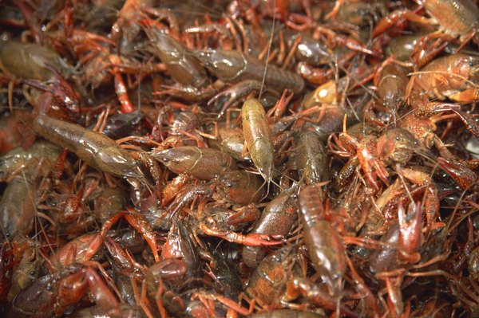
Plants and animals that live in rivers
Freshwater plants - Three types of plants usually live in rivers and streams: algae, mosses and submerged plants.
Invertebrates - Animals that do not possess a backbone are known as invertebrates. These include all types of crustaceans, worms, snails and insects.

Slide 23
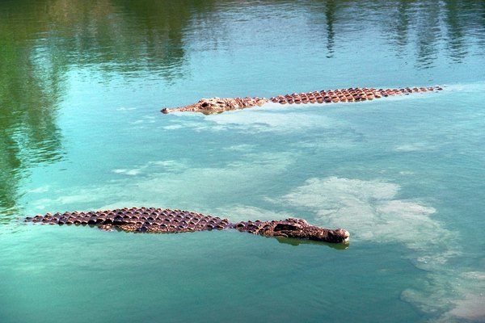
Other animals - Alligators and crocodiles often call rivers and streams home with crocodiles tending to stay toward the mouth of the river, which is more brackish.

Slide 24
Citations:
https://sciencing.com/plants-animals-that-live-in-rivers-streams-13427954.html
https://www.sciencelearn.org.nz/resources/439-river-ecosystems
https://en.wikipedia.org/wiki/River_source
https://en.wikipedia.org/wiki/River_ecosystem?fbclid=IwAR1H_DLjFkT-LiDJ-4ltVERzMujlSbNe646LQtd6_aUazQBV5EyQa-XgPOs
http://eschooltoday.com/science/aquatic-ecosystems/what-is-lotic-ecosystem.html?fbclid=IwAR0pGkk8BisjYlev-c095FVmvFWrImtkF_gqQ4mygkGuP0gFT7c6EXF-jlE
https://sciencing.com/lentic-lotic-ecosystems-7355077.html
http://awsassets.panda.org/downloads/riverecology_eng_bt13dec.pdf
https://floodready.vermont.gov/flood_protection/river_corridors_floodplains/river_corridors
https://www.youtube.com/watch?v=8JM71mcw_LI

