Slide 1
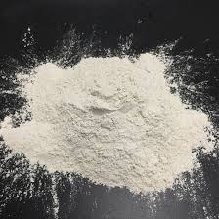
Lime in water
Project made by: Manta Bianca
Pilipăuţanu Tudor

Slide 2
Contents
Lime
Hydrated lime
Bordeaux juice
Water Treatment

Slide 3
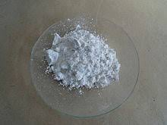
Lime (calcium oxide)
Calcium oxide (lime, burnt lime) comes in the form of a white powder which reacts energetically with water, effervescent with heat release to form calcium hydroxide (lime extinguished).
Calcium oxide is obtained by thermal treatment (burning) at 800º C of the limestone (calcium carbonate) with carbon dioxide release:
CaCO3→CaO+CO2

Slide 4
Hydrated lime
So, lime is used in the treatment of drinking water, as a cheap and widely available alkali. About 50% of the total quicklime production is converted to calcium hydroxide before use.
The reaction is the following:
CaO+H₂O→Ca(OH)₂(hydrated lime)+Q(energy)
As it hydrates, an exothermic reaction results and the solid puffs up. One liter of water combines with approximately 3.1 kilograms of quick lime to give calcium hydroxide plus 3.54 MJ of energy.
To simplify, hydrated lime is the result of adding water to powdered quicklime, putting it in a kiln or oven, and then pulverizing it with water.

Slide 5
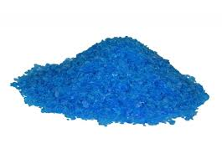
Bordeaux juice
Bordeaux juice (fr. bouillie bordelaise) is a pesticide (algicide and fungicide) made by neutralizing a solution of copper sulphate with lime, in a proportion of 1:1:100 (1 kg of copper sulphate, 1 kg of lime and 100kg of water).
Uses:
Bordeaux juice is used to protect fruit trees (peaches, apricots, plums, apples) and
vines, before flowering and after harvest. In olive growing (olive cultivation), copper is used against peacock eyes and sometimes against bacteria. Bordeaux juice is also used to protect potatoes, tomatoes, strawberries.

Slide 6
Lime in Water Treatment
Lime is used by many municipalities to improve water quality.
Uses:
Water Softening
pH Adjustment/Coagulation
Effect on Pathogen Growth
Removal of Impurities

Slide 7
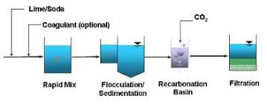
Water Softening
Softening - In water softening, hydrated lime is used to remove carbonate "hardness" from the water. Hardness caused by other calcium and magnesium salts, called noncarbonate hardness, is generally treated by means of the lime-soda process, which entails the precipitation of magnesium by lime. The co-produced calcium salt reacts with the soda ash to form a calcium-carbonate precipitate. Lime-enhanced softening can also be used to remove arsenic from water. Stricter drinking water regulations for arsenic have increased the need for this treatment.

Slide 8
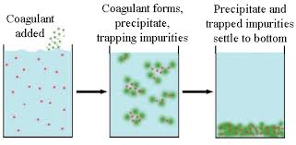
pH Adjustment/Coagulation
pH Adjustment/Coagulation - Hydrated lime is widely used to adjust the pH of water to prepare it for further treatment. Lime is also used to combat "red water" by neutralizing the acid water, thereby reducing corrosion of pipes and mains from acid waters. The corrosive waters contain excessive amounts of carbon dioxide. Lime precipitates the CO₂ to form calcium carbonate, which provides a protective coating on the inside of water mains.

Slide 9
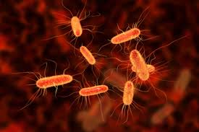
Effect on Pathogen Growth
Effect on Pathogen Growth - By raising the pH of water to 10.5-11 through the addition of lime and retaining the water in contact with lime for 24-72 hours, lime controls the environment required for the growth of bacteria and certain viruses. This application of lime is utilized where "phenolic water" exists, because chlorine treatment tends to produce unpalatable water due to the presence of phenol. This process, called 'excess alkalinity treatment', also removes most heavy metals.

Slide 10
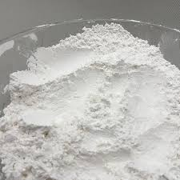
Removal of Impurities
Removal of Impurities - One of the most common methods of removing silica from water involves the use of dolomitic lime. The magnesium component of this lime is the active constituent in silica removal. Lime is also used to remove manganese, fluoride, organic tannins and iron from water supplies.
→Dolomite (MgCO₃*CaCO₃)

Slide 11
Bibliography
https://en.wikipedia.org/wiki/Lime_softening
https://en.wikipedia.org/wiki/Calcium_oxide
https://en.wikipedia.org/wiki/Calcification
https://water-research.net/index.php/water-treatment/tools/hard-water-hardness
https://www.graymont.com/en/markets/environmental/water-treatment
https://fr.wikipedia.org/wiki/Bouillie_bordelaise

Slide 12
Thank you!
"This project has been funded with support from the European Commission. This publication[communication] reflects the views only of the author, and the Commission cannot be held responsible for any use which may be made of the information contained therein."
2019-1-RO01-KA229-063127

