Slide 1
Pollution of water by agriculture.

Slide 2
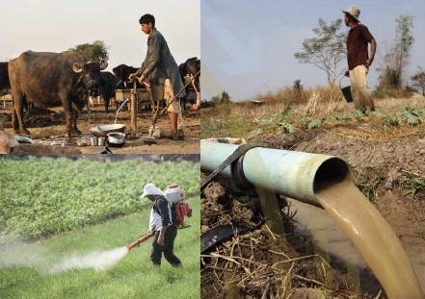
Water pollution
Water pollution is a global challenge that has increased in both developed and developing countries, undermining economic growth as well as the physical and environmental health of billions of people.

Slide 3
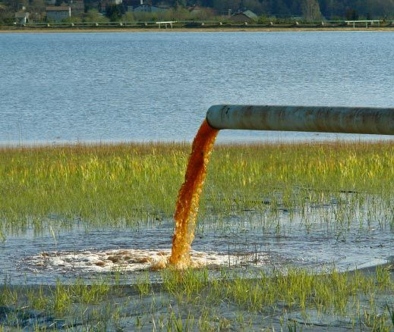
Water pollution
Human settlements, industries and agriculture are the major sources of water pollution. Globally, 80 percent of municipal wastewater is discharged into water bodies untreated, and industry is responsible for dumping millions of tonnes of heavy metals, solvents, toxic sludge and other wastes into water bodies each year.

Slide 4
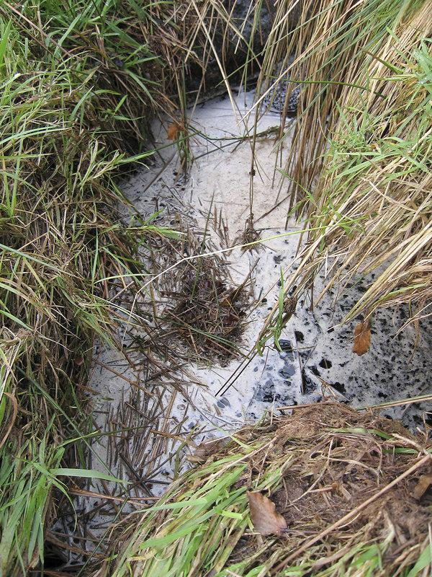
Water pollution from agriculture
Farming also damages aquatic ecosystems and riverbeds. The impact of agriculture on surface and groundwater can be reduced by taking appropriate measures to reduce diffuse pollution
Water pollution from agriculture has associated costs in terms of removing pollutants from drinking water supplies, as well as damage to ecosystems and commercial fishing, recreational, and cultural values associated with rivers, lakes, groundwater and marine waters.

Slide 5
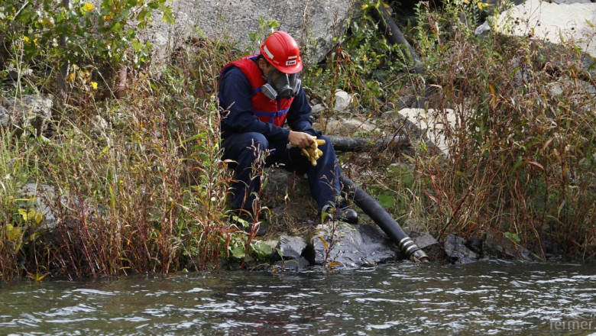
Farmers need to be aware of the damage to chemical fertilizers and the poisoning of water, which continues to take a threatening toll on our country. Hazardous levels of nitrogen deposits and nitrates in drinking water can persist for decades.

Slide 6
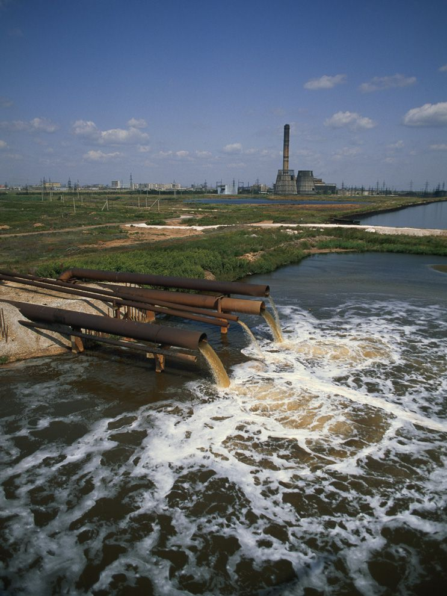
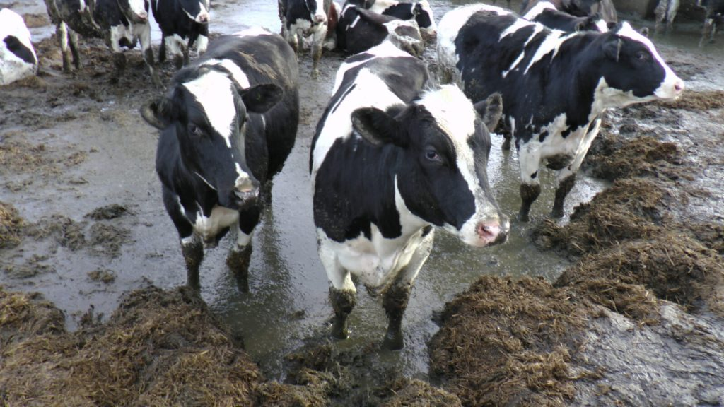
For 80 years, nitrogen fertilizers used to cultivate agricultural fields have been polluting the soil, rivers and lakes. Fertilizers are seeped into drinking water sources, and a number of deaths are reported annually in Bulgaria for cows, sheep and other animals that have drank from contaminated water and fertilizers.

Slide 7
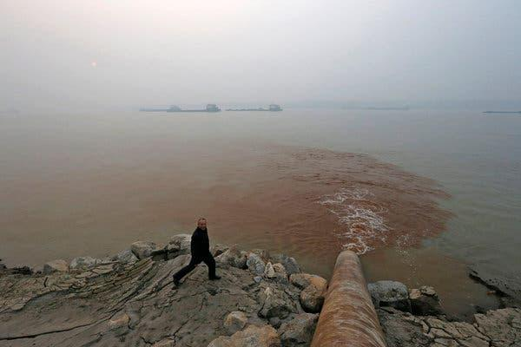
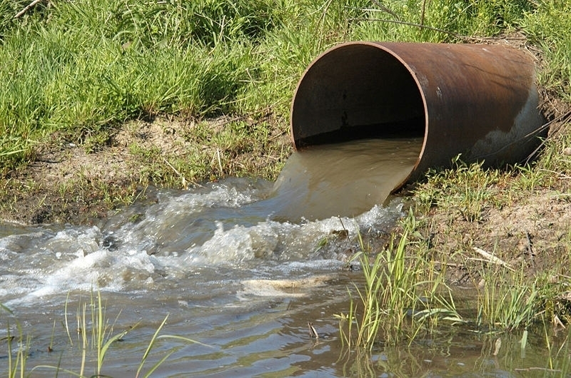
Even if farmers stop using nitrogen fertilizers and nitrates today, increased concentrations will remain in rivers and lakes for decades to come.
Researchers have found that nitrogen builds up steadily in soil, thus creating a long-term source of pollution with groundwater and surface water.

Slide 8
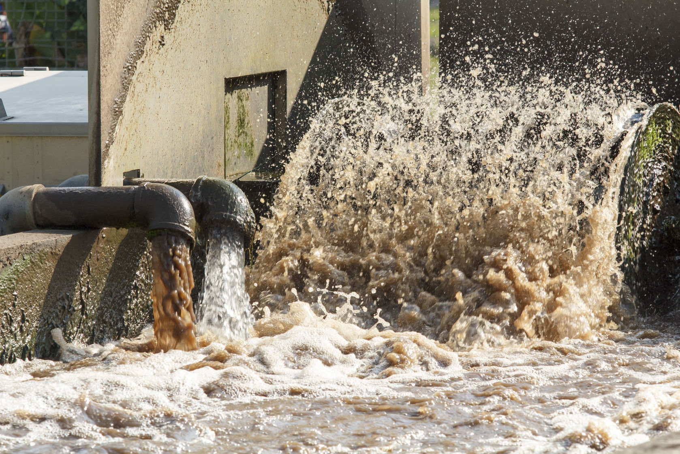
If adequately treated and safely applied, however, wastewater can be a valuable source of both water and nutrients and thereby contribute to food security and livelihood improvement.

Slide 9
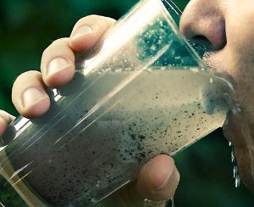
Too much nitrogen causes a lack of oxygen in the water
Unfortunately, when too much nitrogen is added to the fertilizer, the excess enters the waterways, causing oxygen deficiency and impairs soil quality as well as drinking water.

Slide 10
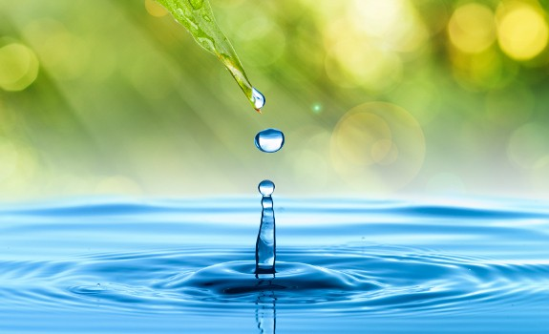
Conserve and preserve. We don’t have much reserve.
Made by Polina and Zornitza

