Slide 1
WATER POLLUTION BY AGRICULTURE (NITRATES)
Project by - Huțuleac Andreea
&
Forminte Andreea
The National Military High School
“Ștefan cel Mare”

Slide 2
CONTENTS
Pollution
Water pollution
Pollution in the UE
Nitrates
Causes
Effects
Solutions
Video
Bibliography

Slide 3
POLLUTION
Pollution contaminates the environment with materials that interfere with human health, quality of life.
Pollution is a big problem countries face all over the world.
There are different forms of pollution:
Air pollution;
Water pollution;
Noise pollution.

Slide 4
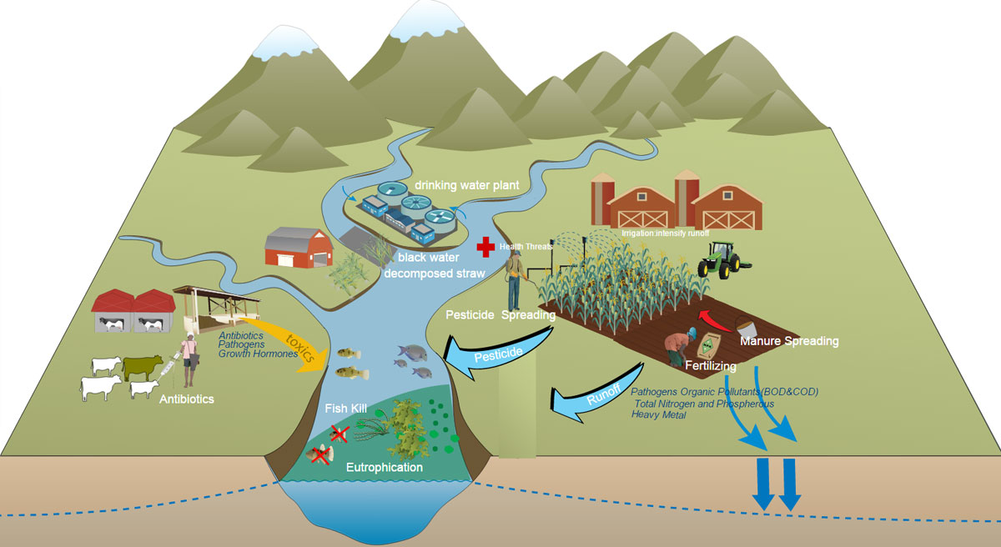

Slide 5
WATER POLLUTION
Water pollution is the introduction into fresh or ocean waters of chemical, physical, or biological material that degrades the quality of the water and affects the organisms living in it.

Slide 6
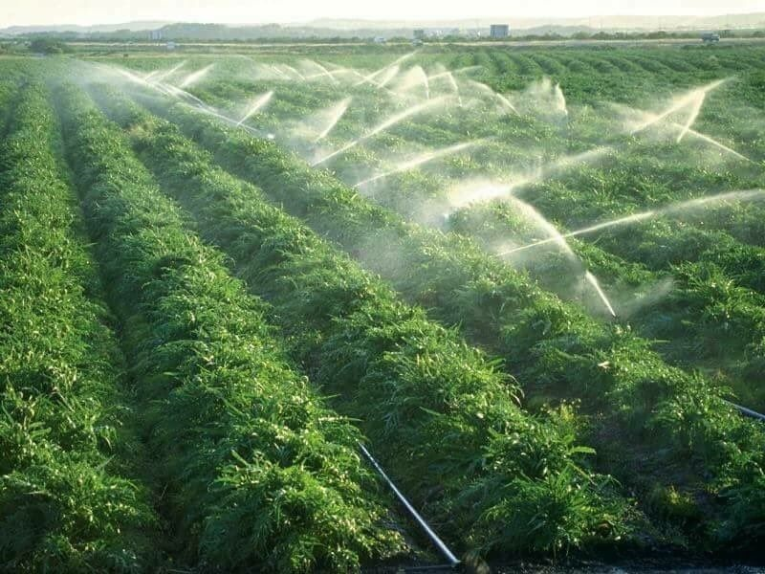
Modern agriculture is responsible for the evacuation of large quantities of agro chemical, organic matter and sediment.
This pollution poses demonstrated risks to aquatic ecosystems, human health and productive activities. For example, high levels of nitrates in water can cause “blue baby syndrome”, a potentially fatal illness in infants.

Slide 7
The greatest concern for human health are pathogens derived from animals, pesticides, nitrates from groundwater, urban metallic elements and emerging pollutants, including antibiotics and antibiotic-resistant genes from excrement Livestock.
One of the biggest problems of water pollution is created by agricultural nitrates.

Slide 8
NITRATES
Nitrates from agriculture are one of the biggest problems for water pollution.
The application of nitrate fertilizers in quantities higher than those that can be used by plants will lead to a high level of nitrates. Nitrates can penetrate the body through ingested foods as well as through drinking water.
Nitrates are very soluble, dissolve easily in water and are very hard to remove.

Slide 9
The nitrate from farming is the most common chemical contaminant found in groundwater aquifers.

Slide 10
POLLUTION IN THE UE
According to a European Commission report published in 2010, the level of pollution with nitrates of EU waters decreases.
A number of regions remain with an alarming level of nitrates concentration. It is the groundwater of certain parts of Estonia, southeastern Holland, Belgium, Great Britain, northern Italy, northeastern Spain, southeastern Slovakia, southern Romania, Malta and Cyprus.

Slide 12
Cause
Pesticides and fertilizers used in agriculture can contaminate both groundwater and surface water, as can organic livestock wastes, antibiotics, silage effluents, and processing wastes from plantation crops.

Slide 13
EFFECTS
pesticide runoff and contamination of surface water and fish;
erosion and sedimentation problems. Release of pesticides (e.g. TBT1) and high levels of nutrients to surface water and groundwater through feed and faeces, leading to serious eutrophication.

Slide 14
SOLUTIONS
To solve the problem of pollution, we should care for our environment and protect it.
Water is another vital source of life. We should save it from pollution because we drink it and other sea creatures live in it.
If we don’t save our environment, our planet will be destroyed.

Slide 16
Agricultural Pollution
The Destruction of Our Rivers

Slide 17
BIBLIOGRAPHY
www.pinterest.com
www.usamvcluj.ro
https://www.cotidianulagricol.ro/poluantii-din-agricultura-reprezinta-o-amenintare-grava-la-adresa-apei-din-lume/
https://www.icpa.ro/documente/coduri/vol2.pdf
https://www.agro.basf.ro/ro/sustenabilitate/gestionarea-apei/puncte-sursa-de-poluare-a-apelor-cu-pesticide/
https://www.youtube.com/watch?v=WRIysSpg2Zs
"This project has been funded with support from the European Commission. This publication[communication] reflects the views only of the author, and the Commission cannot be held responsible for any use which may be made of the information contained therein."
2019-1-RO01-KA229-063127

