Slide 1
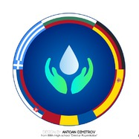
Types of water in our country
Students
Opincă Larisa
Rotari Alexandru
The National Military High School “Stefan cel Mare”

Slide 2
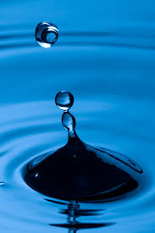
Water
Water is an inorganic, transparent, tasteless, odorless, and nearly colorless chemical substance, which is the main constituent of Earth's hydrosphere, and the fluids of most living organisms.
It is vital for all known forms of life, even though it provides no calories or organic nutrients.

Slide 3
Types of water
In Romania are a lot of types of water witch can be classified from the point of view of flow regime. So, can be the temporary flowing water , the permanent flowing water, standing water and ground water.

Slide 4
Types of water
The temporary flowing water
The temporary flowing water is also called torrent is a temporary and powerful water course, with an unstable flow that appears after the big rains or after the sudden melting of the snow.
A particular category of torrents are muddy torrents, represented by rapid lakes, with the speed witch is between 1 and 15 meters per second, of masses of mud and grevel, in which the volume of solids is higher than the volume of the water

Slide 5
The permanent flowing water
The permanent flowing water is divided into rivers and streams. These fall into fresh water category.

Slide 6
Rivers
The rivers were formed by the union of several streams, which flow naturally downstream, under the effect of gravity.
The river network comprises 78,905 km.
In Romania there are 3500 rivers

Slide 7
The Danube
The most important river from Romania is Danube Delta . It is the second largest river delta in Europe, after the Volga Delta, and is the best preserved on the continent.
The greater part of the Danube Delta lies in Romania (Tulcea County), with a small part in Ukraine (Odessa Oblast).

Slide 8
Danube Delta
Area is 4,152 km² (1,603 sq mi), of which 3,446 km² (1,331 square miles) is in Romania.
With the lagoons of Razim Sinoe (1,015 km² ) with 865 km² (334 sq mi) water surface, located south of the main delta, the total area of the Danube Delta is 5,165 km² .
The Razim–Sinoe lagoon complex is geologically and ecologically related to the delta proper and the combined territory is listed as a World Heritage Site.

Slide 9
Modern Danube Delta
The modern Danube Delta began to form after 4000 BCE in a bay of the Black Sea, when the sea rose to its present level.
A sandy barrier blocked the Danube bay where the river initially built its delta. Upon filling the bay with sediment, the delta advanced outside this barrier-blocked estuary after 3500 BCE, building several successive lobes: the St. George I, the Sulina, the St. George II and the Chilia or Kilia.

Slide 10
Modern Danube Delta
Much of the alluvium in the delta and major expansion of its surface area in the form of lobes resulted from soil erosion associated with the clearing of forests in the Danube basin during the 1st and 2nd millennium.
Probably 40 percent of the Delta was built in the last 1000 years. Finding that was like a eureka moment.

Slide 11
Modern Danube Delta
At present the delta suffers from a large sediment deficit, after the construction of dams on the Danube and its tributaries in the later half of the 20th century.
The Danube consists of an intricate pattern of marshes, channels, streamlets and lakes.
The average altitude is 0.52 m, with 20% of the territory below sea level, and more than half not exceeding one meter in altitude

Slide 12
The Dunes
The Dunes on the most extensive strand plains of the delta (Letea and Caraorman strand plains) stand higher (12.4 m and 7 m respectively). The largest lakes are lakes Dranov (21.7 km²), Roșu (14.5 km²) and Gorgova (13.8 km²).

Slide 13
The steams
The steams are rivers with a small flow, which can be passed easily
Due to certain special filtration stations, water from rivers and streams becomes potable an increases very easily .

Slide 14
The standing waters
The standing waters can be divided into lakes, marshes and ponds.

Slide 15
Lakes
The lakes from Romania are of more types: natural a and artificial, sweet and salty
There are about 3500 lakes in Romania
Natural lakes: crater lakes (St. Ana), liman lakes (Snagov), glacial lakes (Iezer), carstic lakes (Ochiul Beului)
We can boast with salt water. It has a lot of benefits on body, helping to treat certain diseases.

Slide 16
Lake Ursu.
The best known saltwater lake is the Lake Ursu.
It is at 502 meters altitudine and has an area of 40000 square meters. In some areas the water das a depth of 18 meters and a salinity of 250 grams per liter.

Slide 17
Lake Ursu
It is the largest heliothermal lake in the world.
The heliometry phenomenon means that at the surface of the lake a fresh water insulating layer is formed, keeping the heat in the salt water
It prevents irradiation of the heat in the atmosphere.

Slide 18
Romanian volcanic lakes
Saint Ana Lake is the only volcanic lake from Romania

Slide 19
Saint Ana Lake
It is located at the bottom of the crater of an extinct volcano, called Ciomatu Mare, from the Puciosu volcanic mountain.
The lake completes its water only from precipitation, having no springs.
The purity of the water is close to that of the distilled water, with only 0,0029 milliliters of minerals.
The water level does not increase and never decreases
Two cracks formed near the lake

Slide 20
Groundwater
The groundwater comes from the rainfall that seeps into the earth.
It is differentiated by depth. Some are located at shallow depths on the first impermeable layer and some are located at big depths, between two impermeable layers called captive waters.
The groundwater are mineralized: chlorosodic , sulphurous , carbonated, oligomineral water. Some are thermal or radioactive waters such as Baile Felix.

Slide 21
Băile Felix

Slide 22
Tourist attractions
The resorts host many mineral springs with thermal (20-48°C), sulfuric, calcic, sodic, rich in bicarbonate waters known since the beginning of the millennium.
The soothing effect of the waters on articular and muscular pain and on various rheumatic neuralgias accounts for the fame of cures in the resort for the treatment of inflammatory rheumatic diseases (rheumatic polyarthritis, rheumatoid spondylitis, conditions after acute articular rheumatism), degenerative and articular rheumatic diseases, central and peripheral neurological disorders, post-traumatic conditions, endocrine disorders.

Slide 23
Thermal water
The facilities of the two resorts offer treatment of rheumatism and neurological. The modern medical base has at its disposal various facilities for procedures involving electrotherapy, hydrotherapy, aerosols, massage, paraffin packing and other water treatments.

Slide 24
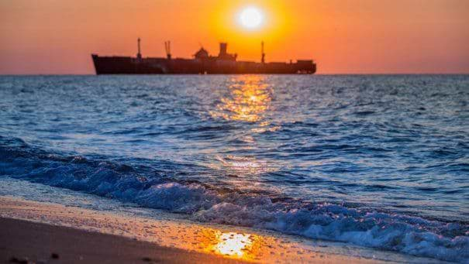
The Black Sea
The salt water from the upper layers has a small salinity of only 17 per thousand, due to the discharge of the rivers in it with approximately 600 square kilometers of the fresh water.

Slide 25
Bibliography
The magazine EduSoft
The guidebook Apenim
The water atlas of Romania
The school atlas –Octavian Mândruț
The Romania geography –Octavian Mândruț
"This project has been funded with support from the European Commission. This publication[communication] reflects the views only of the author, and the Commission cannot be held responsible for any use which may be made of the information contained therein."
2019-1-RO01-KA229-063127

