Slide 1
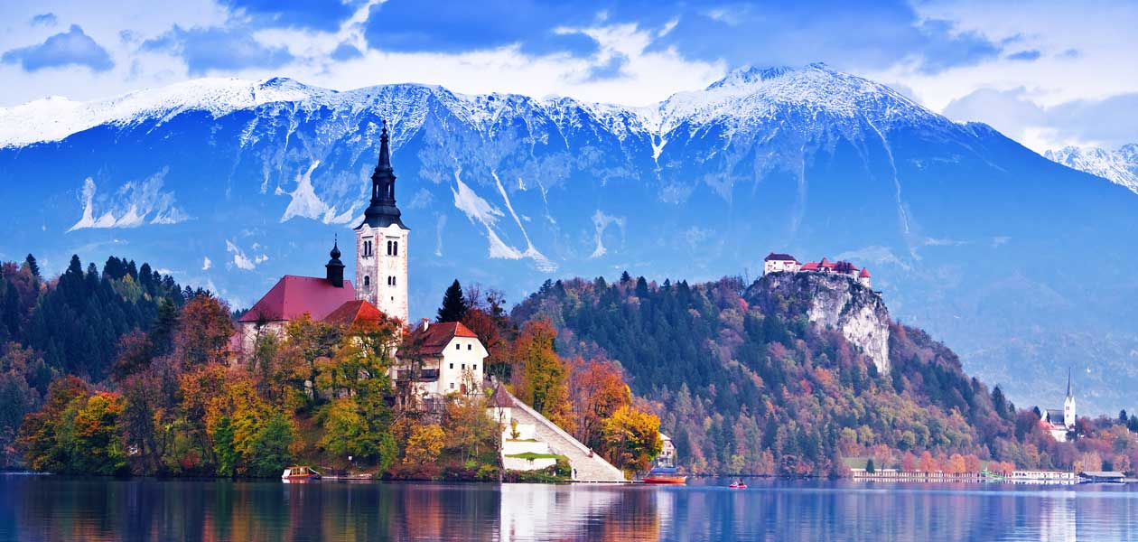
SLOVENIA SLOVENIJA
A big presentation of a tiny country

Slide 2
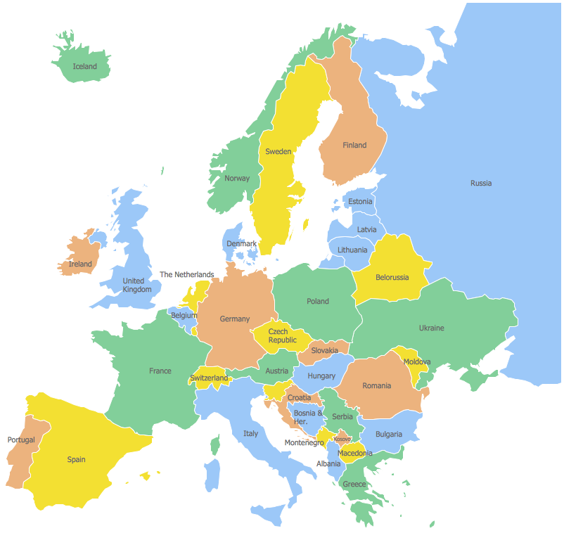
Notes:
Ask audience to guess where Slovenia is.

Slide 3
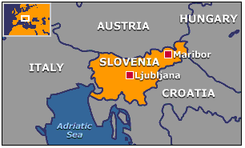
SLOVAKIA SLOVENIA EASTERN CENTRAL EUROPE
Notes:
This should be done as a very friendly, funny reminder.

Slide 4
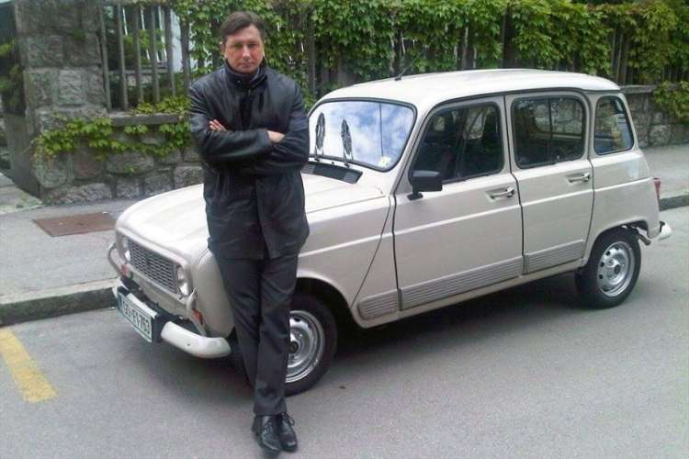
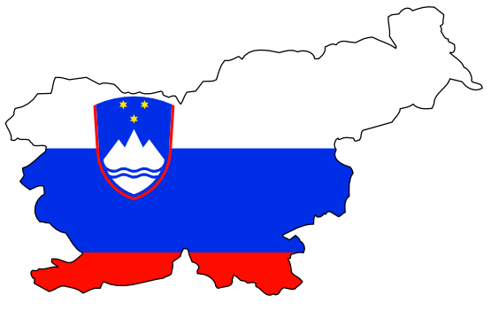
GENERAL INFO
20,273 km²
2.065 million people
Independent since 1991
President: Borut Pahor
Notes:
Try to help the audience imagine how it looks compared to the other partner countries.

Slide 5
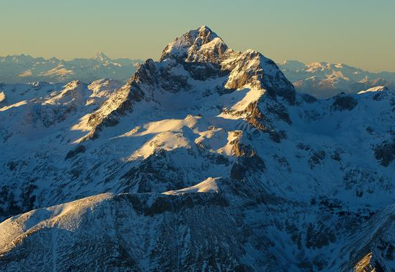
NATIONAL FLAG
Mount Triglav
(2863m)
Notes:
Do mention that every true Slovenian must climb it at least once in their lifetime.

Slide 6
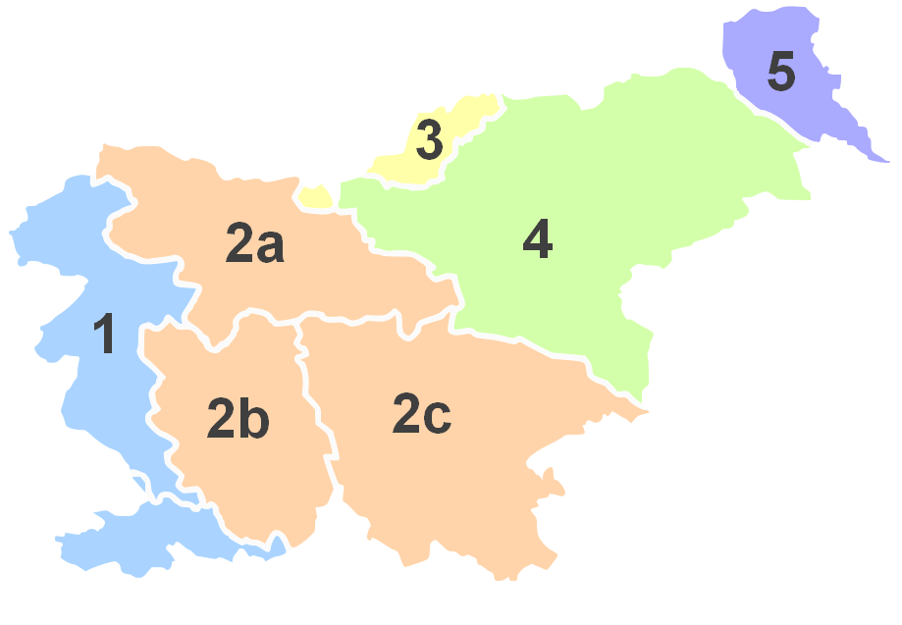
REGIONS
Upper Carniola
(Gorenjska)
Carinthia
(Koroška)
Prekmurje
Styria
(Štajerska)
Slovenian Littoral
(Primorska)
Lower Carniola
(Dolenjska)
Inner Carniola
(Notranjska)
Notes:
The flags actually represent those neighbours of ours whose languages are also accepted as official regional languages in Slovenia (Italy, Austria and Hungary).

Slide 7
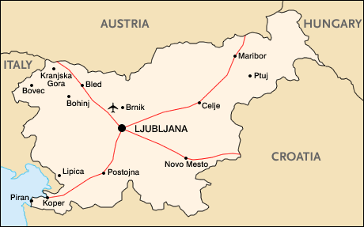
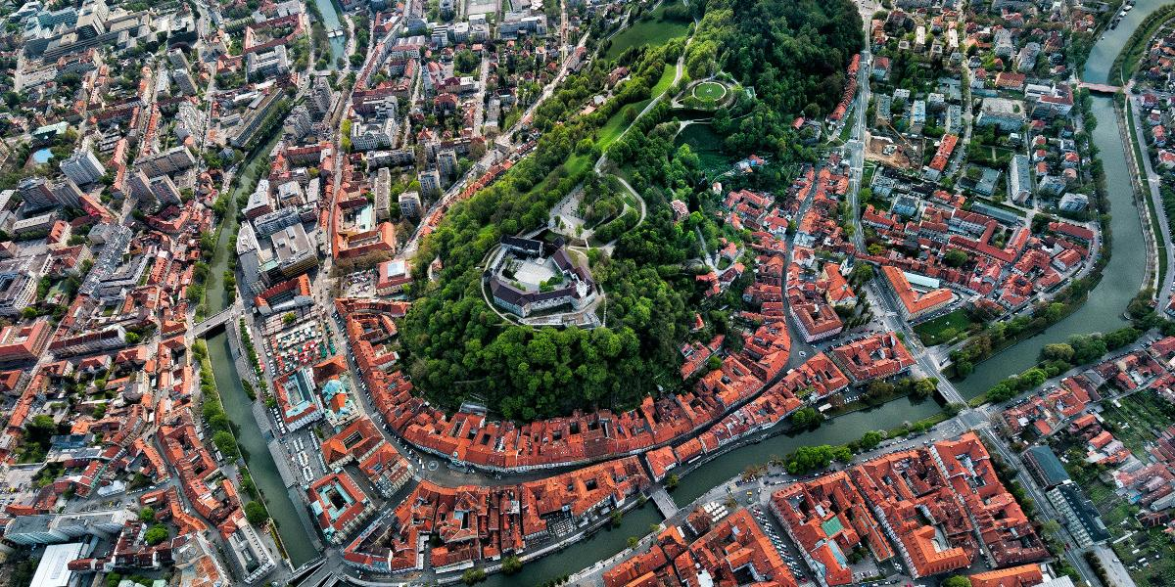
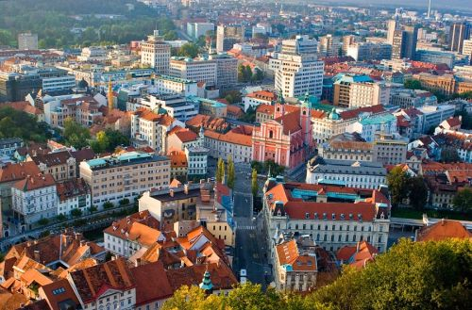
LJUBLJANA
Capital City
Central Slovenia
Notes:
Used to be called Emona during the Roman times

Slide 8
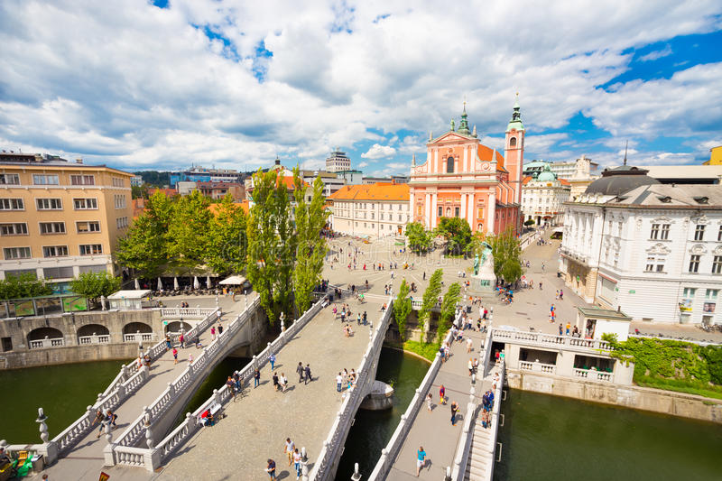
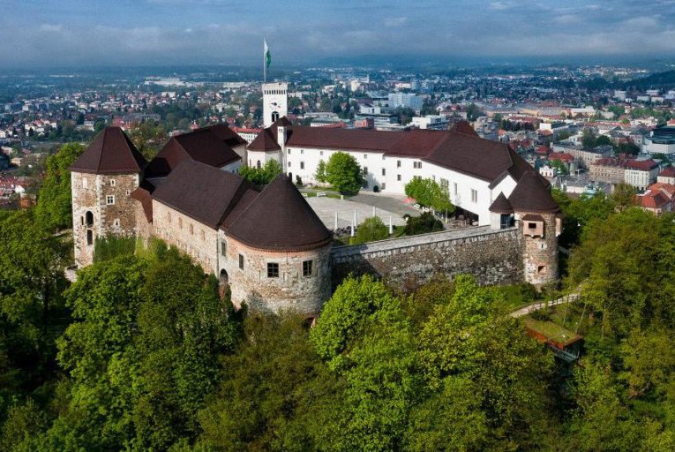
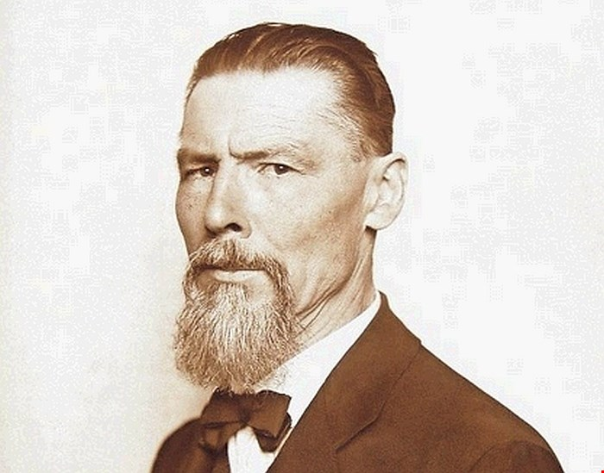
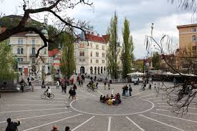
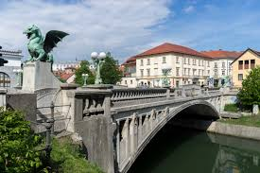
FAMOUS MONUMENTS
Ljubljana Castle (Ljubljanski grad)
Triple Bridge (Tromostovje)
Dragon bridge (Zmajski most)
Prešeren Square (Prešernov trg)
Notes:
After explaining the monuments, you could mention Jože Plečnik who designed the Triple Bridge and some other famous monuments, like our national library, NUK.

Slide 9
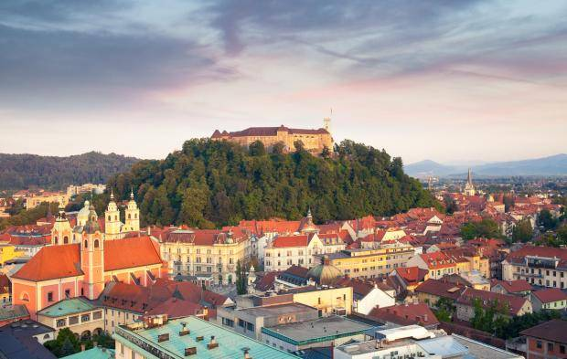
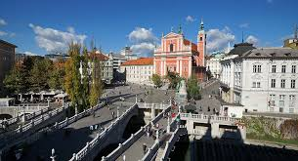
TOURIST HOTSPOTS IN SLOVENIA
Ljubljana
Notes:
Don’t say much more about LJ. But do mention the treasure hunt at this point. Tell them the winner will come out with a lot of bitcoins (which is our national currency), planted all around the city! Ha ha!

Slide 10
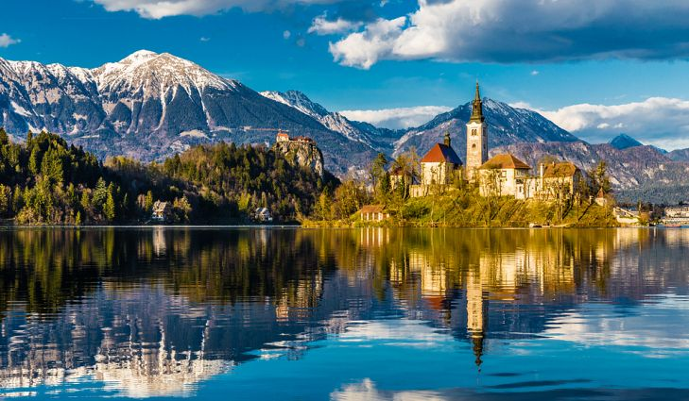
TOURIST HOTSPOTS
Lake Bled
Gorenjska
Notes:
Mention: alpine lake, the island, what does ringing the bell mean?

Slide 11
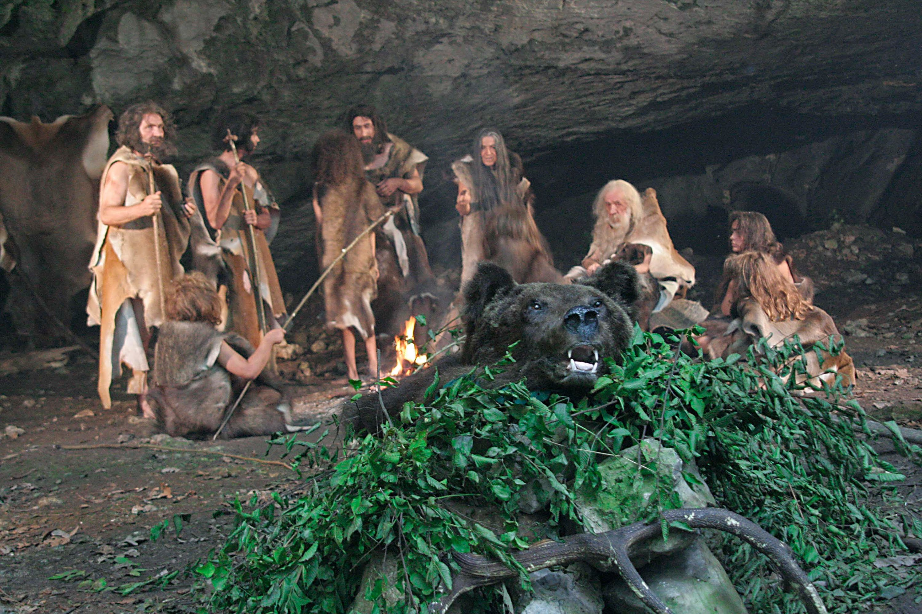
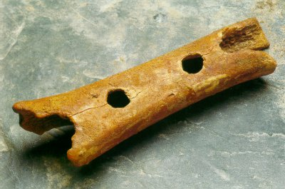
TOURIST HOTSPOTS
Divje babe
Idrija

Slide 12
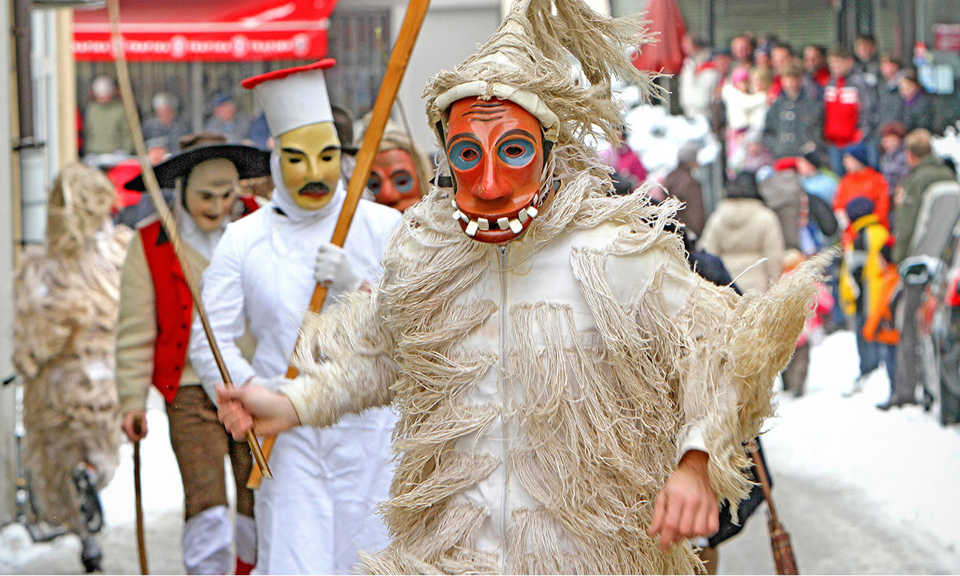
TOURIST HOTSPOTS
Laufarji
Cerkno

Slide 13
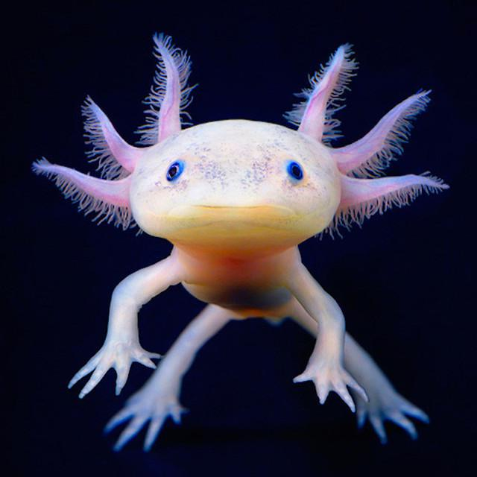
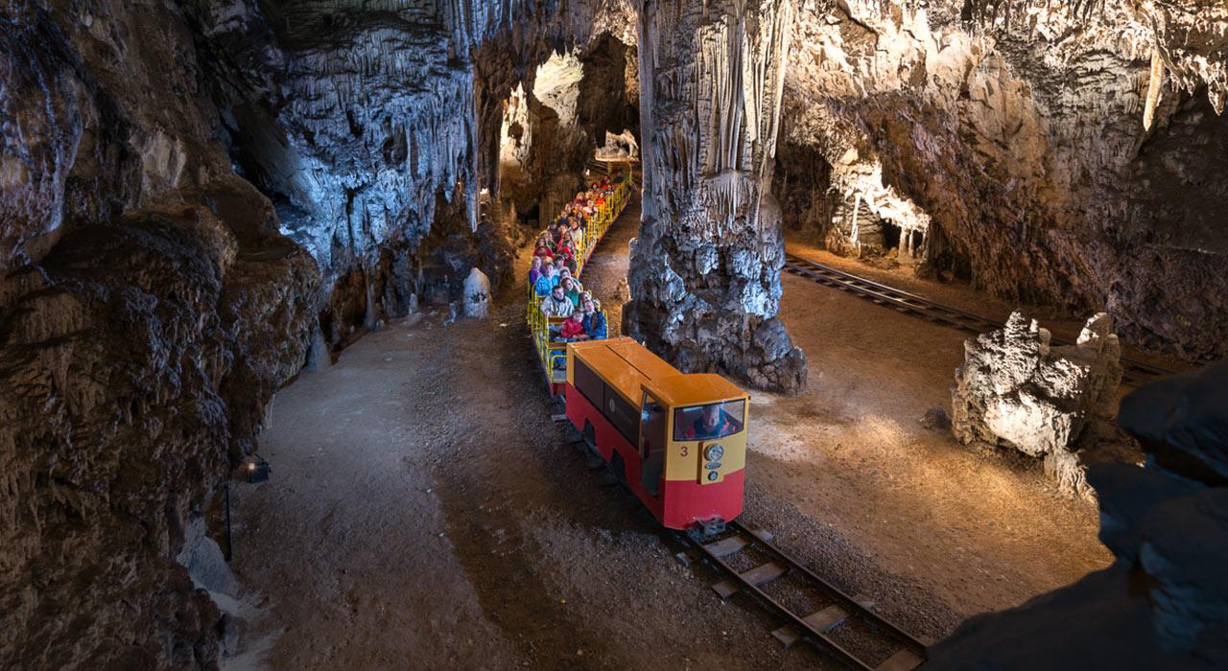
TOURIST HOTSPOTS
Postojna Cave
The Human Fish
Notes:
One of the most advertised spots of Slovenia, but there are many other cave systems in the country.

Slide 14
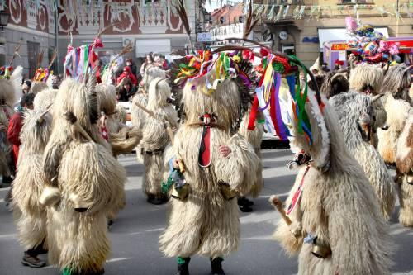
TOURIST HOTSPOTS
Kurentovanje
Ptuj

Slide 15
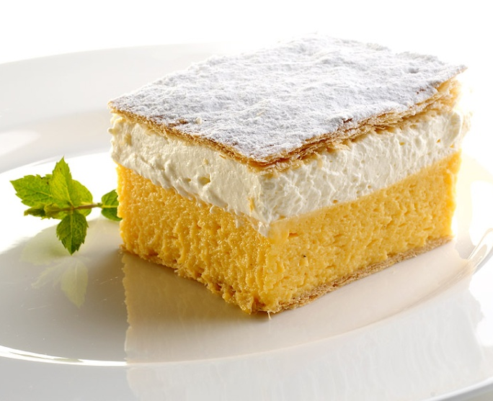
FOOD
Blejska kremšnita
(cream slice)
Alpine region

Slide 16
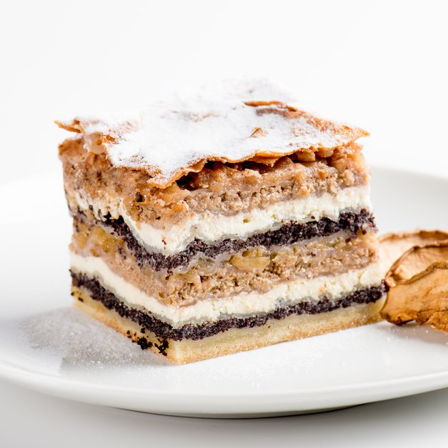
FOOD
Prekmurska gibanica
(“over-the-Mura moving cake”)
Prekmurje
Notes:
Can anyone guess what the key ingredients are? (poppy seeds, cottage cheese and apple)

Slide 17
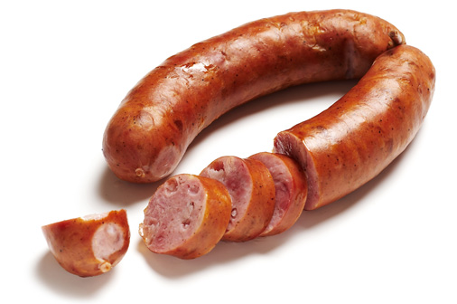
FOOD
Kranjska klobasa
(Carniolan sausage)
Kranj
Notes:
Jaka, if you’re in the mood, tell them this: “We might be a tiny country, but we’re BIG on food!”

Slide 18
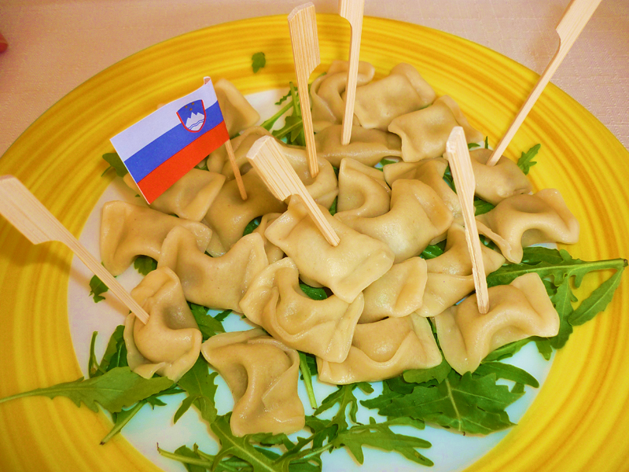
FOOD
Žlikfrofi
(dumplings)
Primorska

Slide 19
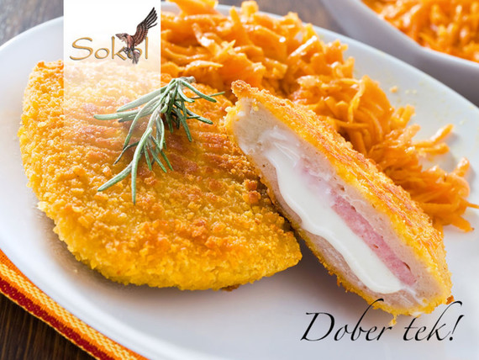
FOOD
Ljubljanski zrezek
(steak – LJ style)
Ljubljana

Slide 20
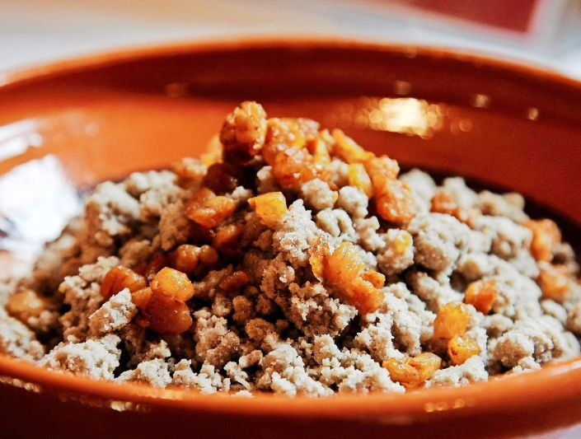
FOOD
Ajdovi žganci
(cereal-based dish)
Gorenjska

Slide 21
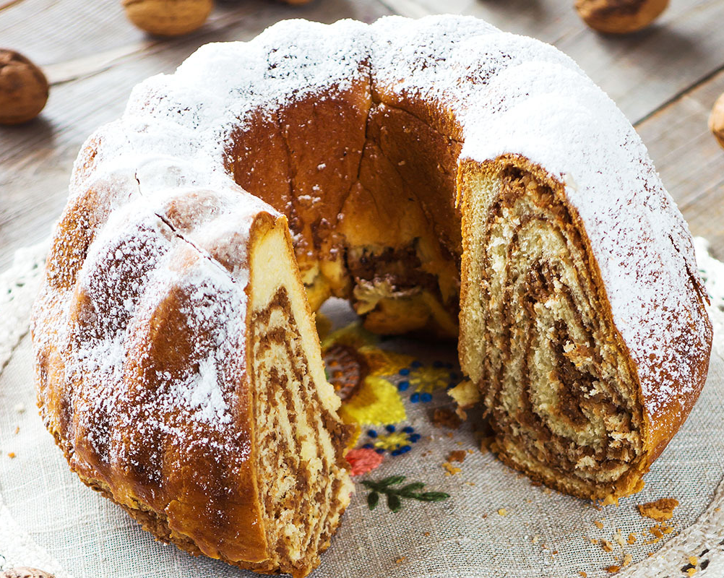
FOOD
Potica
(nut roll)

Slide 22
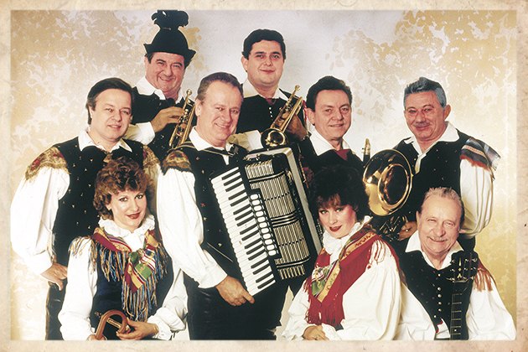
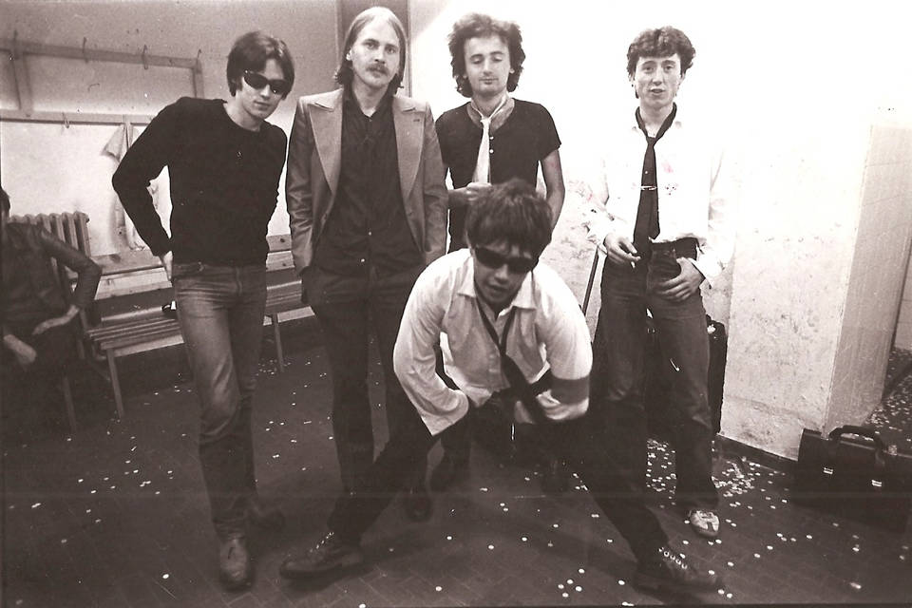
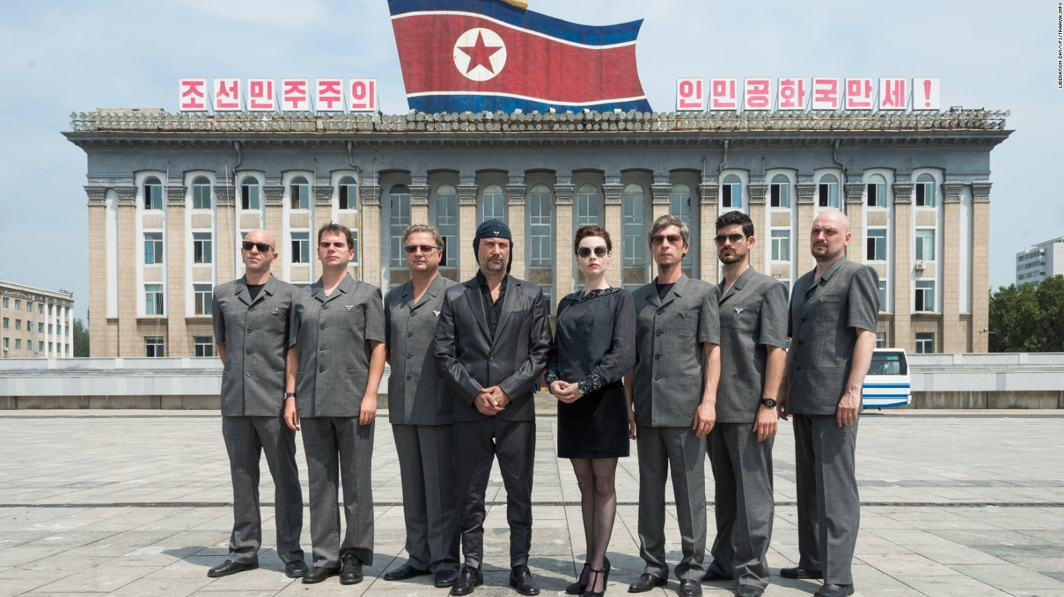
MUSIC
Avseniki (Golica)
BFM
Siddharta
BQL
Laibach
Tanja Žagar
Vili Resnik
Pankrti
Vlado Kreslin
Peter Lovšin
Zoran Predin
Notes:
This is the time to have a short pause and play Na Golici for the audience. Choose two members of the audience and teach them the Polka.

Slide 23
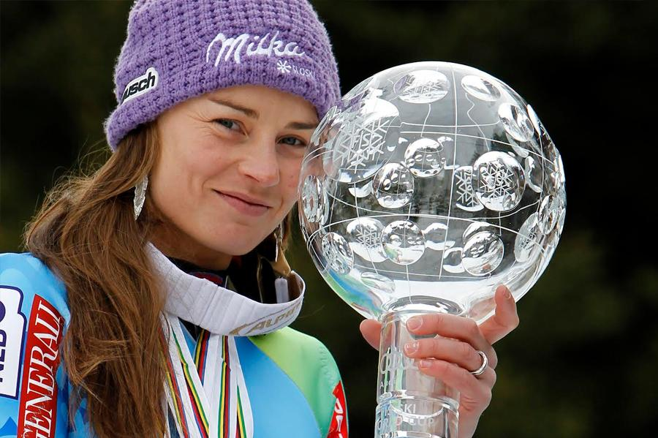
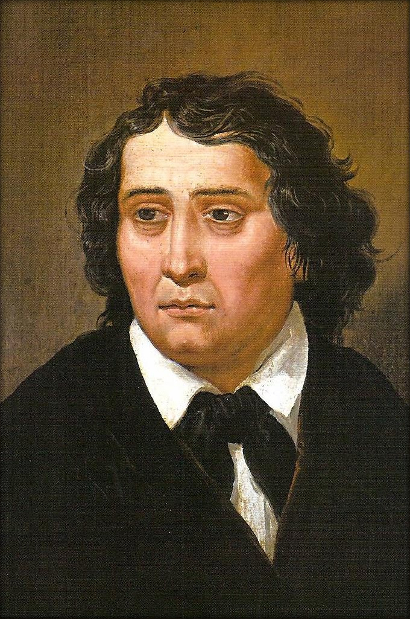
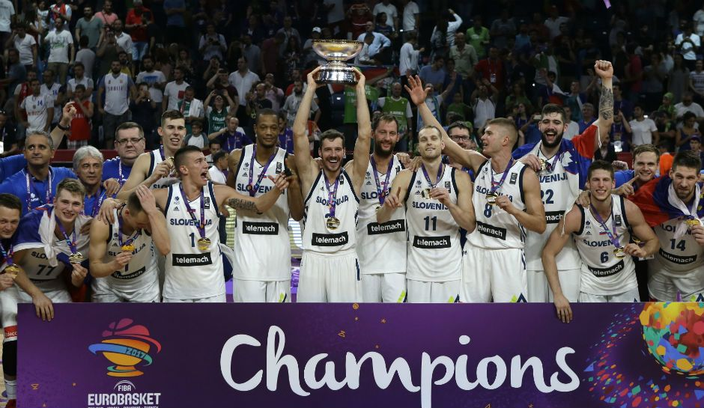
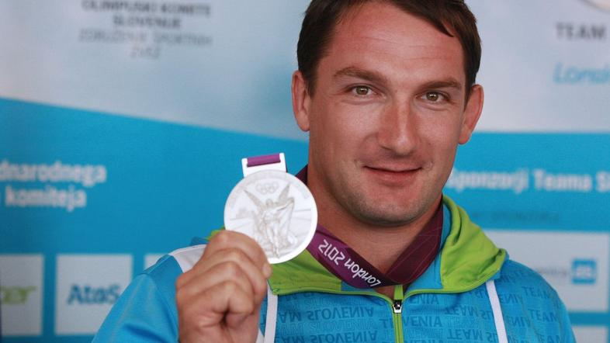
FAMOUS SLOVENIANS
France Prešern
Slovene Basketball national team
Goran Dragić
Peter Prevc
Tina Maze
Petra Majdič
Ilka Štuhec
Primož Kozmus
Rajmond Debevec
Matic Osnovnikar
Notes:
You can also point out that you chose not to include Jan Oblak, because this slide is about humans. (He’s a superhuman!) ;)

Slide 24
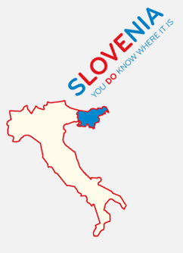
THANK YOU HVALA!
Notes:
Tell the audience we’ve reached the end of this presentation and thank them for their time. Invite them to ask questions.

