Slide 1
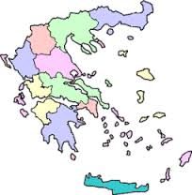
Review on students’ comprehension of the Greek film “Another world (worlds apart) though questionnaire.
Youth Under Camera
E-twinning project
2016-17
Latvia-Czech Republic-Greece

Slide 2
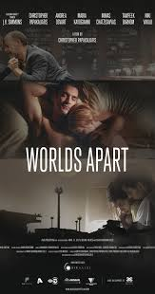
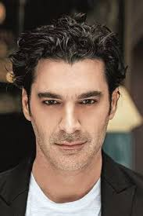
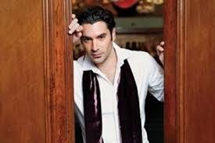
32 students answered the questionnaire about the Greek film.
“Another world (worlds apart)
by Christoforos Papakaliatis

Slide 3
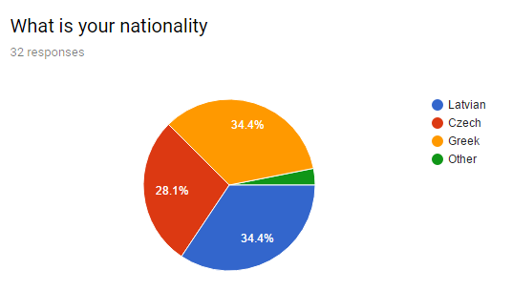
34,4% of the answers were given by Latvian students 34,4% of the answers were given by Greek students 28,1% of the answers were given by Czech students the rest percentage of the answers were given other nationalities.
Participants’ nationality

Slide 4
It’s seems that most students have a good memory so most answers were on the correct option.

Slide 5
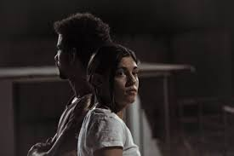
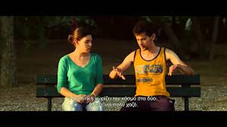
Boomerang (story 1)
Dafni (Greek)
Farel (Syrian)

Slide 6
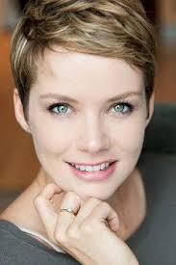
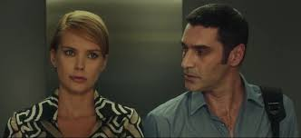
Loseft (story 2)
Giorgos (Greek)
Elisa (German)

Slide 7
Second Chance (story 3)
Maria (Greek) and Sebastian (German)

Slide 8
The immigrants’ persecutor
Dafni’s father (Greek maniac, bankraupt company owner)

Slide 9
The film consists of three stories that are combined finally to one: Boomerang” ( 1st story), Loseft 50mg ( 2nd story), Second chance (3rd story). What are the names of the actors in the film stories according to the above sequence? Correct answer b :Dafni and Farris, Giorgos and Elise, Maria and Sebastian. (65,2%)
Question 1

Slide 10
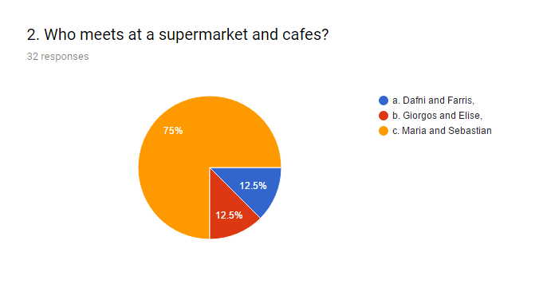
Correct answer c: Maria and Sebastian (74%)
Question 2

Slide 11
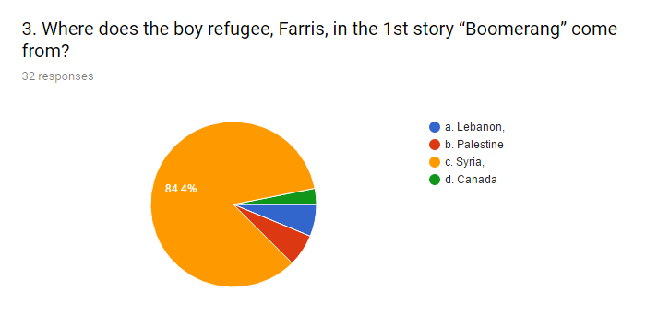
Correct answer c : Farris was a Syrian refugee. 88,4%
Question 3

Slide 12
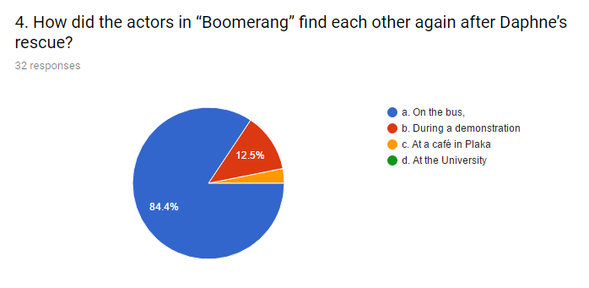
Correct answer a : On a bus. (84,4%) (was it accidental or on purpose?)
Question 4

Slide 13
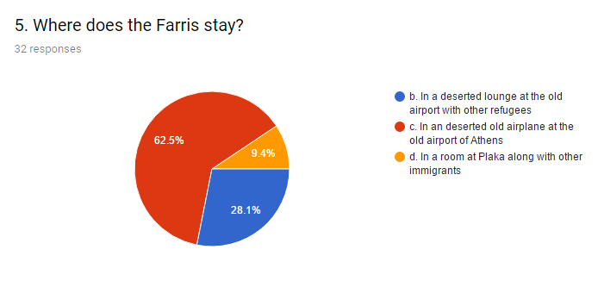
Correct answer c: In a deserted old airplane (62,5%)
Question 5

Slide 14
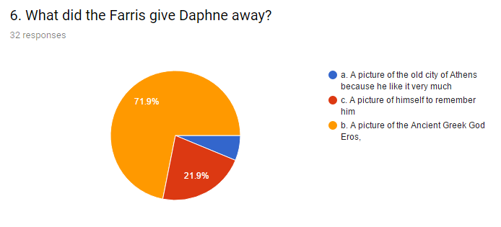
Correct answer c: A picture of the Ancient Greek God Eros (71,9%)
Question 6

Slide 15
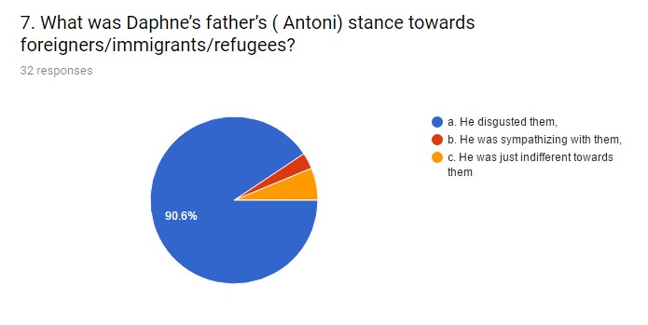
Correct answer a: He disgusted them (90,6%)
Question 7

Slide 16
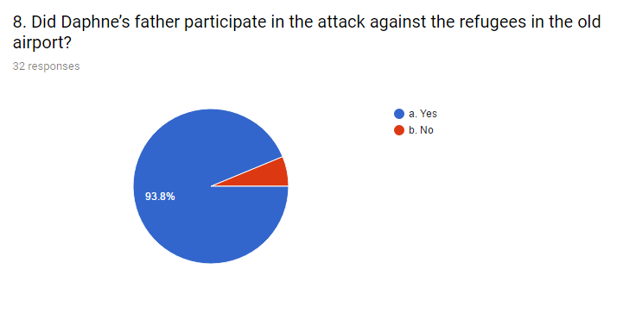
Correct answer a: Yes (93,8%)
Question 8

Slide 17
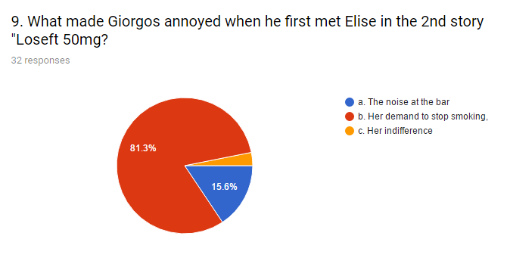
Correct answer b: Her demand to stop smoking(81,3%)
Question 9

Slide 18
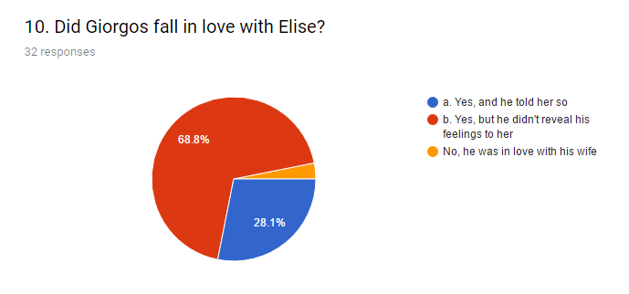
Correct answer b :(68,8%)
Question 10

Slide 19
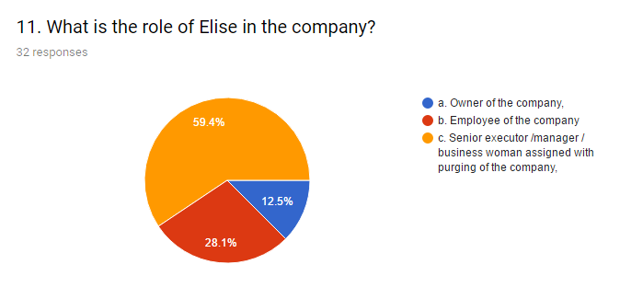
Correct answer c: Senior executor/manager/businesswoman assigned with purging of the company (59,4%)
Question 11

Slide 20
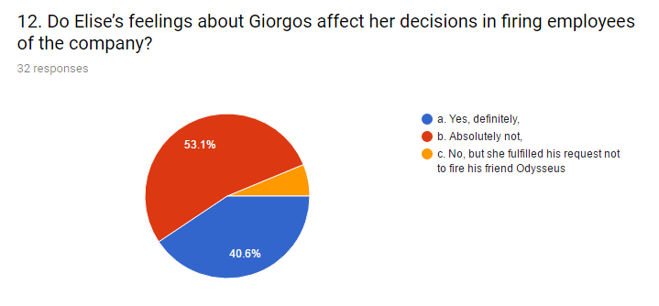
Correct answer b : Absolutely not (53,1%)
Question 12

Slide 21
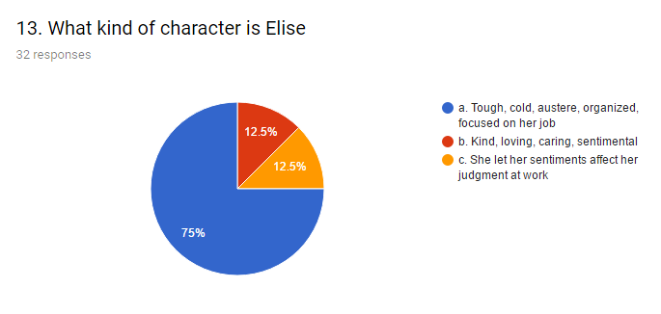
Correct answer a: Tough, cold,austere, organized, focused on her job. (75%)
Question 13

Slide 22
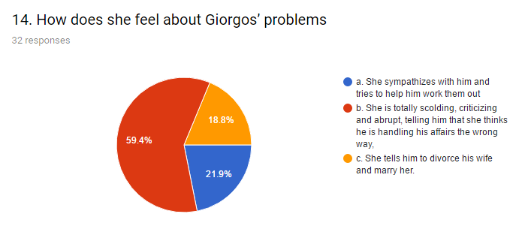
Correct answer b: She is totally scolding, criticizing and abrupt, telling him that she thinks he is handling his affairs the wrong way. (59,4%)
Question 14

Slide 23
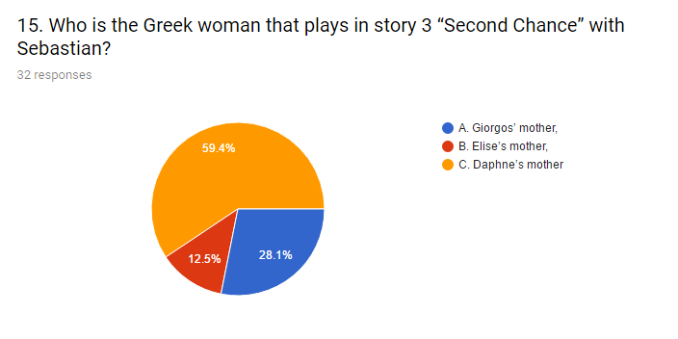
Correct answer c: Daphne’s mother (59,4%)
Question 15

Slide 24
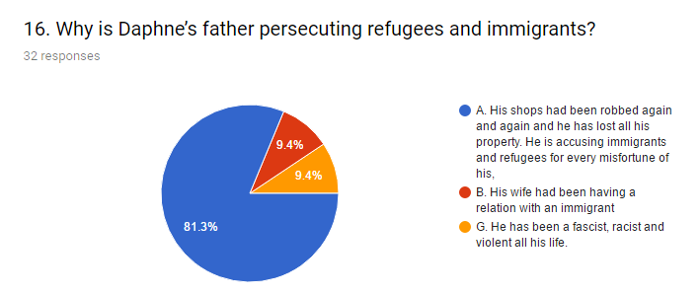
Correct answer a: His shops had been robbed again and again and he has lost all his property. He is accusing Immigrants and refugees for every misfortune of his (81,3%)
Question 16

Slide 25
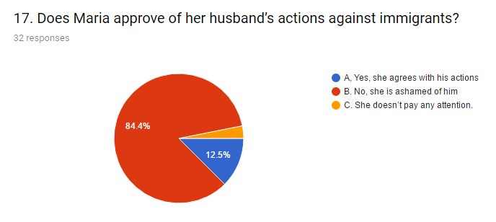
Correct answer b: No, she is ashamed of him (84,4%)
Question 17

Slide 26
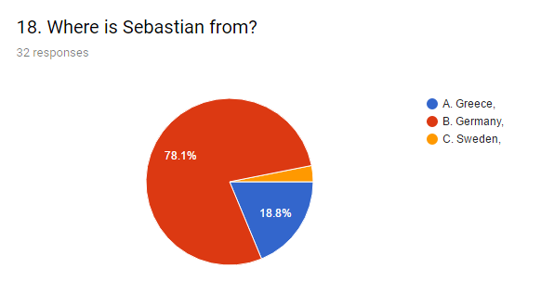
Correct answer b: Germany (78,1%)
Question 18

Slide 27
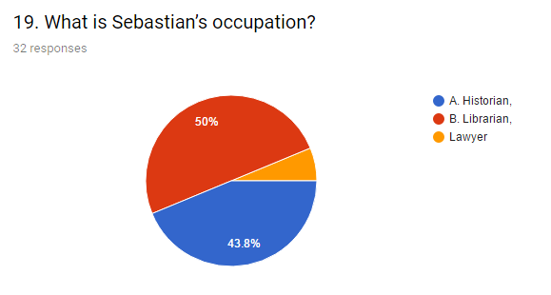
Correct answer c: Historian (43,8%) This is the only question that students’ majority lost. It is because we find Sebastian working in a library so we mistook his profession.
Question 19

Slide 28
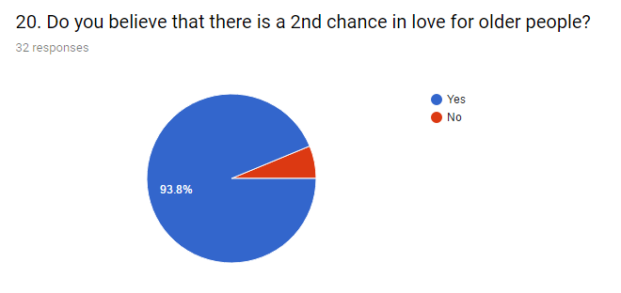
Dominant answer “yes”. (93,8%) This is encouraging!!
Question 20

Slide 29
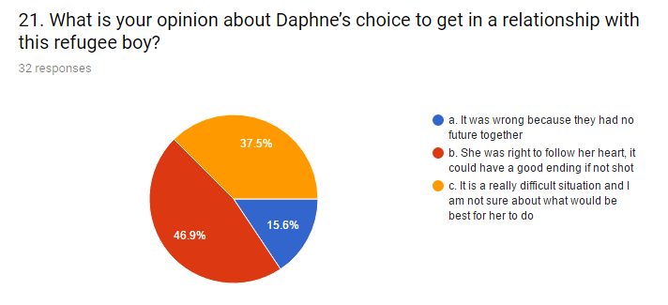
Dominant answer “b”. (46,9%). She was right to follow her heart. The second option is “c” (37,5%). It seems that it isn’t so easy to decide whether that was the right thing for Daphne to do . Only a little minority thinks that it was wrong for Dafne to have a relationship with Farris (15,6%)
Question 21

Slide 30
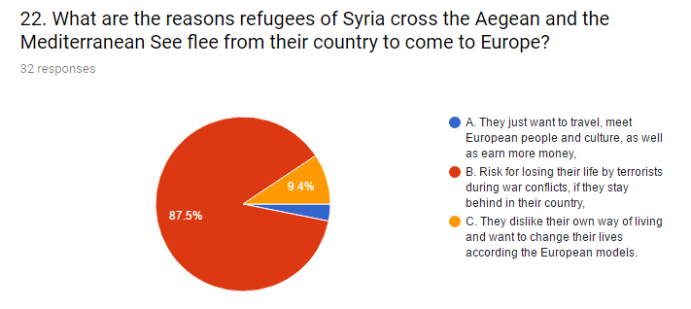
Dominant answer “b”: Risk for losing their life by terrorists during war conflicts, if they stay behind in their country. (87,5%)
Question 22

Slide 31
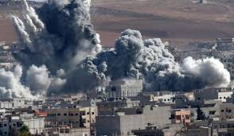
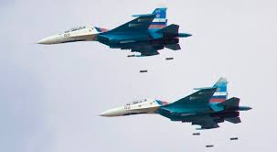
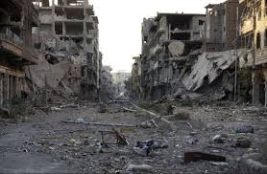
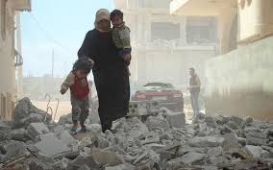
The pictures speak themselves! No need for explanation. Not an ideal place to live. Rather an ideal place to die.
Question 22

Slide 32
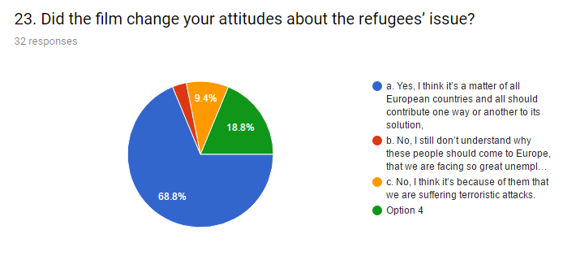
Dominant answer “a” (68,8%) Here we see most students’ attitude is that the refugee’s issue should be of European concern as unavoidably it affects and will affect our lives too. This is relieving and consolidating as there seems to be a sensitivity over this subtle matter. A small percentage (9,4%) thinks that we are suffering terrorism because of them. Is that really so?
Question 23

Slide 33
Of course there are other views too, like it isn’t our fault that they have country problems, so why should we suffer too? One would contradict that since we tend to become a universal community in our time, one country is just going to affect the other in many ways. Financially, technologically, culturally and so on. A percentage of 18,8% doesn’t think that the answers represent their thoughts or they can’t say what is the cause or the solution to the problem.
Question 23

Slide 34
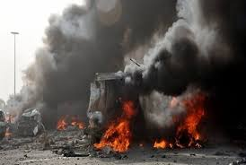
Now that transport and information is far easier than it was in the past, we all should turn to good neighboring and cooperation than just ignore what happens next door or even farther. There are others to that they approach the matter thoughtfully and they just don’t know what is really right way to face the problem. And of course the matter doesn’t seem to bother only a minority of students who are vertical to the attitude that they have to stay back even if their lives are in danger. They are far from us, it is their problem. Is this really the case?
Question 23

Slide 35
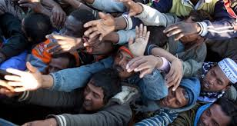
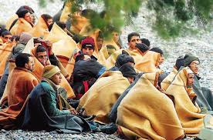
No one contradicts the fact that uncontrolled invasion of immigrants in Europe is the right policy. A well organized way to face it, standing by those people, should rather be the proper way European countries should follow. Working together on the issue, trying to heal and correct the causes of the problem is one way road towards to ending it. But just ignoring the problem might prove fatal for Europe and the whole world.
Question 23

Slide 36
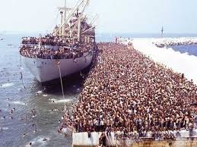
It seems that the phenomenon existed long ago but it was controllable. It also seems that the powerful of the world didn’t estimate the whole situation well or underestimated it or have been acting only according their interests. Now we taste the results of bad policies. It’s really a quite difficult and dangerous situation for all the world. No one knows an effective way to face the problem.

Slide 37
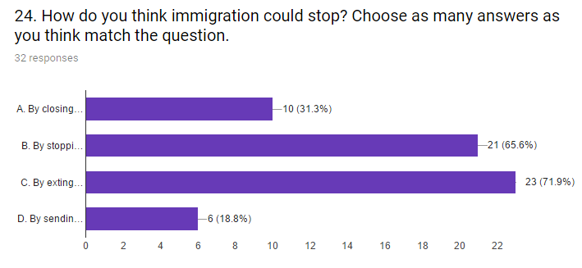
How do you think immigration could stop? Choose as many answers as you think match the question. Dominant answer “b” (65,6%) and “c”(71,9%) .
Question 24
b. By stopping the war in Syria, Middle East and other places in war,
c. By extinguishing poverty all over the world

Slide 38
Question 24
Definitely, governments shouldn’t work for the extermination of mankind. On the contrary they should promote peace in the world. General welfare should be in the picture. International lobbies don’t allow this to happen in the name of profits.
People must fight for their rights no matter the cost. Especially young people should fight for justice in the world but with peaceful weapons. Not using terrorism and attacks against innocent people.

Slide 39
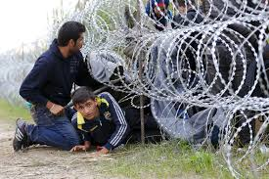
Question 24
Most students believe that extinguishing poverty on Earth, stopping wars and killings is the most wise thing man should strangle for.
Less students believe that we should close borders so as to stop the problem reach our own countries and homes? Is this the solution to the case?

Slide 40
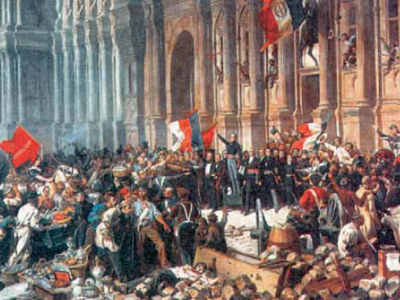
Question 24
Even worse a minority thinks that we have nothing to do with some peoples’ distress and they have to go back to fire and war and destruction. Their lives are of no value for us when we think so.
Definitely the French Revolution conquests shouldn’t be abandoned. This could mean the end of life on Earth. We can’t go back to the past and repeat the same mistakes. Man has got reason and we have to use it for the world benefit and preservation.

Slide 41
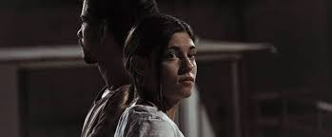
Conclusion
(Boomerang-1rst story)
All people have the right to live in safety. Governments should provide it to their civilians. International benefits often don’t allow it. Then war and crime threatens peoples’ lives who flee away abroad as refuges and immigrants.

Slide 42
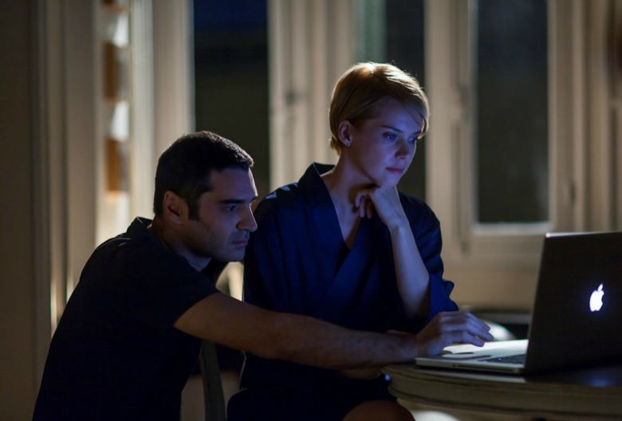
Conclusion
(Loseft 50mg-2nd story)
All people have the right to live a decent way. The economic crises has marked the young people who see their dreams flying away. They are often driven to despair about their uncertain future. They also end up immigrants to some other country, away from their folks and home.

Slide 43
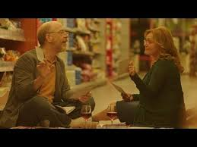
Conclusion
(Second Chance-3rd story)
All people, no matter their age is, have the right to a second chance in love, if something goes wrong with their former relationship.

Slide 44
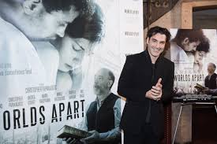
Another world (Worlds apart)
Cooperation of the Greek team

