Slide 1
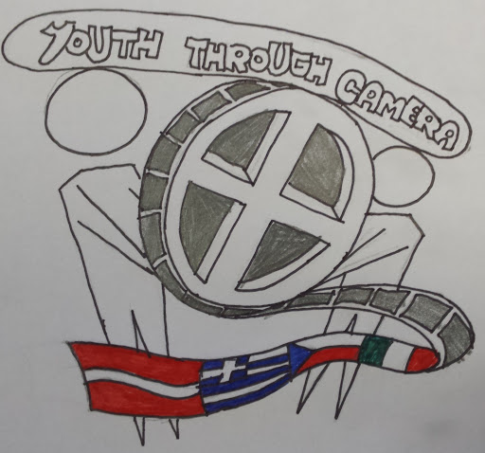
Summaries of students’ comments on documenters on life of young people
Youth Under Camera

Slide 2
Summary of the Italian documenter
“No country of young people”

Slide 3
“No country for young people”
We, young people from Latvia, Czech Republic, Italy and Greece, seem to face, more or less, the same problems concerning our future.
Austerity policies seem to make a vicious circle with no end. Economic crises seem to deteriorate the whole situation.
The bad prospects of carrier and the lack of job opportunities seem to affect us to a high degree with discouraging results on our psychology.
Our hope evaporates and destroys our dreams. It seems to reinforce the badly meant competitiveness among young people.
The phenomenon seems to go beyond Italy and Greece, it seems to spread out to most European countries and even more.

Slide 4
“No country for young people”
Watching the Italian film “No country for young people”, we come to the conclusion that today young people:
1. Have great difficulty in finding a job without previous experience, even if there is high qualification competency.
2. Are obliged to stay at home and be supported by parents and this destroys our self-confidence and self-respect.
3. Spend a lot of family money on education, but high rates of unemployment, especially between young people, increase the feeling of uncertainty and disappointment.
4. Think we are asked too much on educational and skill level to get a job and work area has been turned into very competitive one with little or no job opportunities at all.

Slide 5
“No country for young people”
5. Think that we may be forced to abandon higher education as it doesn’t prove to be a safe factor for getting a job in our countries, depriving us the right to become more wholesome personalities.
6. Lose our trust in State and in politicians, feel unprotected and at risk on survival level.
7. Feel anger and rage about previous governments and generations, as they have inherited us this situation and have condemned us in a life without dignity, obliging us do leave our home country, trying to find a job and become financially independent.
8. Feel that we flee away to countries with more job opportunities as the only solution, although we would prefer to avoid it if given the chance.

Slide 6
“No country for young people”
9. Do prefer to stay in our own countries with less money, than emigrating, missing our people, family and relatives, customs and habits, being strangers among strangers.

Slide 7
Summary on the Czech documenter
“The greatest wish”

Slide 8
“The greatest wish”
The greatest wish
Karlis has given a definition of what is or should be a wish:
“Wish is what you want, what you are willing to reach. It is similar to dream, but I think that wish must be achievable, realistic and possible. You may never reach it because of obstacles in way”.

Slide 9
“The greatest wish”
The greatest wish
Deniss also has given a definition of wish
“Wish: Feeling that one would like to have or do something or to see something happen; a desire, longing, or strong inclination for a specific thing.”

Slide 10
“The greatest wish”
The greatest wish
Maria has made a comparison between the greatest wish of the old couple and our own ones.
“...what we consider now as granted, like freedom or living in your own home when we create our own family, seemed to be the greatest wish for those people.”

Slide 11
“The greatest wish”
The greatest wish
Lena also remarks that:
“They seem to have fought in their lives and seem also to have spent a difficult but happy life together.”

Slide 12
“The greatest wish”
The greatest wish
The Czech students conclude:
We agree with most of the student`s opinions, because our thoughts match about their biggest wish.
We see that wishes change all the time and mostly they are about life conditions.

Slide 13
“The greatest wish”
The greatest wish
According to Karina most of people wish happy and healthy family.
Valters says that everyone is having a wish, no matter who you are.
Lena Kanbouridou talks about one more aspect of wish- doing things you really like.

Slide 14
“The greatest wish”
The greatest wish
However, sometimes our wishes are limited by our recourses.
Greek students are talking about difficult period in their country, economically and politically and this affects their greatest wishes.

Slide 15
Summary of the Greek documenter
“Is there true love?”

Slide 16
Is ther true love?
It seems that the film “Is there true love?” has caused a lot of reflection and thinking among us.
Many views, aspects were put forward on the matter. Most important is that there is justification on the various opinions.

Slide 17
Is ther true love?
The interaction has caused great thinking and has challenged us to think a little more about “true love”, if it really exists, if it’s worth giving it a try or sacrificing personal wants and desires, needed to support and maintain it in case it is found.

Slide 18
Is ther true love?
There has been pointed out that it is in our nature to need someone to share our life, to love and be loved, to make family, to care and be cared for.
From this point to the one that true love is established, it is meant clear, that someone has to invest on that. Otherwise it can’t last, it just goes away.

Slide 19
Is ther true love?
It comes out that we, young people, while we fall easily in love, we don’t know how to support it, either because selfishness trying to change the other person towards our likes and wills, or because of what we have to sacrifice in order to give space to love.

Slide 20
Is ther true love?
It has also been referred to the difficulty of combining work demands with giving the necessary time to keep a relationship alive. No doubt there is a true point here.
Quick rhythms of modern life, little opportunities in work area, low payment and unemployment, long working hours, high cost of life, expectations for a good standard of living make all the matter complicated.

Slide 21
Is ther true love?
Despite the obstacles and difficulties most students believe that there is true love and if found, it’s worth working for it as it, itself, has a lot to offer to those who share it and taste it.

Slide 22
Summary of Latvian documenter
Of dresses:
Mothers and Daughters

Slide 23
Of dresses: Mothers and Daughters
Boys seem not to have been challenged so much by the documenter as it isn’t in their nature to focus on fashion so much, although they can’t deny that they don’t care about it at all. They admit they follow the general trends as long as it suits their style and personality.

Slide 24
Of dresses: Mothers and Daughters
On the other hand, many girls commented on the lifestyle and personality of the two acting girls, Nadine and Paula. Their remarks are similar and have pointed out that although they, themselves like to take care of their look, dressing style and hairstyle, most of them agreed that it is an exaggeration trying to apply all fashion orders during all hours, from morning till evening, even at school.

Slide 25
Of dresses: Mothers and Daughters
The majority agree that each one has to behave and dress the way that pleases him or her taking into account not to provoke or have in mind that all hours aren’t the same and there should be a difference between dressing for school and dressing for outings. You can’t also go out in the snow wearing a mini skirt suffering the cold and risking your health only just to get others’ approval.

Slide 26
Of dresses: Mothers and Daughters
They stated that there seem to be a good relation between the girls in the films and their mothers, but most pupils liked Paula who seems to be more independent and do what SHE thinks Is good for her. Nadine, on the other hand seems to be more affected by her mother and she need her approval for her dressing style and not only that.

Slide 27
Of dresses: Mothers and Daughters
The fact that the two girls are only 13 has made special impression. They seem to hurry to grow up instead of enjoying their early teens in a more restless way.
All think that they should be more relaxed and not be so much preoccupied with their appearance at this age. There is no doubt that fashion magazines, TV, friends and society play a significant role in forming young people’s characters and behavior.

Slide 28
Of dresses: Mothers and Daughters
Perhaps mothers should have put forward another model during their growing up and have spent time on talking about everything that might lead them to be able to filter what they see, trying not to become victims of fashion or adopt every imposed model which may restrict or alter oneself or being.

Slide 29
Of dresses: Mothers and Daughters
We are closing with Jan Muhlfeit( CEO of Microsoft) words “Worlds is full of copies, only originals play the prime league“, that the Czech student Rotislav referred to, pointing out that only being ourselves can possibly make the difference.

