Slide 1
That’s the way I am

Slide 2
-My name is marta.
-i was born on 15/01/2003.
-i am 11 years old.
-i have a brother.

Slide 3
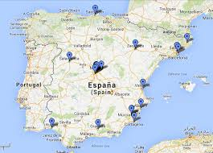
-i am from SPAIN, AND I SPEAK
SPANISH.
-I GO TO ALBORADA SCHOOL IN VIGO

Slide 4
-I HAVE GOT BROWN HAIR.
-I HAVE GOT BROWN EYES.

Slide 5
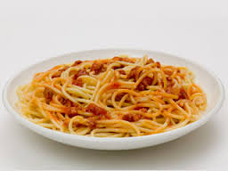
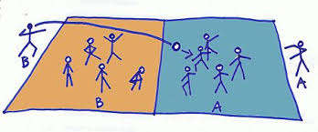
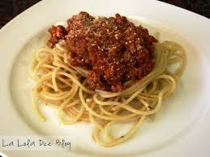
-MY FAVORITE FOOD IS SPAGHETTI.
-MY FAVORITE SPORT IS ‘’BRILÉ’’.

Slide 6
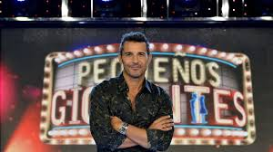
-I LIKE WATCHING TV PROGRAMMES,
ESPECIALLY ‘’PEQUEÑOS GIGANTES’’.
IT’S A PROGRAMME WHERE SMALL
CHILDREN SHOW THEIR TALENTS.

