Slide 1







DIRES PROJECT: Learning, Teaching and Training meeting Nr 4
09.10.2016 – 15.10.2016
HELEN-KELLER- SCHULE - MAULBURG- GERMANY
Topic: RESPECT
Presentation of the ISC students for the course in a German class
LA VILLE DU BOIS - FRANCE

Slide 2
Once upon a time: respect

Slide 3



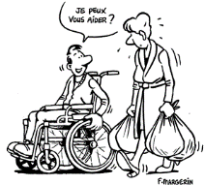

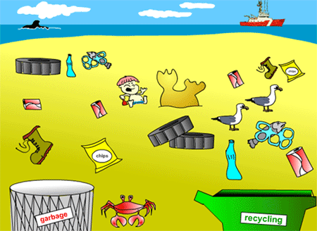




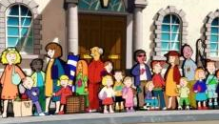




RESPECT FOR HUMAN BEING
RESPECT FOR NATURE
RESPECT FROM CHILD TO ADULT
RESPECT OF SPORTS RULES
TO RECEIVE …ONE MUST FIRST GIVE !!!!!!!!!!!!!!!!!

Slide 4



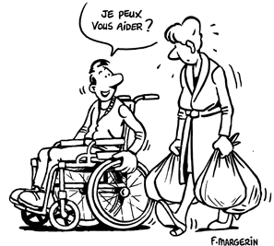

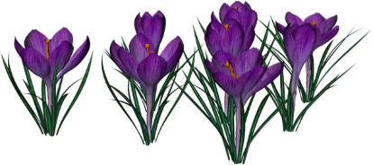


RESPECT FOR HUMAN BEINGS
CAN I HELP YOU?

Slide 5






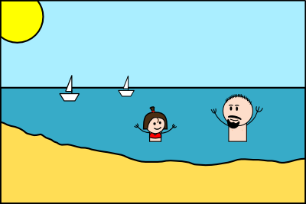
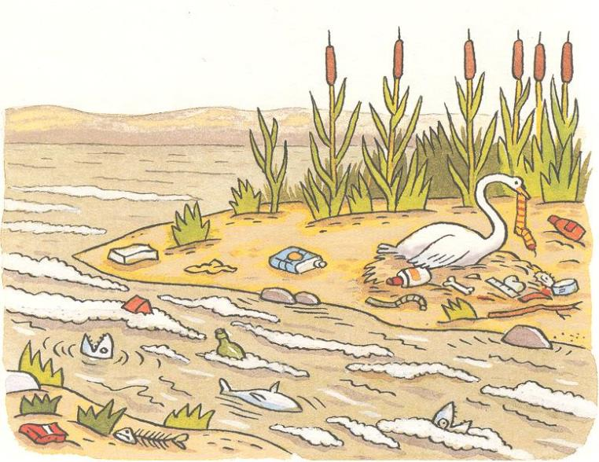
RESPECT FOR NATURE
A more beautiful world
Cleaner world,
Must respect the planet

Slide 6


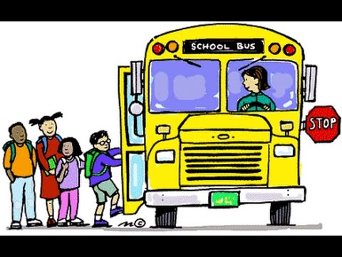
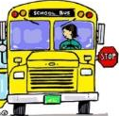

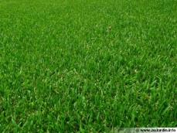





RESPECT FROM CHILD TO ADULT

Slide 7






RESPECT OF SPORTS RULES
Surpassing oneself
Self control
Loyalty
Joy in sport

Slide 8
PRESENTATION
My country, my city, my school
And my Erasmus+ travel

Slide 9

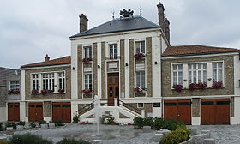
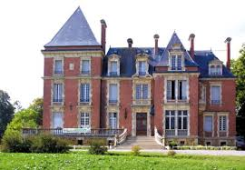




MY COUNTRY FRANCE
My city la ville du bois
My school I.S.C.
My Erasmus + travel to HKS in Maulburg, Germany

Slide 10


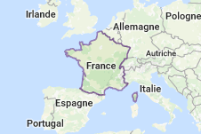

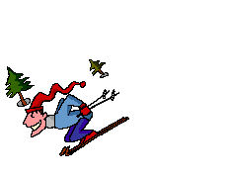



France
Capital: Paris
Area: 643 801 km²
Inhabitants: 66,03 million
Seas and Ocean : Nordsea, Chanel, Atlantic Océan and Mediterranean Sea
Mountains : Pyrenees, Alps, Vosges, Central Massiv, Jura
National Anthem: La Marseillaise

Slide 11
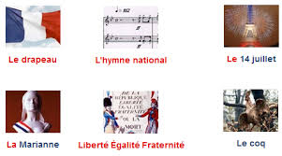
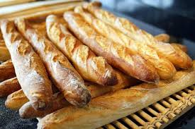
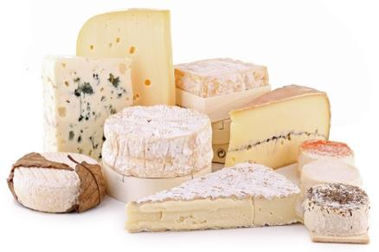
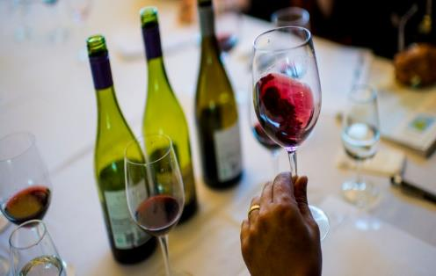
France and its symbols
We love ……..
Bread Cheese Wine… and a lot of other things!!!!

Slide 12







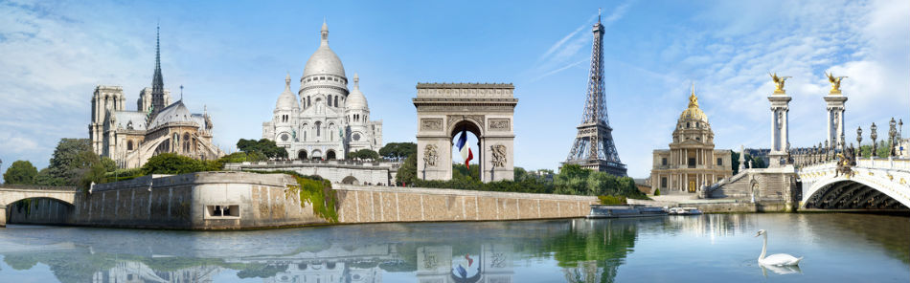
FRANCE
Mode
Parfums

Slide 13
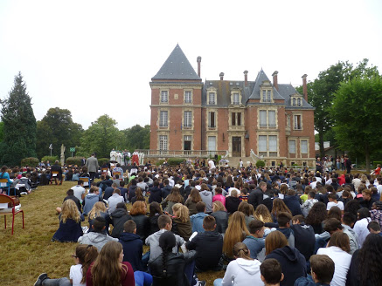




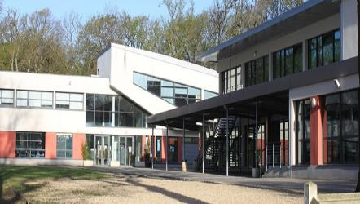
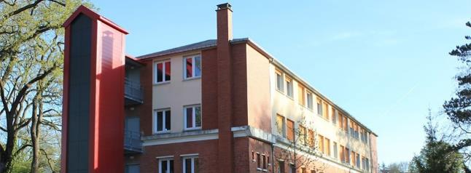
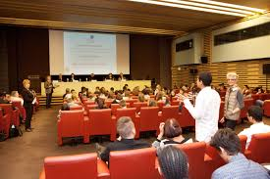
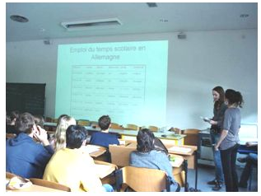

My school: INSTITUTION DU SACRE CŒUR (ISC)
1505 students

Slide 14
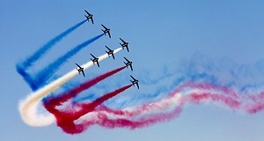

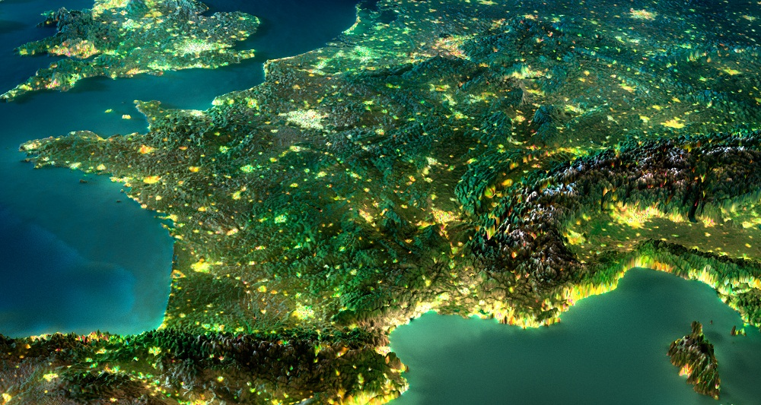






My ERASMUS+ Travel to Helen-Keller-Schule in
Maulburg, Germany
Mer du
Nord
F
R
A
N
C
E
Manche
Maulburg
Atlantic Ocean
Our delegation with 11 people coming from La Ville du Bois, France is going to Maulburg during a week: SUPER!!!
Méditerranée

Slide 15
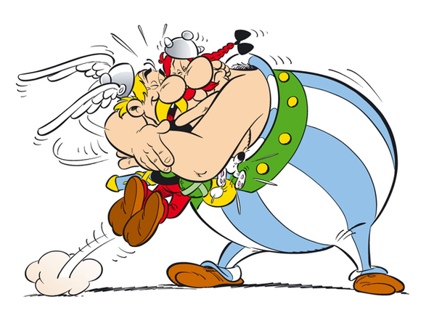

In the German school HKS
we will meet 34 other participants from Germany, Ireland, Italy, Turkey and become…

Slide 16

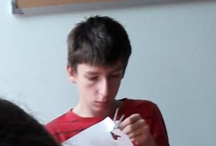
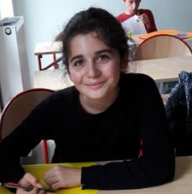
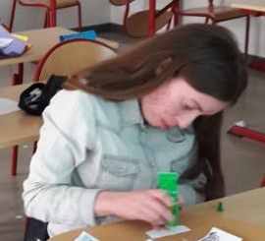

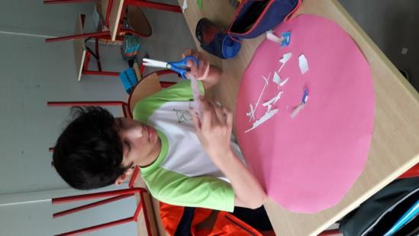
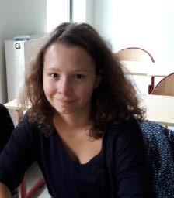

institution du sacre cœur (ISC), la ville du bois
thank you for listening to
The presentation of our
French students!
Alexandre, Constance, Dildar Noé, Léa, Lilian,
Lou, Quentin and Valentine, Students at the ISC School
Powerpoint: the students with Mrs Villet, Educator

