Slide 1
In this part
we would like to introduce
some important Turkish
traditional values …

Slide 2
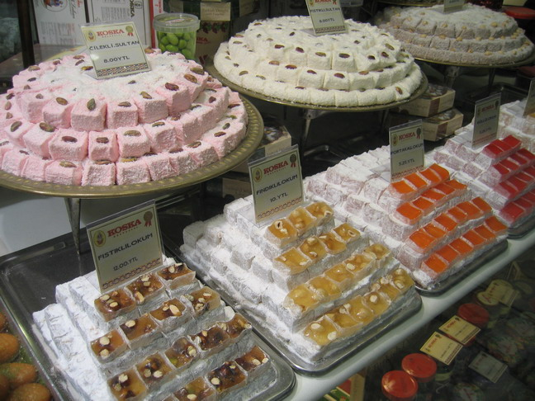
Turkish Delight
It is a kind of candy and very famous in Turkey but contrary to candy it is very soft. Turkish people serve Turkish delight to their guests on religious holidays. As you see in the picture there are many types of them.

Slide 3
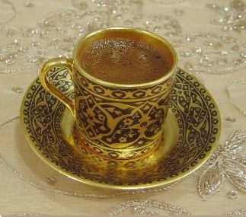
Turkish Coffee
Turkish coffee is very important in Turkish culture. It is generally drunk after breakfast. It is served in special tiny cups.

Slide 4
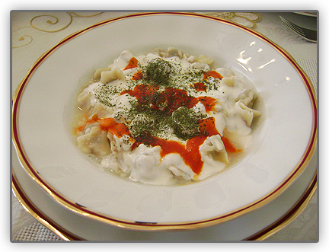
Turkish Manti
It is called ‘Mantı’ in Turkey. It consists of many bundles with meats in it.
It is served with garlic yoghurt sauce and tomatoe sauce on it. It is difficult but a very delicious meal.

Slide 5
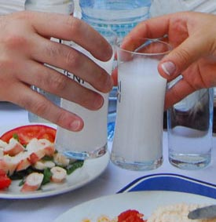
Turkish Rakı
It's similar to Greek ouzo and French pastis.
When mixed with ice and/or water for drinking, it turns milky white. Because of its color and hefty alcoholic punch, Turks call it lion's milk.

Slide 6
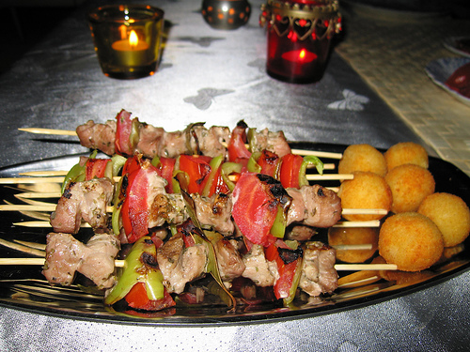
Turkish Kebab
Lamb meat(generally) is grilled with
Green pepper and tomatoe pieces on sticks. Turkish men eat Turkish Kebab with Turk’s traditional drink ‘Rakı’.

Slide 7
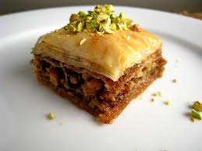
Baklava
It is a kind of dessert. We can say that it is our national dessert. It is very hard to make it. Our grandmothers make it well, we just know how to eat it :)

Slide 8
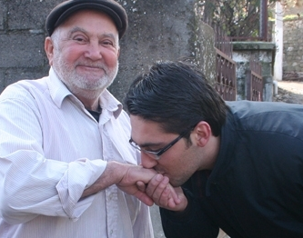
It is a common attitude in Turkey and also in Muslim countries. When we visit old people, we kiss their hands and put it onto our forehead. Especially on religious days, grandchildren visit their grandparents and kiss their hands, immediately after it grandparents give money to the grandchildren.

Slide 9
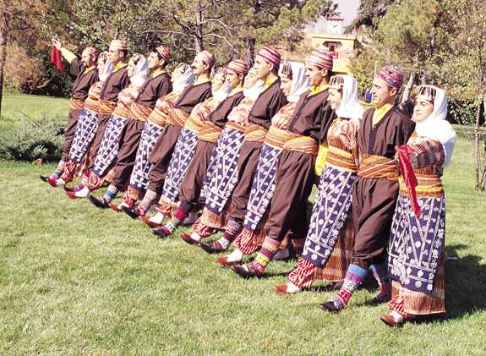
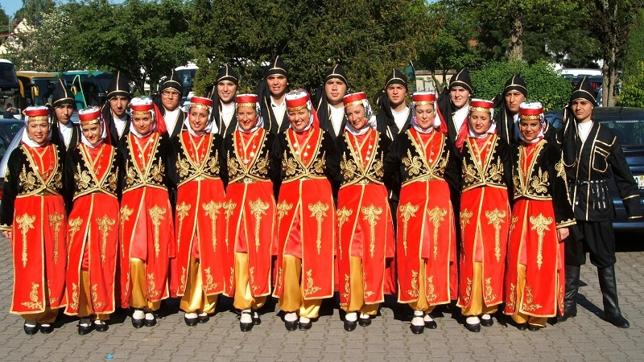
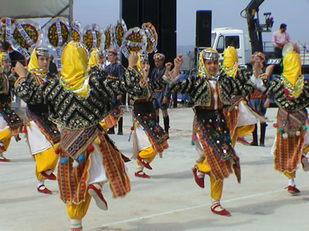
Folk-dance
Folk dance is our traditional dance and it can differ from region to region,and also the clothes are different in every region.

