Slide 1
ERASMUS+ project DIRES
Disability-Inclusive schools-Respect-Europe-Social dialogue
Mobility in Ireland: 17-23/01/2016
Our Lady of Fatima, Wexford
Presentation of the French team
ISC- Ville du Bois

Slide 2
Institution du Sacré Coeur
The ISC has 1500 students
and a staff of 130 persons
950 students in the middle school
450 students in the high school

Slide 3
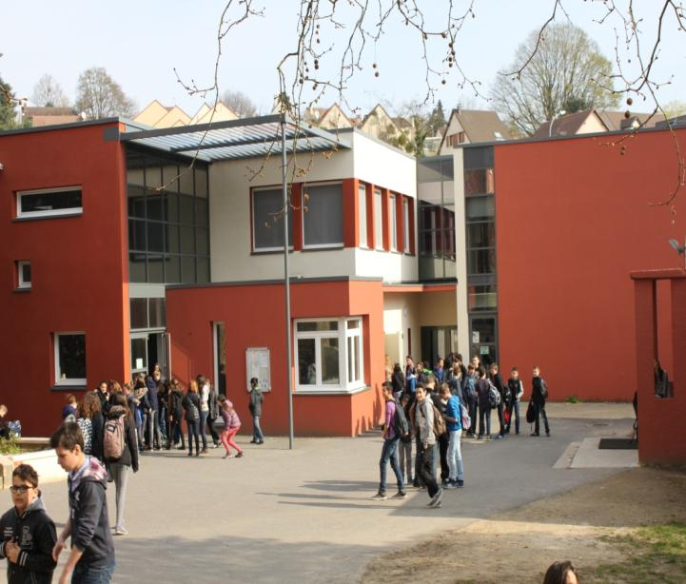
The middle school year 7 to year 10

Slide 4
The high school year 11 to year 13

Slide 5
Not far away from the castle of Versailles, the ISC is located 25km in the south of Paris

Slide 6
The Disneyland castle and the Louvres museum

Slide 7
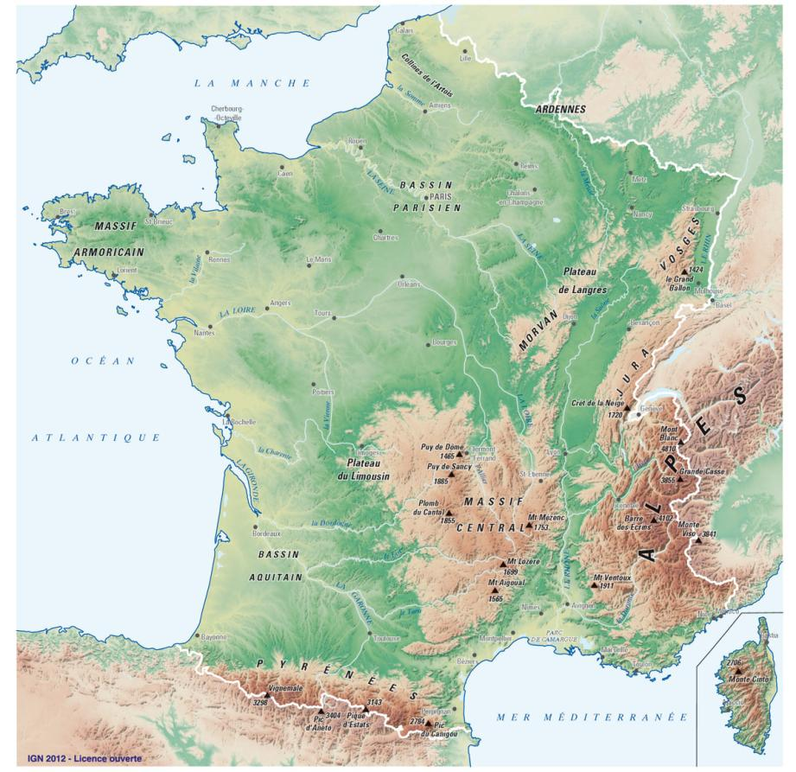
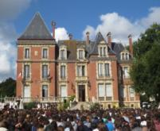
France
France
Capital:Paris
Population:66 million people
Area:643801 million km²

Slide 8
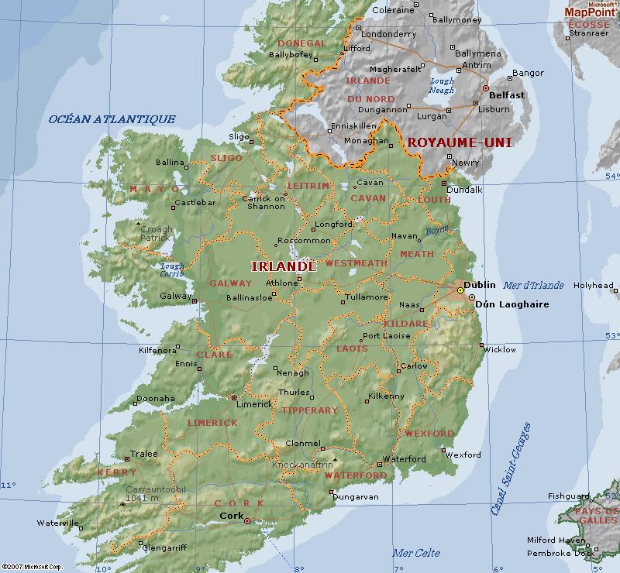
From France to Ireland
780 km by plane

Slide 9
Ireland EIRE
Capital: Dublin
4.6 million people
Area:70273

Slide 10
The staff preparing the mobility in Ireland

Slide 11
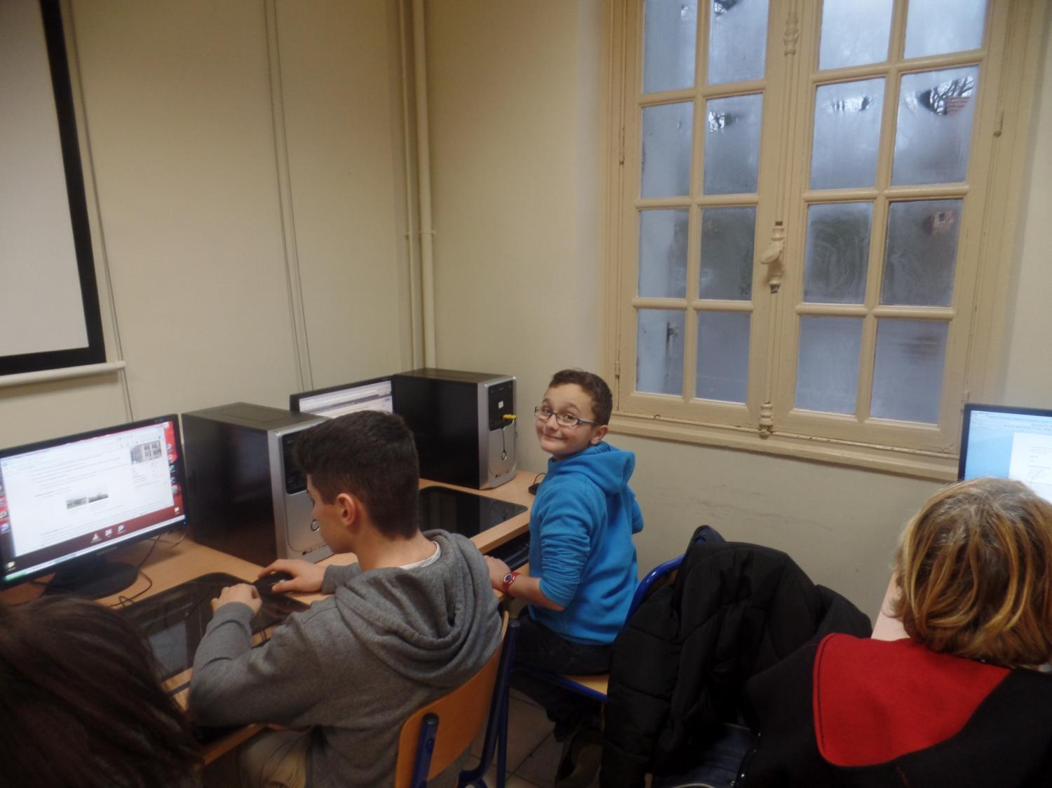
Sometimes you have to work alone…

Slide 12
…but playboys never stay alone for a long time

Slide 13
It is always easier with a little help from my friends

Slide 14
Sara,Marc Antoine,Christopher and Danielle at work

Slide 15
Raphael,Christopher and Artus with their special needs assistants

Slide 16
Mario and Marc Antoine in their class room

Slide 17
Léa, Mélodie and Raphael in the U.L.I.S classroom.
U.L.I.S=plan for students with special needs in inclusion in regular schools

Slide 18
You can have fun at work!

Slide 19
Lessons with Christophe, special needs assistant

Slide 20
Let’s play together!
I will show you pictures of French monuments.
Try to guess their name.

Slide 21
How is called the tower behind Mr Snowman?

Slide 22
What is the name of this church?
Think about the name of my school

Slide 23
One of the most famous cathedral in France
Think about the name of your school

Slide 24
What is the name of this castle?
We have already seen this castle before…

Slide 25
Where is this castle?
I think we have already seen it...

Slide 26
What is this?

Slide 27
What is the name of the museum behind the pyramid?
This is the most famous French museum.

Slide 28
The French delegation thanks you for your welcome

Slide 29
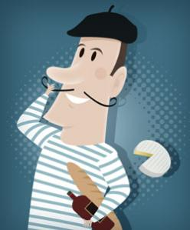
Powerpoint: Patrice Bourdiau, French Educator at the ISC School

