Slide 1
Erasmus + DIRES (2015-2017) Disability- Inclusive schools- Respect- Europe- Social Dialogue TRANSNATIONAL MOBILITY FOR EUROPEAN STAFF
November 8-13 th 2015
ISC school- Passage de Graville- 91 620 La Ville du Bois
France

Slide 2
Summary
Presentation of the ERASMUS + project DIRES
Welcome of the European delegations at the ISC
Breakfast and visit of the ISC school
Courses by the European delegation for the French students
Meetings for the European staff of the project
Press conference
Visit of the ULIS structure
Visit of Paris by night
Departure of the delegations
Dissemination of the project
European staff of the project

Slide 3
Presentation of the Erasmus+ Project DIRES Six schools in five countries

Slide 4
The aims of DIRES
To develop the European cooperation between different schools:
primary
secondary
special schools
mainstream schools
To involve more Students with Educational special Needs in European projects
To encourage the mobility of mainstream students and SEN students together
To involve all the school community : Head, staff, students and families
To encourage the community to pratice their English skills and competences also in another languages
To develop inter cultural competences and the awareness of the European citizenship

Slide 5
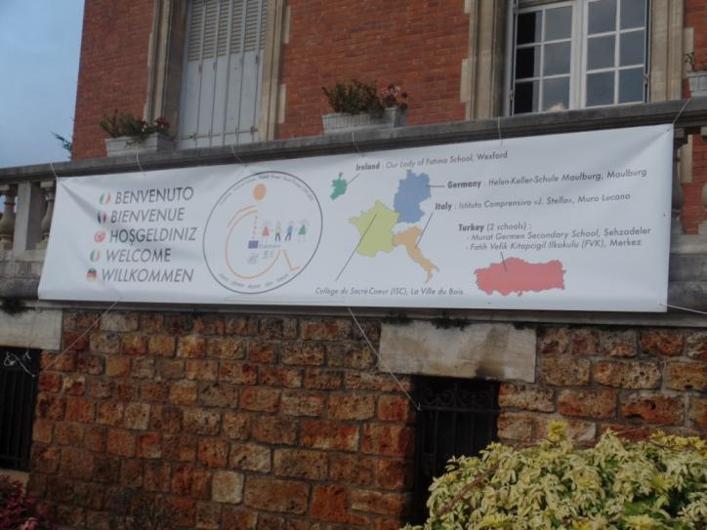
Welcome of the European delegations Isc school

Slide 6
DIRES European delegations

Slide 7
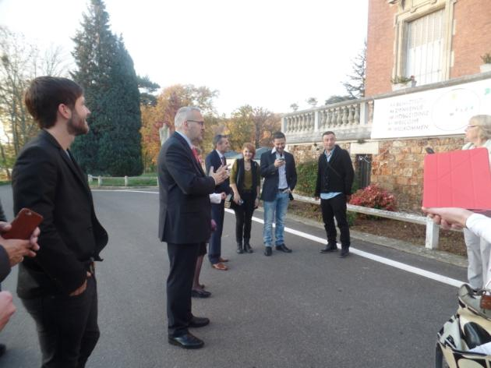
Welcome by Mr Jammes, headmaster

Slide 8
Breakfast at the cafeteria (1/3)

Slide 9
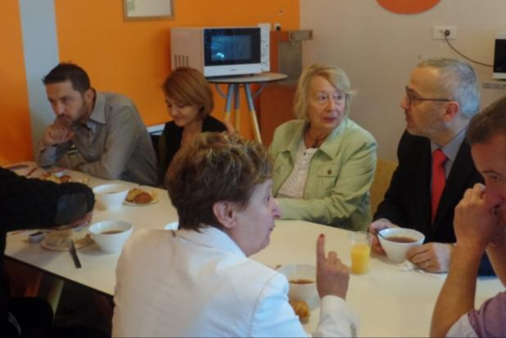
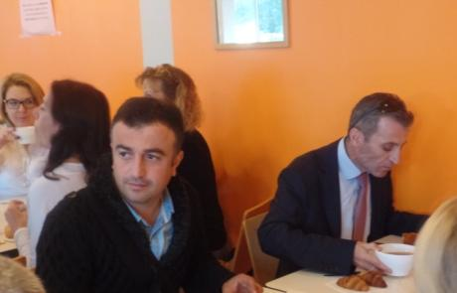
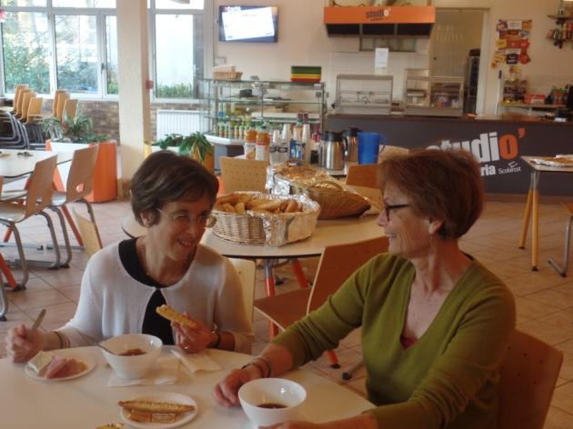
Breakfast at the cafeteria (2/3)

Slide 10
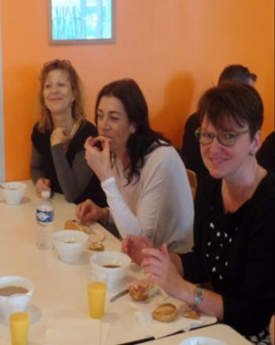
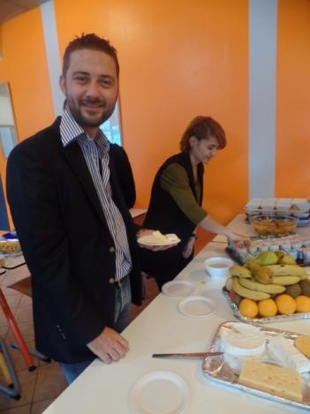
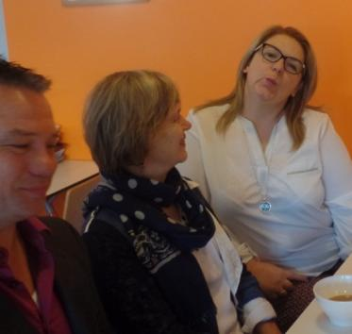
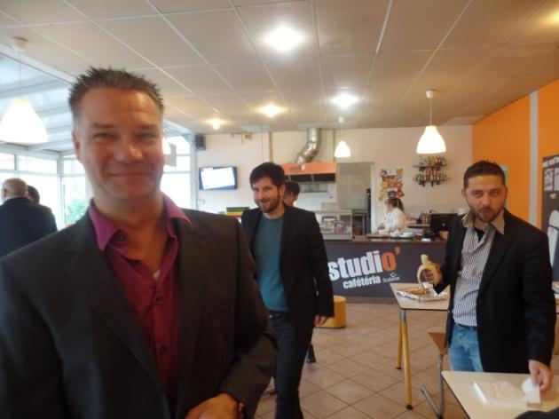
Breakfast at the cafeteria (3/3)

Slide 11
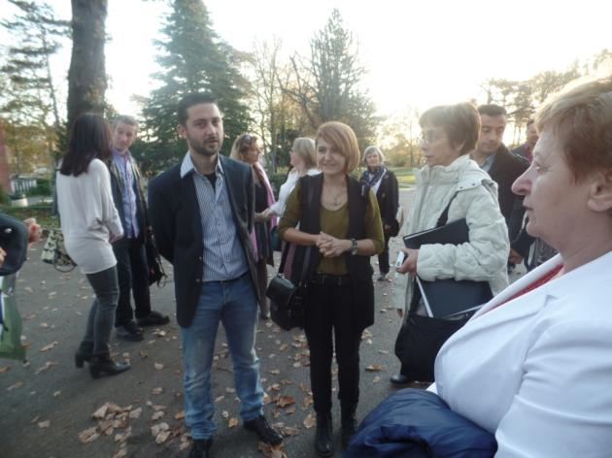
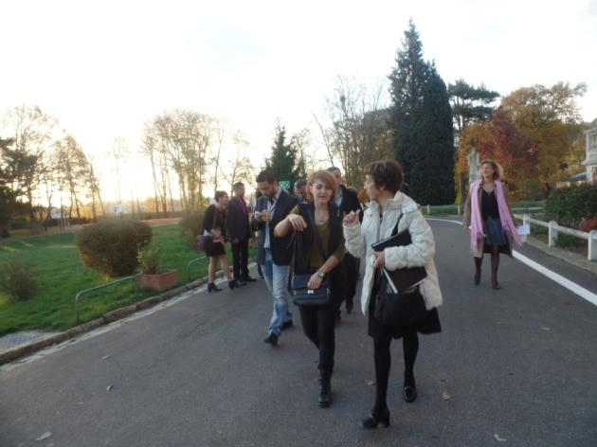
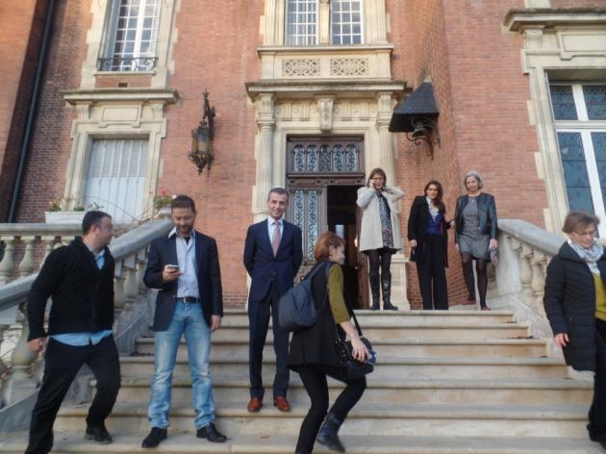
Visit of the ISC school (1/6)

Slide 12
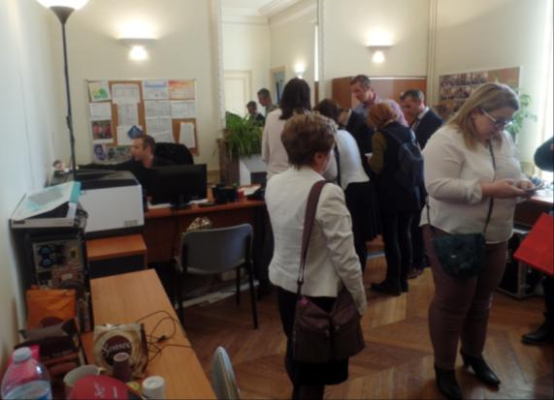
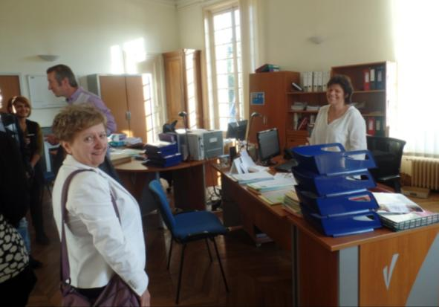
Visit of the ISC school (2/6)

Slide 13
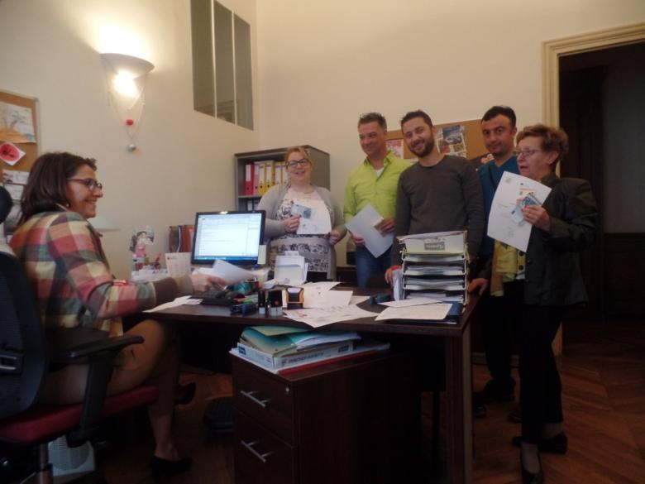
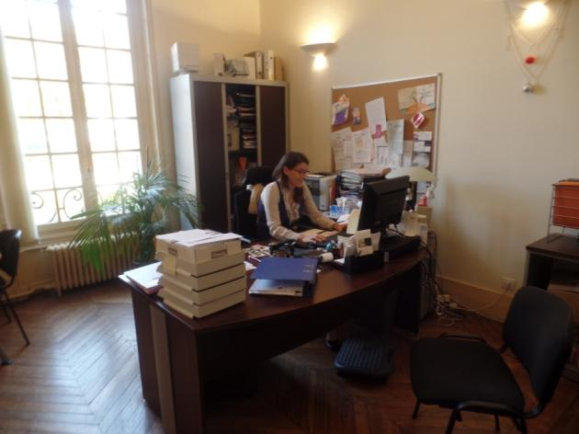
Visit of the ISC school (3/6)

Slide 14
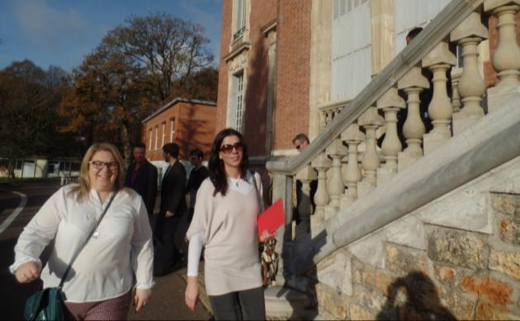
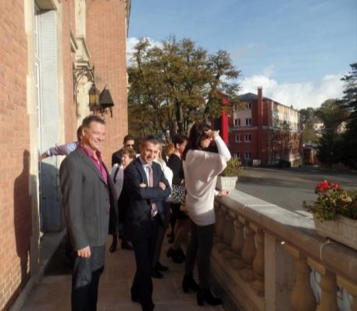
Visit of the ISC school (4/6)

Slide 15
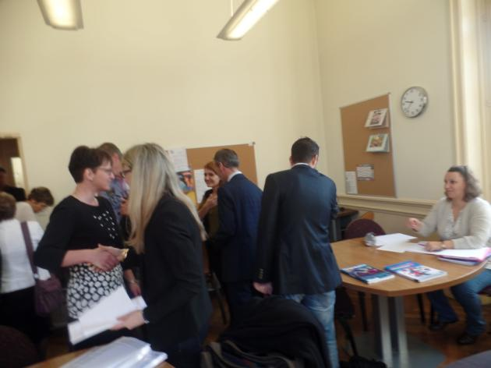
Visit of the ISC school (5/6)

Slide 16
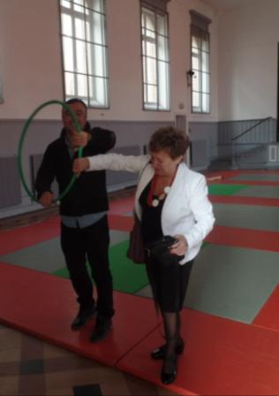
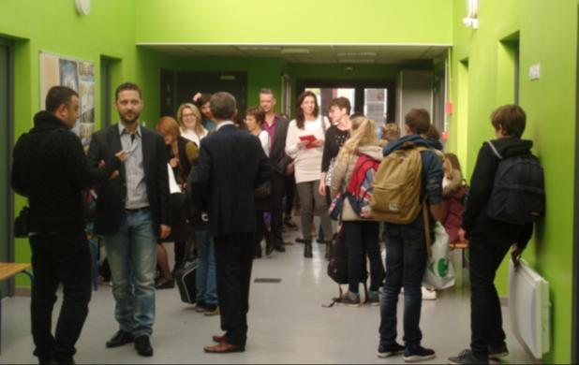
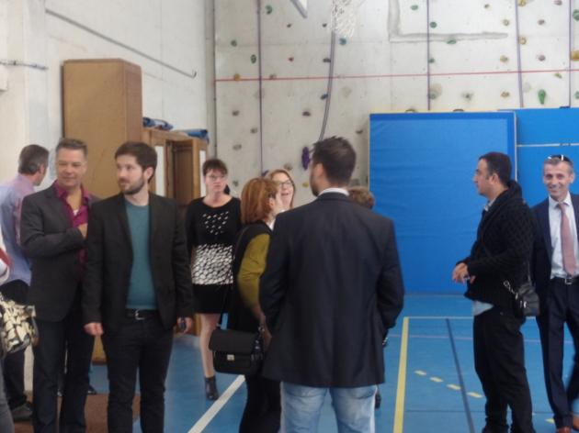
Visit of the ISC school (6/6)

Slide 17
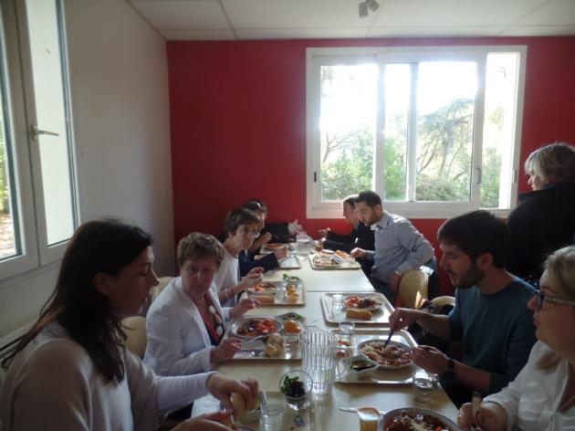
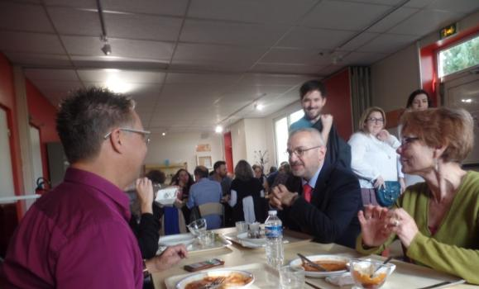
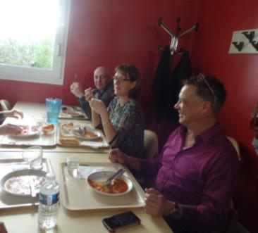
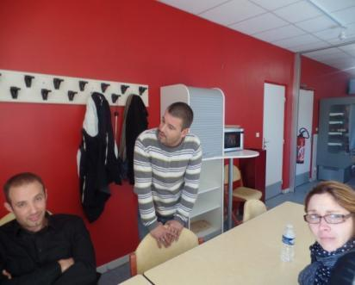
Eating together at the school restaurant

Slide 18
Courses by the European delegations
Preparation and… stress!

Slide 19
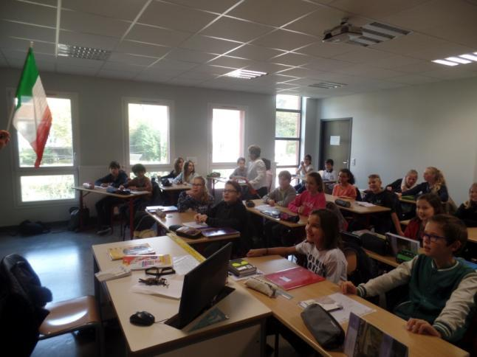
Course by the Italian teachers,
Filomena and Filomena

Slide 20
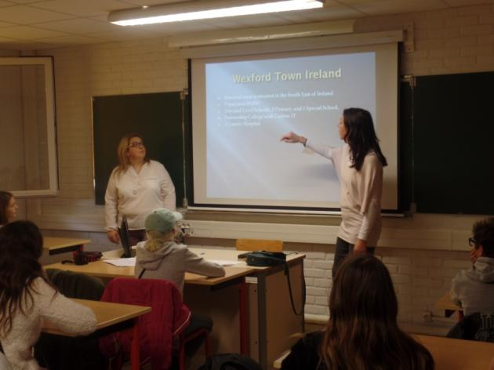
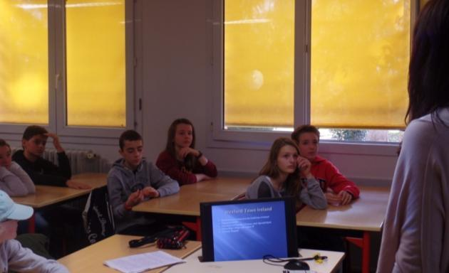
Course by the Irish teachers, Glenda and Melissa

Slide 21
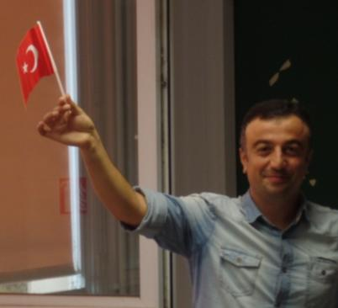
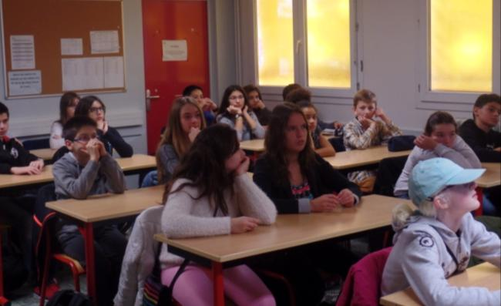
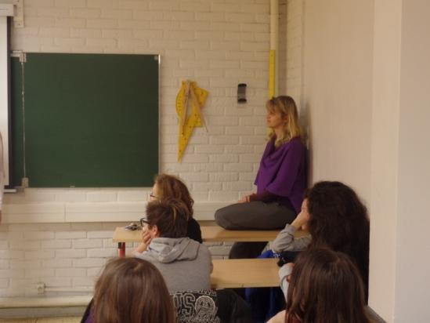
Course by the Turkish teachers, Nurdan and Tansel

Slide 22
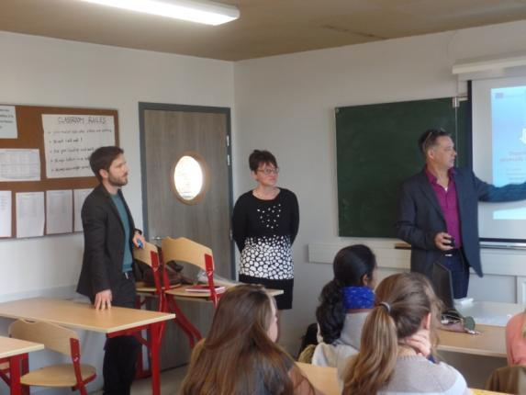
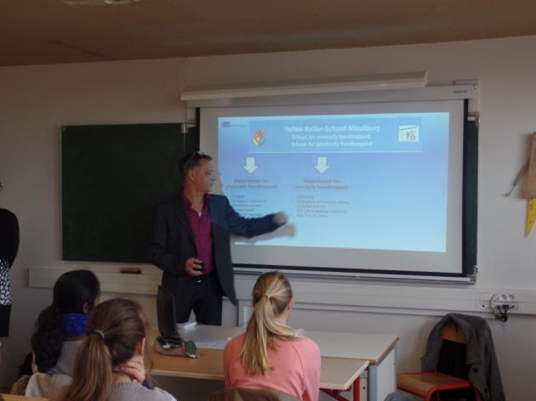
Course by the German teachers, Benjamin, Frank and Petra

Slide 23
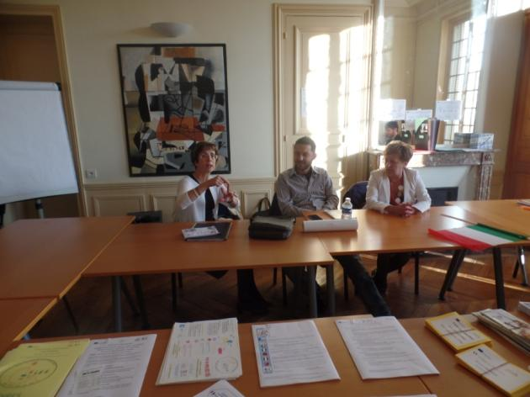
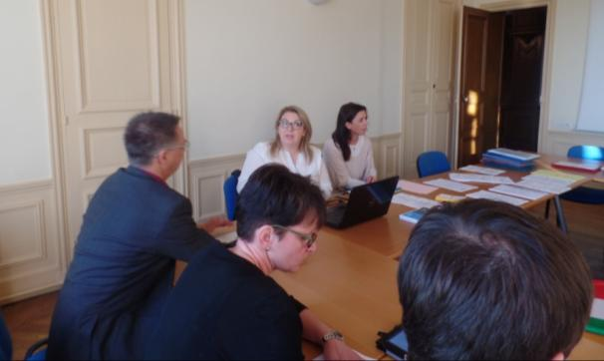
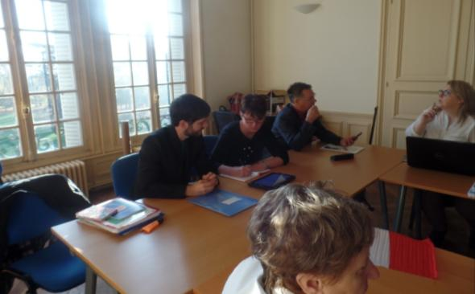
Meetings for the European staff of the project

Slide 24
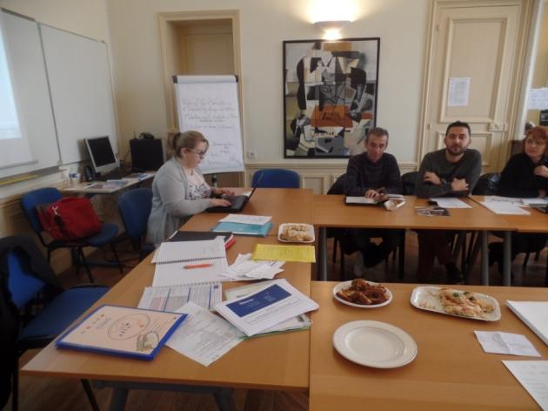
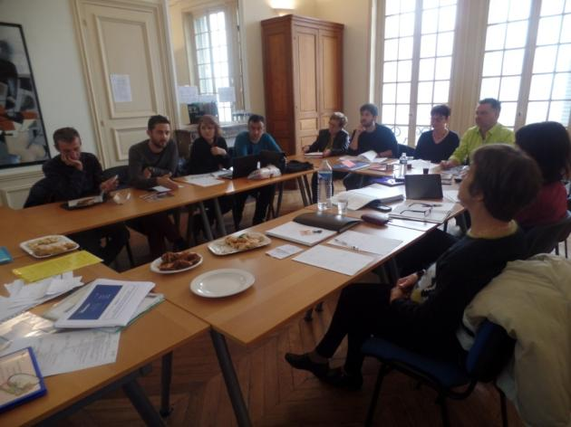
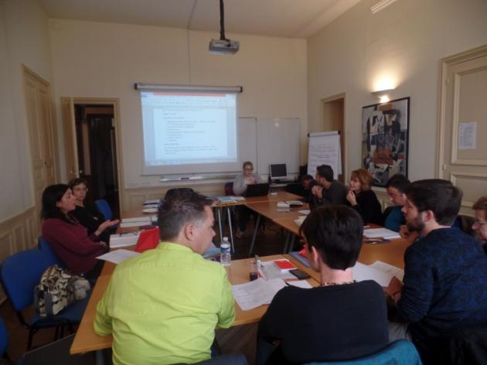
Meetings for the European staff

Slide 25
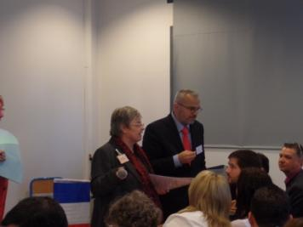
PRESS CONFERENCE (1/14) Preparation

Slide 26
PRESS CONFERENCE (2/14) Audience and guests

Slide 27
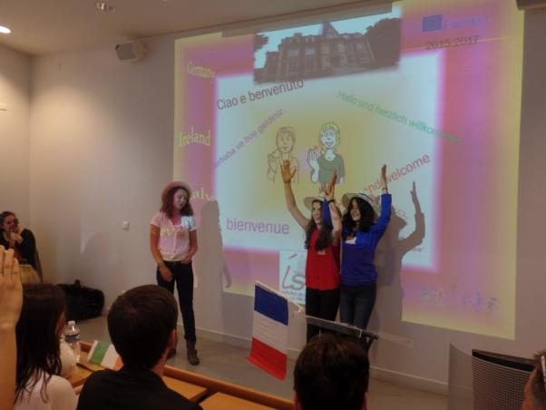
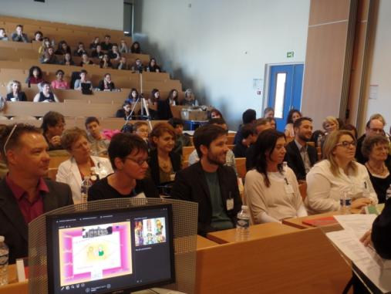
PRESS CONFERENCE (3/14) Introduction by young French students

Slide 28
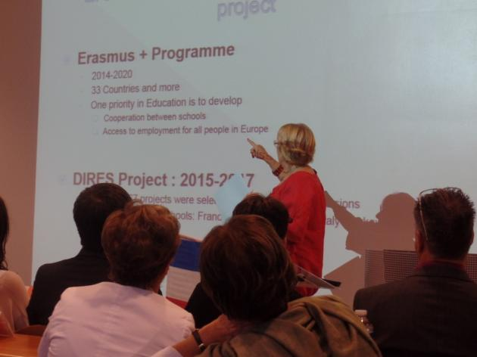
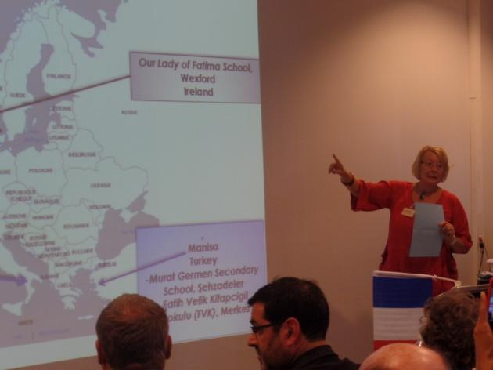
PRESS CONFERENCE (4/14) Presentation of the Erasmus + project DIRES

Slide 29
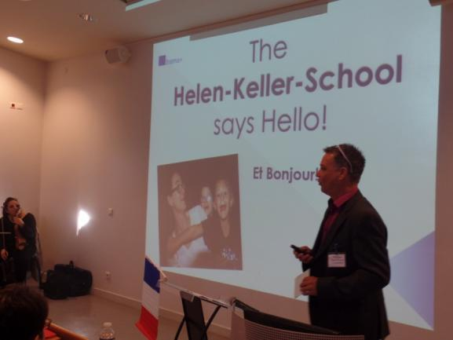
PRESS CONFERENCE (5/14) Presentation of the German school by Frank

Slide 30
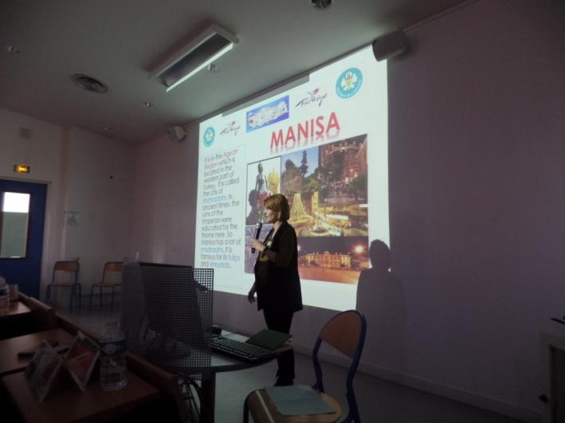
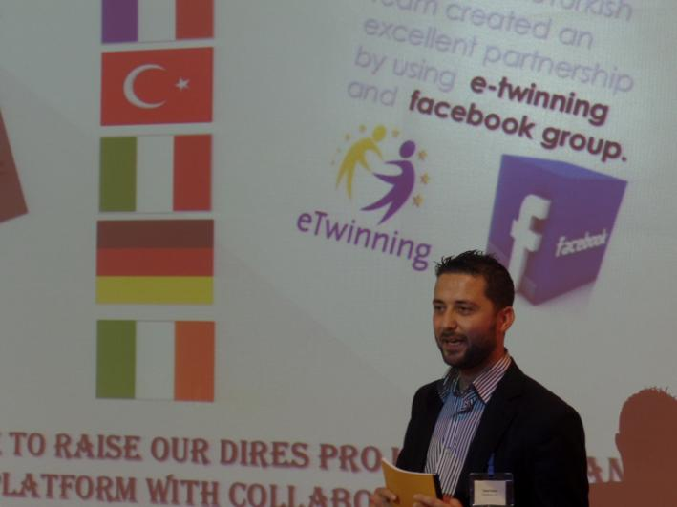
PRESS CONFERENCE (6/14) Presentation of the Turkish schools by Nurdan and Tansel

Slide 31
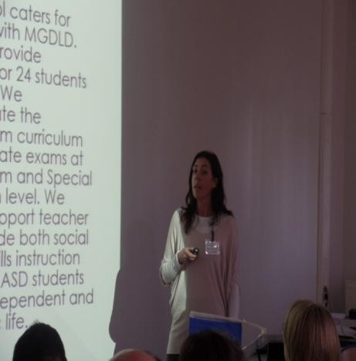
PRESS CONFERENCE (7/14) Presentation of the Irish school by Glenda

Slide 32
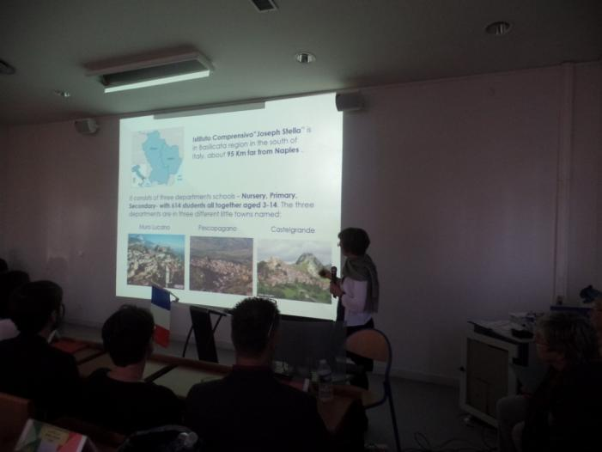
PRESS CONFERENCE (6/) Presentation of the Turkish school by
PRESS CONFERENCE (8/14)
Presentation of the Italian school by Filomena

Slide 33
PRESS CONFERENCE (9/14) Presentation of the French school by Danielle

Slide 34
PRESS CONFERENCE (10/14) Presentation of the Ulis structure by Christine

Slide 35
PRESS CONFERENCE (11/14) The GUESTS Marie-France Mailhos, President of AEDE France, European Association of Education

Slide 36
PRESS CONFERENCE (12/14) The GUESTS
Louis-Marie Piron, General Delegate for International and European relationship for French Catholic Schools

Slide 37
PRESS CONFERENCE (13/14) The GUESTS
Philippe Richard
NGO-UNESCO Liaison Committee : International Office for Catholic Education (OIEC)

Slide 38
PRESS CONFERENCE (14/14) Families

Slide 39
Tasting specialities of the 5 countries involved in the DIRES project

Slide 40
Inclusion at the ISC in ULIS Structure for students with Special Educational Needs (1/5) Christine and her 10 students welcome the European staff in their ULIS dedicated classroom where they are when they are not in classes with mainstream students

Slide 41
Inclusion at the ISC (2/5) The French delegation of students: 2 are Ready for the mobility in Ireland January 17-23 th 2016!

Slide 42
Inclusion at the ISC (3/5) The French delegation of students: 3 are ready for the mobility in Italy March 6-12th 2016!5

Slide 43
Inclusion at the ISC (4/5) The French delegation of students Ready for the mobility 2016-2017!

Slide 44
Inclusion at the ISC (5/5) Mobility 2016-2017 Very happy to welcome the DIRES European partners:
The German delegation
The 2 Turkish delegations

Slide 45
Visit of Paris by night

Slide 46
Visit of Paris by night

Slide 47
Paris by night

Slide 48
Paris by night

Slide 49
Departure of the European delegations The Irish and the Italian delegations

Slide 50
Departure of the European delegations The 2 Turkish delegations

Slide 51
Dissemination of the project (1/2)
Intern dissemination at the ISC School: Press conference/ Courses
Number of participants, students and adults: 260
Class: 6eme
Students:32
Class:
5eme
Students: 32
Class:
3eme
Class:
4eme
Students: 31
Class: 3eme D
Class: 6eme F
Classes: 4eme A/C/E/
Classe: 5eme F
Students: 32

Slide 52
Dissemination of the project (2/2)
Extern dissemination:
Five Partner schools in 5 countries: Germany, France, Ireland, Italy and Turkey
Local newspaper: Le Républicain
Association: AEDE France, European Association of Education
Enseignement catholique
UNESCO
MAIF: Seminar for Schooling and Disability

Slide 53
DIRES: 5 countries, 6 schools (1/2) European staff of the project
Germany: Helen-Keller-Schule, Maulburg
Frank Peiszan, Deputy headmaster
Petra Brombacher,Coordinator
Benjamin Haag
Ireland: Our Lady of Fatima School, Wexford
Glenda Mc Keown, Coordinator
Melissa Sinnott, ASD Support teacher
Italy: Istituto Comprensivo « J. Stella », Muro Lucano
Miss A.M.F. Pinto, Headmistress
A.Filomena Mungiello,Coordinator
Turkey :
Murat Germen Secondary School, Şehzadeler
Ercan Ayyıldız , Headmaster
Tansel SAKACI, Coordinator
Fatih Vefik Kitapcigil Ilkokulu (FVK), Merkez
Fatma Nurdan AKSOY Coordinator , Teacher of English.
Zirkrullah ÇAKIR : Guidance Counselor

Slide 54
DIRES: 5 countries, 6 schools (2/2) European staff of the project France-ISC Hostschool
M. Jammes, Headmaster and Coordinator
Danielle Lavollée, European Coordinator
Christine Magne, Ulis Coordinator
Frédérique Gauthier, Educational Consultant Guidance
Violaine Ludmann, Executive secretary
Véronique Proust , School Receptionist
Patrice Bourdiau, Educator
Nicole Villet, Educator
Agnès Goupil, Bookkeeper
Laurence Martin, Educator
Florence Georges, Educational Consultant Guidance
Céline Topolski, Art Teacher
Marina Bobrikoff, Art Teacher
Marie-Liesse Van Heeswyck, Teacher of Geography
Marie-Anatolie Jaozandry, Teacher of French
Isabelle Moulin, Teacher of English
Grégory Gigou, IT manager
Janos Dula, Educator

Slide 55
Photos: Frédérique Gauthier, Educational consultant guidance Powerpoint with the cooperation of all the staffs: Danielle Lavollée, European coordinator

