Slide 1
our region:
EMILIA ROMAGNA

Slide 2
1.
EMILIA ROMAGNA:
geography
Giacomo Minotti

Slide 3
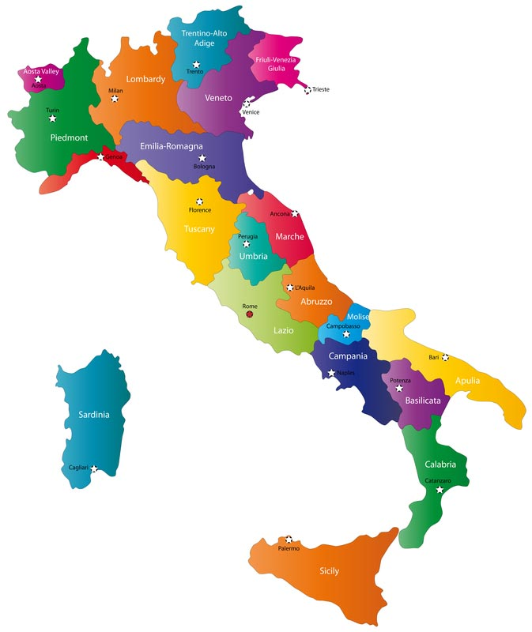
where is Emilia Romagna situated in Italy?
Emilia Romagna region is situated in northern Italy and it borders the Veneto and the Lombardy to the north, the Piedmont and the Liguria to the west, the Tuscany, the Marche and San Marino to the south and the Adriatic sea to the east.
Adriatic sea
Tyrrhenian Sea

Slide 4
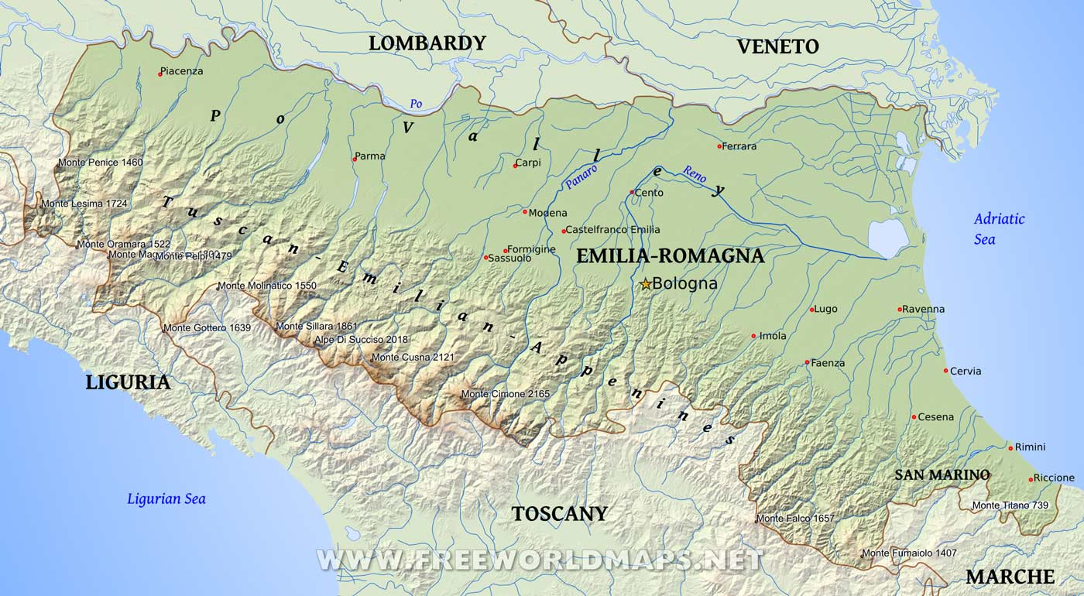
Emilia Romagna’s territory
The territory of Emilia Romagna is divided into a:
48% of flat land, the Po Valley, in the northern territory of the region.
27% of mountains, the Apennines, in the southern territory.
25% of hill, situated between the mountains and the Po Valley

Slide 5
Emilia Romagna’s typical climate
Emilia Romagna’s typical climate is a temperate subcontinental climate with hot and humid summers and cold and harsh winters.
In north-eastern Emilia Romagna there’s an hotter climate than in the Apennines, where is colder.

Slide 6
2.
EMILIA ROMAGNA: demography
Tommaso Senni

Slide 7
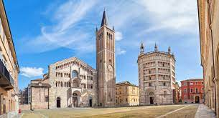
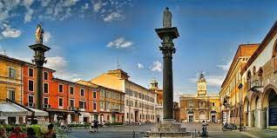
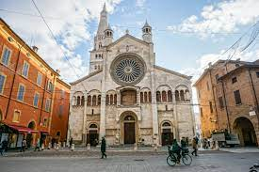
Emilia Romagna has 9 counties.
Modena (MO) has a total of 704.672 people in a surface of 2.687,88 km2 and a density of 262 people per km2.
Parma (PR) has a total of 453.604 people in a surface of 3.447,40 km2 and a density of 132 people per km2.
Ravenna (RA) has a total of 386.309 people in a surface of 1.859,39 km2 and a density of 208 people per km2.

Slide 8
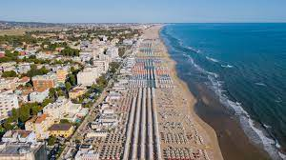
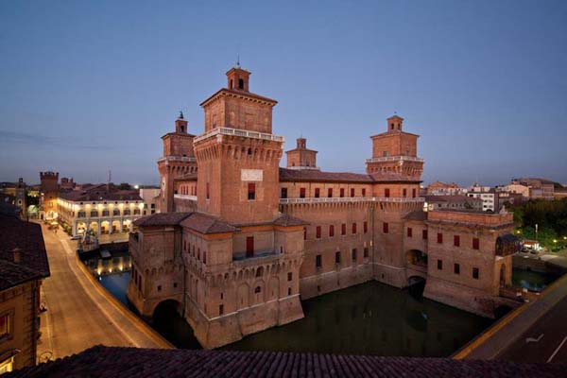
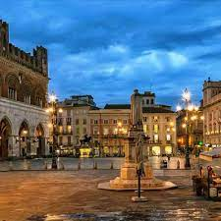
Emilia Romagna has 9 counties.
Ferrara (FE) has a total of 341.967 people in a surface of 2.627,38 km2 and a density of 130 people per km2.
Piacenza (PC) has a total of 284.075 people in a surface of 2.585,76 km2 and a density of 110 people per km2.
Rimini (RN) has a total of 335.478 people in a surface of 865,01 km2 and a density of 388 people per km2.

Slide 9
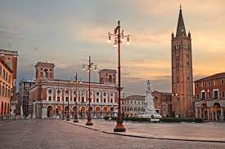
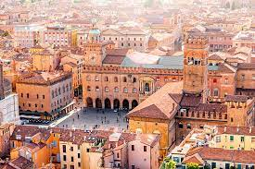
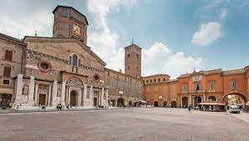
Emilia Romagna has 9 counties.
The capitol city of Emilia-Romagna is Bologna (BO), It has a total of 1.019.539 people in a surface of 3.702,25 km2 and a density of 275 people per km2.
Reggio Emilia (RE) has a total of 526.349 people in a surface of 2.291,15 km2 and a density of 230 people per km2.
Forlì - Cesena (FC) has a total of 393.556 people in a surface of 2.378,32 km2 and a density of 165 people per km2.

Slide 10
3.
EMILIA ROMAGNA:
second sector
economy
Stela Xhumri

Slide 11
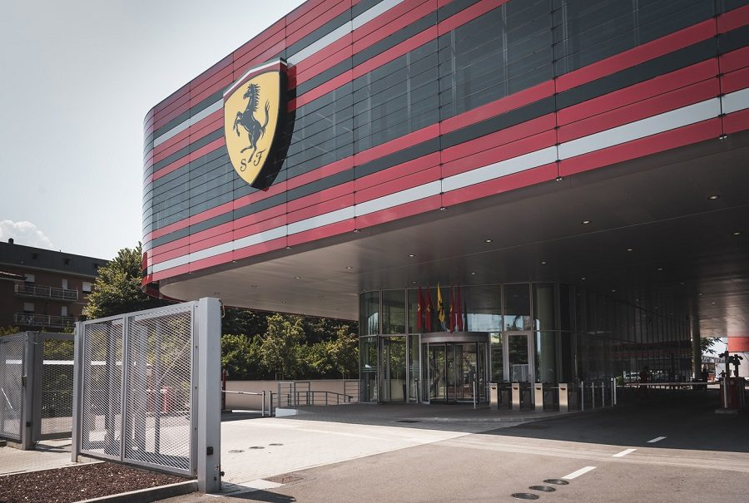
The region Emilia Romagna is famous for its food industries with products appreciated abroad such as Parmigiano-Reggiano cheese. Also important are the factories specialized in the mechanical sectors such as Ferrari and Lamborghini. In addition, small industries of clothing, ceramics and construction are also important.

Slide 12
4.
EMILIA ROMAGNA:
third sector
economy
Melissa Alagic

Slide 13
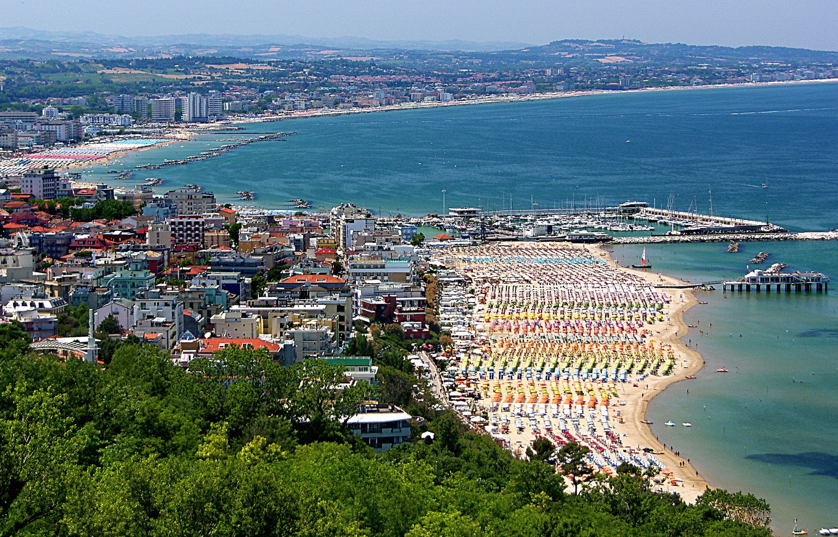
the service industry
In Emilia Romagna the service industry is developed thanks to “Riviera Romagnola” which counts 10 000 tourists in the summer , given the numerous hotels and clubs. In winter the most visited places are the apennine mountains , where you can ski , and the most important cities in the region.

Slide 14
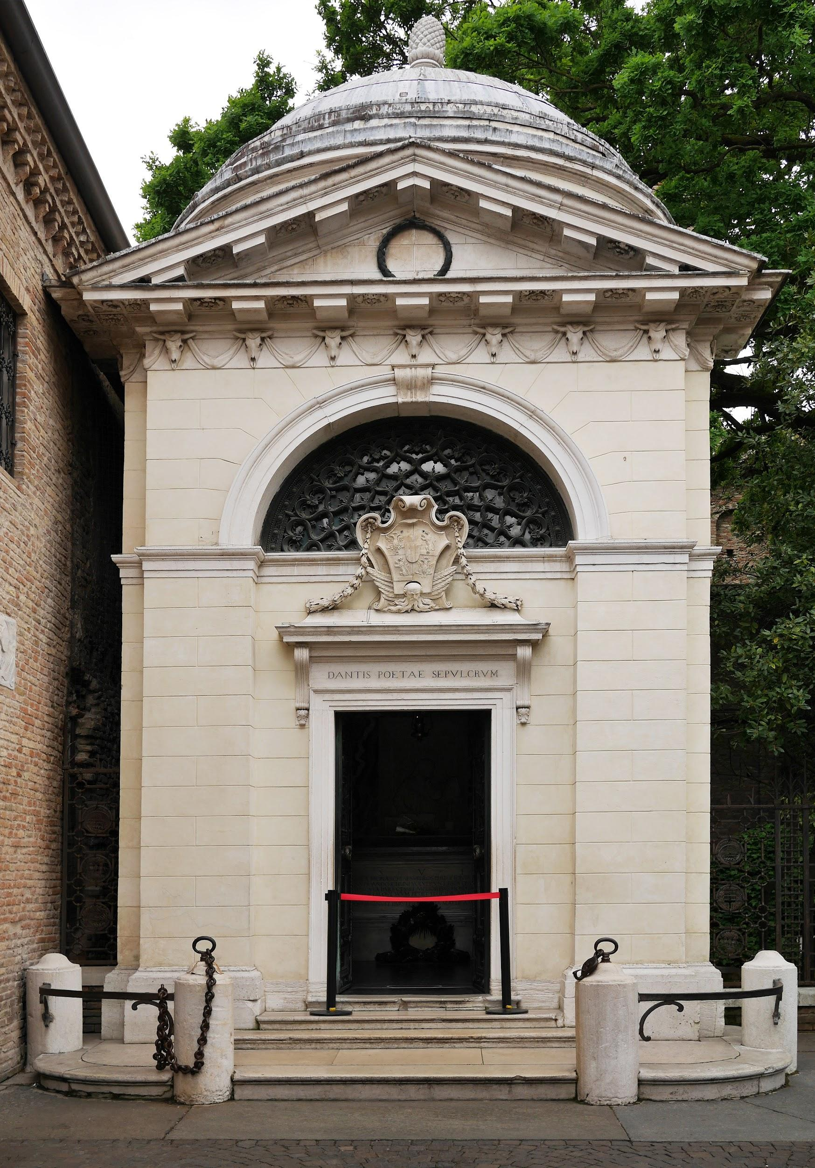
In Emilia romagna there are 4 universities and numerous assets protected by UNESCO , given the artistic currents of the Renaissance and other eras present in the most important cities for example Ravenna and others .

Slide 15
5.
EMILIA ROMAGNA:
BOLOGNA
Sara Sciarra

Slide 16
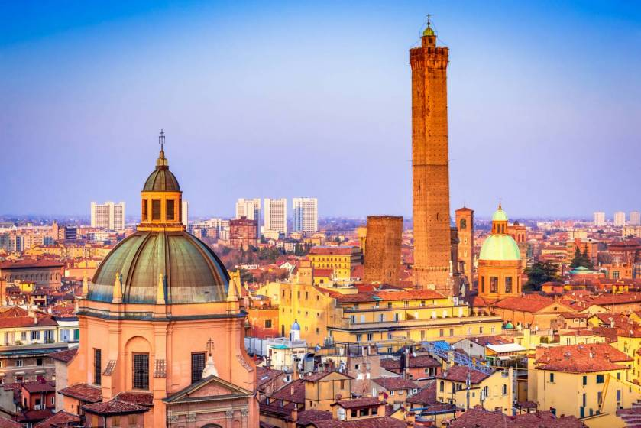
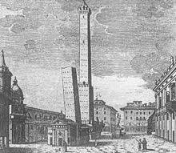
Bologna is an Italian town and capital of Emilia - Romagna.
geography
Bologna is located in the pianura Padana, close to the first hills of the Tuscan - emilian Apennines, has a humid temperate climate with very hot and humid summers and rather cold and humid winters.
history
Bologna took part in the fight against Barbarossa, which ended up with the Peace of Constance in 1183, after the fight against Barbarossa It experienced a strong expansion, including construction ( there was a period called those of tower-houses)It was one of the main centres of commercial exchange thanks to an advanced system of channels that allowed the transit of large quantities of goods and provided the necessary energy to power many industrial mills. At the end of the XIII century it had 50,000, perhaps 60,000 inhabitants. It played a very important role during the Risorgimento and, during World War II, was an important center of the Resistance. The most famous episode of the Resistance of Bologna was the Battle of Porta Lame, fought on November 7, 1944.

Slide 17
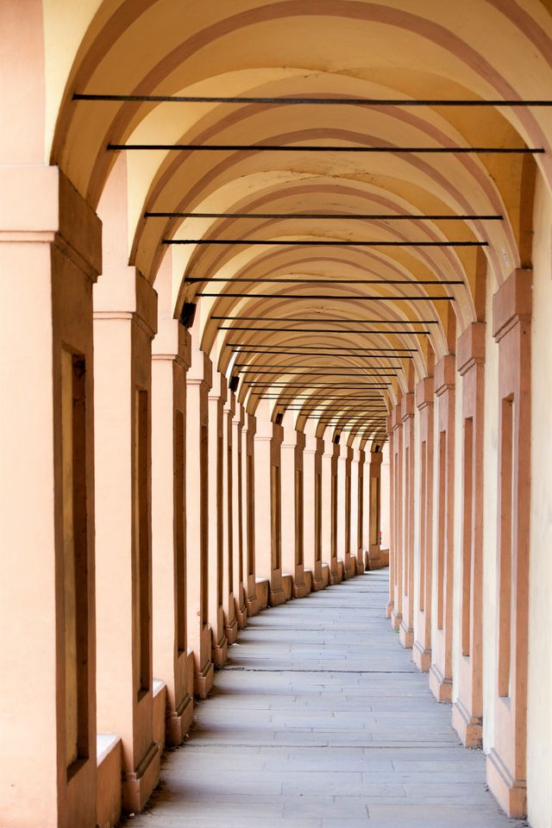
monuments
Bologna hosts one of the most ancient universities in the occidental world, it also accommodates lots of students. Her fame is due to its long arcades and a well-preserved city centre, one of the largest in Italy.
arcades
Bologna is the city of arcades: over 38 km in the historic center. They are found in almost all the streets of the center and their origin is partly due to the strong expansion that Bologna had in the late Middle Ages. In 2021 its arcades were recognized as a World Heritage Site by UNESCO.
towers
It is known for its towers, among the surviving towers we can mention the Torre Azzoguidi (61 meters high), the Torre Prendiparte (59.50 meters), and the well-known two towers: the Torre degli Asinelli and the Torre della Garisenda, they’re built by Ghibelline nobles in the twelfth century. The most outstanding of the two, the Garisenda, was mentioned several times by Dante Alighieri, in the Divine Comedy (Inferno, XXXI, 136-140).
The reasons why so many towers were built are not yet clear, but it is thought that the richest families, in the period of struggle for the investitures pro-imperial and pro-papal, used them as an instrument of offense and/ or defense and as a symbol of power. In later times they were used in different ways: prisons, civic towers, shops, housing.

Slide 18
6.
EMILIA ROMAGNA:
TYPICAL FOOD
Miriam Sassaoui

Slide 19
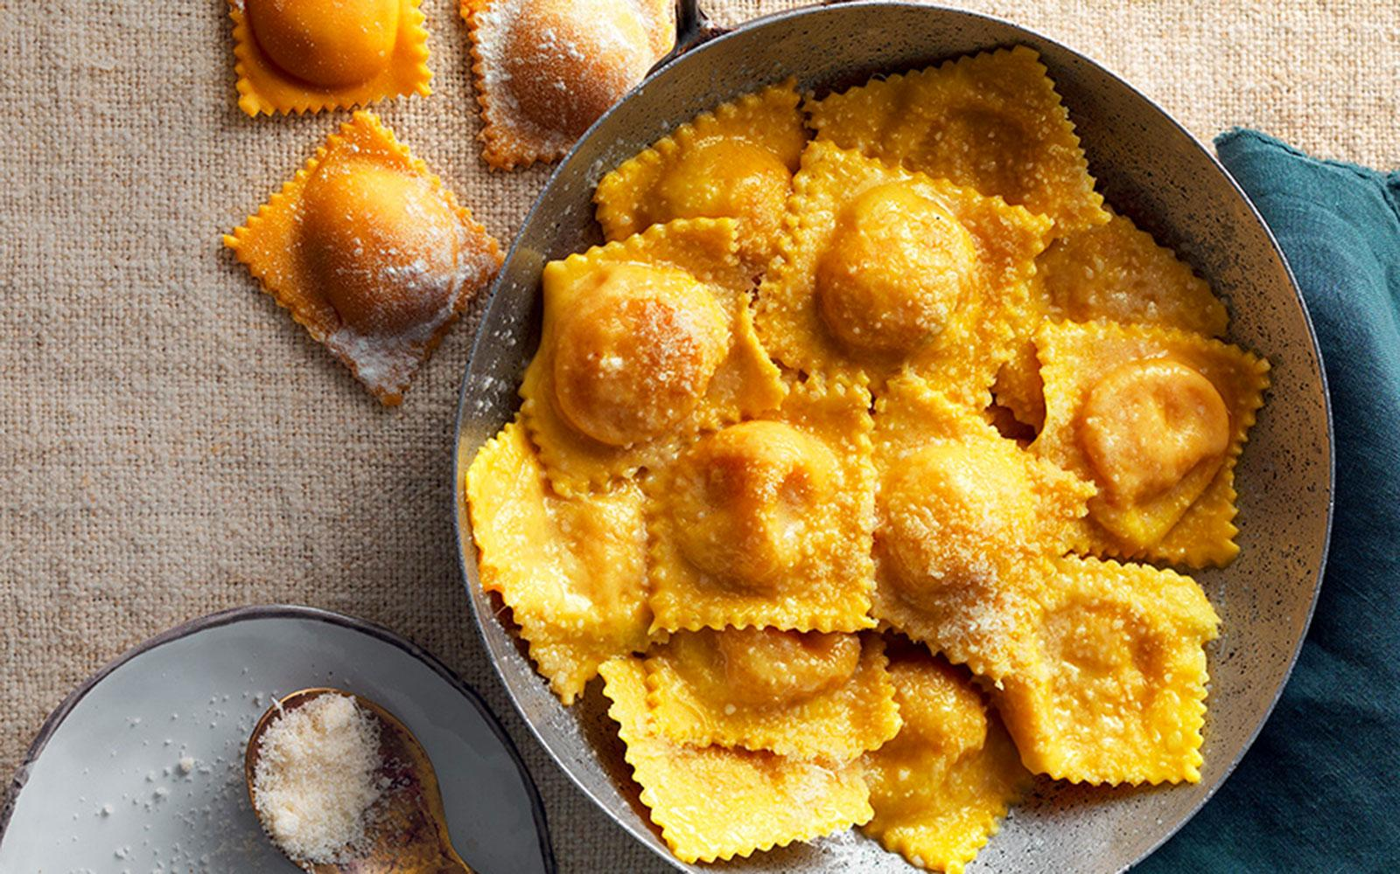
typical food in Emilia Romagna
cappelletti
Along with the tortelli, one of the tastiest Emilian dishes is cappelletti. It is always fresh pasta like tortelli, preferably rolled by hand, with a filling of meat, bread or cheese. You can taste them in broth, or accompanied by a sauce. Once they were prepared after Lent ( period preceding the celebration of Easter) and were destined for the tables of great occasions.

Slide 20
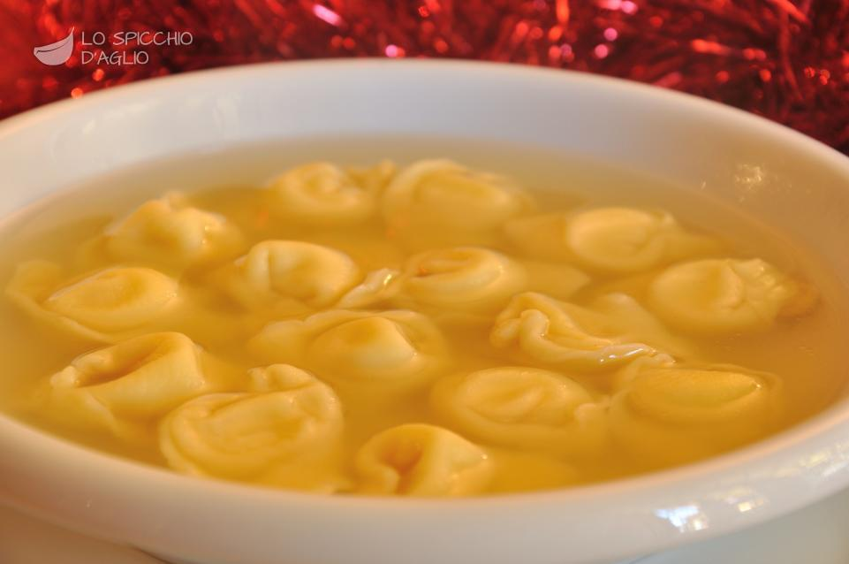
typical food in Emilia Romagna
tortellini
Among the first dishes of the tradition stand out the tortelli, widespread in all the provinces of Emilia. Usually the tortelli can be filled with various condiments such as: herbs, ricotta, pumpkin, or potatoes. In some provinces it is typical to eat them in the company of friends and relatives, during the night of San Giovanni, which falls on June 23.

Slide 21
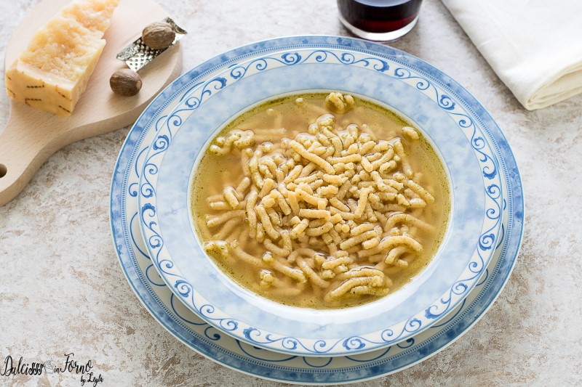
typical food in Emilia Romagna
passatelli
One of the region’s most popular first courses is passatelli, perfect for cold days. It Is a pasta format typical of Emilia Romagna. The simple ingredients are breadcrumbs, parmesan and eggs, usually served in broth. In the past this exceptional soup was used as a kind of home medicine, reserved for women in the period after childbirth. Over the years it has become a festive dish and is historically consumed both in the city and in the countryside during holiday periods.

Slide 22
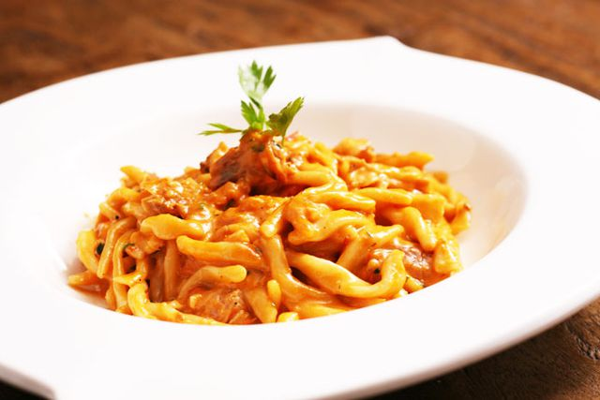
typical food in Emilia Romagna
strozzapreti
Strozzapreti are a type of fresh pasta from Romagna very old, very easy to prepare and really very cheap. Made with three simple ingredients: flour, water and salt. The origin of the name seems to derive from the time of the dominion of the Papal States in Romagna. In that time it seems that the priests took eggs to the wife who, left without eggs to make fresh pasta, they invented a dough composed only of water and flour. While they were making this pasta, they wished the priest to choke on the stolen eggs. As a condiment for strozzapreti are used various sauces

Slide 23
The End
Melissa Alagic
Giacomo Minotti
Miriam Sassaoui
Sara Sciarra
Stela Xhumri

