Slide 1
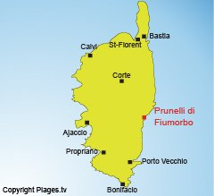
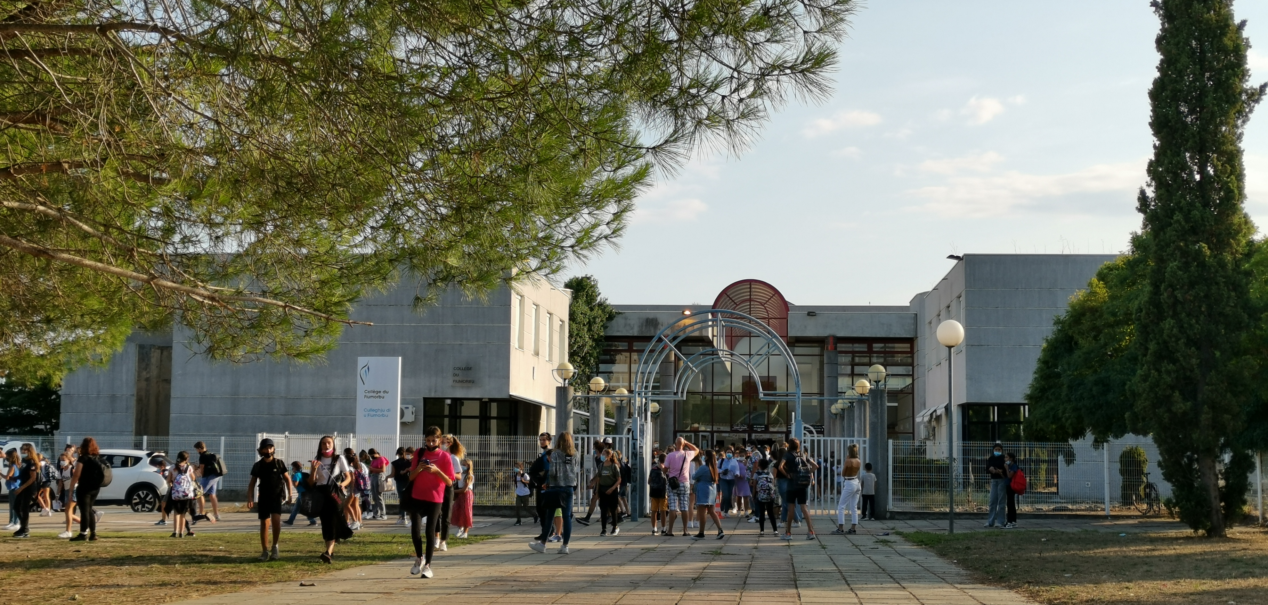
S.T.A.R.S & C.R.E.A.T.I.V.I.T.Y
KA227-28E1A842
Program: Erasmus+
Key Action: Cooperation for innovation and the exchange of good practices
Action Type: Partnerships for Creativity
Gender equality / equal opportunities Teaching and learning of foreign languages Environment and climate change
“Virtual training courses at Collège du Fiumorbo”
Day 1: Wednesday October 13th
Brigitte Collomb

Slide 2
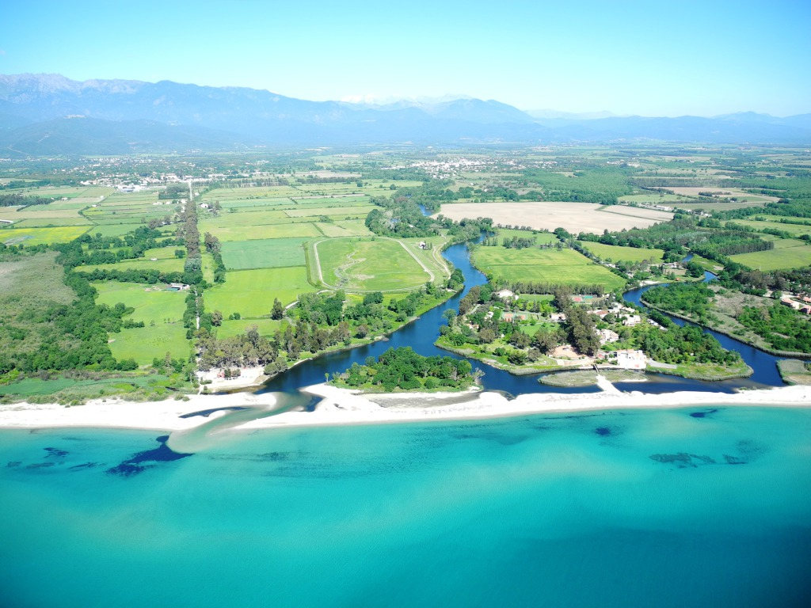

Slide 3
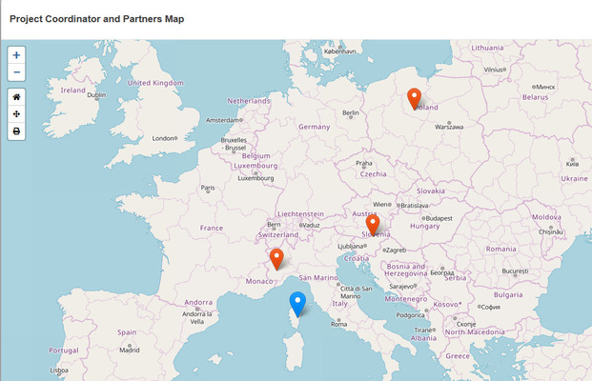
8.30 – 9.00: opening time.
Welcome to this transnational teachers’ meeting in France. I am particularly happy to spend a few days with you!
I am Brigitte Collomb, English teacher, eTwinning ambassador and quality project evaluator for eTwinning France, Erasmus développeur and leader of innovative project for Corsica.
Could you please make your own introduction?
Katarzyna Sopolińska - Poland
Joanna Pstrong - Poland
Annunziata Favasuli – Italy
Michela Nirino - Italy
Božidarka Vivat – Slovenia
Mihaela Hozjan – Slovenia

Slide 4
According to our application form, the purpose of this meeting is:
Organize training courses to start the project according to quality standards so that:
all the participants should able to use the TwinSpace functionalities as well as the basic collaborative tools we use in projects
manage the idea of project planification, communication, documentation: taking pictures, shooting videos and opening a YouTube channel in order to document the activities
advertise our products and measure their impact
Understand the idea of creativity as regards project-based learning

Slide 5
Each participant will play an important role in this project:
France: coordinate the whole project, create the activities on the TwinSpace; the mobility magazines, train the other partners in the required fields in order to assure project efficiency and quality on the Twinspace, mobility documentation and newsletters written collaboratively on Madmagz.
Poland: Twinspace co-founder; in charge of teacher training; will be in charge of measuring the project and results impacts at various stages on our various targets and of analysing and promoting the results. It will be the responsible school to prepare a detailed ‘risk management plan ‘,

Slide 6
Italy: will be co-founder of our Wiki TwinSpace with France. They will be in charge of dissemination, valorisation and sustainability of our project and results; they will create a dissemination plan and strategy (what? To Whom? When? / Timetable, activities, feedback) thanks to a Matrix including the tools used; with measurable, realistic objectives that adhere to a timetable in order to maximize the use and transfer of project results by targets groups and other stakeholders. Advertising our project results thanks to several channels (events, social media, media, ...), networking and lobbying. Dissemination activity will imply collaboration with the students to work on other aspects of creativity.
Slovenia: will be our technical advisor with the IT teachers; they will create technical and artistic tutorials. They will be in charge of project branding and visual identity in collaboration with the other partners and students. They will create our virtual tours and write some reports and articles dedicated to the technical tools and innovative digital tools. They will advise us the best eco-friendly practices for the project management. They will be in charge of competences valuation. (formal, non-formal and informal)

Slide 7
Each participant will play an important role in this meeting!
Today’s Program:
DAY 1: Wednesday October 13th 2021
8.30 – 9.00: Opening time.
9.00 – 9.30: Ice breaking activity
9.30 – 10.00: eTwinning & Erasmus+ synergy
10.00 – 12.30: How to use the TwinSpace and the basic tools.
12.30: Media minute! Special Slovenia!

Slide 8
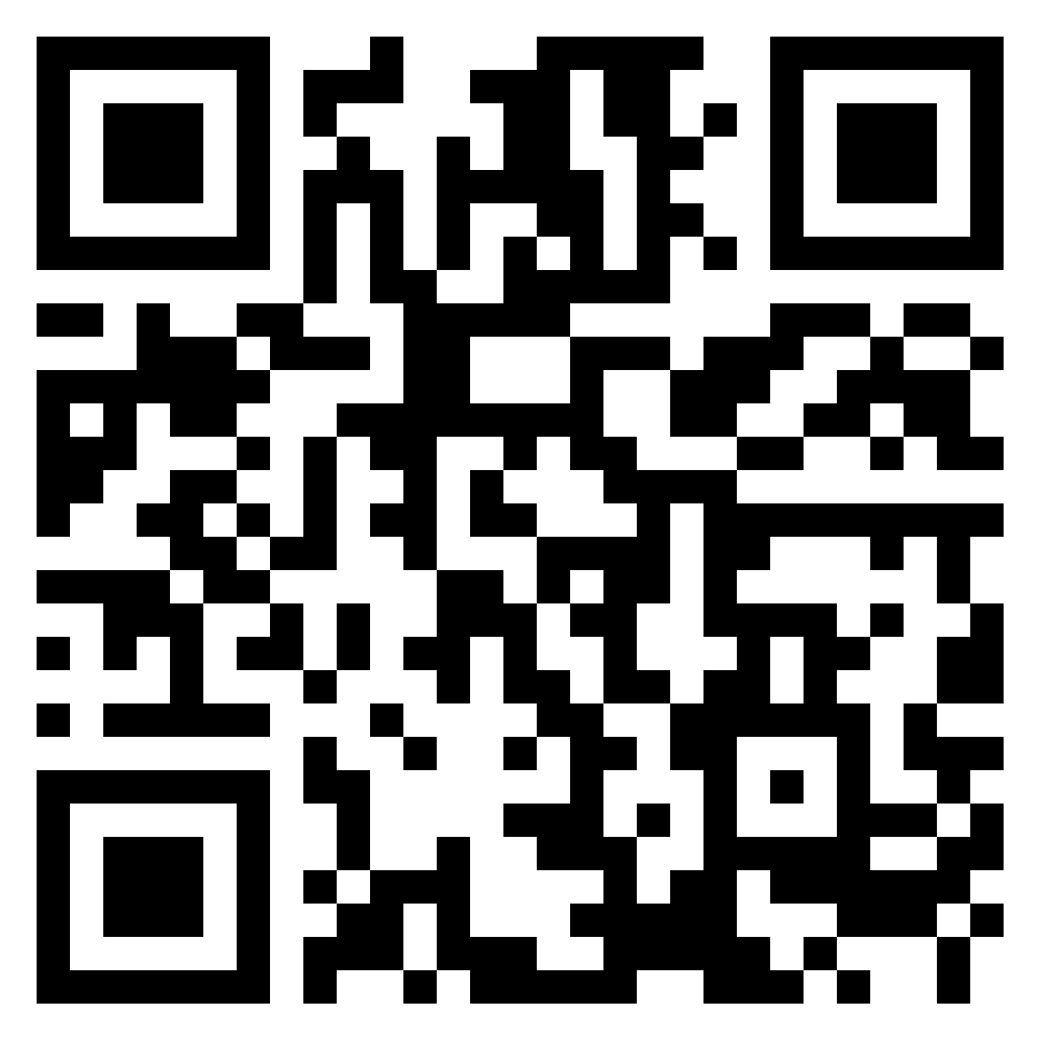
9.00 – 9.30: Ice breaking activity
https://padlet.com/brigitte_collomb/eazmmmeyg7gn

Slide 9
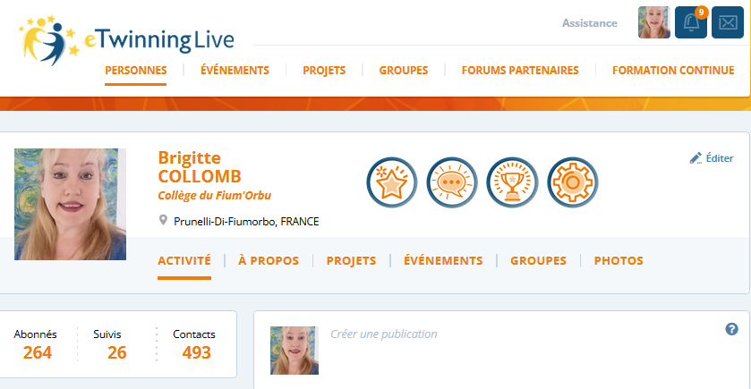
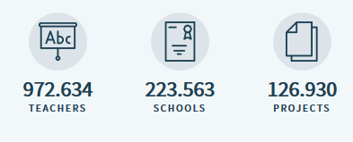
9.30 – 10.00: eTwinning & Erasmus+ synergy
You are an eTwinner!
eTwinning is a community, a network, an online platform.
An action of the Erasmus+ program (European Commission),
The eTwinning community involves hundreds of teachers from all school subjects, who learn from each other, share practices and ideas from kindergarten to high school, which make eTwinning the largest teacher network in the world.
And it has a home: eTwinning Live.

Slide 10
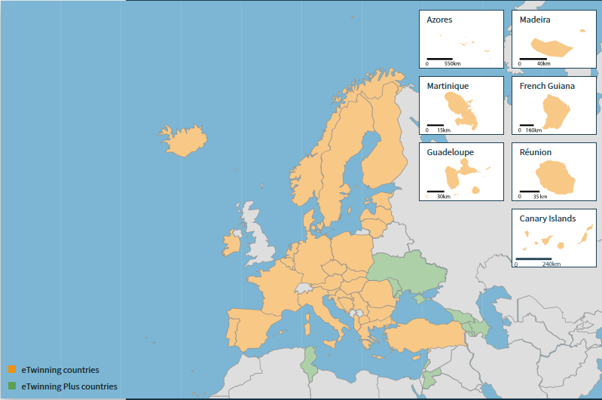
44 countries form the eTwinning and eTwinning Plus community in Europe where eTwinners form strategic partnerships, exchange innovative practices, develop European citizenship, digital literacy and lifelong learning.

Slide 11
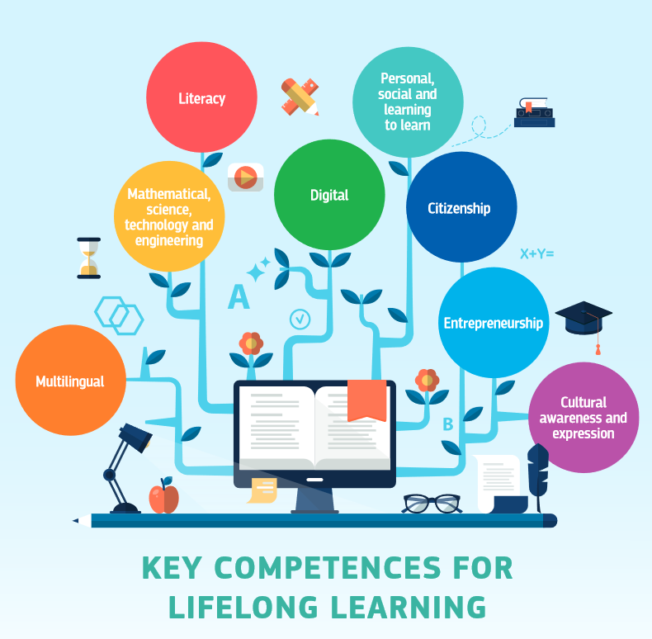
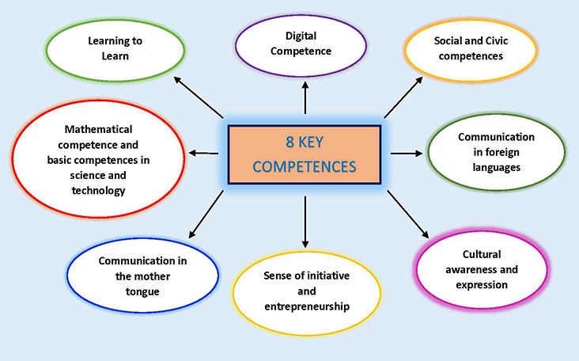
QUALITY PROJECTS :
A community that supports and strengthens the development of the 8 key competences and basic skills for all from an early age and throughout life.
Key competences and basic skills are necessary for personal fulfilment and development, employability, social inclusion and active citizenship.
eTwinners / Erasmus+ teachers propose educational strategies to develop these competences through their projects. (educational, pedagogical, didactic)

Slide 12
1. communication in the mother tongue: ability to express and interpret concepts, thoughts, emotions, facts and opinions both orally and in writing.
2. communication in foreign languages: as above, but includes mediation skills (i.e. summarizing, paraphrasing, interpreting or translating) and intercultural understanding skills.
3. Mathematical competence and basic competences in science and technology: sound and reliable command of arithmetic-mathematical competences, understanding of the natural world and the ability to apply knowledge and technology to perceived human needs (such as medicine, transport or communications).
4. Digital competence: safe and critical use of information and communication technology at work, in leisure and for communication.
5. learning to learn: ability to effectively manage one’s own learning, both individually and in groups
6. Social and civic competences: ability to participate effectively and constructively in social and working life and to engage in active and democratic participation, especially in increasingly diverse societies.
7. initiative and entrepreneurship: the ability to turn ideas into action through creativity, innovation and risk-taking, as well as the ability to plan and manage projects.
8. Cultural awareness and expression: the ability to appreciate the creative importance of ideas, experiences and emotions expressed through a variety of media such as music, literature and the visual and performing arts.

Slide 13
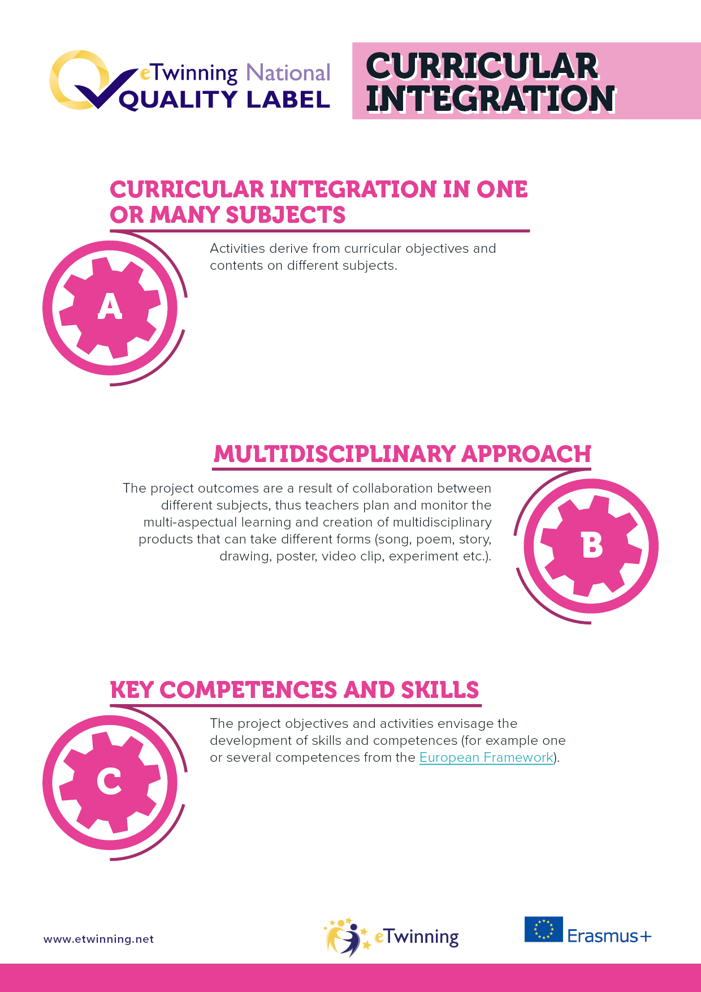
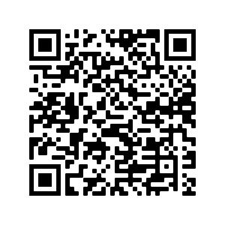
QUALITY PROJECTS = CRITERIA FOR QUALITY LABELS
https://www.etwinning.net/en/pub/benefits/recognition/etwinning-national-quality-lab.htm

Slide 14
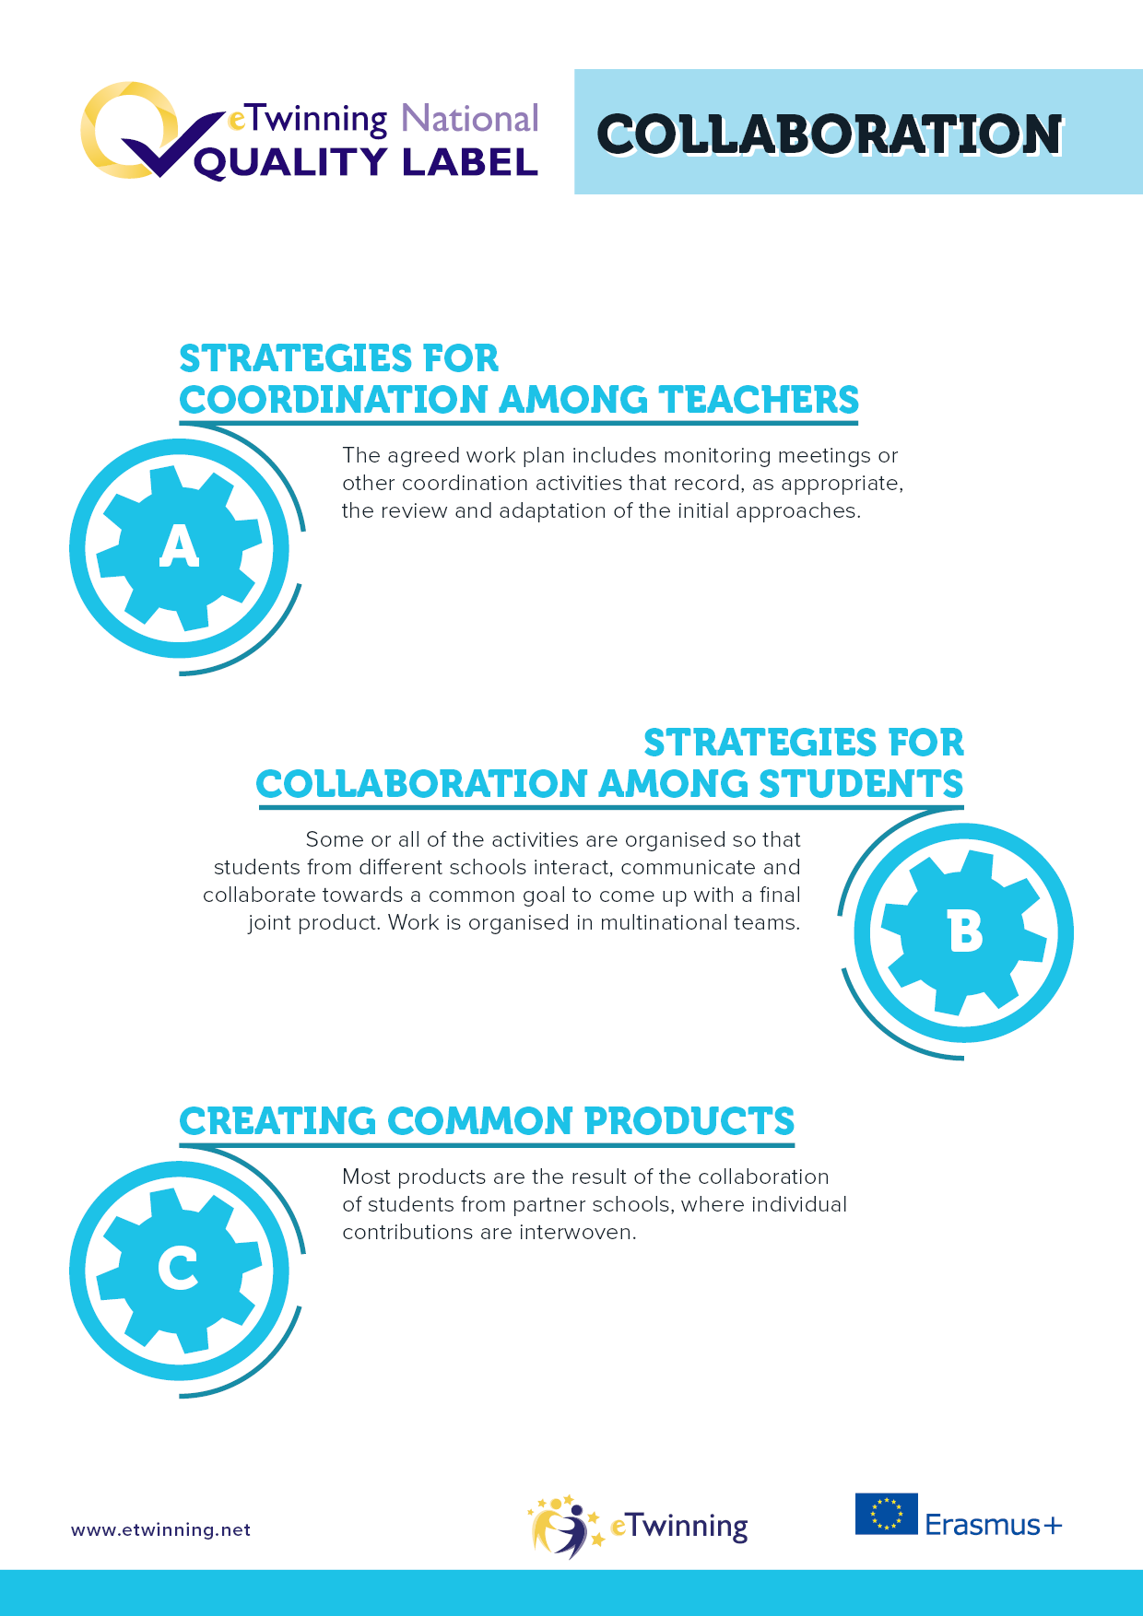
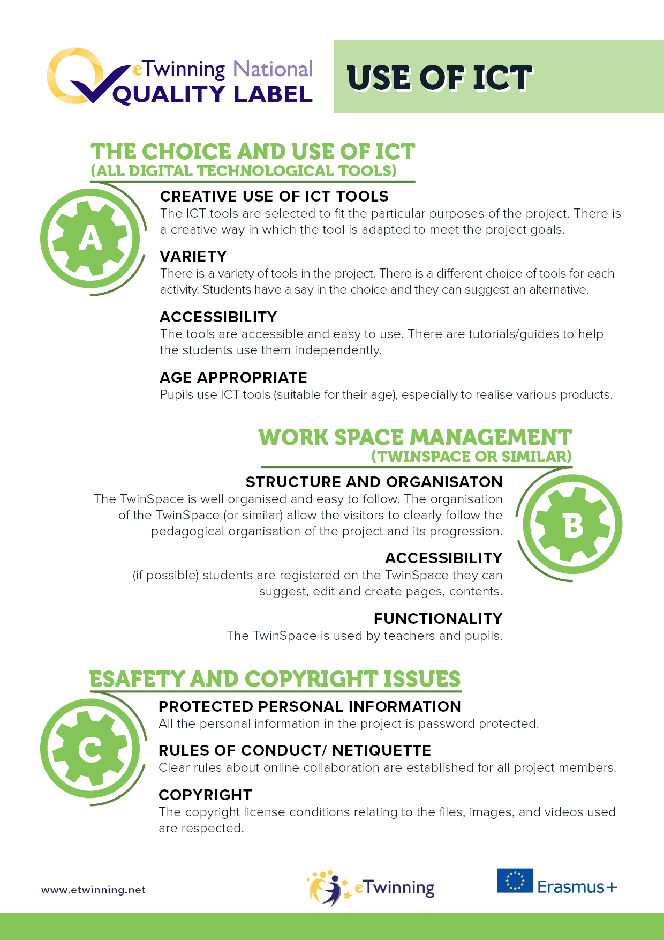

Slide 15
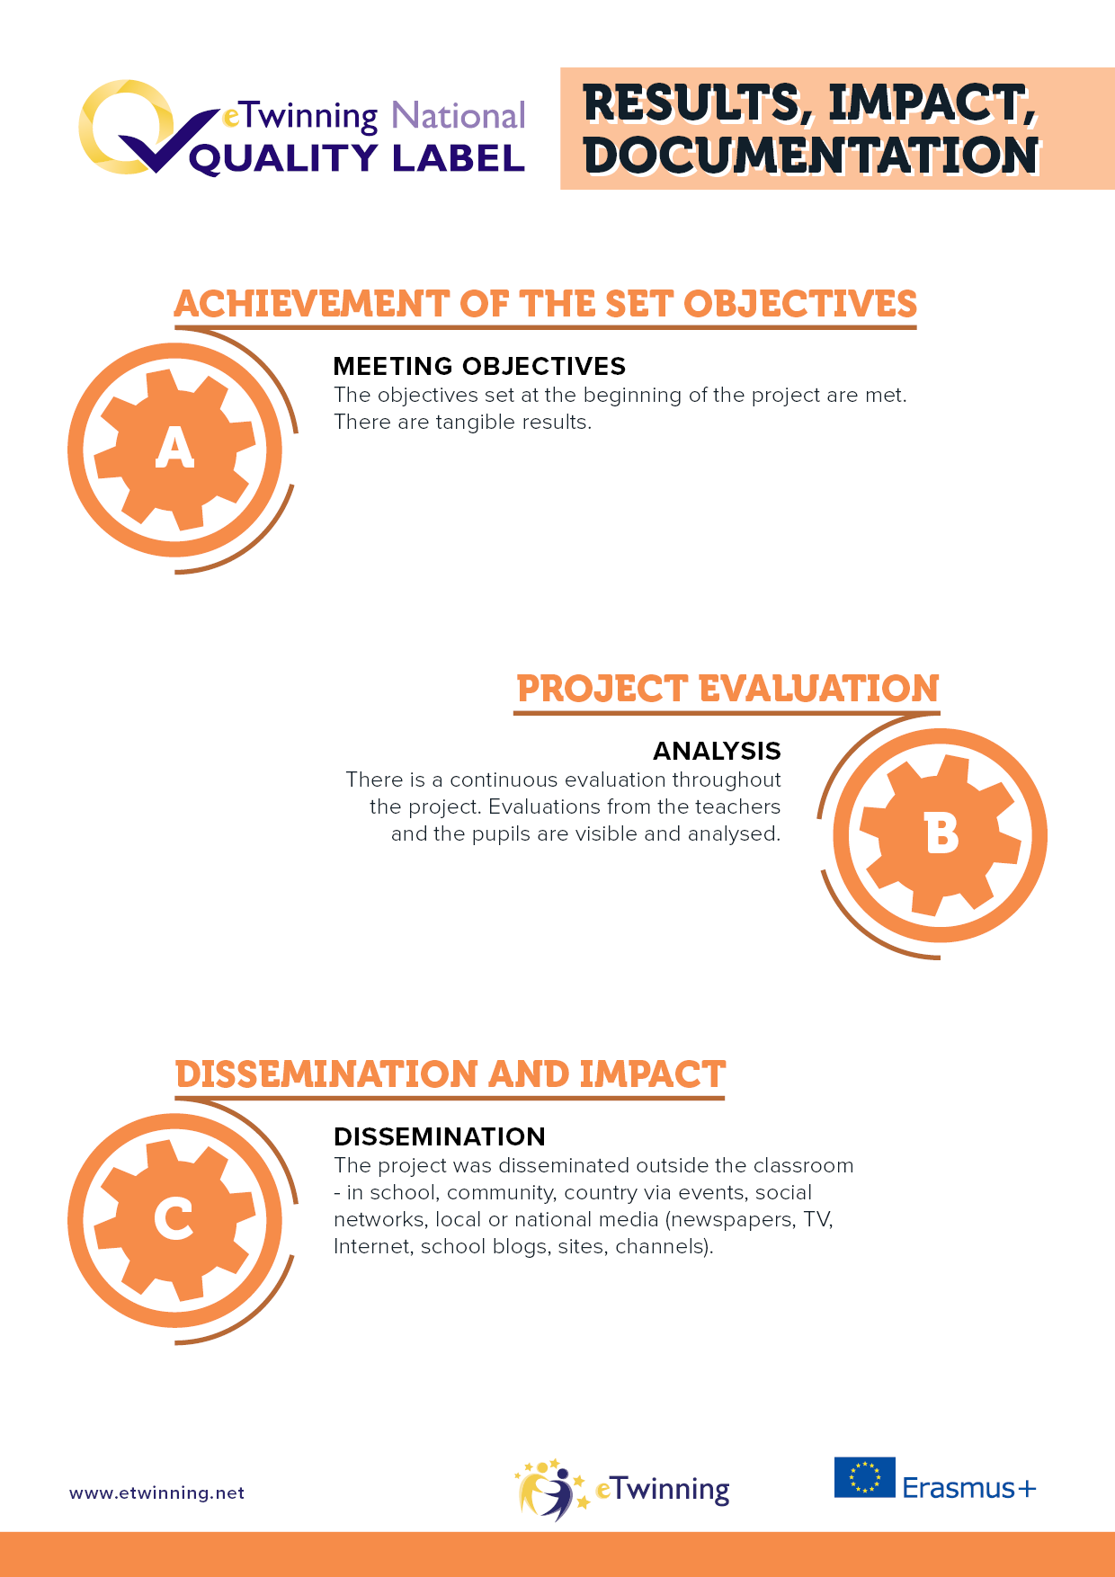
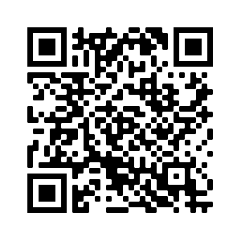

Slide 16
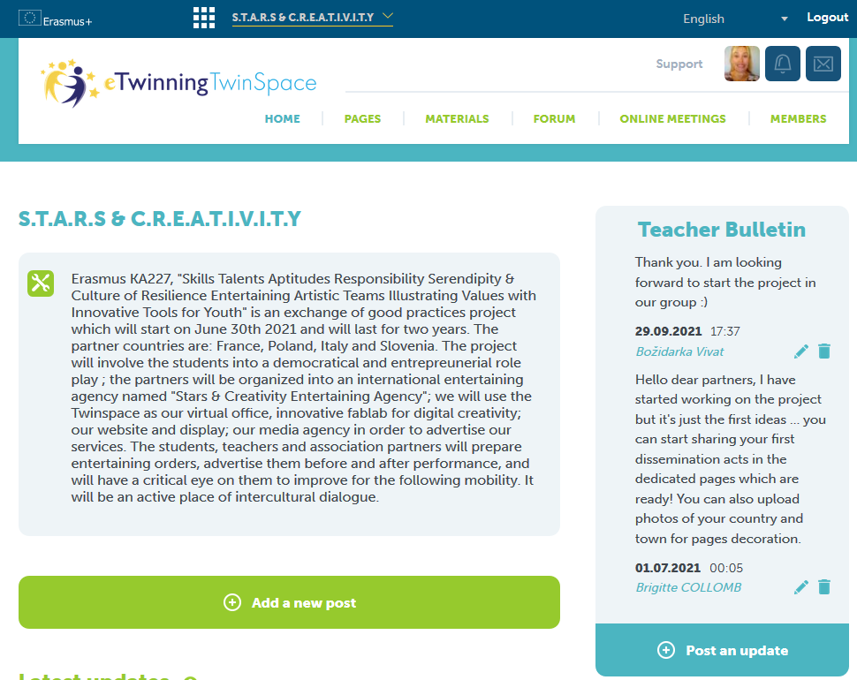
A TwinSpace for each of your eTwinning Erasmus project.
Open for every registered project
Easy and adapted tools:
Project journal
Teacher bulletin
Publication (blog style) in Pages and subpages.
Insertion of digital tools, videos, audio, photos, tables, links
Exchange of documents in the Materials
Videoconference and chat
Forums
Invitation of students, visitors, teachers outside Europe to your TwinSpace.
TO: share, collaborate, interact, choose, vote, communicate, teach and maintain regular contact between partners. To disseminate and promote your project.

Slide 17
How to use eTwinning in our Erasmus project?
VISIBILITY
Partners finding
Twinspace
Collaboration
evaluation
Dissemination
eTwinning = TwinSpace « S.T.A.R.S & C.R.E.A.TI.V.T.Y »
Quality labels
Erasmus Cooperation for innovation and the exchange of good practices
Action Type: Partnerships for Creativity
Mobility in Poland
Mobility in Italy
Mobility in Slovenia
Mobility in France
Report
Application
Funding
VISIBILITY

Slide 18
10.00 – 12.30: How to use the TwinSpace and the basic tools.
WORSHOP ON OUR TWINSPACE!
1
Task sheet
(It’s in the “Materials”, in the folder Collège du Fiumorbo-France”

Slide 19
12.30: Media minute! Special Slovenia!
DAY 2: Thursday October 14th
8.30 - 9.00: virtual coffee time to exchange useful tools animated by Slovenia!
9.00 – 10.00: what is a quality project? followed by a round table.
10.00 – 11.00: project evaluation to measure our project impact on the different targets & our “risk management plan” presented by Poland
11.00 – 12.30: Round table: Stars & Creativity Entertainment Agency is green, social and creative! (Associations we could work with)
12.30: Media minute! Special Poland!
Slovenia is giving a short summary of our first morning.
Everybody can contribute, question, interact!
For tomorrow:
Upload today’s pictures and screenshot in the « materials »
Answer the forum messages
Tweet on the day’s TwinBoard about Day 1.
Have a pleasant afternoon!
See you tomorrow!

