Slide 1
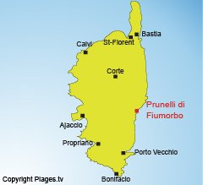
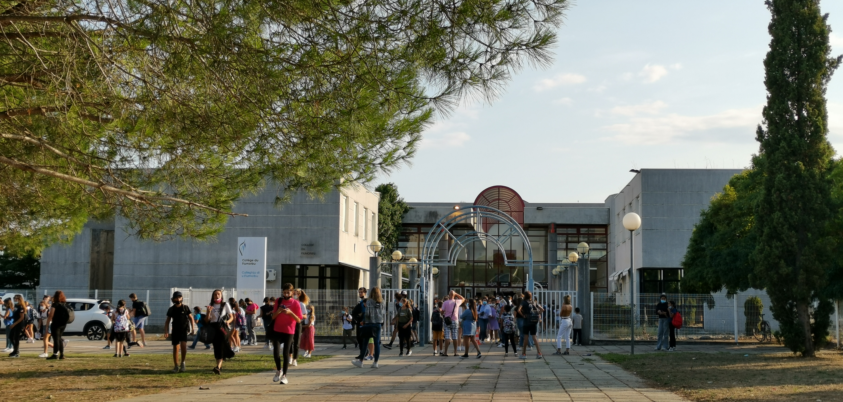
S.T.A.R.S & C.R.E.A.T.I.V.I.T.Y
KA227-28E1A842
Program: Erasmus+
Key Action: Cooperation for innovation and the exchange of good practices
Action Type: Partnerships for Creativity
Gender equality / equal opportunities Teaching and learning of foreign languages Environment and climate change
“Virtual training courses at Collège du Fiumorbo”
Day 3: Wednesday October 15th

Slide 2
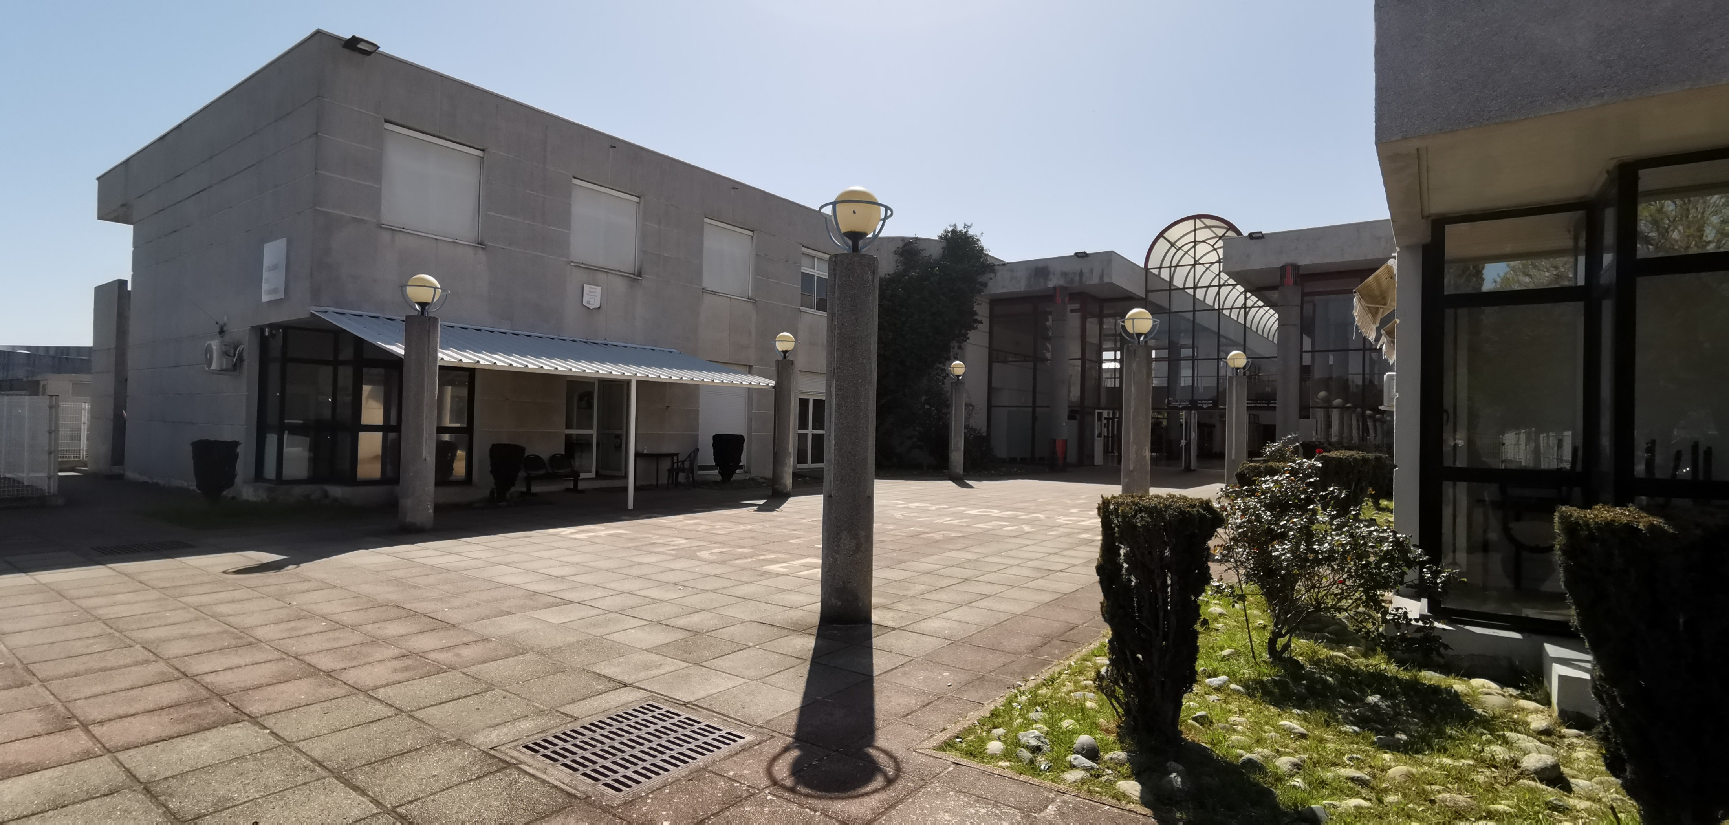
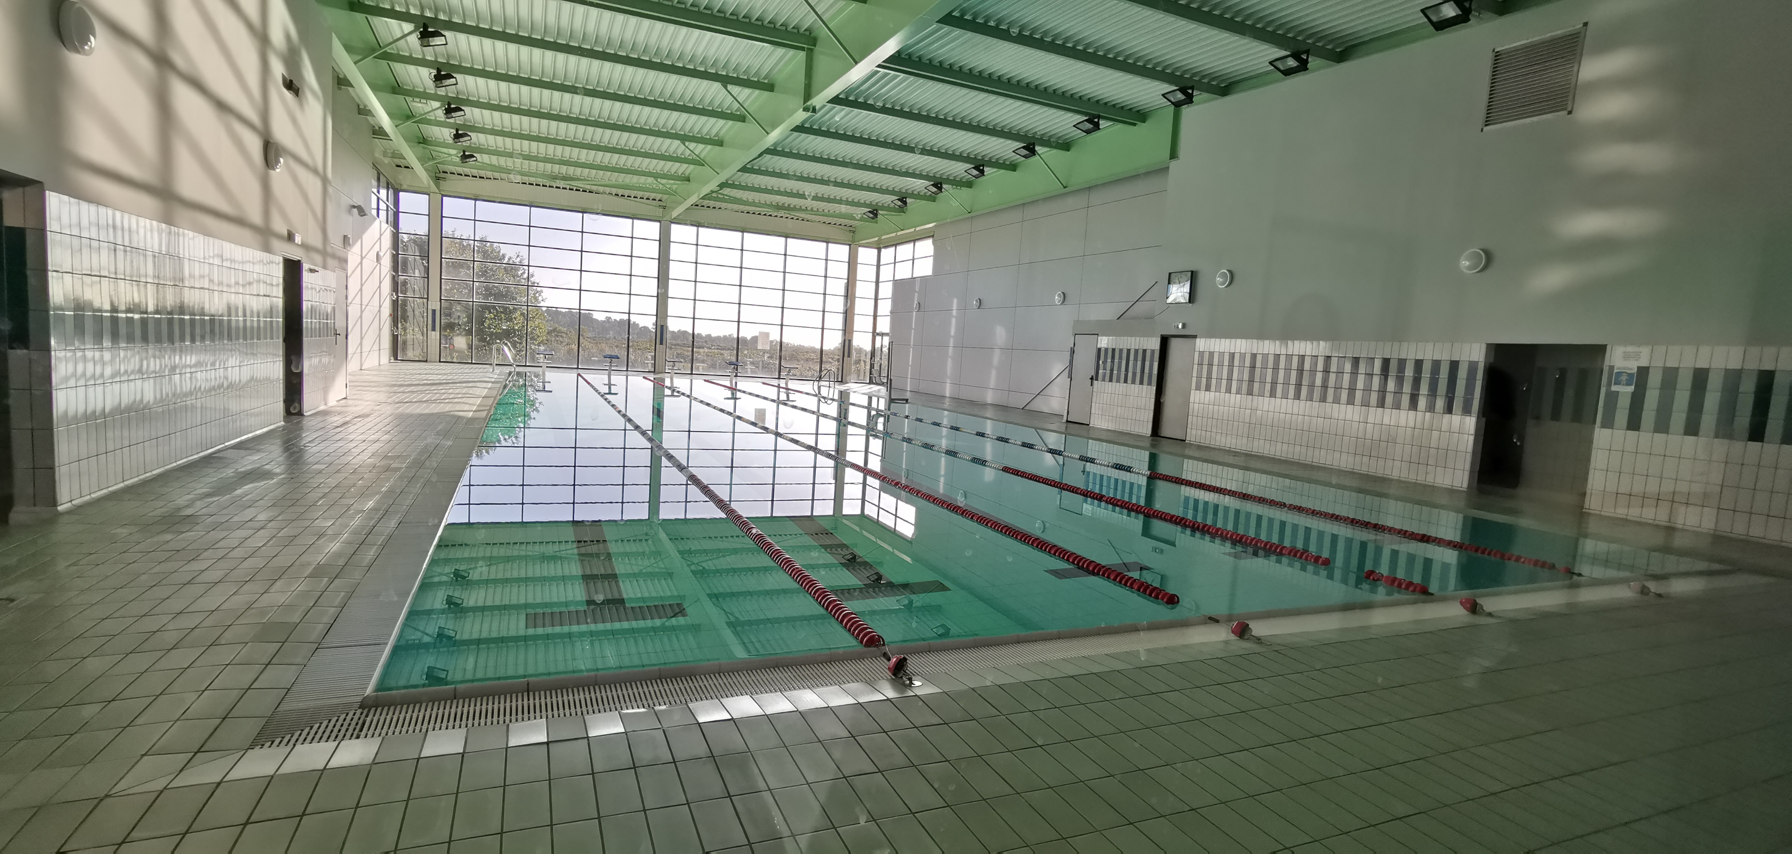
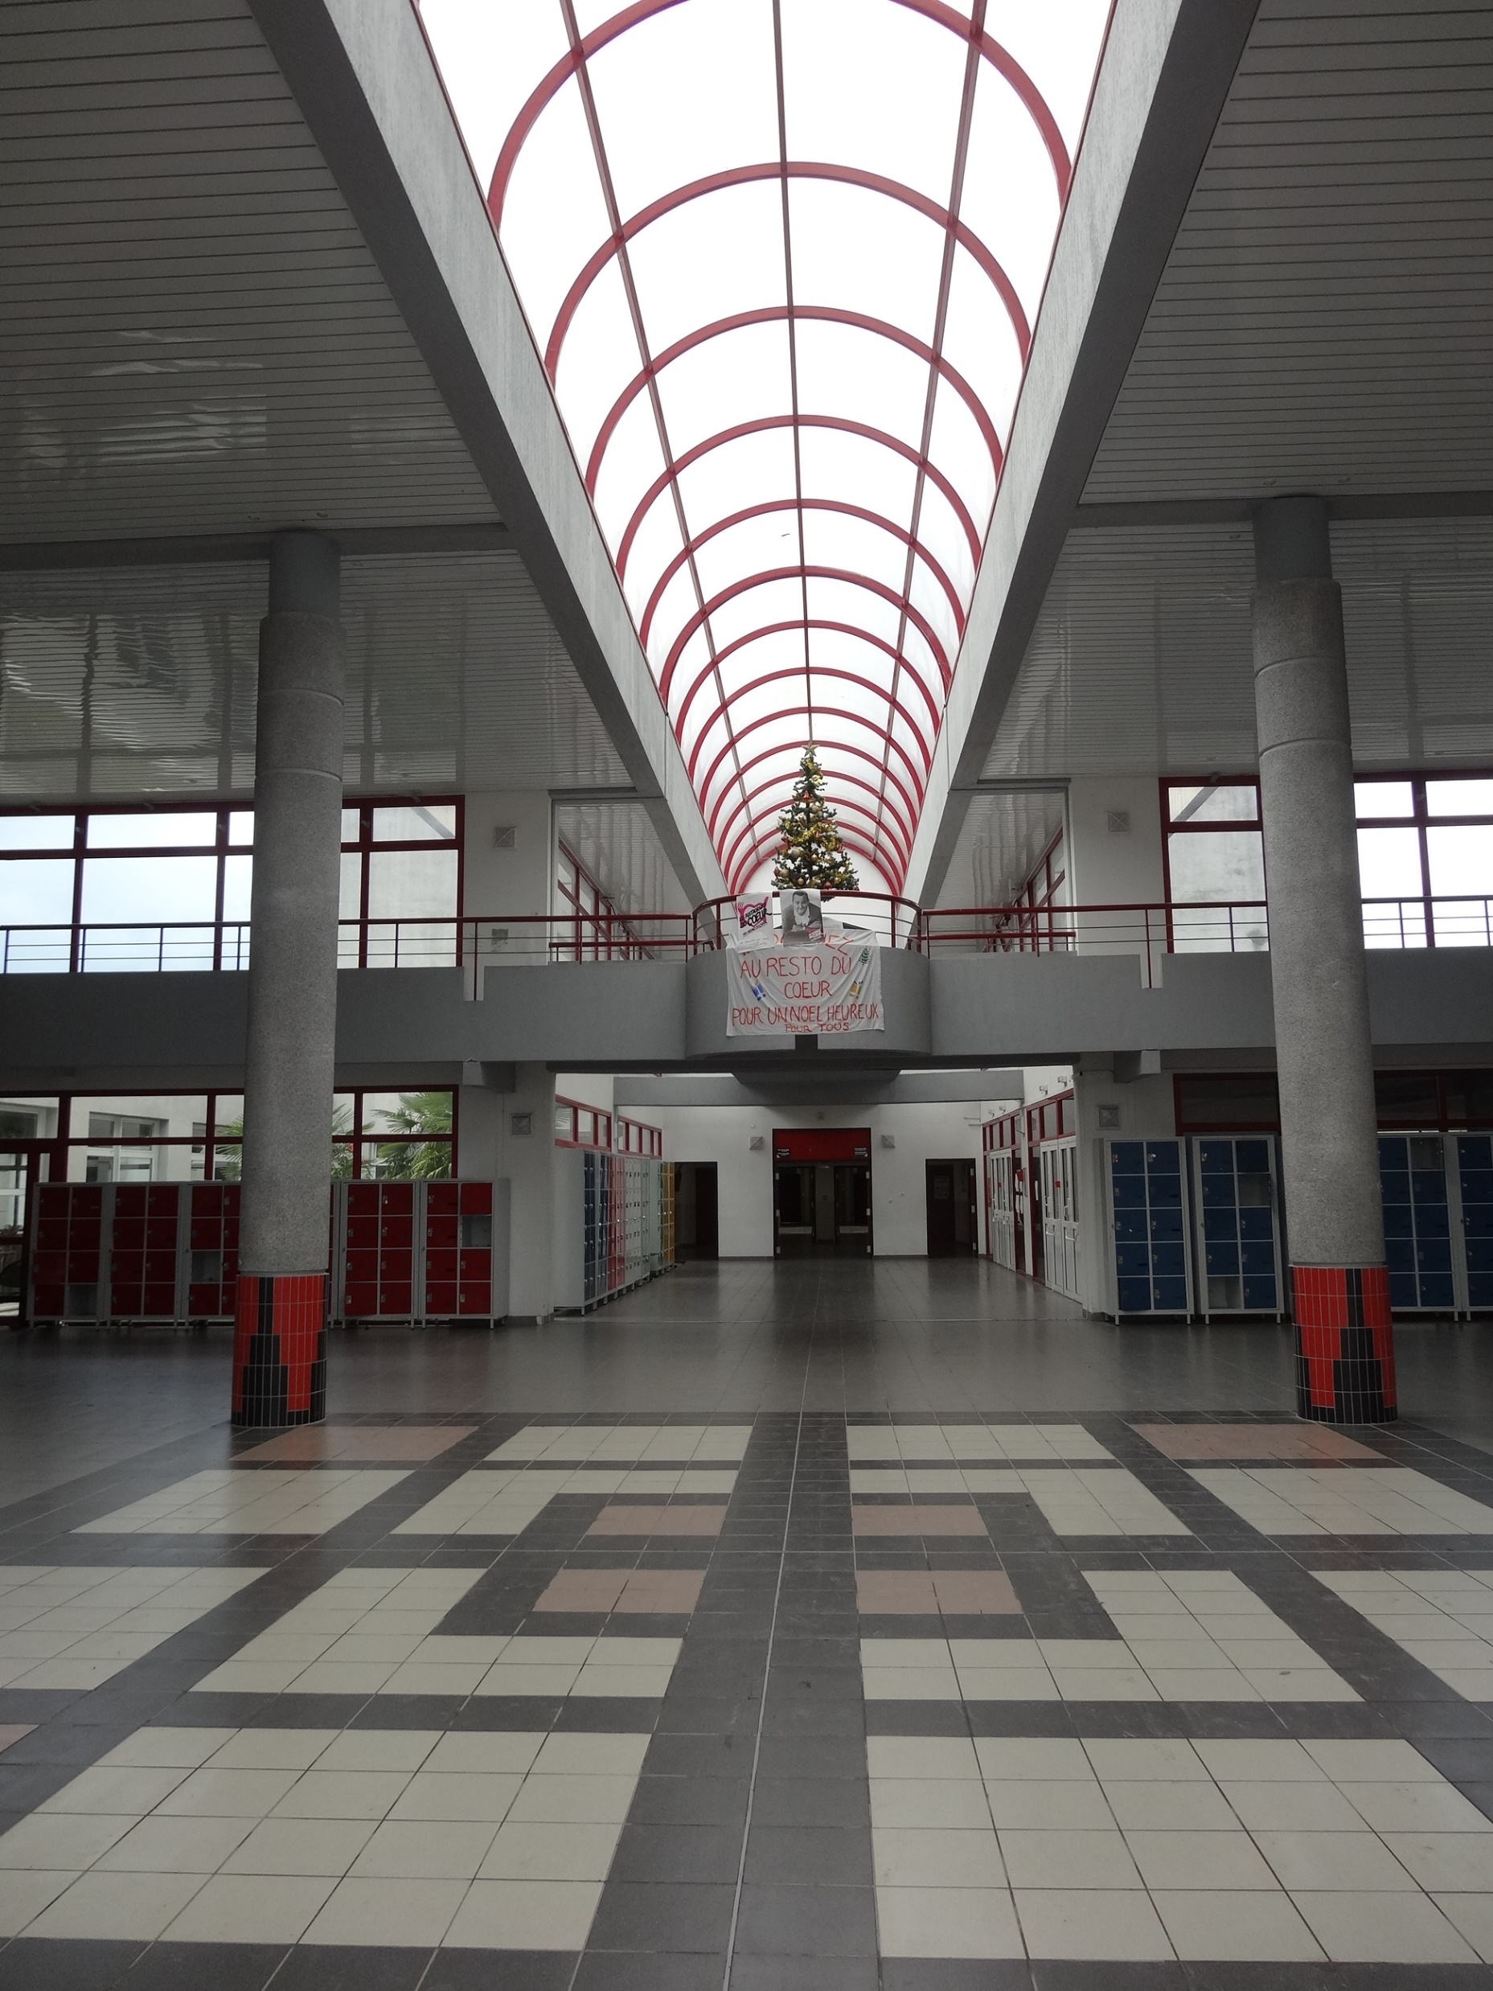
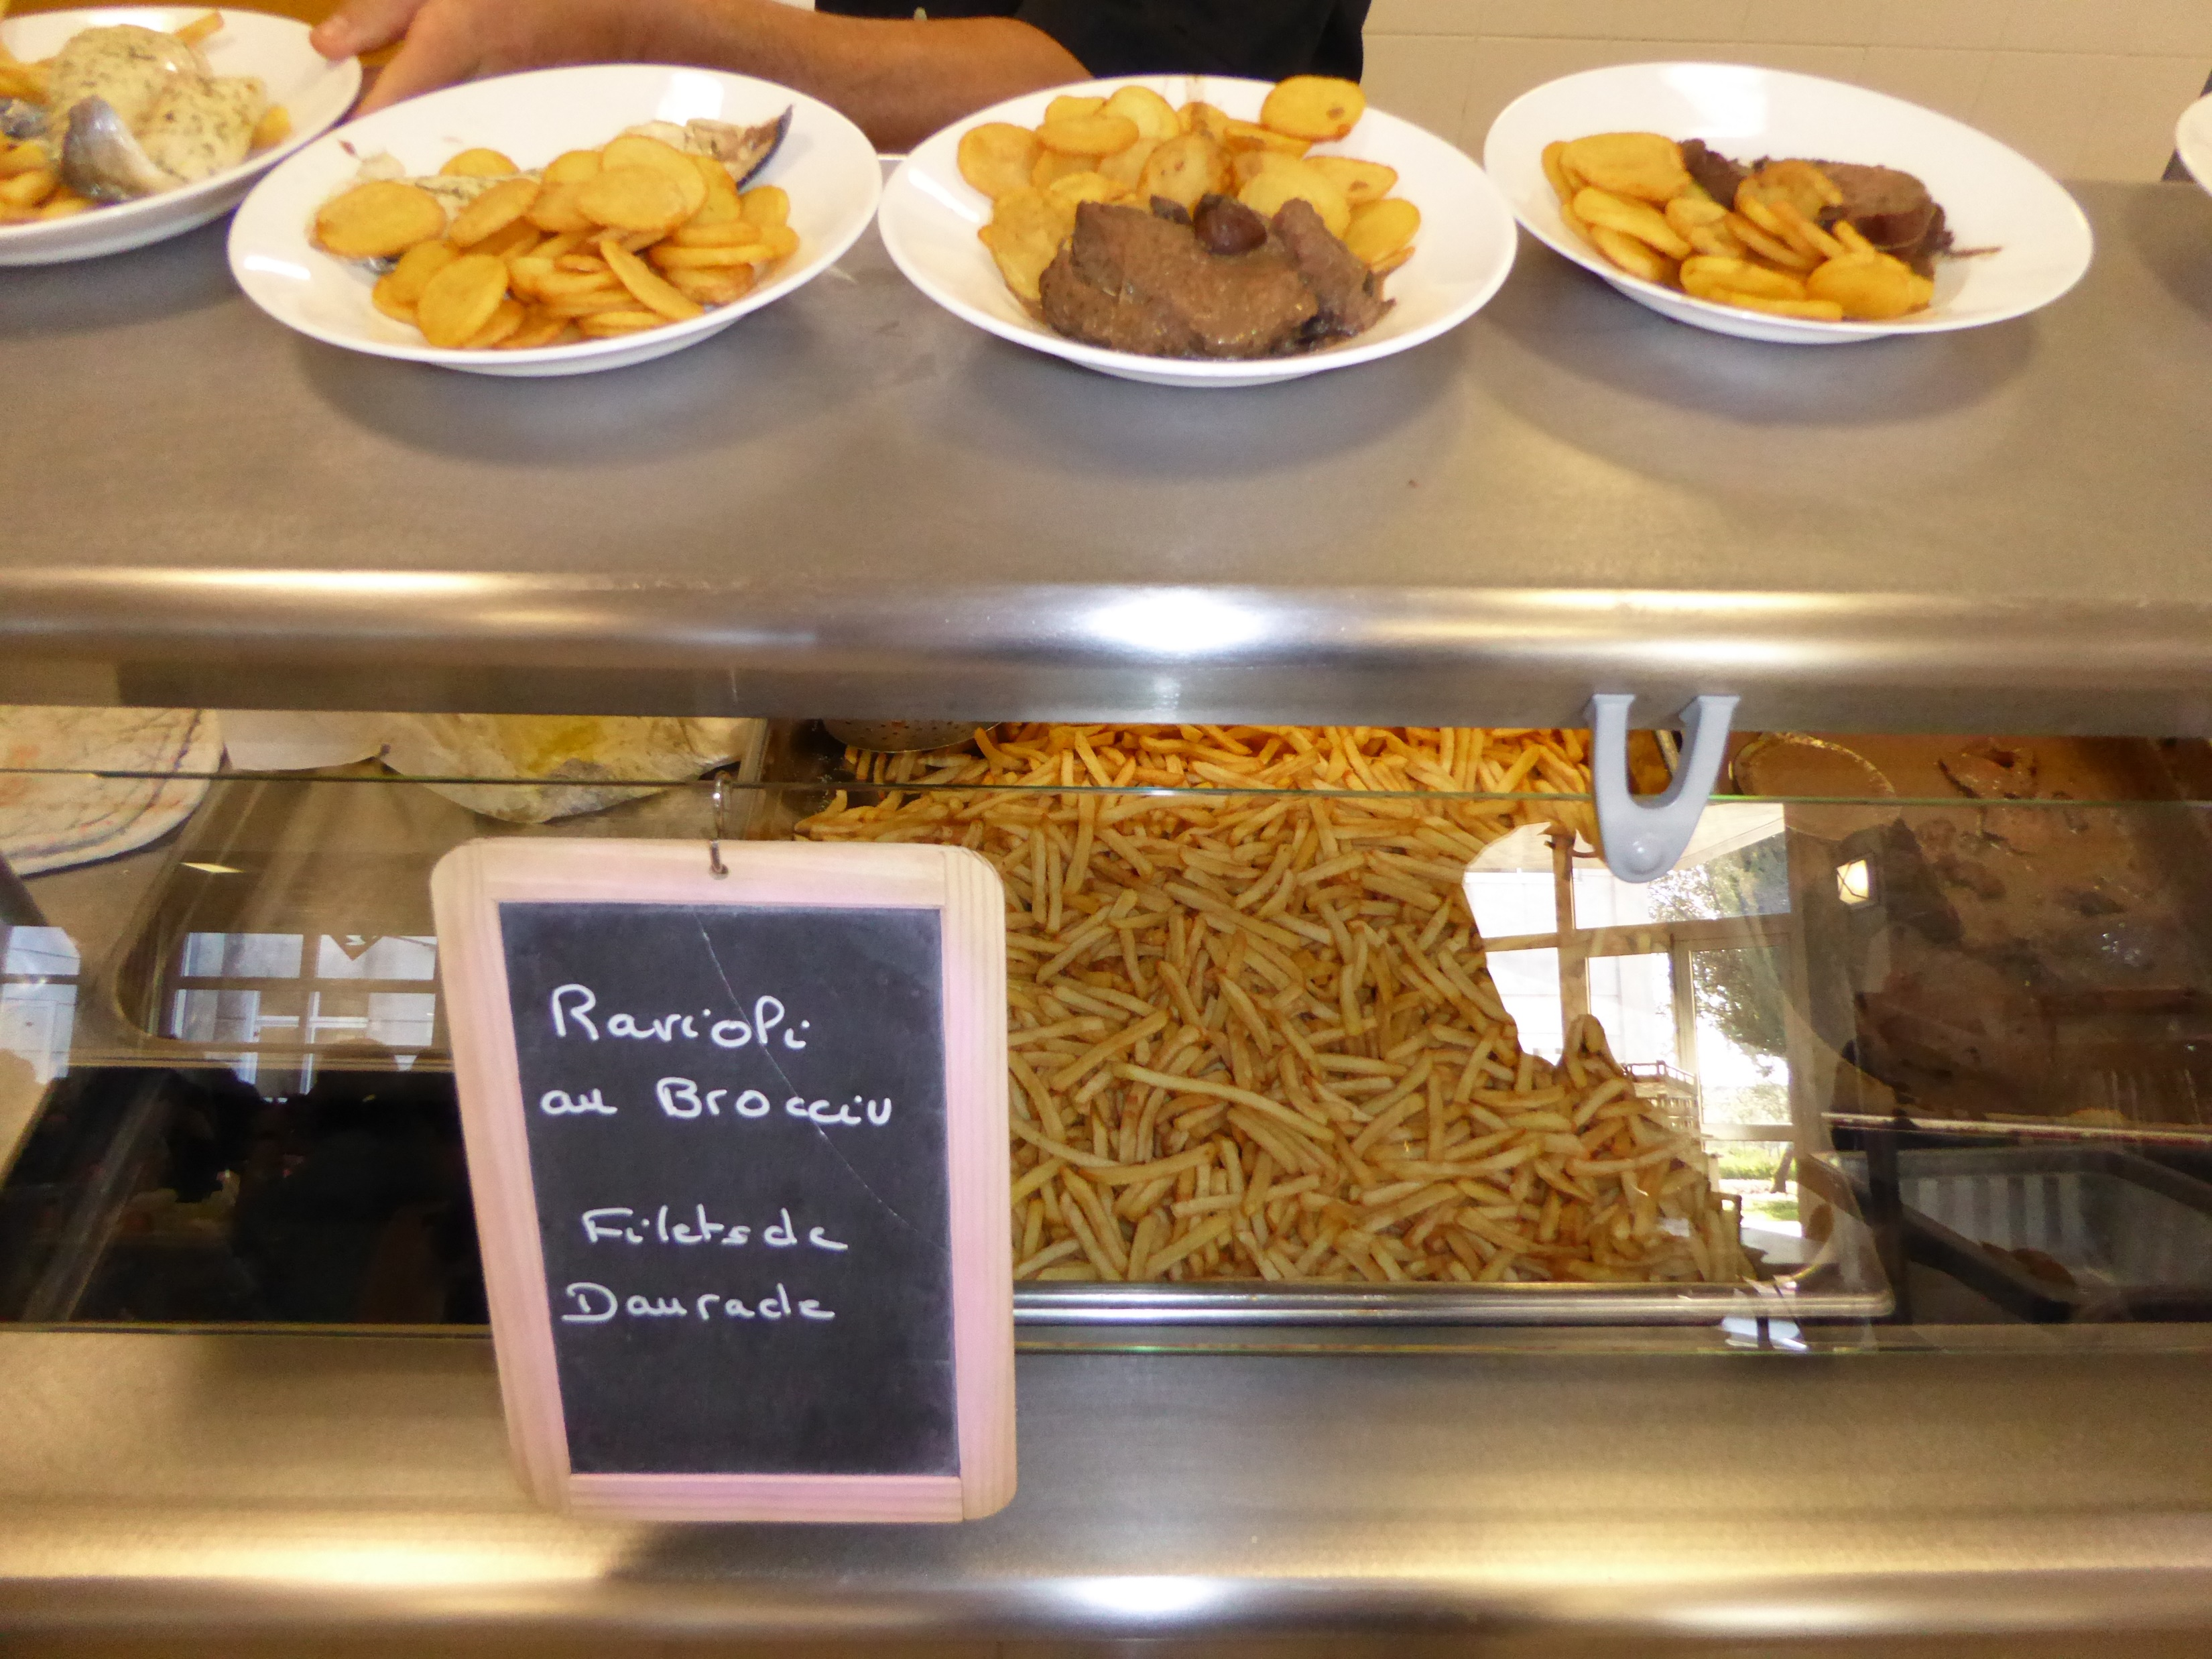
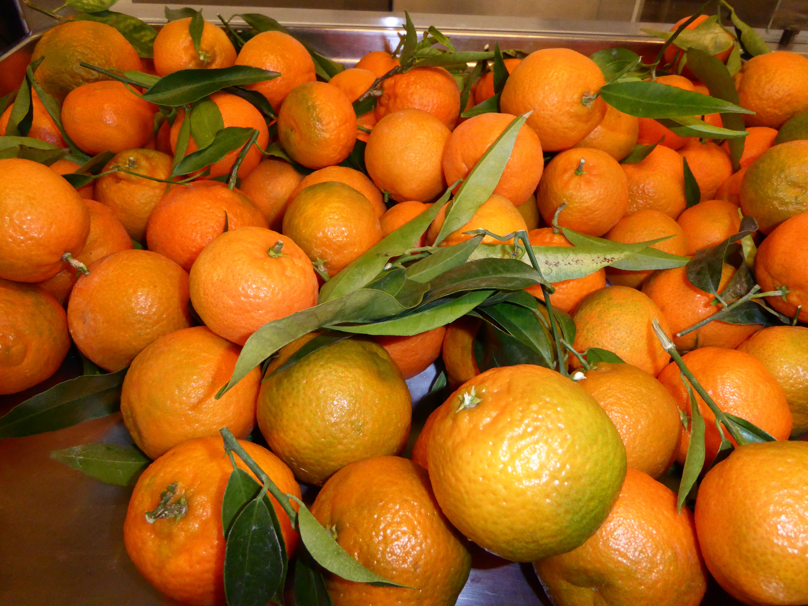
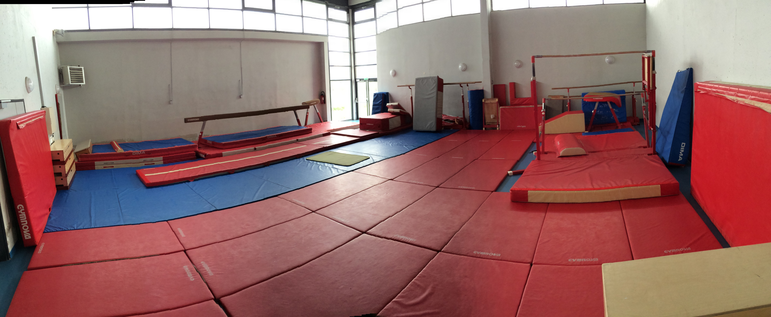
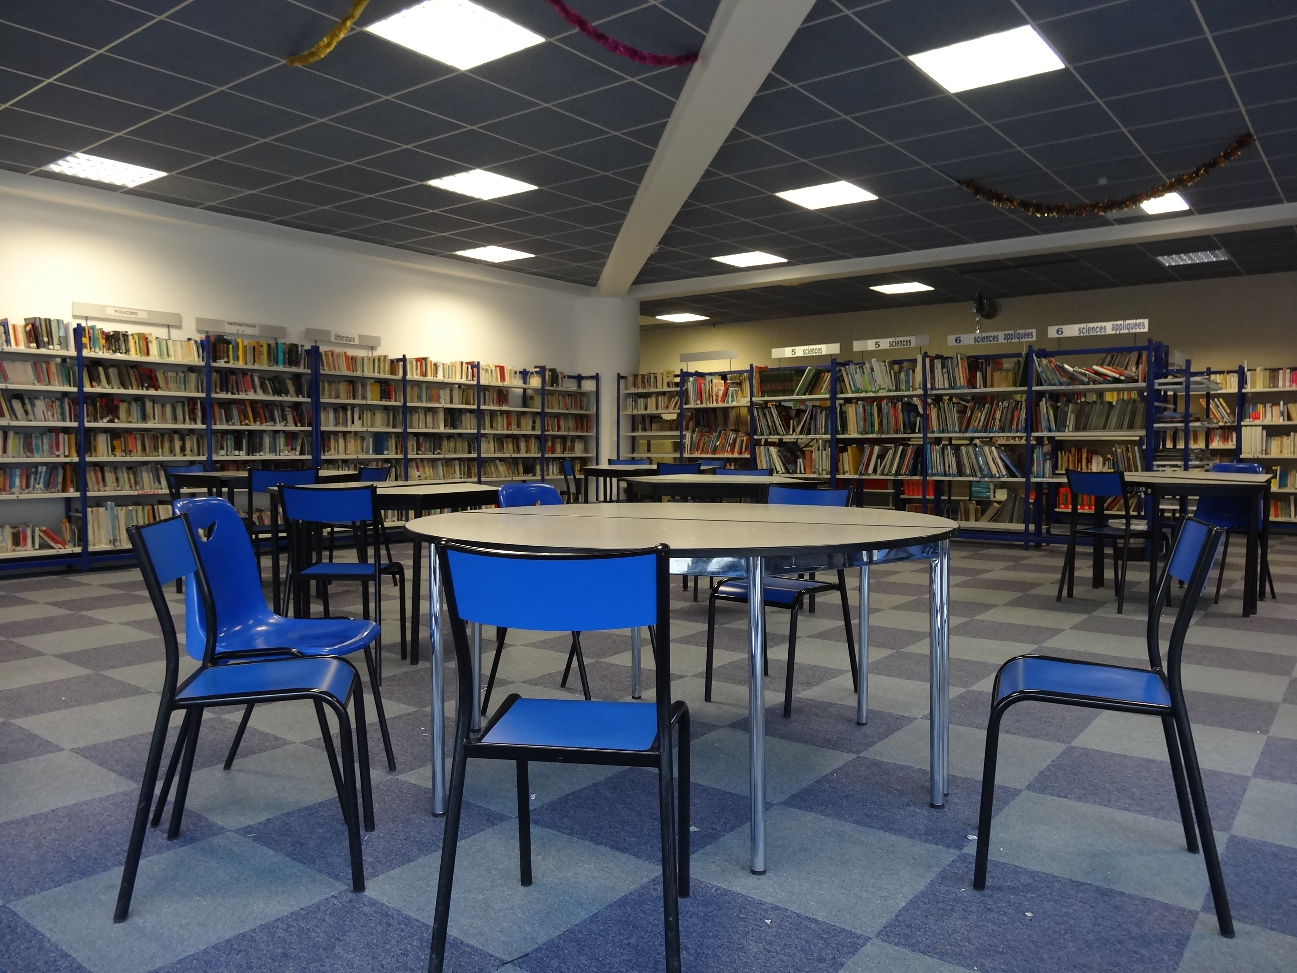
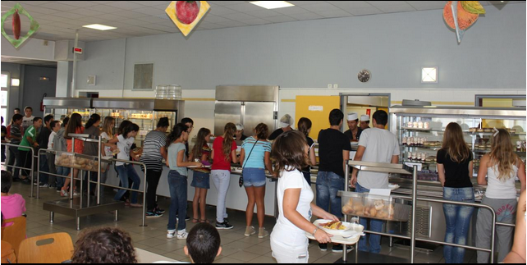

Slide 3
Today’s Program:
DAY 3: Friday October 15th
8.30 - 9.00: virtual coffee time & eTwinner Kahoot!
9.00 – 10.00: Teaching creativity with eTwinning & Erasmus!
10.00 – 11.00: dissemination of the project results & our dissemination plan presented by Italy.
11.00 – 12.00: Media minute! Special Italy & newsletter writing.
12.00 – 12.30: meeting evaluation and “apéro” feedback! Delivery of the participation certificate!

Slide 4
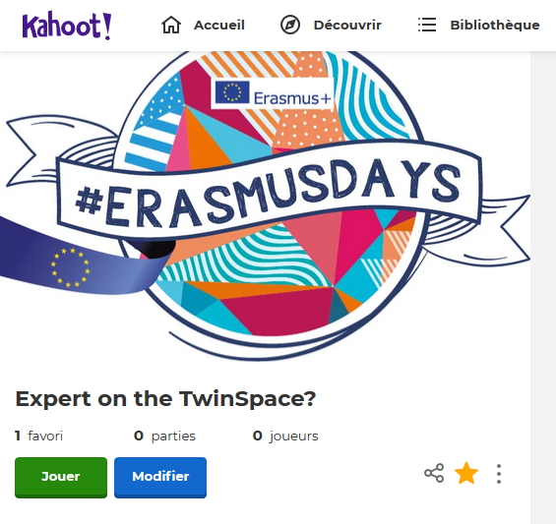
8.30 – 9.00: virtual coffee time & expert on the TwinSpace Kahoot!
https://kahoot.it/

Slide 5
9.00 – 10.00: Teaching creativity with eTwinning & Erasmus!
https://view.genial.ly/613ba643124b880d527e803f

Slide 6
10.00 – 11.00: dissemination of the project results & our dissemination plan presented by Italy.

Slide 7
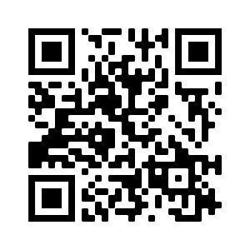
newsletter writing.
OBJECTIVES:
Create our first virtual Transnational Teachers' Meeting newsletter.
Disseminate our experience and results.
REMEMBER:
Promotion = Hello! We have a project (advertorial, one-way relationship) Dissemination = Here’s what we’ve learned and how you can use it (exchange of ideas, growth)
Follow this link to collaborate on Madmagz:
https://madmagz.com/collab-r/15pbq-lgjea5-alp0

Slide 8
TO DO LIST!
Finish TwinSpace work (forums, Tweets, sharing PowerPoints, photos and videos )
Write our newsletter according to our decided content. (See on the dedicated page)
Create and complete a special covid news page.
Disseminate our newsletter and public TwinSpace pages!
12.30: Media minute! Special Italy!
Italy delivers a summary about today’s activities.
Everybody can contribute, question, interact!
This is the end of our meeting!

