Slide 1
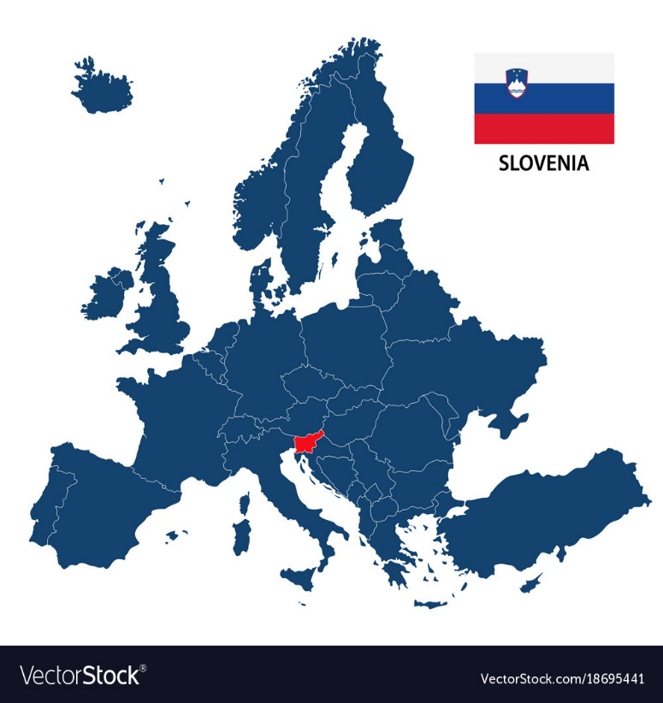
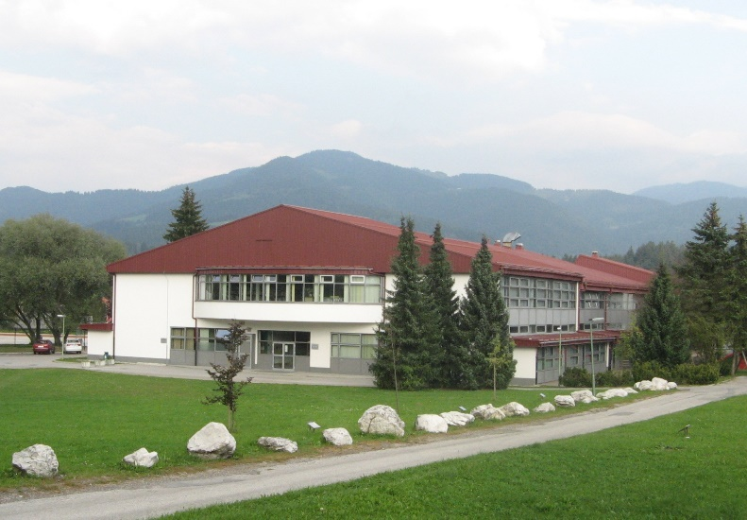
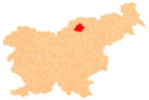
SLOVENIA, SLOVENJ GRADEC AND OUR SCHOOL:
Tia Karner, Katarina Čepin and Lara Jeznik

Slide 2
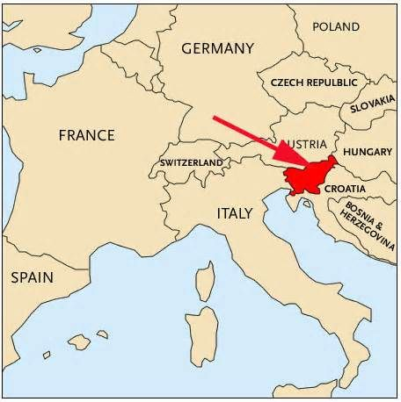
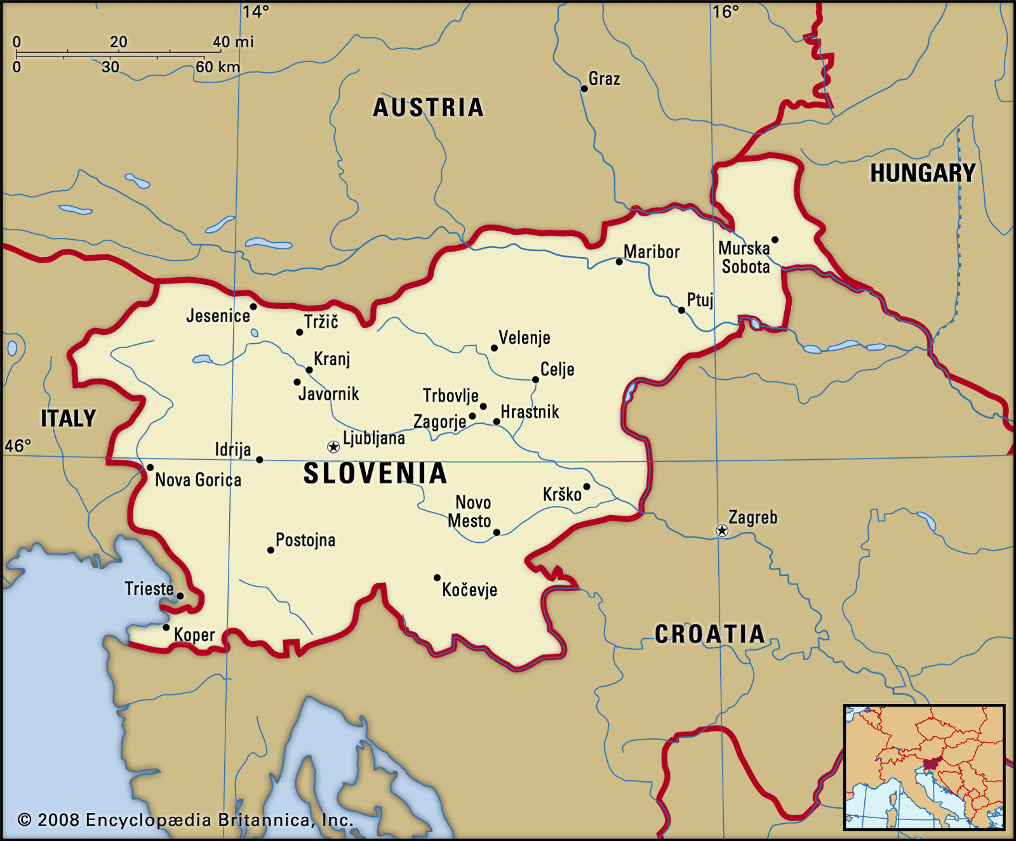
1. WHERE EVEN Is SLOVENIA?
Slovenia is a country located in Central Europe at the crossroads of main European cultural and trade routes. It is bordered by Italy to the west, Austria to the north, Hungary to the northeast, Croatia to the southeast.

Slide 3
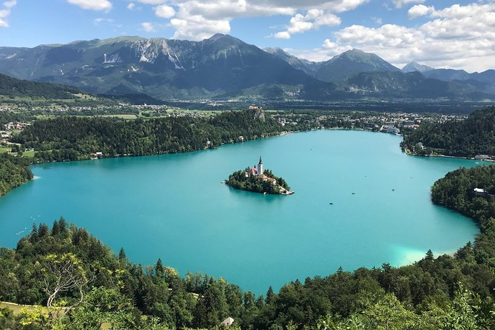
2. Some intEresting facts about slovenia:
Everything in One Small Package (Slovenia has everything from castles and caves to villages and vineyards. Thanks to a mostly modern infrastructure, most major attractions are a short ride away by car, bus or train — two hours or less.)
2. It’s Healthy, Safe and Green! Slovenia is actually on list called top 10 safe countries for travells.
3. With its central location, Slovenia blends the best of Western and Eastern Europe: Italian-influenced food and art, Germanic efficiency and Slavic pride.

Slide 4
3. This is our flag:
CLICK HERE AND LISTEN TO NATIONAL ANTHEM OF SLOVENIA: https://www.youtube.com/watch?v=w-WuhiuEOQc&ab_channel=BlueMarbleNations
The text was written by poet France Prešeren
The melody was written by composer Stanko Premrl

Slide 5
4. WE LIVE IN SLOVENJ GRADEC!
Slovenj Gradec is the town developed between Mount Uršlja gora and the western Pohorje mountain range at the confluence of the rivers Mislinja and Suhodolnica.
In Slovenj Gradec we have 3 primary schools (from grade 1 to 9).

Slide 6
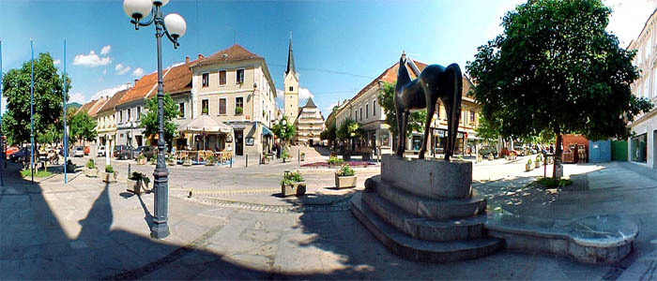
In 1989 the town was given the honorary title of Peace Messenger City.
Of special interest are the former City Hall housing the Koroška Art Gallery and the Koroška Regional Museum, the Church of Sv. Elizabeta from 1251, the birth house of the composer Hugo Wolf, Rotenturn Manor, the Soklič Museum, and the Church of Sv. Duh.

Slide 7
5. OUR SCHOOL: PRVA OSNOVNA ŠOLA SLOVENJ GRADEC
We are in 8. class in primary school Slovenj Gradec. (school has 9. grades)
School has around 50 teachers
It was build in 1667
From 1667 to 1992 our school was called Osnovna šola Franja Vrunča Slovenj Gradec
Our headmistress is Lidija Konečnik Mravljak
School can boasts with many awards from different competitions

Slide 8
6. Here is a short video we filmed:
20210418_1080p.mp4
CLICK HERE:

