Slide 1
eTWINNING DAY 2019 EUROPE DAY
9 MAY 2019

Slide 2
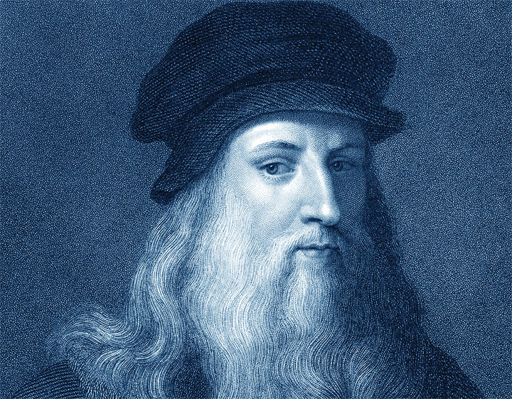
IN THE FOOTSTEPS OF LEONARDO DA VINCI eTwinning project
5 PARTNER SCHOOLS
2 schools from TURKEY
2 schools from Italy
1 school from Serbia

Slide 3
LAB ACTIVITIES AT MS REALE’S WORKSHOP(1)
Leonardo da Vinci moved from Vinci to Florence in 1466 to become an apprentice at Verrocchio’s workshop.
In the Middle Ages and during the Renaissance, artists made all of their own paints, tempera paint made from a combination of egg yolks and other ingredients ground into a fine powder.
But egg tempera had several limitations, (for example it dried fast), so in the 15th century painters in the Netherlands began using oil paints that dried slowly, were vivid and could be mixed and blended to get shades.
Leonardo was one of the first Italian artists to use oil paints and he experimented different kinds of material to use for paint.
A Renaissance workshop

Slide 4
MAKE YOUR OWN PAINT
YOU NEED:
Yolk
1 teaspoon vinegar
spices: curry and curcuma, for the yellow and orange colours
dark dirt to get black.

Slide 5
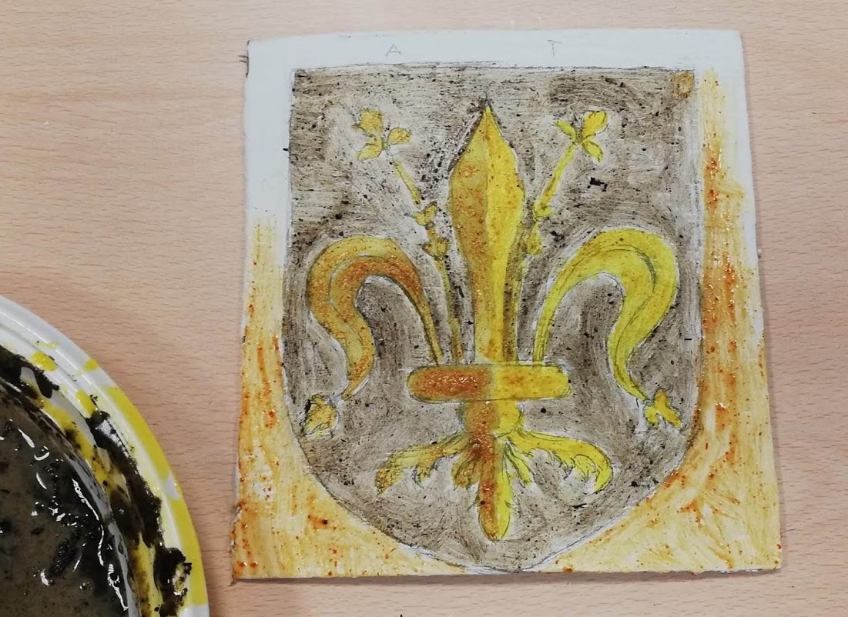
Students drew and painted the Lily, emblem of Florence, on a tablet with a layer of plaster.

Slide 6
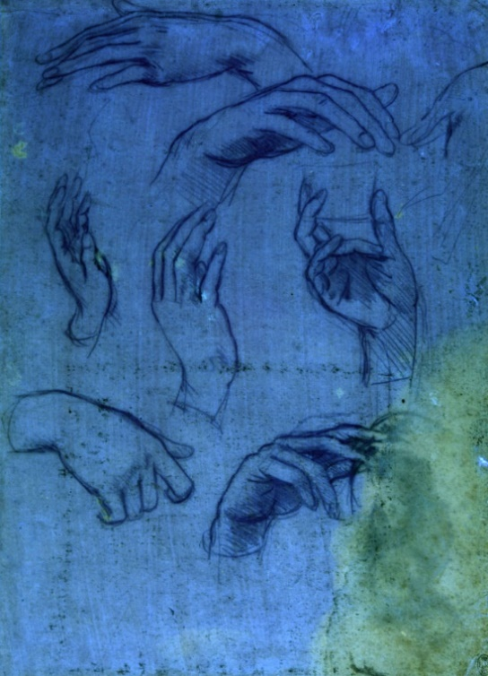
Leonardo Da Vinci’s empty pages hold a secret few could imagine: more than a dozen studies of hands drawn in a metal substance turned to invisible ink over time.
The two pieces of paper, now known to be studies of the hands for the Adoration of the Magi, c1481, are to go on display to the public for the first time, at the Queen’s Gallery, Buckingham Palace, as part of the 500th anniversary of Leonardo’s death.
High-energy X-ray fluorescence has revealed the sketches called Studies of hands for the Adoration of the Magi.

Slide 7
Studies of hands for the Adoration of the Magi.
The technology also clarifies how these incredible drawings managed to vanish in plain sight over the centuries.
Because of the high content of copper in da Vinci’s metal stylus, a chemical reaction transformed the lines into transparent copper salt.

Slide 8
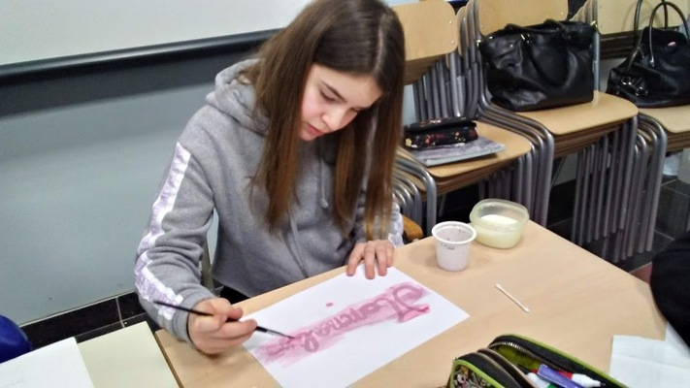
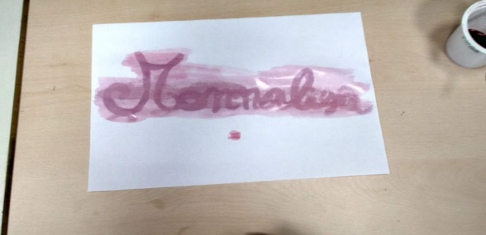
LAB ACTIVITIES AT MS REALE’S WORKSHOP(2) MAKE YOUR OWN INVISIBLE INK
STEP 1
Mix together 1/4 cup of baking soda with 1/4 cup of water, dip the Q-tip into the mixture and write the message.
1. Juice invisible ink
YOU NEED:
baking soda and water
Q-tips
white paper
cranberry juice
paint brush
STEP 2
Paint the juice across the paper
WHY DOES IT WORK?
Because the juice is acidic and the baking soda is a base, and the two interact when they touch.

Slide 9
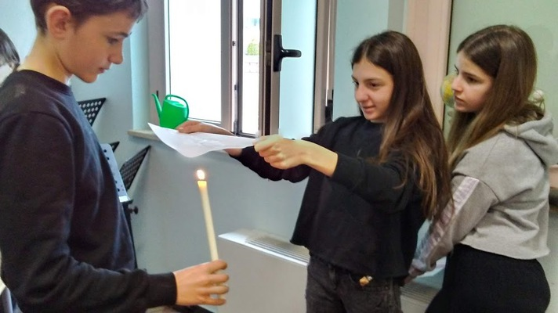
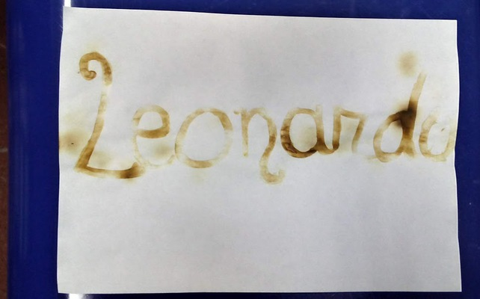
Milk invisible ink
STEP 1
Dip the Q-tip into the milk, write the message on a white paper, the let it dry.
YOU NEED:
milk
Q-Tips
paper
heat source (candle)
STEP 2
Pass it closely over a candle and read the message

Slide 10
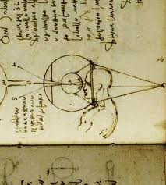
OUR SCIENCE LAB WITH MR. ANTONIO TRIVISONNO
Leonardo’s drawing of the human eye
Leonardo thought the eye was the most important and amazing organ in the body.
One of the first things Leonardo noticed when he studied the structure of the eye in detail was its ability to change the size of the pupil according to its exposure to light.
He first observed this phenomenon while painting a portrait, and then tested it in a series of experiments in which he exposed subjects to varying amounts of light. “The pupil of the eye,” he concluded, “changes to as many different sizes as there are differences in the degrees of brightness and darkness of the objects which present themselves before it.”
The camera obscura sketched by Leonardo da Vinci in Codex Atlanticus (1515), preserved in Biblioteca Ambrosiana, Milan (Italy).
One of the most interesting optical inventions Leonardo worked with was a camera obscura. Leonardo wasn’t the first person to use one of these, but he was the first person to connect the way a camera obscura worked with the way the human eye worked

Slide 11
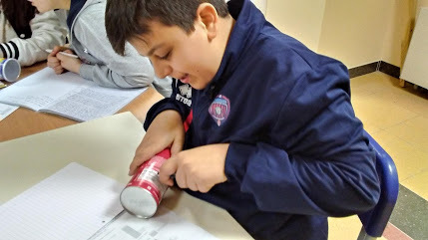
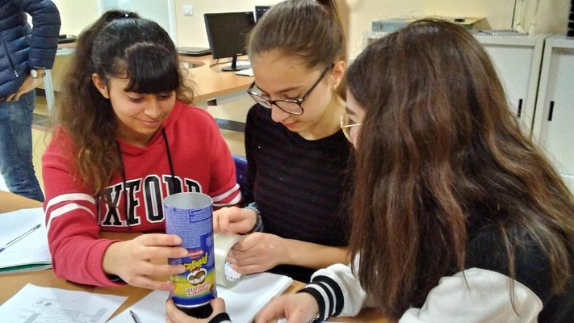
MAKE YOUR OWN PORTABLE CAMERA OBSCURA
STEP 1
Cut the canister about 2 inches from the bottom
YOU NEED:
potato chips canisters
Xacto knife
duct tape
pushpin
parchment paper
scissors
STEP 2
Cover the top of the shorter piece with parchment paper, put the lid on it then put the longer part on top of that. After that, tape them together.

Slide 12
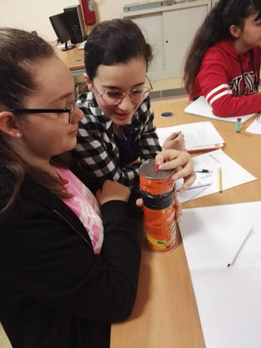
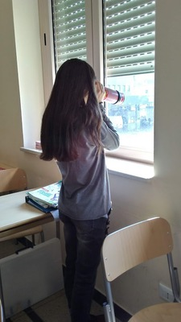
STEP 3
Poke a hole in the bottom of the short end with a pushpin.
What a fantastic view!
Everything is upside-down!
STEP 4
Now look through the open end...

Slide 13
WHAT A UNIQUE GENIUS!
“No image, even of the smallest object, enters the eye without being turned upside down.”

Slide 14
Thanks for your attention!

