Slide 1
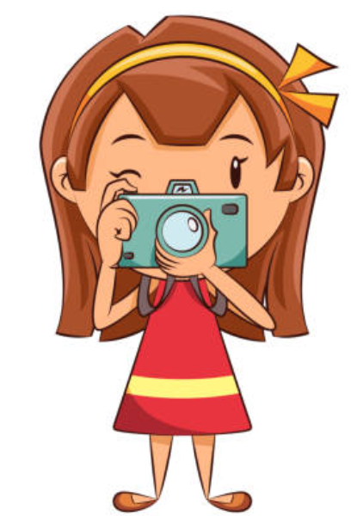
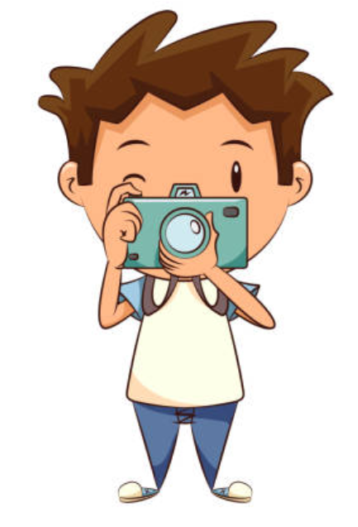
Our activities in December - February
“Teaching and Learning through photography art”

Slide 2
Our winter activities
Our goal was to prepare lessons with the help of photographs . In this presentation you will see how our students presented the history of our school and the activities back in time.

Slide 3
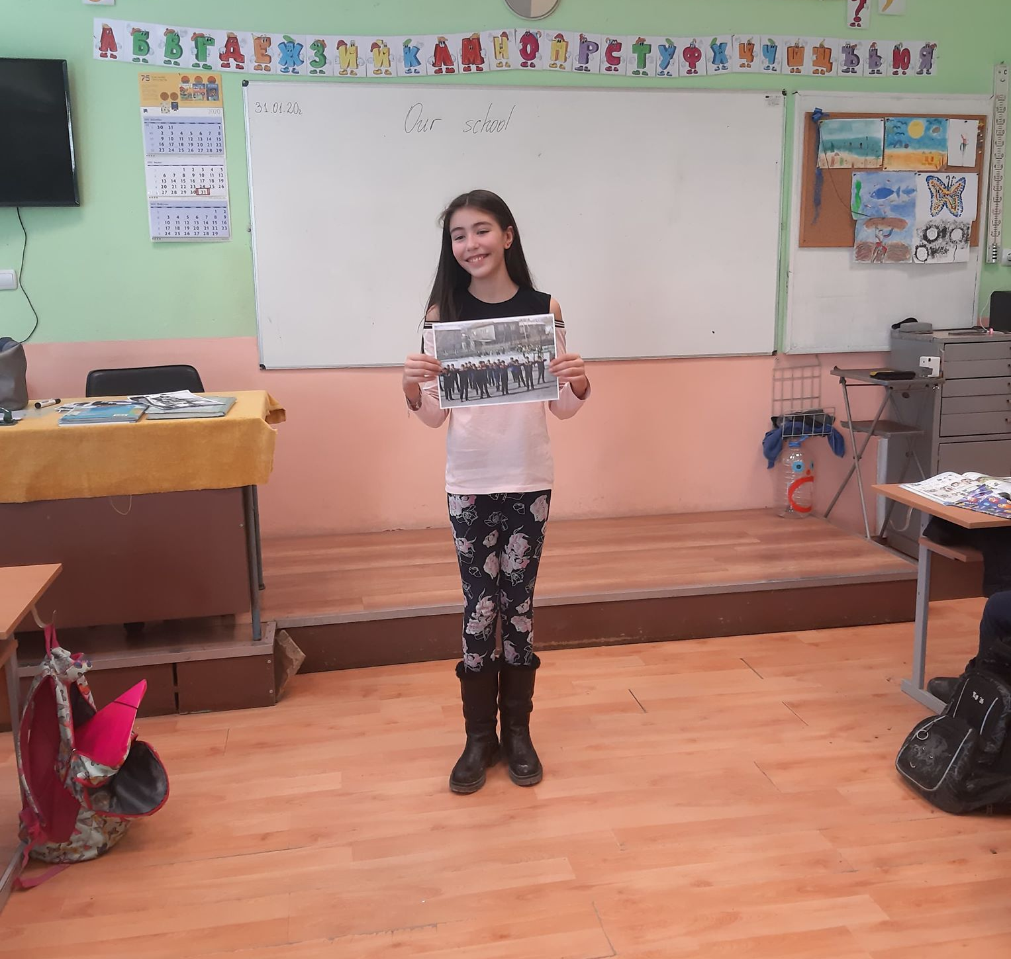
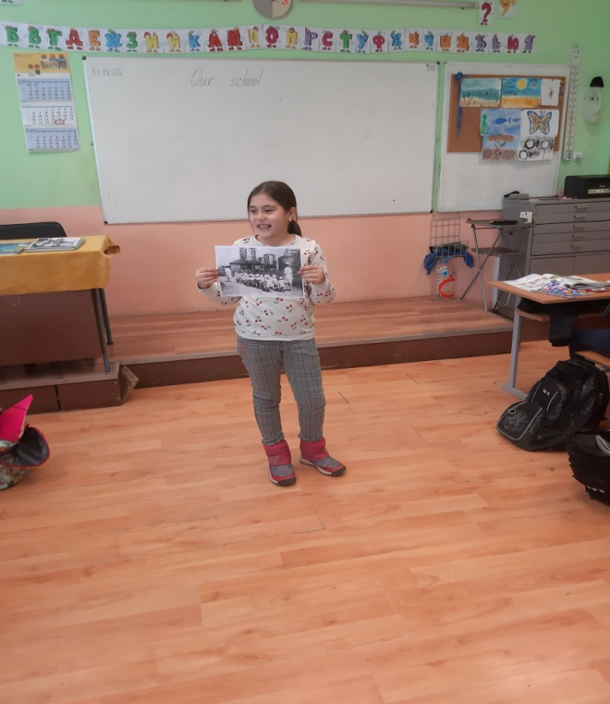
The students showed different pictures of the school – the building, the classrooms and the lessons.

Slide 4
We made a quiz and the students had to guess what kind of activity is on the pictures! It was very interesting for them because all pictures were from the historical period of socialism.

Slide 5
Everybody love prizes!
We went to the room of our principal where we saw all the cups and medals from old school teams.

Slide 6
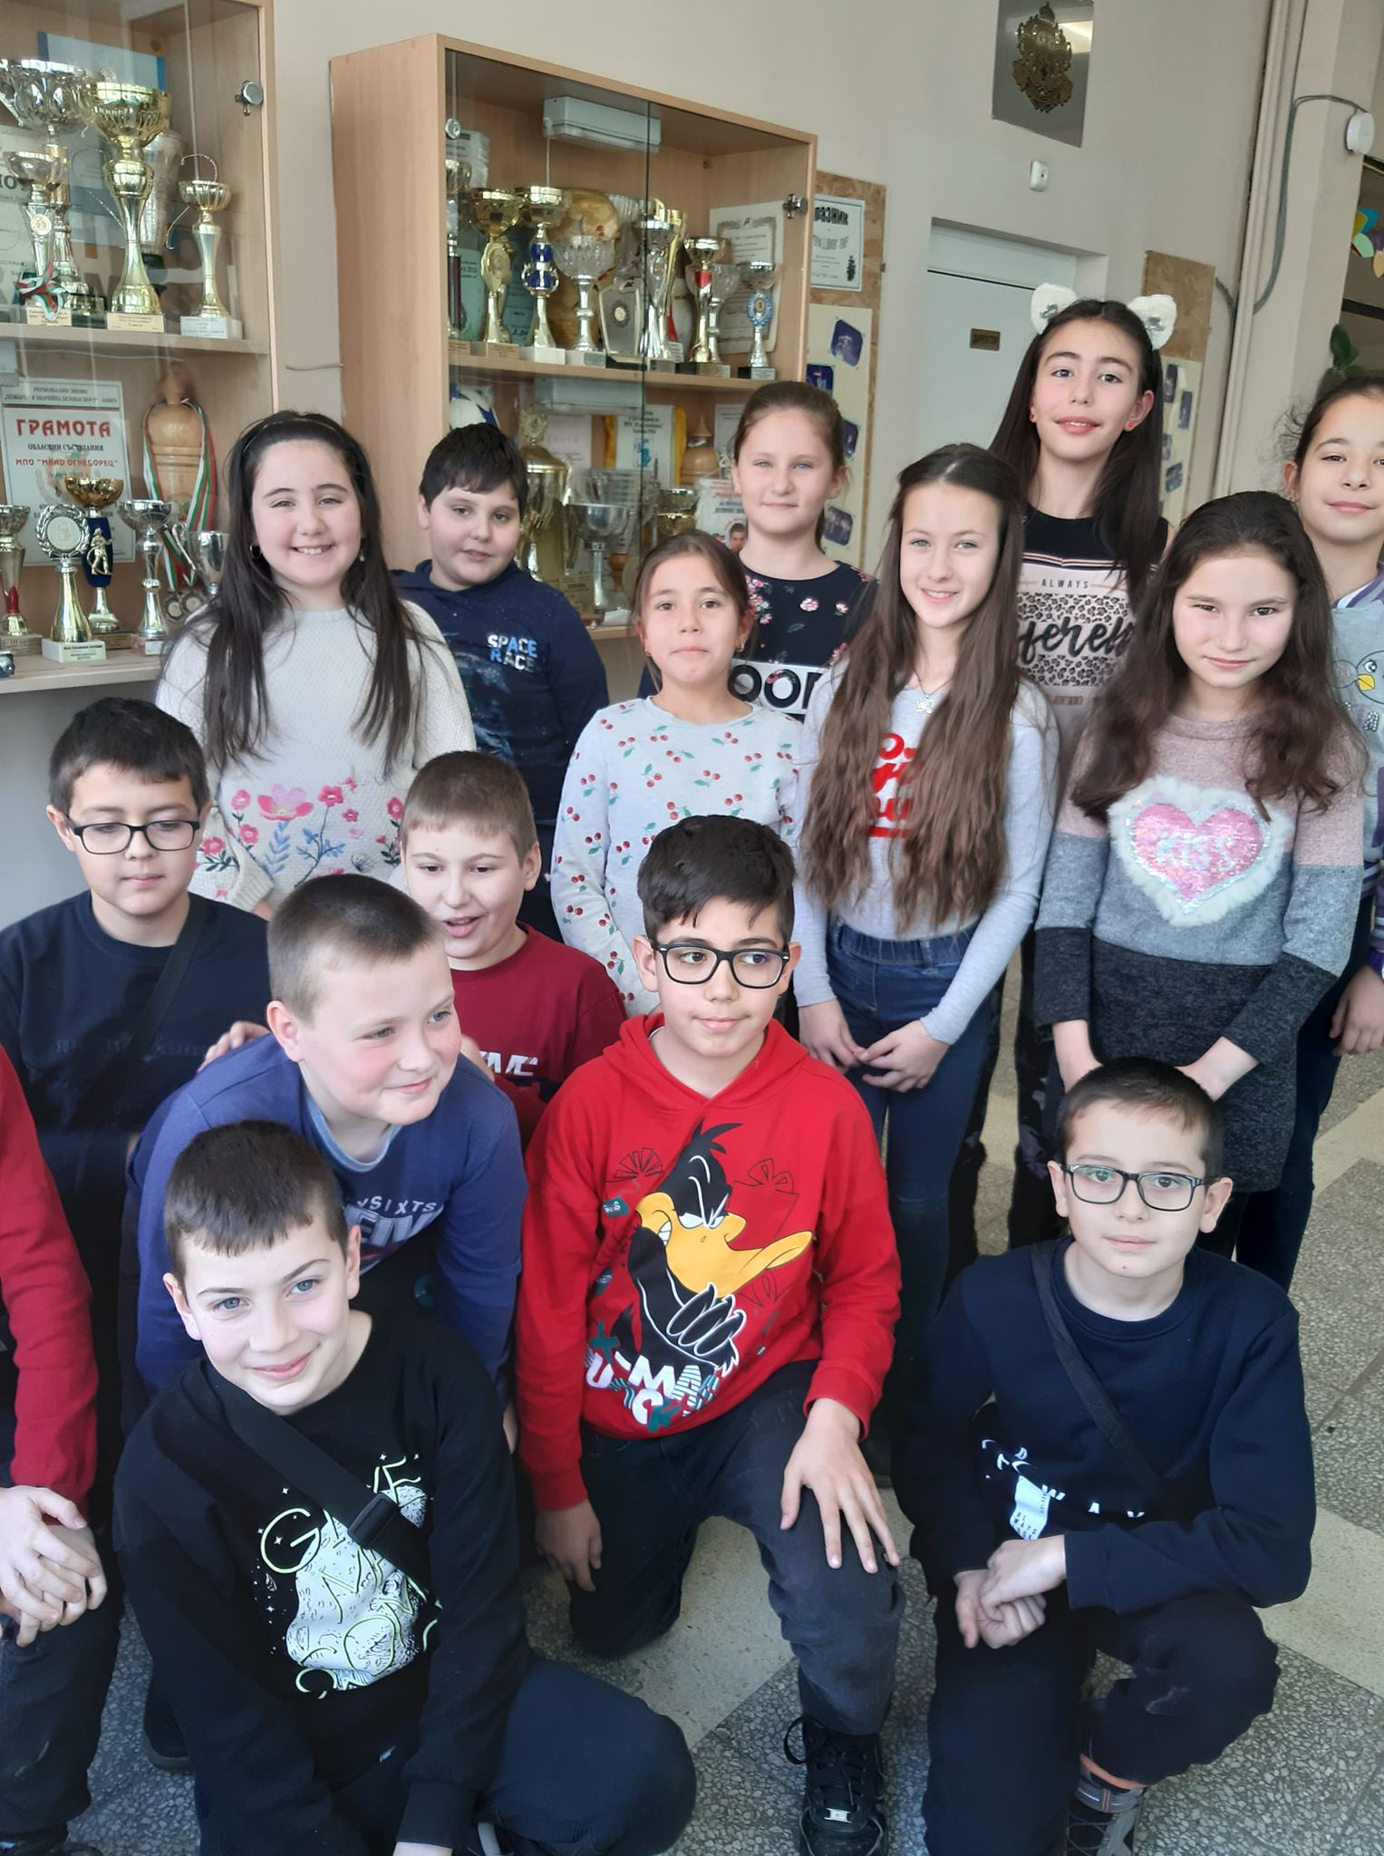
We are very grateful for the rich history of our school!
We will continue adding medals and awards in its collection!
We are happy to be part of this school!

Slide 7
Thank you!
And now is time for our movie ☺

