Slide 1
Latvia
Gulbītis Primary School

Slide 2
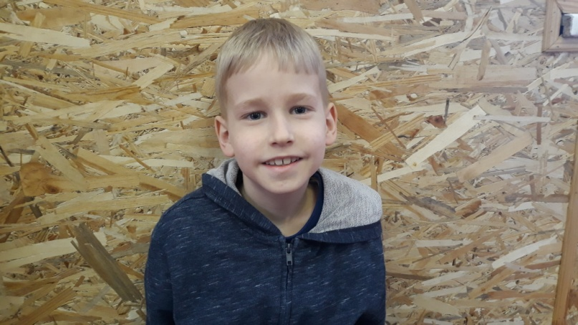
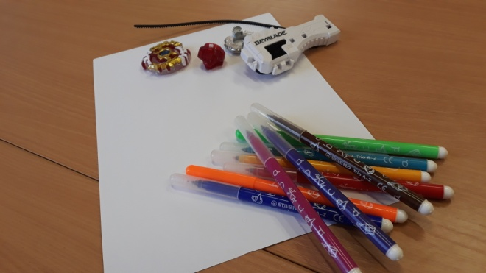
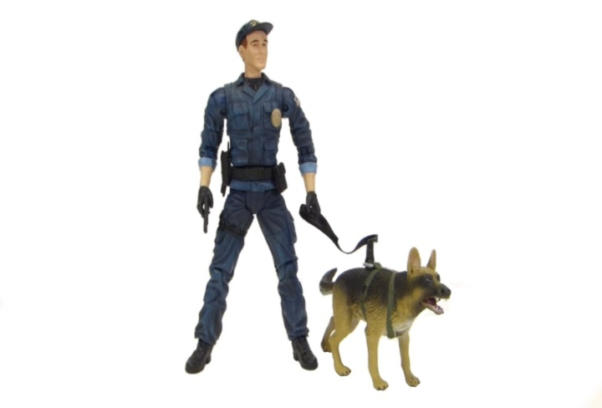
My name is Oliver. I am 8 years old.
I study at Gulbītis Primary School in 1st grade.
I like to draw and bleibleid.
In the future, I want to become a policeman.

Slide 3
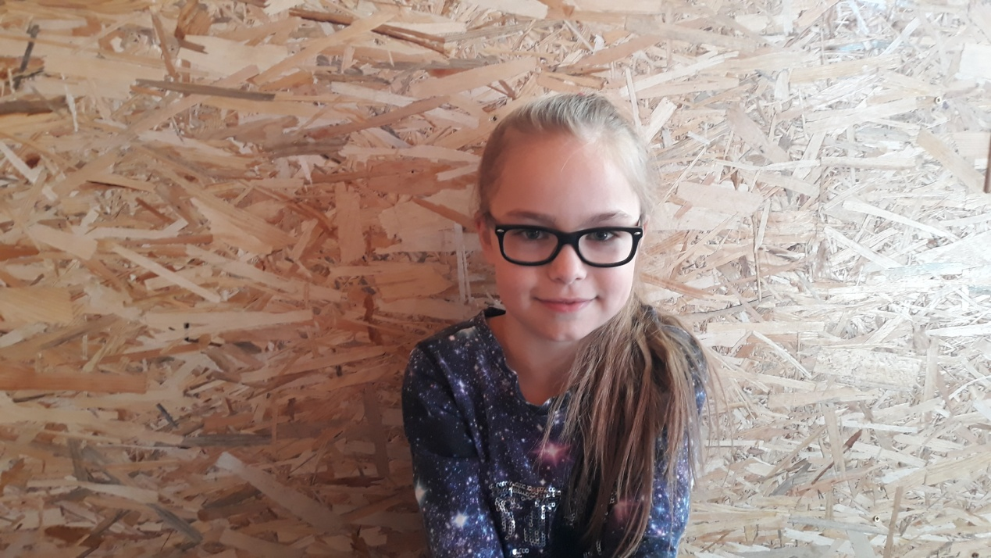
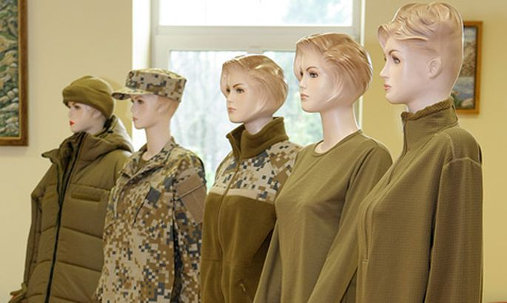
My name is Linda. I am 10 years old and I study in Gulbītis Primary School 3rd grade. I like playing floorball because it's an active and interesting game. In the future, I want to become a soldier because it is a decent and reliable job.

Slide 4
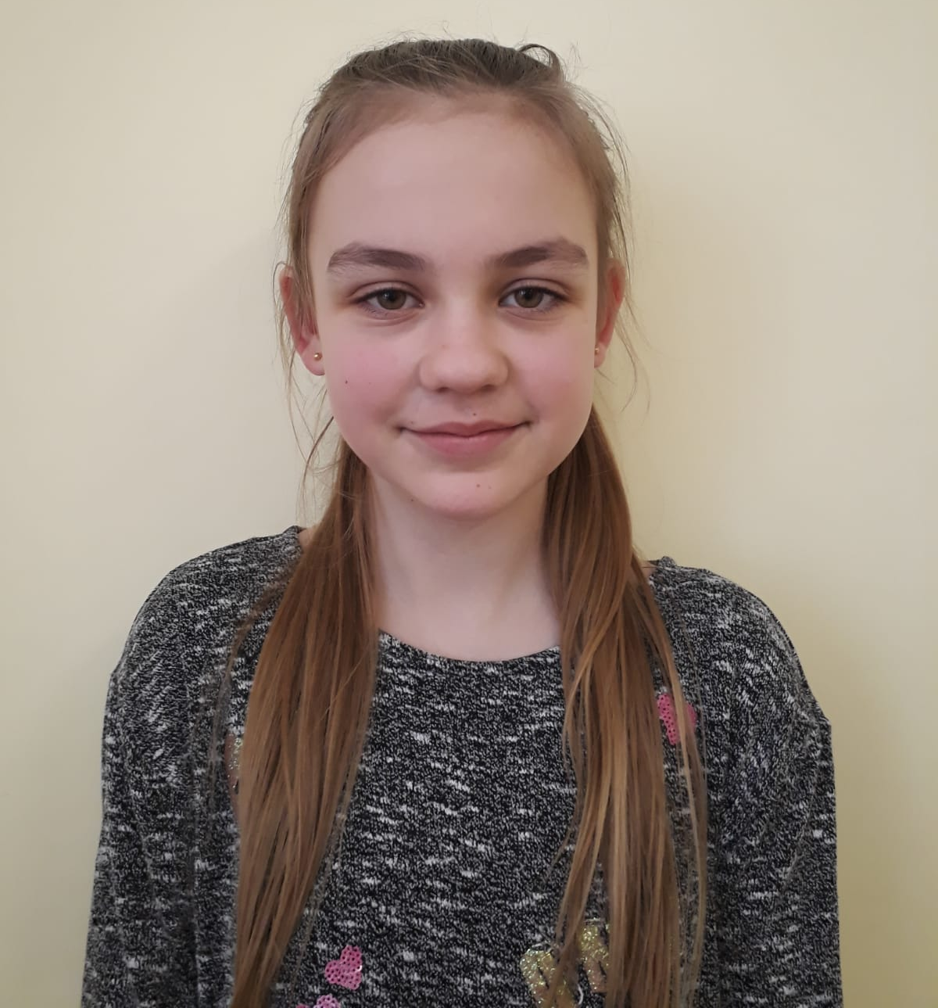
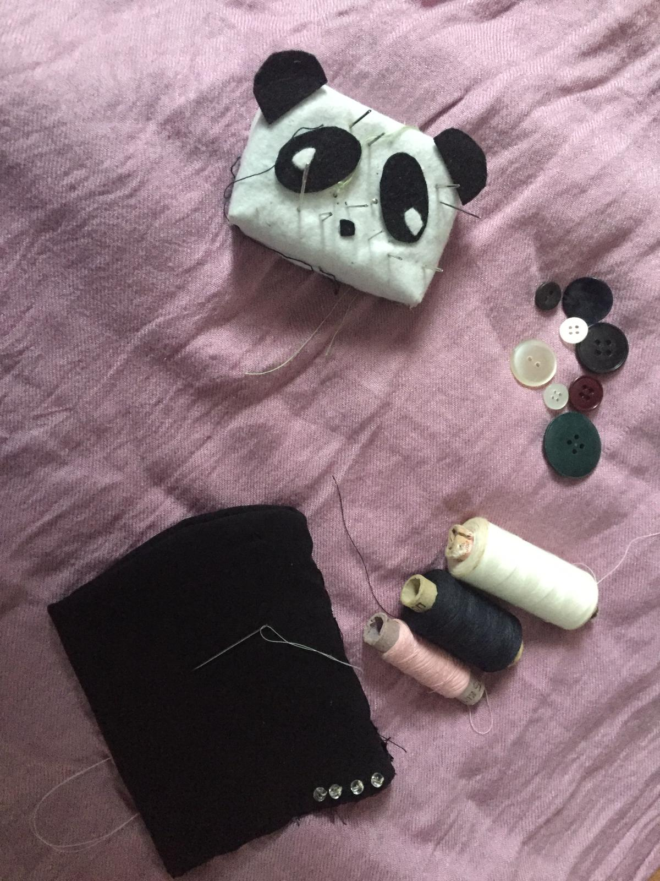
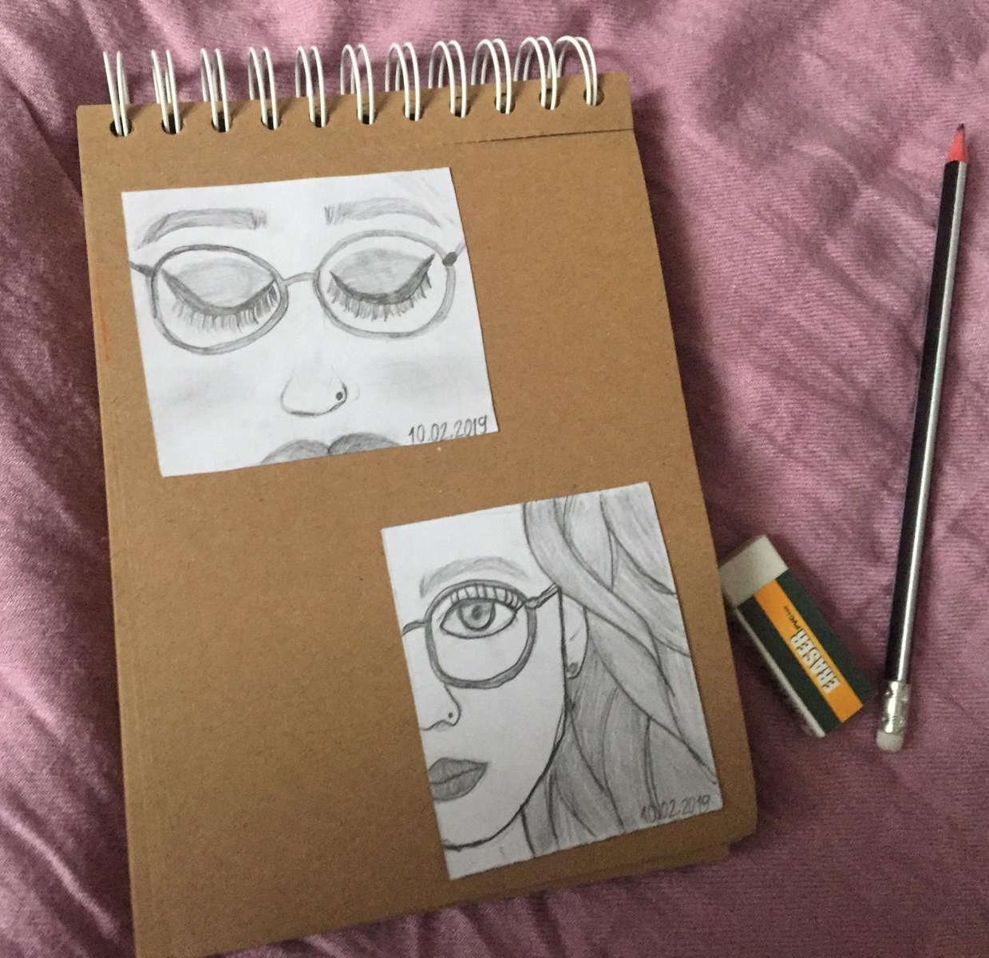
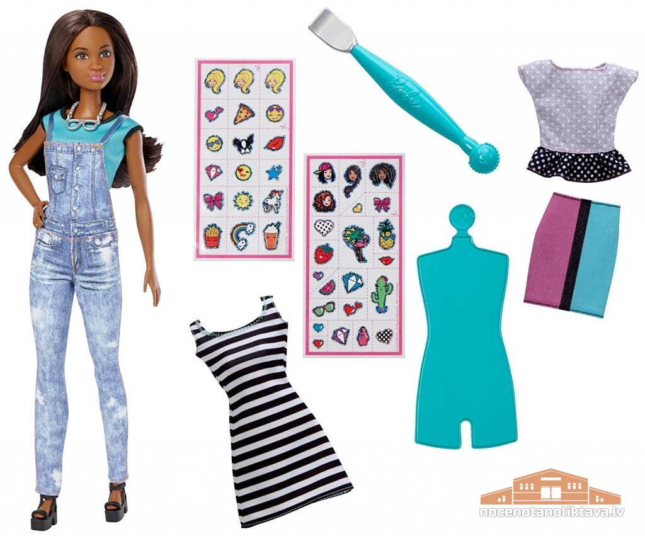
My name is Azanda.
I’m 10 years old. study in Gulbītis Primary School 4th grade.
My hobby are sewing, drawing and sport. I want to become a designer.

Slide 5
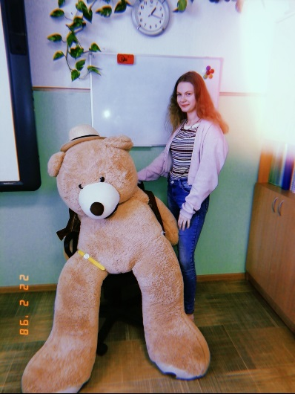
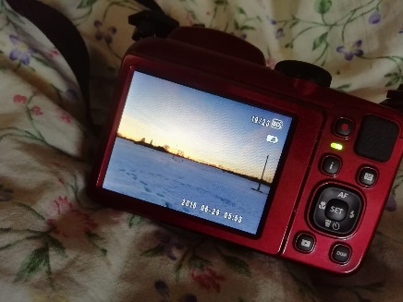
My name is Aleksa. I am 11 years old. I study in Gulbītis Primary School 5th grade. My hobby is take pictures and draw. In the future, I want to become photographers because I really like photography.

Slide 6
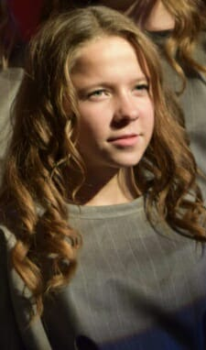
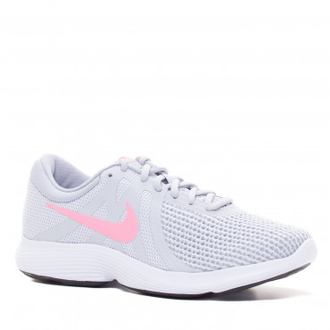
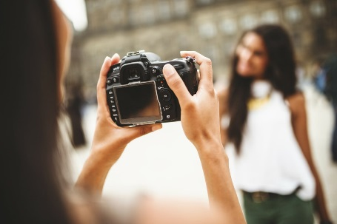
My name is Inese. I’am 13 years old. I study in Gulbītis Primary School 6th grade.
I like to take photo. My hobby is run.
I want to be a photografer because want to be in nature.

