Slide 1
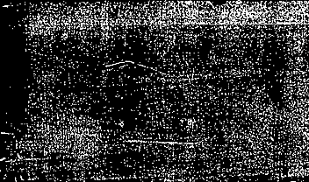

Education in school until 1990 and today

Slide 2

School uniforms
Uniforms were introduced to discipline children and make all pupils equal in terms of clothing.
Girls had to wear dark dresses (black aprons in junior classes) or blouses and skirts. Hair always had to be braided. They were not allowed to paint nails, wear rings, etc. Boys were required to wear dark suits.
During celebration: for girls - white aprons or white blouses, black skirts; boys - white shirts, dark suits.
The uniforms were checked thoroughly every morning.
Uniforms in Gulbitis school were revoked in 1988.

Slide 3
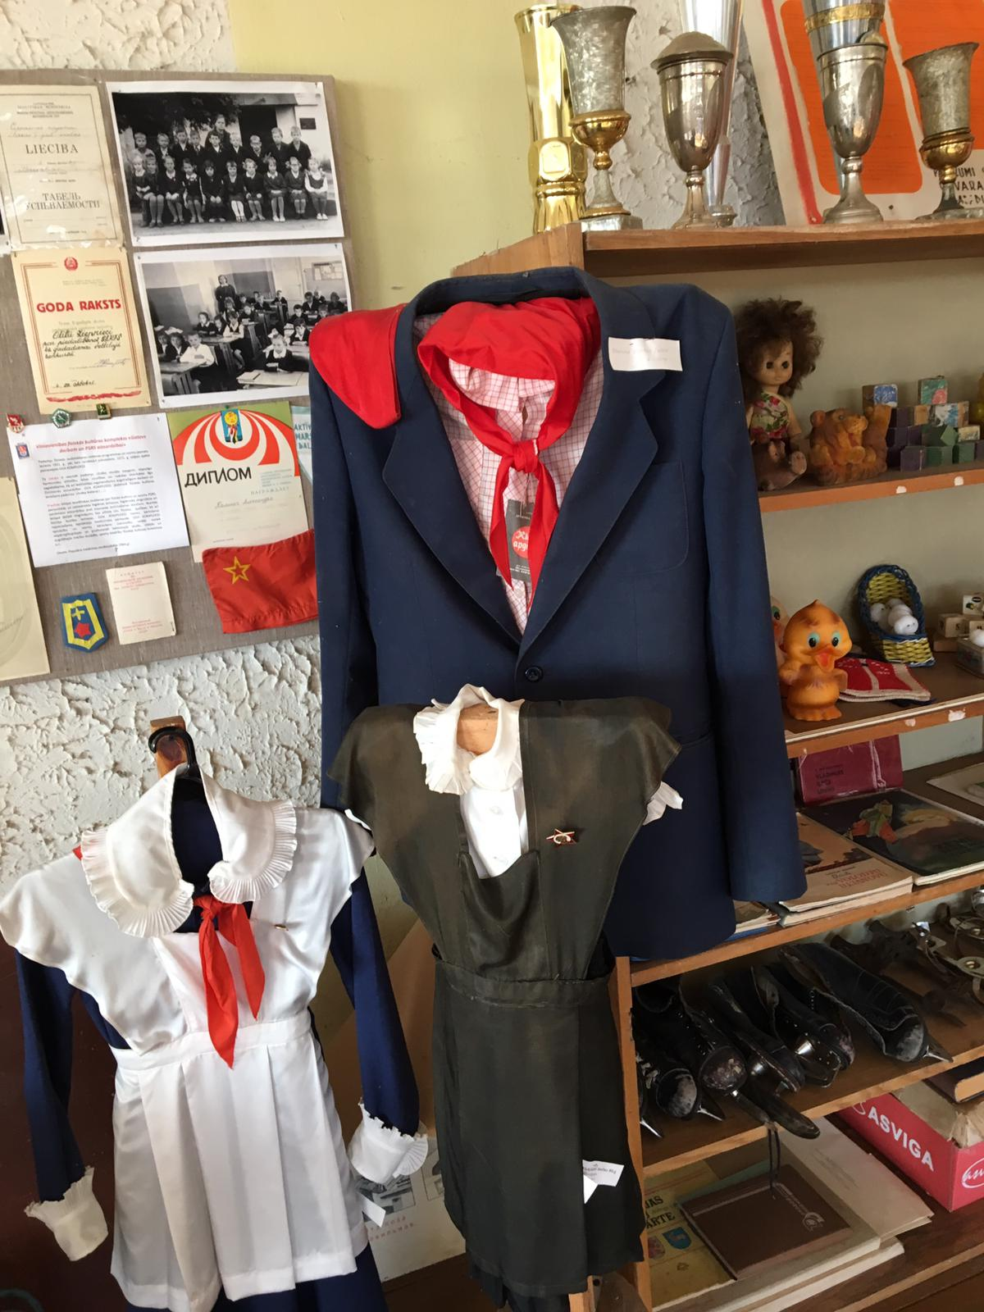

Slide 4
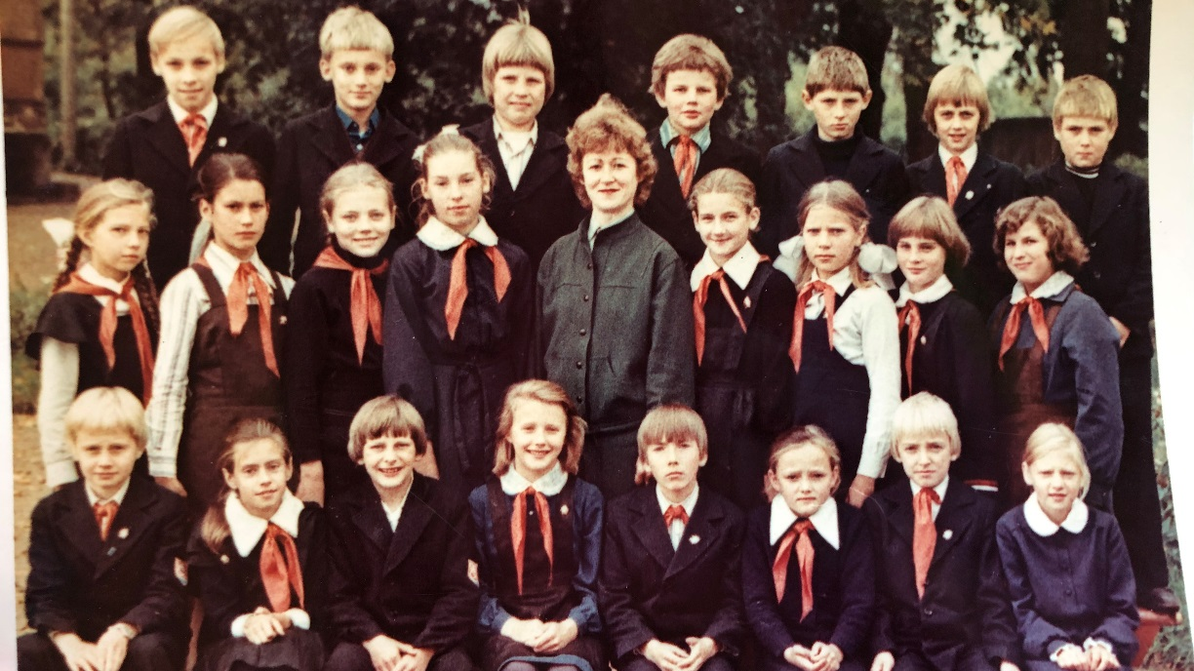

Slide 5
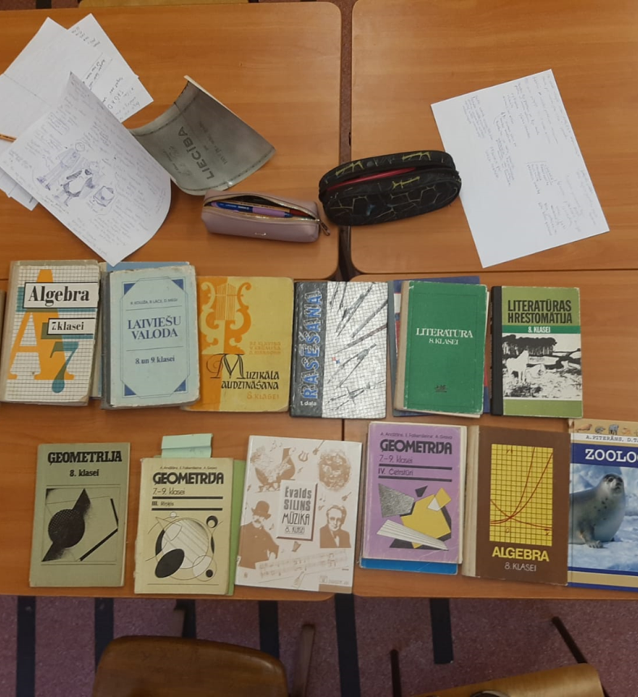
Textbooks
Books had more difficult tasks, were not that colorful, did not have pictures and were in tiny print.
More tasks with rules such as: Rewrite text and perform the task.

Slide 6
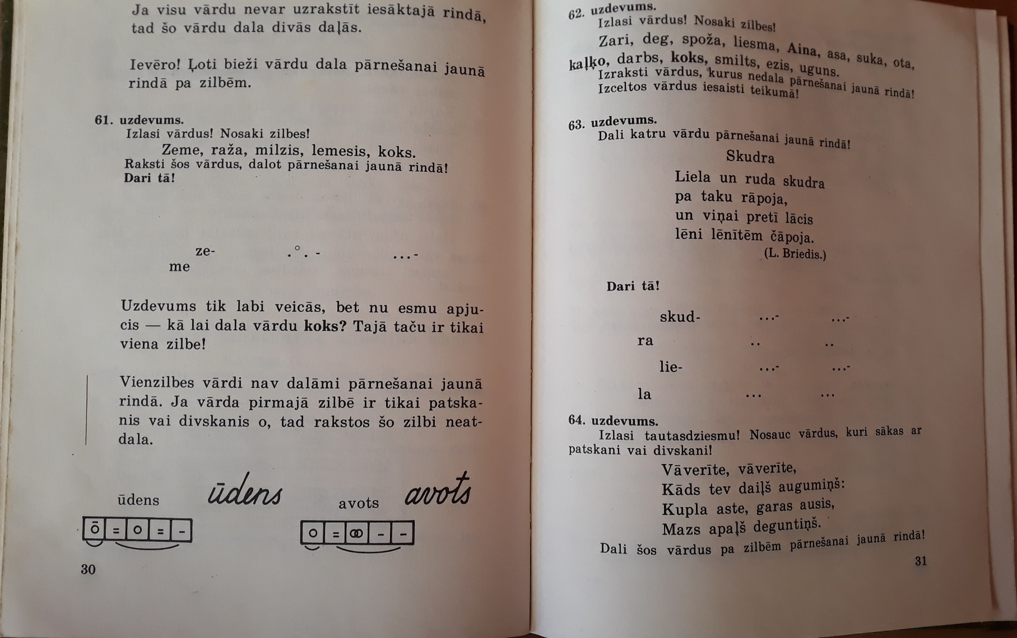
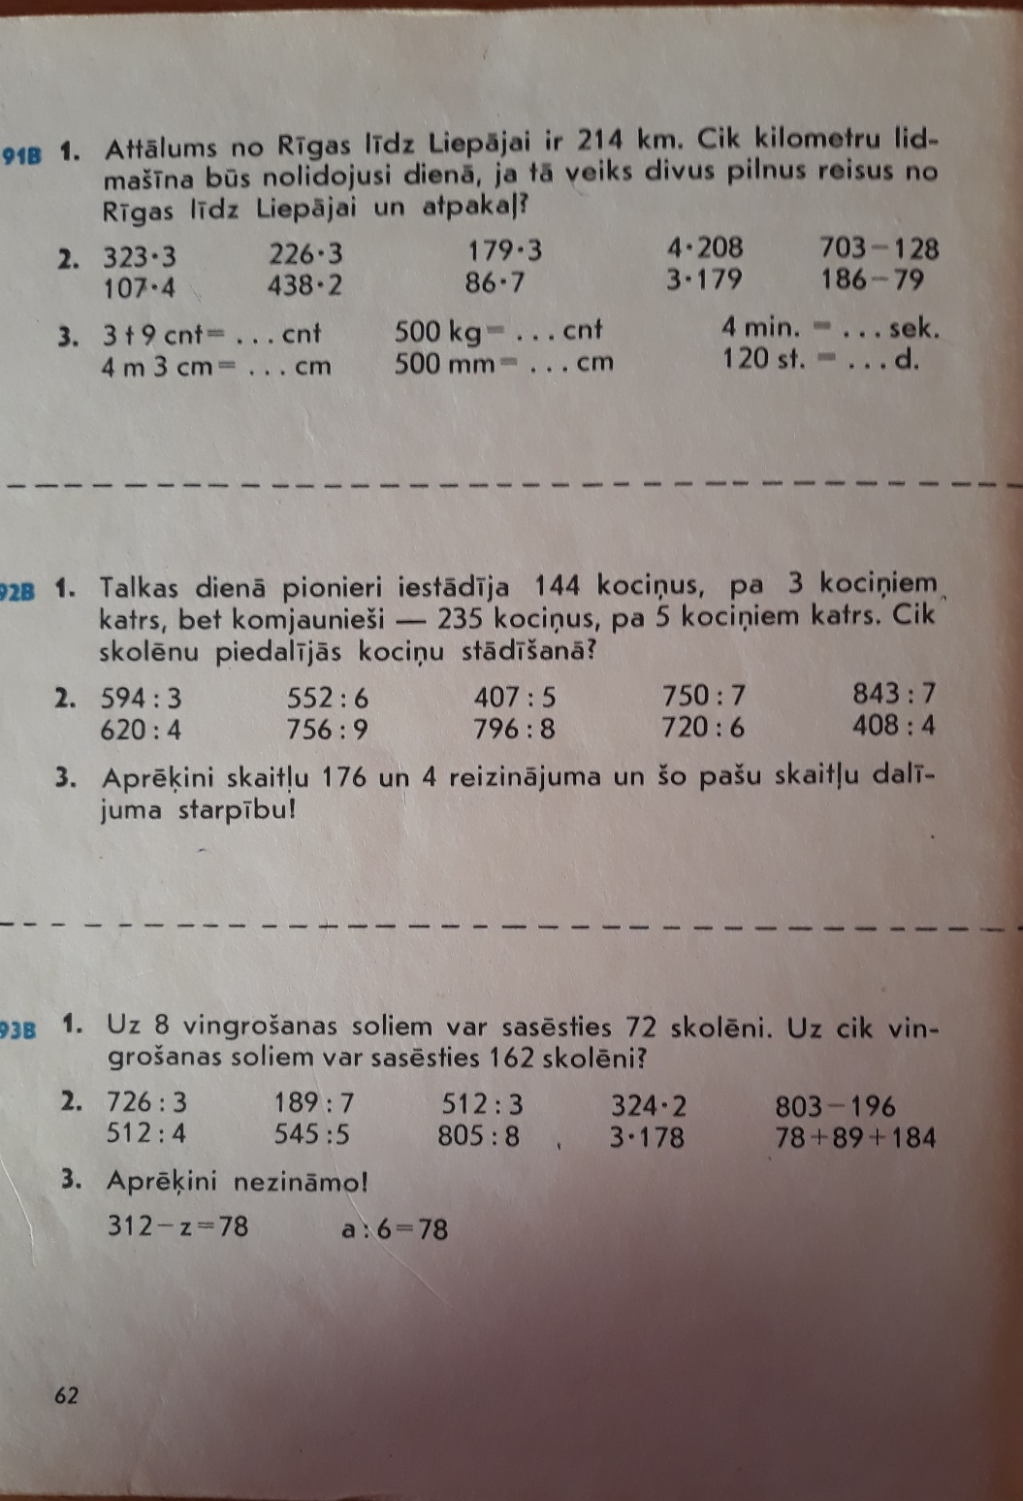

Slide 7
Subjects at school
Now:
Between 1970-1990:
Latvian
Literature
Russian
English
Biology
Chemistry
Geography
Physics
Sport
Music
World and Latvian history
Latvian (handwriting was assessed)
Latvian literature (starting from the 3rd grade)
Russian (starting from the 2nd grade)
Russian literature (10th to 11th grade)
German (starting from the 4th grade)
Biology (starting from the 5th grade)
Chemistry (had to study for 2 years)
Geography (starting from the 5th grade)
Physics (had to study for 2 years)
Physical culture (gymnastic in 1930’s)
Singing and music
History (starting from the 4th grade)

Slide 8
Subjects at school
Now:
Between 1970-1990:
Social science
Mathematics
Art
Housekeeping
Informatics
Class parenting
Ethics
The doctrine of society (10th to 11th grade)
Basics of law
Fine art (only till the 6th grade); (drawing in 1930’s)
Craftmanship (housekeeping in 1930’s)
Class parenting
Astronomy (10th to 11th grade)
Technical drawing (8th grade)
Basic military training (also in 1930’s)
Algebra
Geometry
Tractor study / Mechanized milking

Slide 9
Learning process
Pupils studied much harder because of the strict order. Late attendance was not tolerated because then you had to go to see the director and explain yourself, which was a great shame.
Recognition letters and honors were handed to the pupils for their best performance and behaviour. They were colorless.
In addition to grading - homework, book order, behaviour and diligence were assessed.
Classes were 45 minutes long and breaks – 10 minutes. Lunch break was 20 minutes for everyone.
School year was divided in quarters.
Ten-point grading scale appeared only in 1993, before that highest grade was a five.

Slide 10
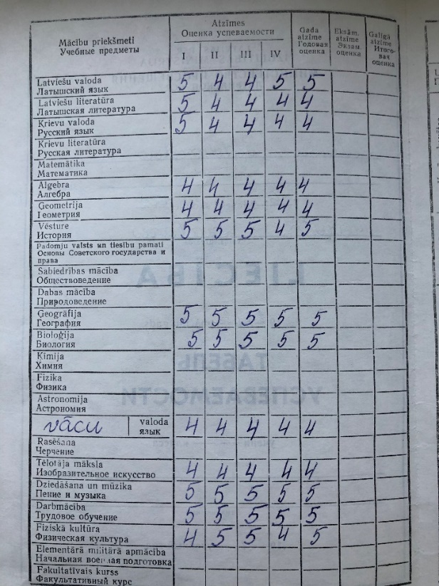
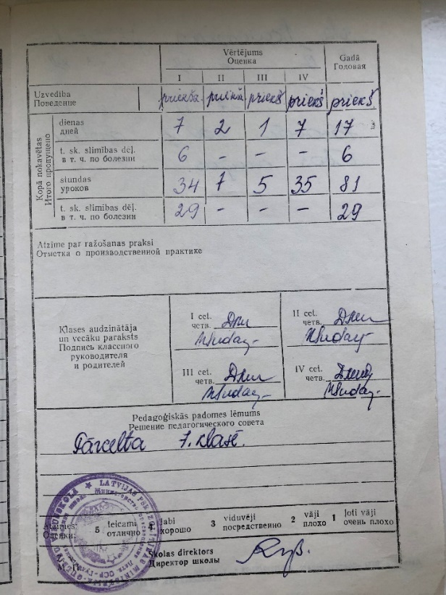
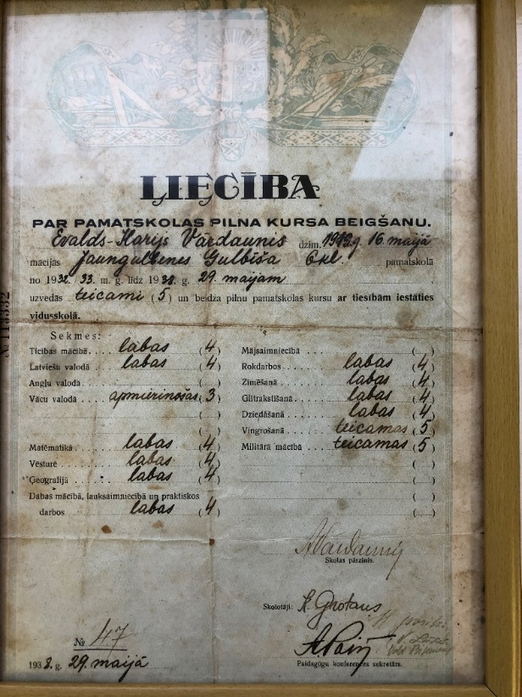
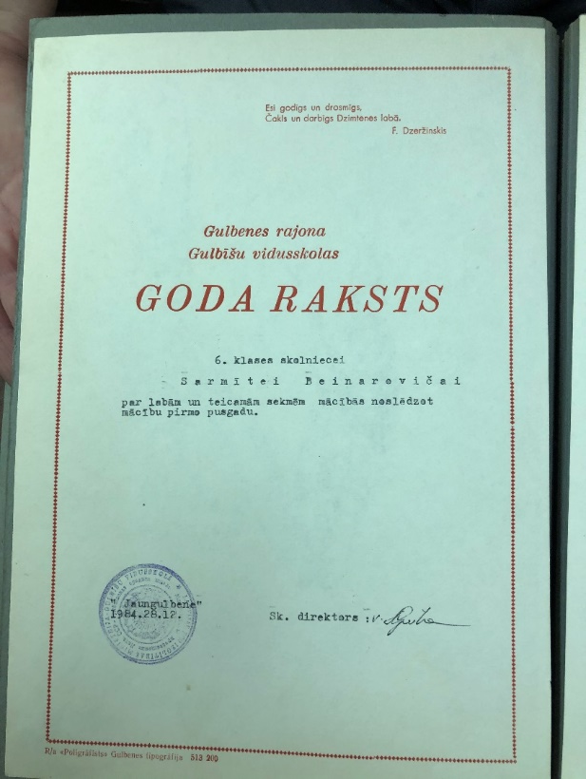

Slide 11
Rules in the school
The order in school was much tougher. During breaks pupils had to walk around the hallway in pairs and by holding hands.
Pupils carried the wood themselves, cleaned the classrooms and had to help in the kitchen. Every class had a schedule for their duties.
The misbehaviour of pupils was reflected on a wallpaper in the hallway. In later years, class on duty produced a report that was read out in the mornings in front of entire school. Each offender was deeply ashamed of the violations committed.

Slide 12
Conclusions
A lot has changed since then -books, classes, events, teachers, pupils themselves and order in the school.
There are no uniforms in many schools today. Is it good or bad – that is a decision to be made everyone by themselves.
Length of the classes and semesters and the diversity of subjects have changed. Today books are no longer used so often, and the amount of classes have diminished.
Grades could be earned at every class e.g. for homework, attitude in class and specific topics.

Slide 13
Conclusions
Pupils still receive statements after each semester, apprises and honours.
Periods between lessons don’t have to be spent walking up and down the hallway holding hands anymore.
Pupils are not afraid from teachers anymore and are standing up to them.
Pupils do nonsense bunkums even more that they used to. It used to be very rare that there was fight in school. Nowadays it happens more often, and everyone knows about it immediately.

Slide 14
After school activities in the 20th century and today

Slide 15
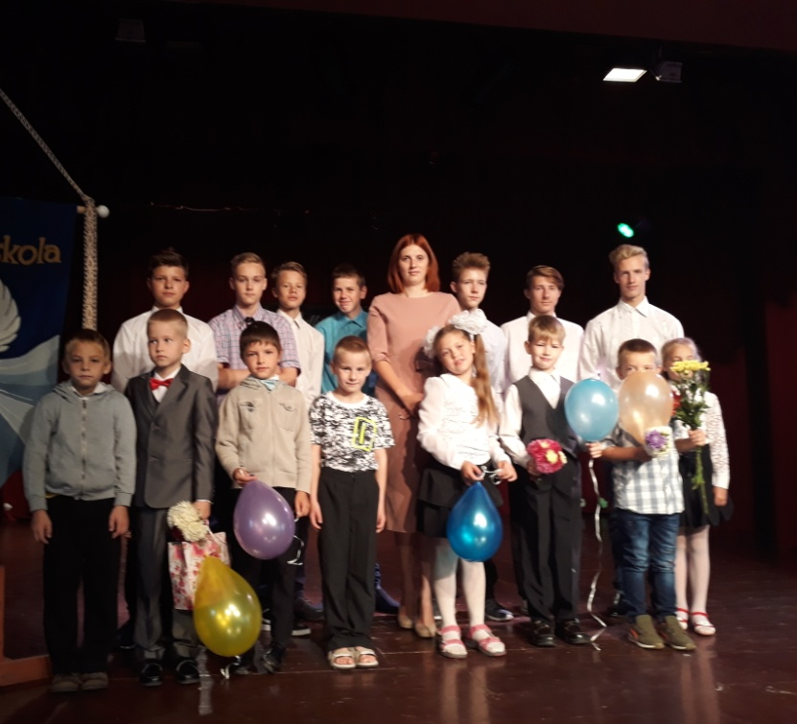
September 1st (First day of school)
Then: Pupils came to school with flowers, for their teachers, dressed in celebratory uniforms. Festive opening ceremony followed by regular school day with lessons.
Now: Flowers for teachers are optional. No lessons that day, just festive events.

Slide 16
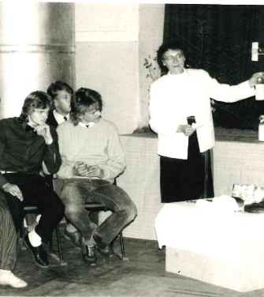
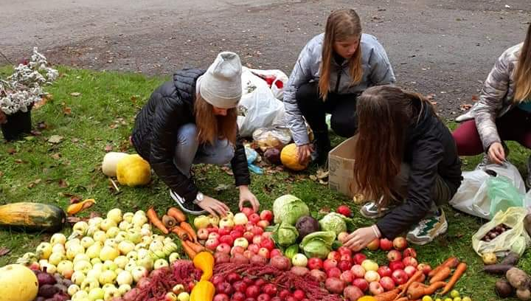
Autumn harvest festival / Miķeļdiena (Latvian autumn equinox)
Then: Award a diplomas for well-done jobs in Kolhoz (collective farm in USSR) during summer and autumn. Expositions of flower and vegetable compositions, contests, ball.
Now: Vegetable expositions and collective compositions.

Slide 17

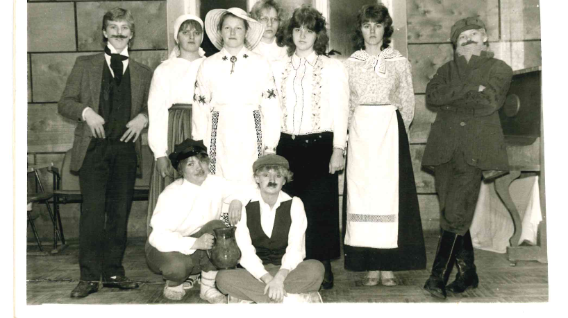
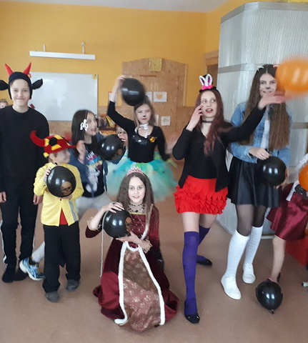
Carnival / Halloween
Then: The carnival was a pleasure for pupils. Costumes and performances were carefully prepared.
Now: Costumes can be bought in shop. Event takes place in classroom.

Slide 18
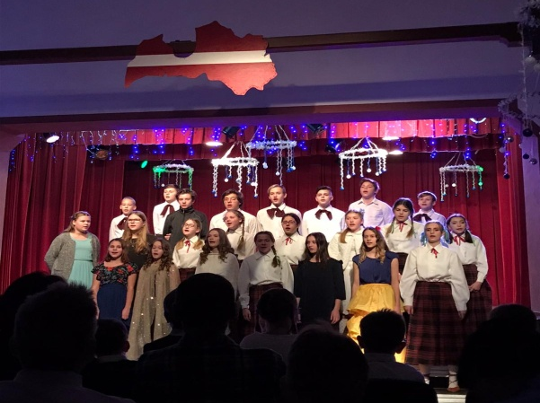
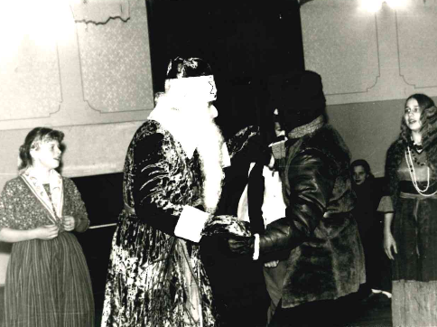
New years and Christmas
Then: It was illegal to celebrate Christmas; however celebrating New Year was allowed. Concert, Ded Maroz (the literal translation "Grandfather Frost” - a similar figure to Santa Claus), Christmas treats including a lot of apples, ball.
Now: Christmas celebrations, thematic concert, party.

Slide 19
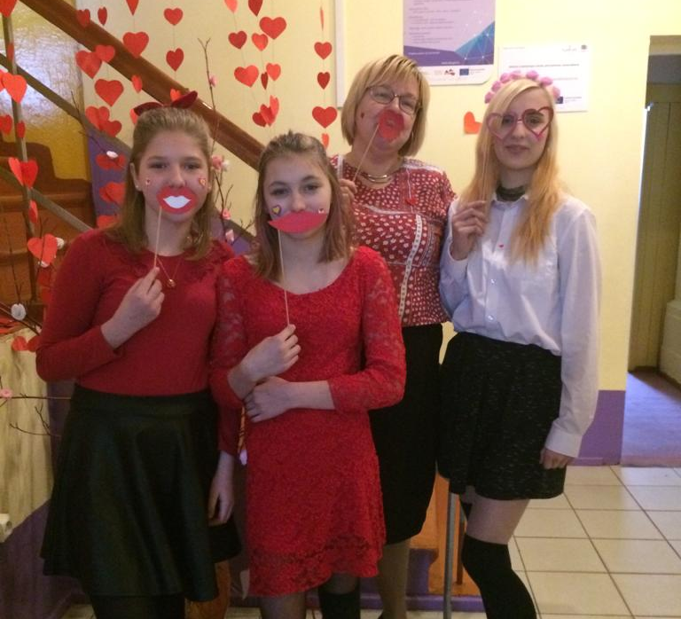
8th of March – Women’s Day and Valentine’s Day
Then: Boys greeted girls. On 8th of March children also greeted their mothers.
Now: children greet each other on Valentine’s Day.

Slide 20
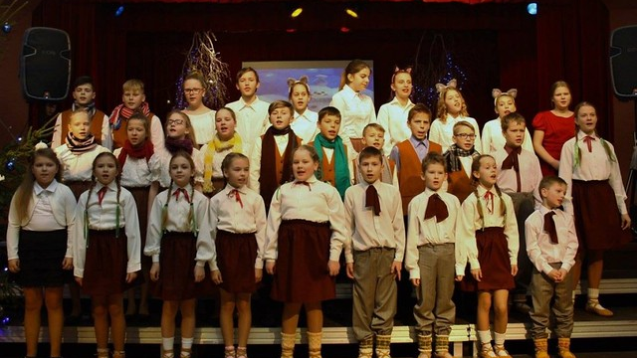
Report concert/event
Then and now: Circle or class prepares performance and/or a concert.

Slide 21
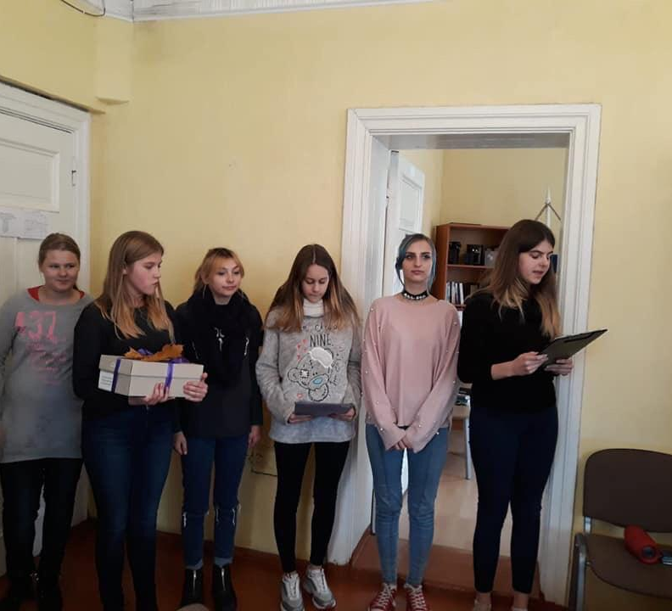
Teachers day
Then: Pupils thanked their teachers for their hard but noble job with sweet words and festive mood.
Now: Pupils greet their teachers with sweet words, performances, surprises.

Slide 22

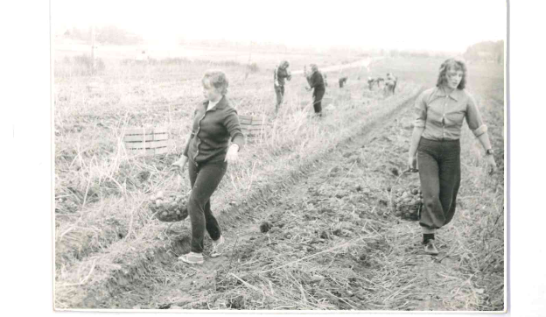
Work in Kolhoz (collective farm) and school
In September potato harvesting took place. Everyone from grades 4th- 11th had to attend.
Summer job for one month, to earn free lunch at school. It could be some job in school garden or cleaning surroundings or putting firewood in shed.

Slide 23
Other activities then
80's: contest about Lenin for 1st – 3rd graders
Physical activity day (track and field, skiing, running)
Victory day – 9th of May, hike to Military cemetery (Brāļu kapi) in Jaungulbene
Communists Saturday joint work in April
Žetonvakars (Event when graduates receive rings with school symbolic)
Poetry day
School Olympiads in various subjects
Latvian literature afternoons
School march parade
Hikes, excursions

Slide 24
Interesting facts
For festive events girls always had to wear white blouse and black skirt
There were pioneer and young communist organizations
Reward for achievement usually was a book
School march parades were very popular back then

Slide 25
After school activities then
Kokle circle (a Latvian national musical instrument similar to the harp/zither)
Cattle breeding circle
Physical education circle
Choir-mandatory
Folk dance circle
Chess circle
Typewriting circle

Slide 26
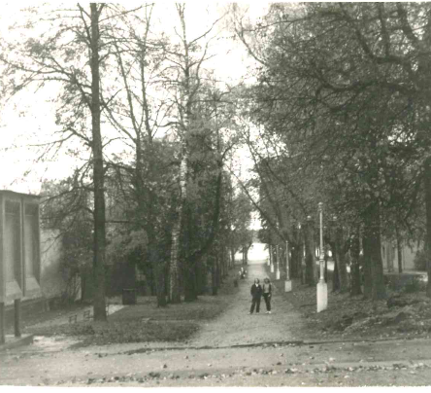
Field trips
Then: Pupils went to field trips. Hike “Meeting golden autumn” was mandatory for everyone. There were almost no excursions in 20th century.
Now: There are almost no hiking trips, but there are many excursions.

Slide 27
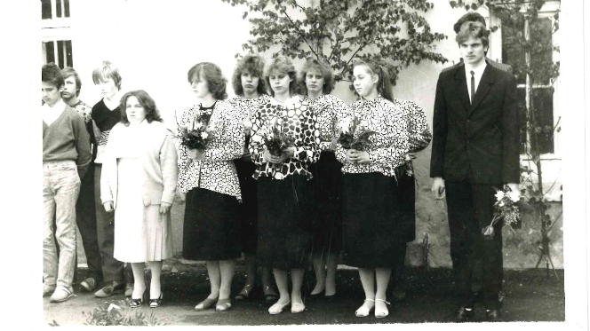
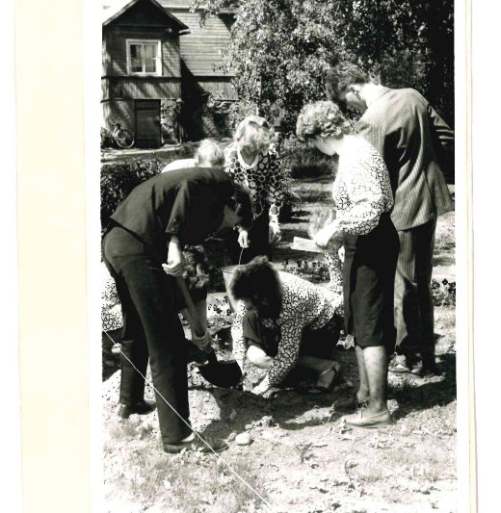
Celebration before exams
Then: teachers meeting took place, where they draw up protocol with pupils that are enrolled to exams. Ceremony where protocol is red out loud in front of all pupils took place. Pupils together with teachers’ planted trees or roses. Pupils from grade 8 and 11 received flowers and greetings from their schoolmates
Now: each class prepares greetings or performance for the 9th grade graduates.

Slide 28
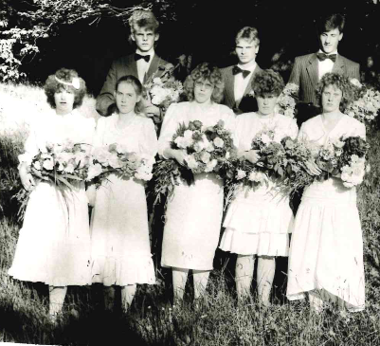
School graduation
Then: graduating 8th grade, girls wore same-colored blouse (mostly white) and black skirt. Boys wore dark suits, white shirt. Graduating 11th grade girls wore white dresses.
Now: Gifts are prepared for school and class teacher, and flowers to all other teachers.

Slide 29

Thank you for attention!

