Slide 1
Welcome to Lovech

Slide 2
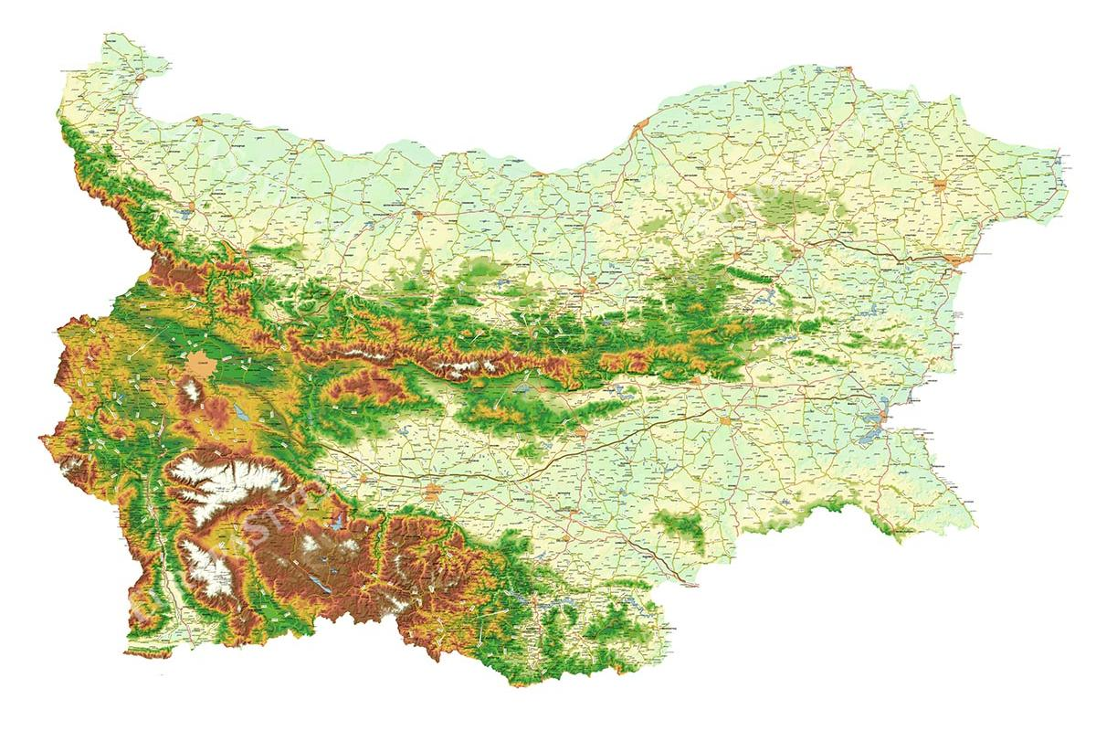
Where is our town located?

Slide 3
How to reach Lovech from the capital of Bulgaria – Sofia?
By bus: distance 150km (2.5 hours) from Central Bus Station
But first!
You should catch the metro from Sofia Airport to Sofia Central Station
From “Sofia Airport“ station to “Serdika” station (Line 1) (30 minutes)
Switching lines on “Serdika” station to “Central Bus Station” (5 minutes walking + 5 minutes travelling)

Slide 4
“Sofia Airport” Station Terminal 2

Slide 5
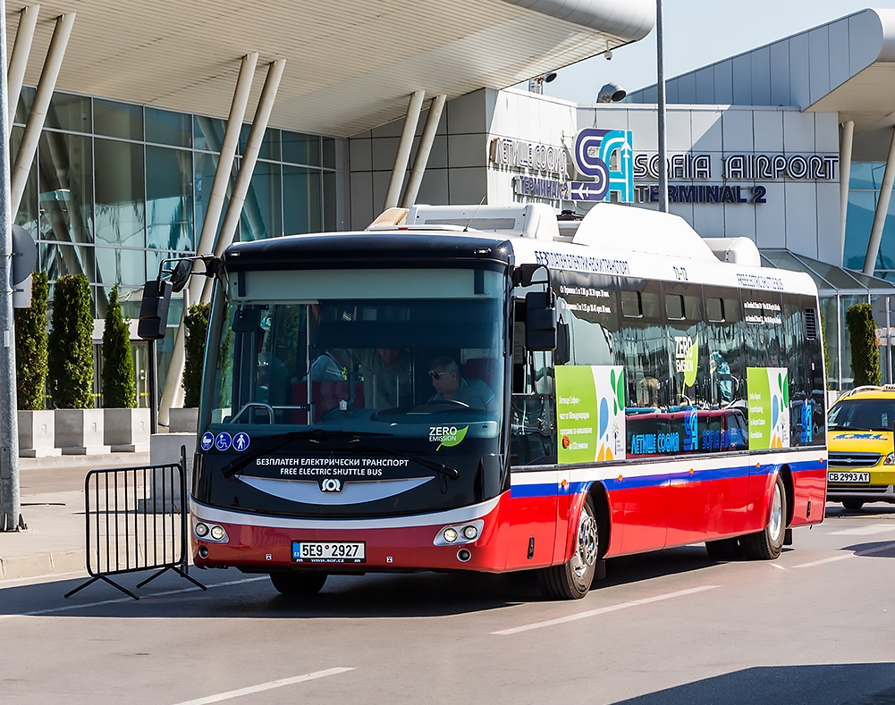
From Terminal 1 to Terminal 2
Please keep in mind there is no
direct metro line from Terminal 1.
You should take the shuttle bus
in front of Terminal 1 (15 minutes)
It is free.
Working hours: 5:00 to 23:00

Slide 6
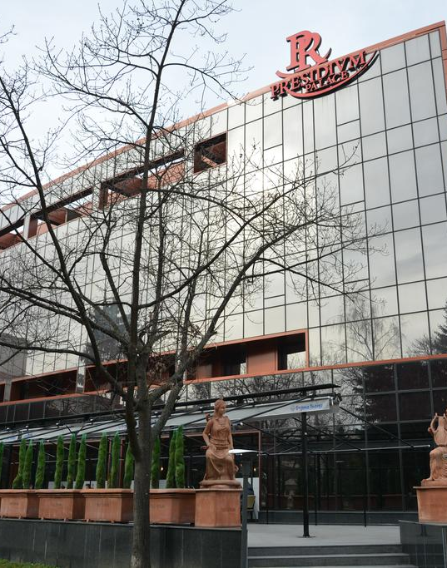
Your hotel in Lovech
Located on the main street
10 minutes walking distance from Old town of Lovech
2 minutes walking distance from the bus stop
Enjoy your stay!

Slide 7
Our school is expecting you! ☺

