Slide 1
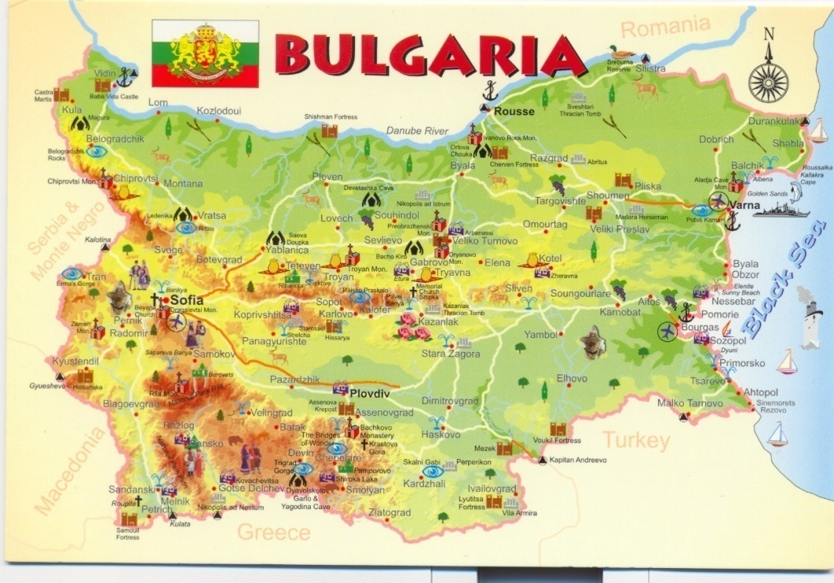
Education system in Bulgaria

Slide 3
According to the type of instruction and the educational level, schools are:
Primary: grade 1 through grade 4;
Lower secondary: grade 5 through grade 7;
Basic: grade 1 through grade 7;
Upper secondary schools, also named high schools: grade 8 through grade 10;
Specialized upper secondary/Specialized high schools;
Secondary general schools, grade 1 through grade 10;
Vocational upper secondary schools - grade 8 through grade 12
Vocational schools: from grade 11 through grade 12 with a two-year training course-vocational colleges;

Slide 4
According to the way of funding, schools are:
State schools – they are of national importance and are funded by the national budget
Municipal schools are of local importance and are funded by the municipal budget
Private schools are partly funded by the state or municipal budget and pupils pay fees for their education.

Slide 5
PRE-SCHOOL EDUCATION
Pre-primary education embraces children between 3 and 6/7 years old.
Optional kindergarten education is provided for children between three and four years old.

Slide 6
BASIC EDUCATION
Basic education (1-7 grades) in Bulgaria comprises:
primary school (grades 1-4)
pre-secondary school (grades 5-7).
After successful completion of grade 4, a Certificate of Primary Education is issued.
A Certificate of Basic Education is issued after successful completion of grade 7.

Slide 7
SECONDARY EDUCATION
Secondary education in Bulgaria can be divided into secondary general and vocational.

Slide 8
GRADING SYSTEM
Usual grading system in the school is:
6: excellent;
5: very good;
4: good;
3: sufficient;
2: poor.
Highest on scale: 6
Lowest on scale: 2

Slide 9
HIGHER EDUCATION
The types of higher education institutions are Universities, Colleges and Specialized Higher Schools.
It includes the following stages:
First stage – 4 years, leading to a Bachelor’s degree;
Second stage - 5 years, or 1 year after a Bachelor’s degree, leading to a Master’s degree;
Third stage – a three-year course of study after a master’s degree, leading to a Doctor’s degree.

